Slide 1
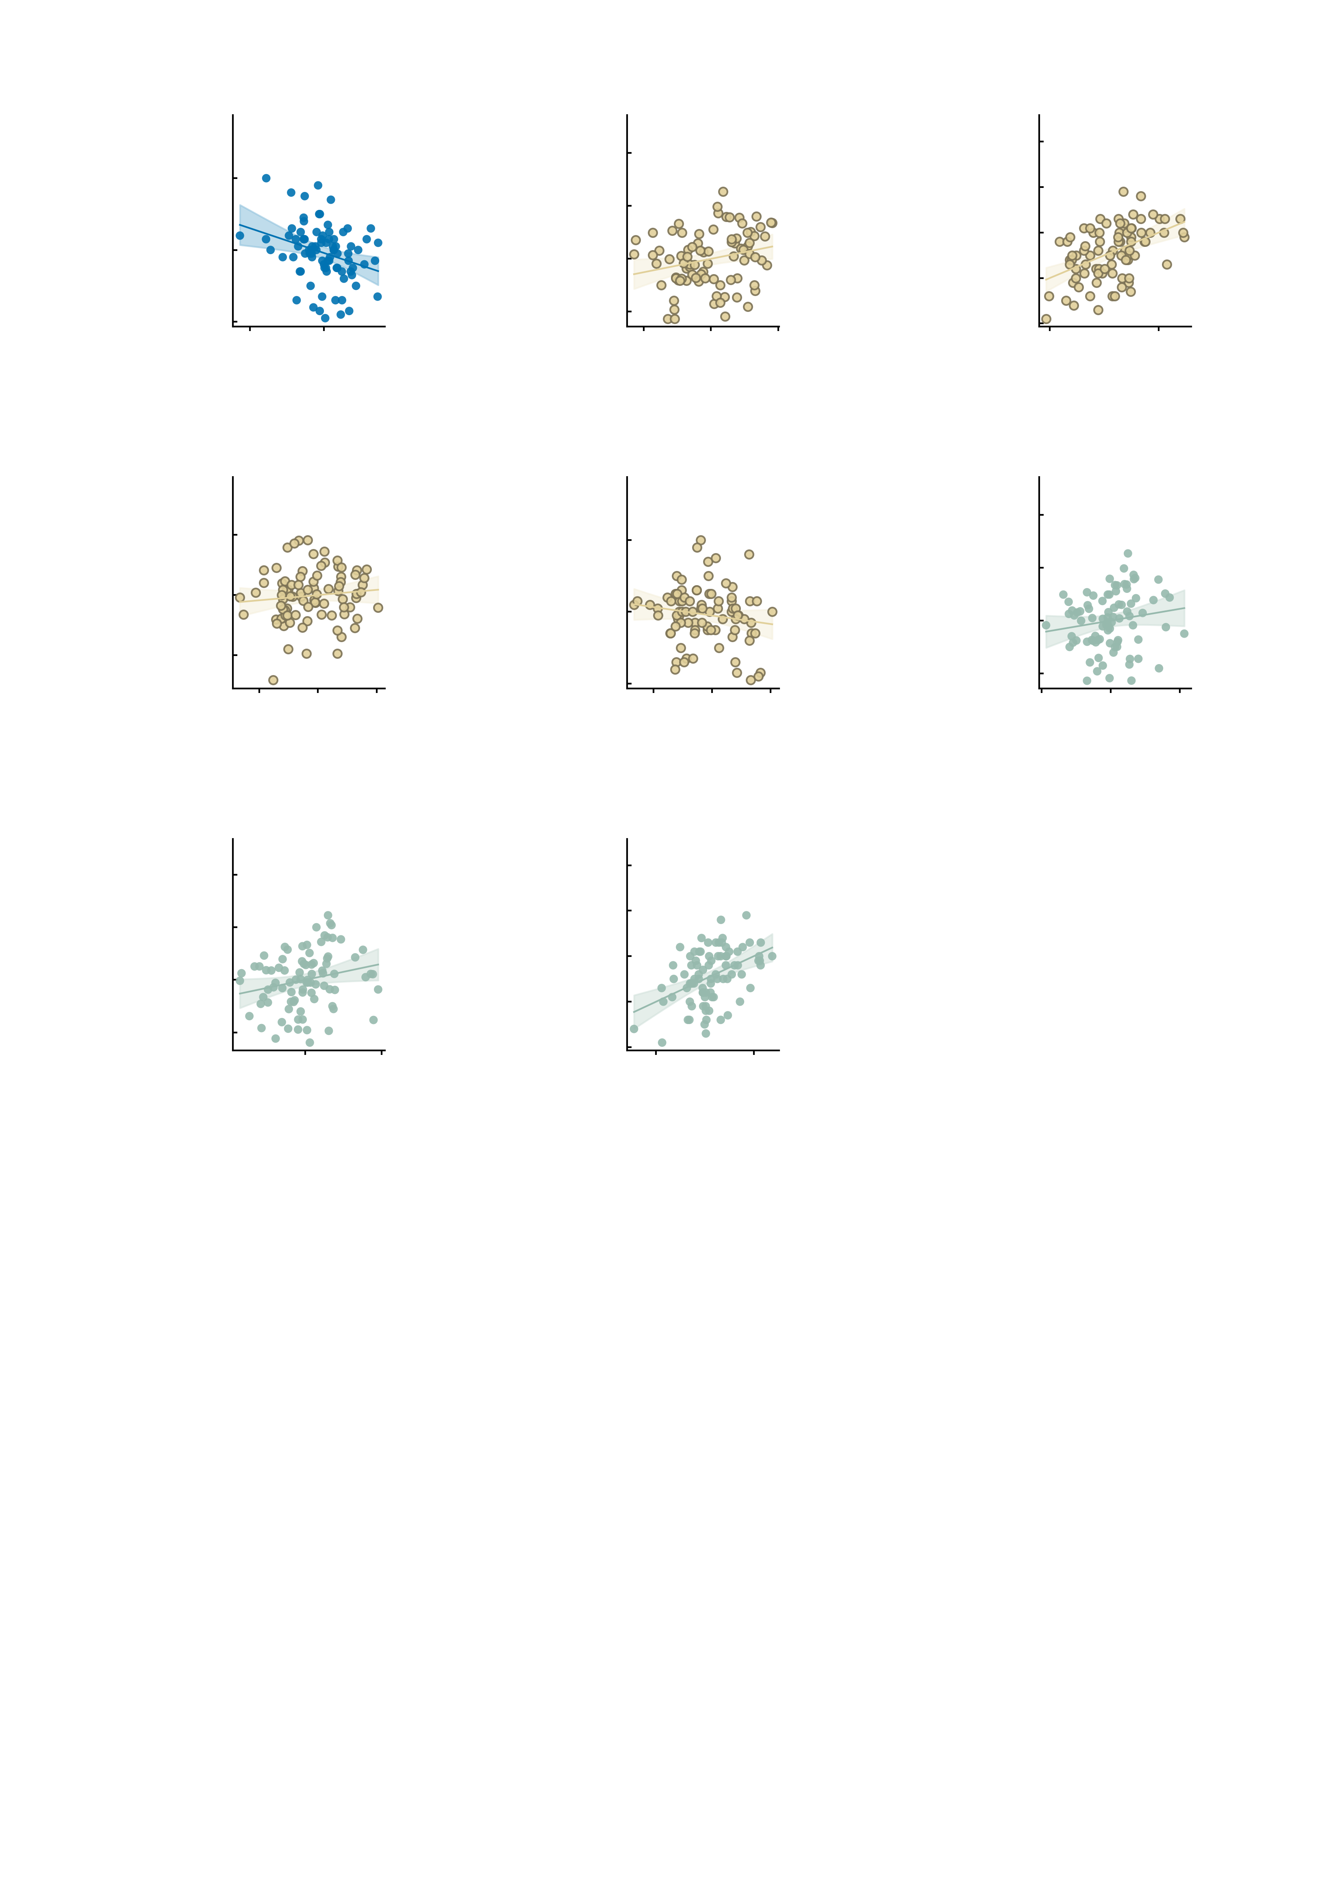
a
60
b
30
c
30
Age 19
r = −0.30
AMPA
covariate: symptoms
r = 0.24
20
Model of b
(AMPA + items)
r = 0.48
40
20
Symptom change,
age 19–23
(residual)
10
Internalising total,
age 19
10
Symptom change,
age 19–23
20
0
0
-10
-10
-5.0
0
-2.5
0.0
2.5
-20
-10
0
10
20
-20
-20
-10
0
10
Restoration index
(residual)
Empirical NP
-20
Predicted symptom change
-20
-30
d
4
e
60
f
30
AMPA
r = 0.10
AMPA
r = −0.16
GABA-A
covariate: symptoms
r = 0.16
2
40
20
Empirical NP,
age 19
Internalising total,
age 19
Symptom change,
age 19–23
(residual)
0
10
20
0
-2
0
-10
-20
-4
-10
0
10
20
-20
-10
0
10
20
-40
-20
0
20
40
Restoration index
(residual)
Restoration index
Restoration index
-20
-20
g
30
h
30
GABA-A
covariate: empirical NP
r = 0.22
Model of g
(GABA-A + empirical NP)
r = 0.44
20
20
Symptom change,
age 19–23
(residual)
10
10
Symptom change,
age 19–23
0
0
-10
-10
-20
-20
0
20
40
-20
-20
-10
0
10
Restoration index
(residual)
Predicted symptom change
-30
Supplementary Fig. S14 | Longitudinal prediction of symptom trajectories from the virtual perturbations. Unit of observation, one participant; n = 85 IMAGEN participants with a digital twin at age 19 and a symptom assessment at age 23. The symptom measure is the internalising total, the sum of items 3-6 of the battery; the outcome is its change from age 19 to 23. The restoration index is the difference between the symptom score predicted from the simulated baseline twin and from the perturbed twin, computed separately for the AMPA and the GABA-A perturbation with the same weights; longitudinal change was used neither in model fitting nor in the perturbation nor in the construction of the index. In every panel one dot is one participant, the line is the ordinary least-squares fit and the band its 95% confidence interval. Correlations are Pearson, with Fisher-z intervals; all tests two-sided and unpaired, with no correction for multiple comparisons (two pre-specified indices over two pre-specified covariate sets). Permutation P values come from 5,000 permutations of the outcome, matched to each increment. In b, f and g both axes are residualised on that panel's covariates, so the plotted slope is the contribution the index makes over and above them; there the partial correlation and the nested F test are the same test on the same residual degrees of freedom and their P values agree exactly. a, the mapping the index is built on: the empirical NP at age 19 against the concurrent internalising total, r = -0.30 (95% CI -0.48 to -0.10, P = 0.00488). The weights of the mapping were fitted on the imaging sample, not on this sample's later change. b, the AMPA index against later symptom change with the four baseline symptom items as covariates: partial r = +0.242 (95% CI +0.02 to +0.44), df = 79, t = 2.22, P = 0.0295; delta R2 = 0.0477 (R2 0.1853 to 0.2330), F(1, 79) = 4.91, P = 0.0295, permutation P = 0.0428. Greater predicted restoration corresponds to greater symptom reduction. With the baseline empirical NP as covariate instead, the same index gives partial r = +0.243 (95% CI +0.03 to +0.43), df = 82, t = 2.27, P = 0.0259; delta R2 = 0.0502 (R2 0.1515 to 0.2017), F(1, 82) = 5.15, P = 0.0259, permutation P = 0.0388; that scatter is Fig. 5f of the main figure and is not repeated here. c, the model of b as a prediction: its fitted values against the empirical change, r = 0.483, R2 = 0.2330, F(5, 79) = 4.80, P = 0.0007. These are in-sample values, so the correlation shown is that model's multiple R and the panel carries no independent test; this is the model quoted in the main text. d, the AMPA restoration index against the baseline empirical NP, r = +0.10 (95% CI -0.11 to +0.31, P = 0.34) -- the index is not a repackaging of the baseline scan. e, the AMPA restoration index against the baseline internalising total, r = -0.16 (95% CI -0.36 to +0.06, P = 0.153) -- nor of baseline symptoms. The GABA-A index behaves the same way against the scan (r = +0.07 (95% CI -0.14 to +0.28, P = 0.506)) and is weakly related to baseline symptoms (r = -0.23 (95% CI -0.42 to -0.01, P = 0.0379)). f, the GABA-A index with the baseline symptom items as covariates: partial r = +0.159 (95% CI -0.06 to +0.36), df = 79, t = 1.43, P = 0.156; delta R2 = 0.0206 (R2 0.1853 to 0.2060), F(1, 79) = 2.05, P = 0.156, permutation P = 0.1876 -- it adds nothing there. g, the GABA-A index with the baseline empirical NP as covariate: partial r = +0.224 (95% CI +0.01 to +0.42), df = 82, t = 2.08, P = 0.0405; delta R2 = 0.0426 (R2 0.1515 to 0.1941), F(1, 82) = 4.33, P = 0.0405, permutation P = 0.0592 -- it reaches the conventional threshold on the F test but not on the permutation test. h, the same for the model of g, the GABA-A model that reaches significance: r = 0.441, R2 = 0.1941, F(2, 82) = 9.88, P = 0.00014 -- also in-sample and also without an independent test. The cross-validated versions of these models are in Supplementary Fig. S13c, where the out-of-sample R2 is 0.111 for the four items plus the AMPA index, 0.136 for the empirical NP plus the AMPA index and 0.088 for the four items plus the GABA-A index.

