Slide 1
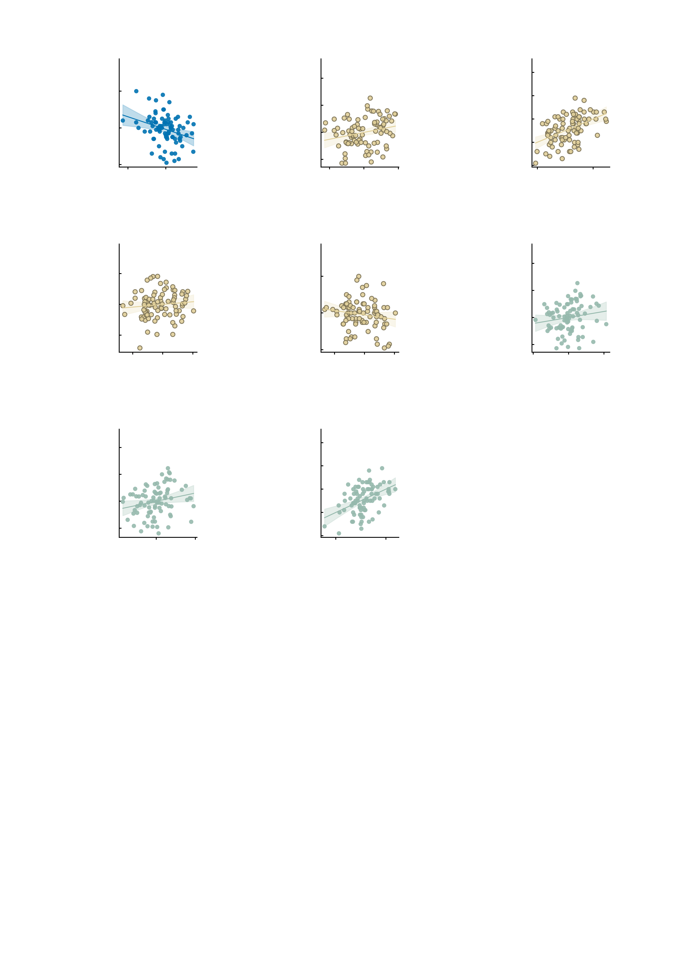
a
60
b
30
c
30
Age 19
r = −0.30
AMPA
covariate: symptoms
r = 0.24
20
Model of b
(AMPA + items)
r = 0.48
40
20
Symptom change,
age 19–23
(residual)
10
Internalising total,
age 19
10
Symptom change,
age 19–23
20
0
0
-10
-10
-5.0
0
-2.5
0.0
2.5
-20
-10
0
10
20
-20
-20
-10
0
10
Restoration index
(residual)
Empirical NP
-20
Predicted symptom change
-20
-30
d
4
e
60
f
30
AMPA
r = 0.10
AMPA
r = −0.16
GABA-A
covariate: symptoms
r = 0.16
2
40
20
Empirical NP,
age 19
Internalising total,
age 19
Symptom change,
age 19–23
(residual)
0
10
20
0
-2
0
-10
-20
-4
-10
0
10
20
-20
-10
0
10
20
-40
-20
0
20
40
Restoration index
(residual)
Restoration index
Restoration index
-20
-20
g
30
h
30
GABA-A
covariate: empirical NP
r = 0.22
Model of g
(GABA-A + empirical NP)
r = 0.44
20
20
Symptom change,
age 19–23
(residual)
10
10
Symptom change,
age 19–23
0
0
-10
-10
-20
-20
0
20
40
-20
-20
-10
0
10
Restoration index
(residual)
Predicted symptom change
-30

