Slide 1
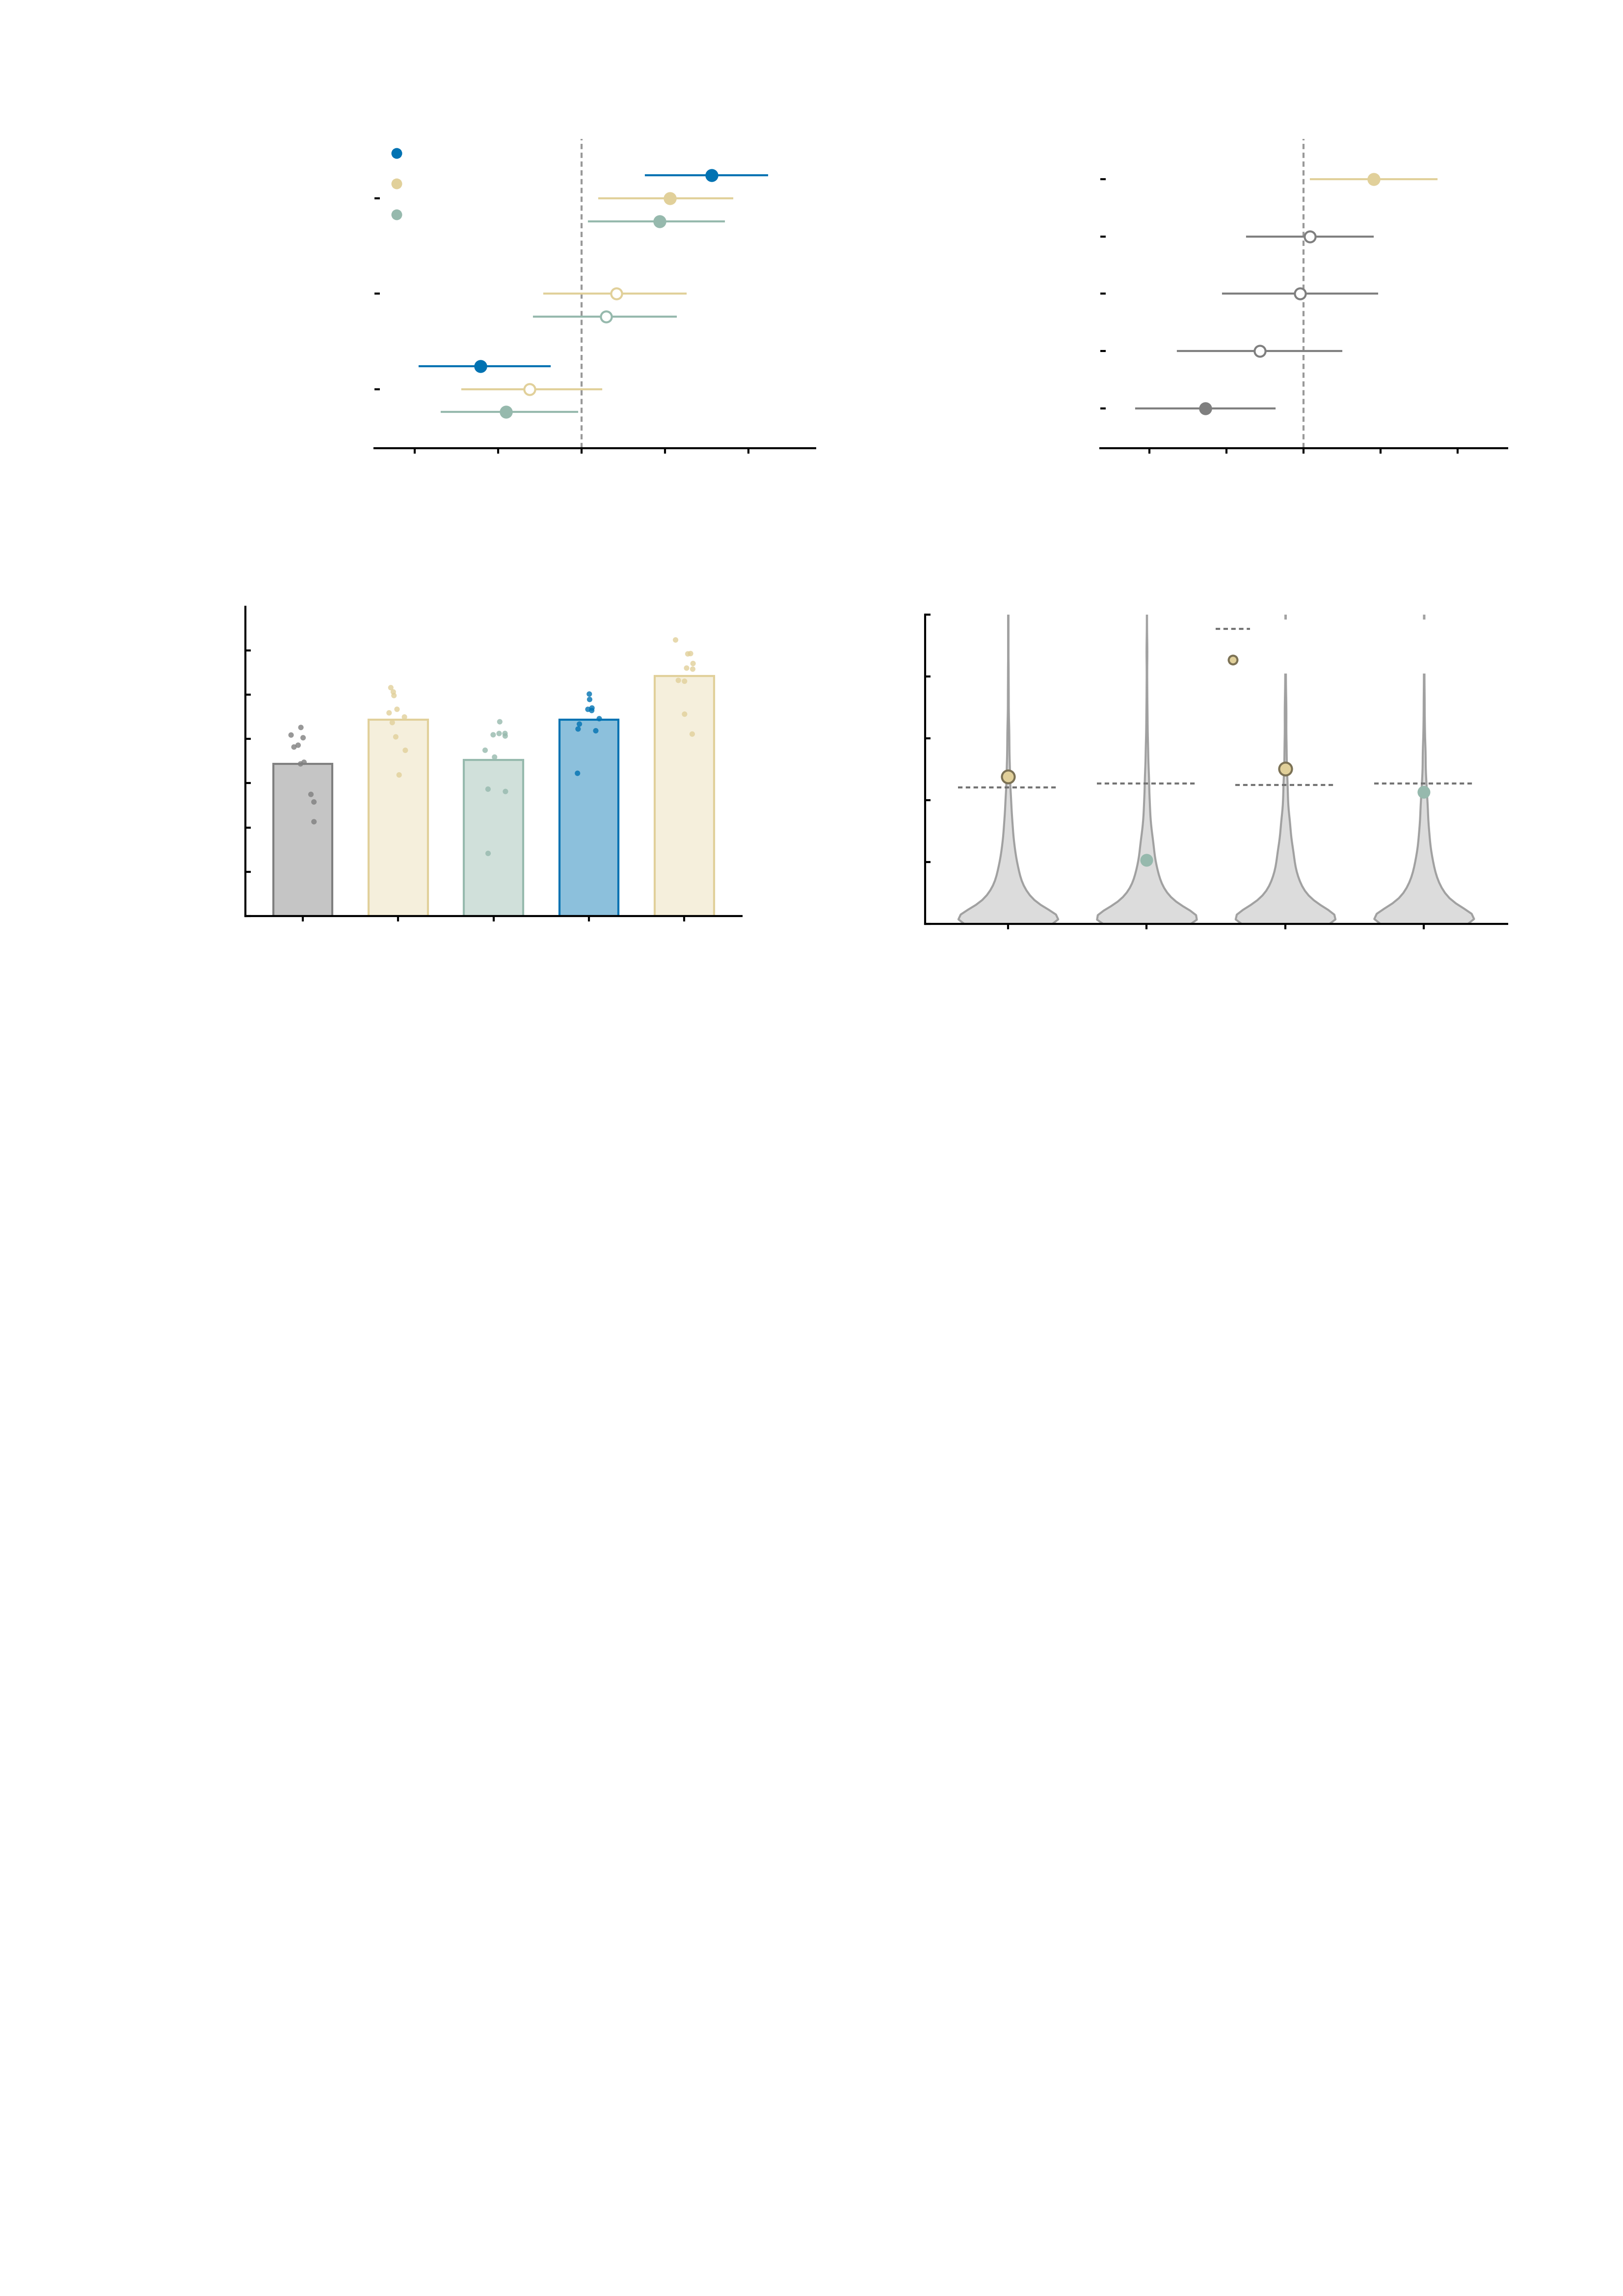
a
Baseline measured NP
b
Symptom change
at FU3
AMPA index
AMPA restoration
index
GABA-A index
Internalising item 1
Baseline measured NP
Internalising item 2
Baseline internalising
total
Internalising item 3
Internalising item 4
-0.75
-0.50
-0.25
0.00
0.25
0.50
0.75
-0.75
-0.50
-0.25
0.00
0.25
0.50
0.75
Pearson r (95% CI)
Standardised beta (95% CI)
c
0.175
d
0.10
0.150
95th centile of the null
0.125
0.08
Observed
0.100
0.06
*
*
Out-of-sample R^2
Incremental R^2
n.s.
0.075
0.04
0.050
0.02
n.s.
0.025
0.000
0.00
AMPA
over
four
items
GABA-A
over
four
items
AMPA
over
measured
NP
GABA-A
over
measured
NP
Four items
+ AMPA index
Measured NP
Measured NP
+ AMPA
+ GABA-A index
Supplementary Fig. S13 | The longitudinal prediction in full: what the restoration index adds over baseline behaviour and baseline connectivity. The follow-up sample is the n = 85 IMAGEN participants with a digital twin at baseline (age 19) and a symptom assessment at FU3 (age 23). The behavioural measure is the baseline internalising total, the sum of items 3-6 of the battery, and the outcome is that same sum at FU3 residualised on its baseline value; item-level correlations are tabulated in long_correlations_n85.csv and are not drawn here. The restoration index is the similarity of a participant's perturbed twin to the healthy pattern, computed separately for the AMPA and the GABA-A perturbation, with the same weights for both. Correlations are Pearson with Fisher-z 95% confidence intervals; all tests two-sided; filled symbols mark an uncorrected P < 0.05 in a and b. This figure holds the analyses behind Fig. 5h and 5i without repeating them: the index-versus-outcome scatter and the permuted R2 of the full model are in the main figure. a, every pairwise correlation the prediction rests on. Measured baseline connectivity already carries signal: it tracks the baseline internalising total (r = -0.30 (95% CI -0.48 to -0.10, P = 0.00488), Benjamini-Hochberg q = 0.013 across the panel's targets) and later symptom change (r = +0.39 (95% CI +0.19 to +0.56, P = 0.00023), q = 0.002), which is the baseline any claim for the twins has to beat. Both indices track later change (AMPA r = +0.26 (95% CI +0.05 to +0.45, P = 0.0148); GABA-A r = +0.23 (95% CI +0.02 to +0.43, P = 0.0309)) and neither is explained by the baseline scan (AMPA r = +0.10 (95% CI -0.11 to +0.31, P = 0.34); GABA-A r = +0.07 (95% CI -0.14 to +0.28, P = 0.506)), so an index is not a proxy for measured connectivity. Against the baseline internalising total the AMPA index is flat (r = -0.16 (95% CI -0.36 to +0.06, P = 0.153)) and the GABA-A index is weakly negative (r = -0.23 (95% CI -0.42 to -0.01, P = 0.0379)). b, the full model of FU3 symptom change on the AMPA restoration index and the four internalising items: R2 = 0.233, F(5, 79) = 4.80, P = 0.0007. The index carries an independent contribution (standardised beta = +0.227, 95% CI +0.023 to +0.431, t(79) = 2.22, P = 0.0295), as does one item (internalising item 4, beta = -0.319, P = 0.00603); the other three do not (P 0.28-0.93). The items enter separately here rather than as their sum, which is why they are listed individually; the item numbering follows the order of the battery and the per-column domain mapping is not verified in the source data. c, out-of-sample accuracy, 10-fold cross-validation with pooled out-of-fold predictions and 10 repeats (bars, mean over repeats; points, the individual repeats). Adding the AMPA index raises cross-validated R2 from 0.086 +/- 0.018 to 0.111 +/- 0.016 over the four items, and from 0.111 +/- 0.013 to 0.136 +/- 0.016 over measured baseline connectivity; the GABA-A index adds nothing (0.088 +/- 0.023). These are out-of-sample values and carry no test. d, incremental R2 of each index over each covariate set, against its own permutation null (grey violin, 5,000 permutations of the outcome; dashed line, the null's 95th centile). Over the four items the AMPA index adds 0.048 (F(1, 79) = 4.91, P = 0.0295, permutation P = 0.043) and over measured baseline connectivity 0.050 (F(1, 82) = 5.15, P = 0.0259, permutation P = 0.039). The GABA-A index adds 0.021 (P = 0.156, permutation P = 0.188) and 0.043 (P = 0.0405, permutation P = 0.059), i.e. it reaches the conventional threshold over the measured scan but not over behaviour and not on the permutation test. The y axis is cut at 0.10 so that the observed values stay readable; the nulls are thin above that and reach 0.145-0.167 at their maxima, with 99th centiles of 0.074-0.078. Symbols give the permutation P; *P < 0.05, **P < 0.01, ***P < 0.001; n.s., not significant. The increments are a few per cent of variance in a sample of 85, and the nulls are shown so that they can be read against what chance produces here.

