Slide 1
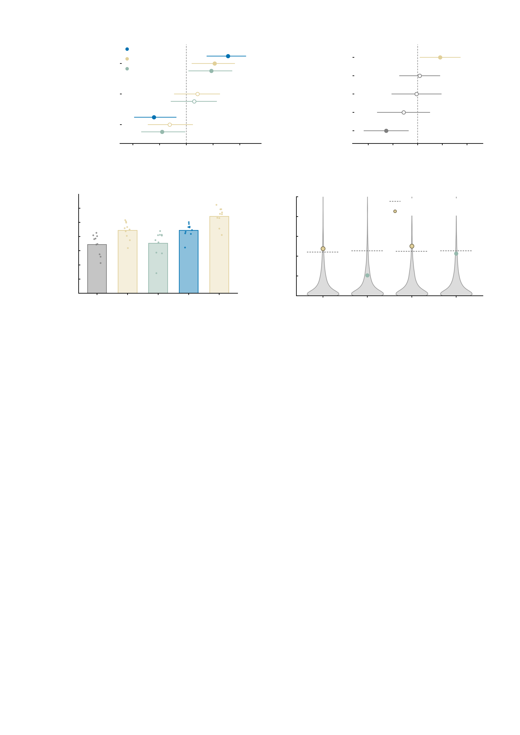
a
Baseline measured NP
b
Symptom change
at FU3
AMPA index
AMPA restoration
index
GABA-A index
Internalising item 1
Baseline measured NP
Internalising item 2
Baseline internalising
total
Internalising item 3
Internalising item 4
-0.75
-0.50
-0.25
0.00
0.25
0.50
0.75
-0.75
-0.50
-0.25
0.00
0.25
0.50
0.75
Pearson r (95% CI)
Standardised beta (95% CI)
c
0.175
d
0.10
0.150
95th centile of the null
0.125
0.08
Observed
0.100
0.06
*
*
Out-of-sample R^2
Incremental R^2
n.s.
0.075
0.04
0.050
0.02
n.s.
0.025
0.000
0.00
AMPA
over
four
items
GABA-A
over
four
items
AMPA
over
measured
NP
GABA-A
over
measured
NP
Four items
+ AMPA index
Measured NP
Measured NP
+ AMPA
+ GABA-A index

