Slide 1
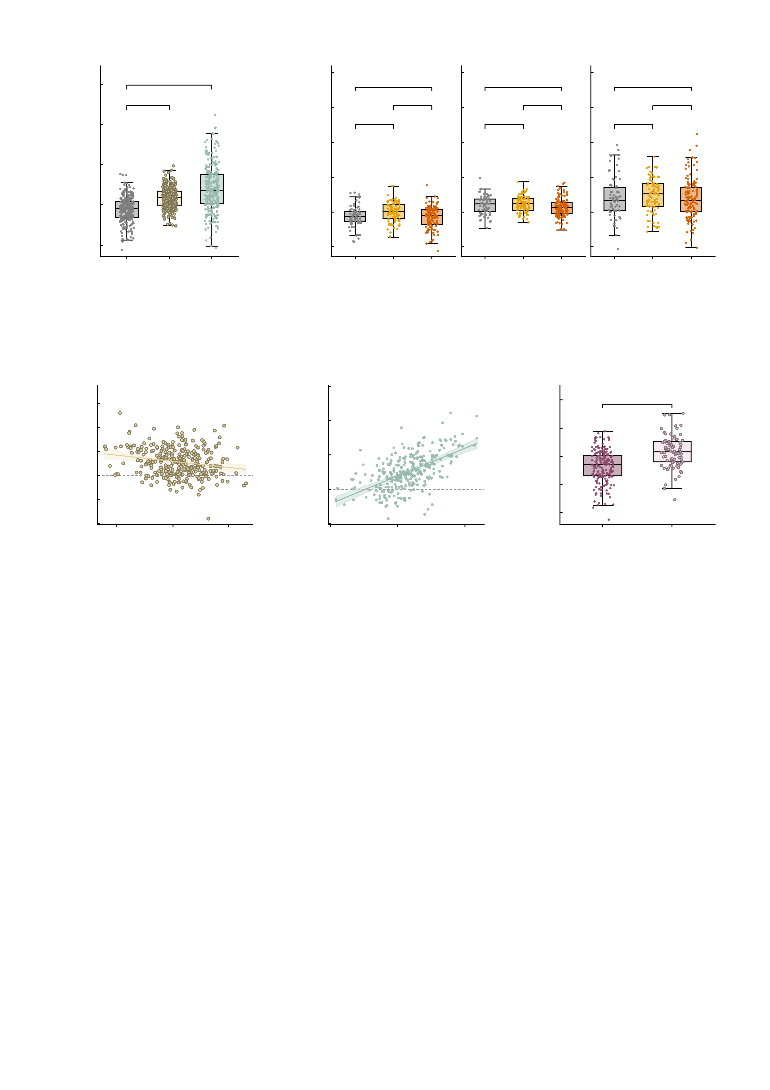
a
8
b
10
***
8
Baseline
n.s.
After AMPA
After GABA-A
6
***
***
n.s.
*
n.s.
n.s.
4
6
**
n.s.
n.s.
MID summed FC
4
2
MID summed FC
2
0
0
-2
-2
Baseline
+AMPA
-4
HC
Patient
HC
Patient
HC
Patient
-4
+GABA-A
High-symptom
High-symptom
High-symptom
c
d
8
e
3
4
AMPA
r = −0.20
6
GABA−A
r = 0.57
2
***
3
4
2
1
1
Change in MID summed FC
Change in MID summed FC
Baseline MID summed FC
0
2
0
-1
0
-1
-2
-2
-2
-2
-1
0
1
-4
2
-2
0
2
4
-3
both up
any down
Mean of baseline and
perturbed MID summed FC
Mean of baseline and
perturbed MID summed FC
-3
-4
Supplementary Fig. S15 | Robustness of the baseline-dependent, bidirectional response when the network phenotype is restricted to MID-specific NP connectivity. The virtual AMPA and GABA-A perturbations were re-analysed in the population-scale simulations with the network phenotype restricted to the NP-related MID-specific connectivity, i.e. the summed six MID edges, in place of the 12-edge NP factor of Fig. 4. Unit of observation is one digital twin; n = 288 (HC 69, high-symptom 89, patients 130). The GABA-A perturbation is applied on top of AMPA, as everywhere else in this work. Box plots show the median, 25th-75th percentiles and 1.5 x IQR whiskers with every twin overplotted; *P < 0.05, **P < 0.01, ***P < 0.001; n.s., not significant. All tests two-sided. a, within-subject effect of each perturbation on the same measure. AMPA raises it by +0.556 +/- 0.609 (239/288 twins, 83.0%, increase; paired t(287) = 15.49, P = 9.4e-40, Wilcoxon P = 4.3e-33, Cohen's dz = 0.913) and GABA-A by +1.022 +/- 1.038 (243/288, 84.4%; t(287) = 16.71, P = 2.9e-44, Wilcoxon P = 1.7e-35, dz = 0.985). The bidirectional response of Fig. 4 is therefore reproduced on the MID-specific measure. b, the three clinical groups in each condition (one-way ANOVA; the symbol is that F test, pairwise contrasts Benjamini-Hochberg-corrected over the three within a condition). At baseline the groups differ, F(2, 285) = 7.47, P = 0.00069 (means HC -0.267, high-symptom -0.002, patients -0.307; q = 0.00848 / 0.653 / 0.00068 for HC vs high-symptom / HC vs patients / high-symptom vs patients). After AMPA the difference is much reduced but not abolished, F(2, 285) = 3.75, P = 0.0246 (q = 0.429 / 0.18 / 0.0234; only high-symptom versus patients survives correction), and after GABA-A it is absent, F(2, 285) = 0.72, P = 0.488 (q = 0.597 / 0.854 / 0.597). On the 12-edge NP factor the contrast was already absent after AMPA (Fig. 4c), so on MID-specific connectivity the convergence is partial under AMPA and complete under GABA-A. The three sub-panels share one y scale. c, Oldham's test for the AMPA perturbation: the change against the mean of the baseline and perturbed level, which is the non-circular way to ask whether the response depends on where a twin starts. r = -0.198 (n = 288, df = 286, P = 0.00074); variance ratio 0.695 (s.d. 0.609 to 0.508), and the slope of the perturbed level on the baseline level is 0.347 (95% CI 0.259 to 0.435, below the identity slope of 1: t = -14.57, P = 2.4e-36). The negative correlation and the variance ratio below 1 are the same fact: the spread contracts, so twins low at baseline gain more and the group converges towards a common level. d, the same for GABA-A: r = +0.569 (n = 288, df = 286, P = 3.8e-26); variance ratio 3.326 (s.d. 0.609 to 1.111), and the slope of the perturbed level on the baseline level is 0.712 (95% CI 0.517 to 0.907, below the identity slope of 1: t = -2.90, P = 0.00402) -- here the correlation is positive and the variance ratio above 1, i.e. the spread expands, so the perturbation moves twins apart rather than together. Oldham's test is used instead of the baseline-versus-change correlation because the change contains the baseline with a negative sign; that circular quantity is r = -0.653 for AMPA and -0.169 for GABA-A and is reported only so that it is not mistaken for the test. e, the baseline level of the two response groups defined on the MID measure itself (both up, n = 208; any down, n = 80; 75.3% of twins fall in the same group as under the NP-factor rule). Twins that respond in both conditions start lower: -0.347 +/- 0.562 versus +0.170 +/- 0.571 (Welch t = -6.91, df = 141.3, P = 1.6e-10, Hedges' g = -0.92, Mann-Whitney P = 2.1e-10). The grouping is defined by the sign of the change, so the change itself is not tested between these groups -- the baseline is, and it is the quantity the split was not built on. The share of both-up twins also differs across the clinical groups (HC 56/69 = 81.2%, high-symptom 55/89 = 61.8%, patients 97/130 = 74.6%; chi2(2) = 7.94, P = 0.0189).

