Slide 1
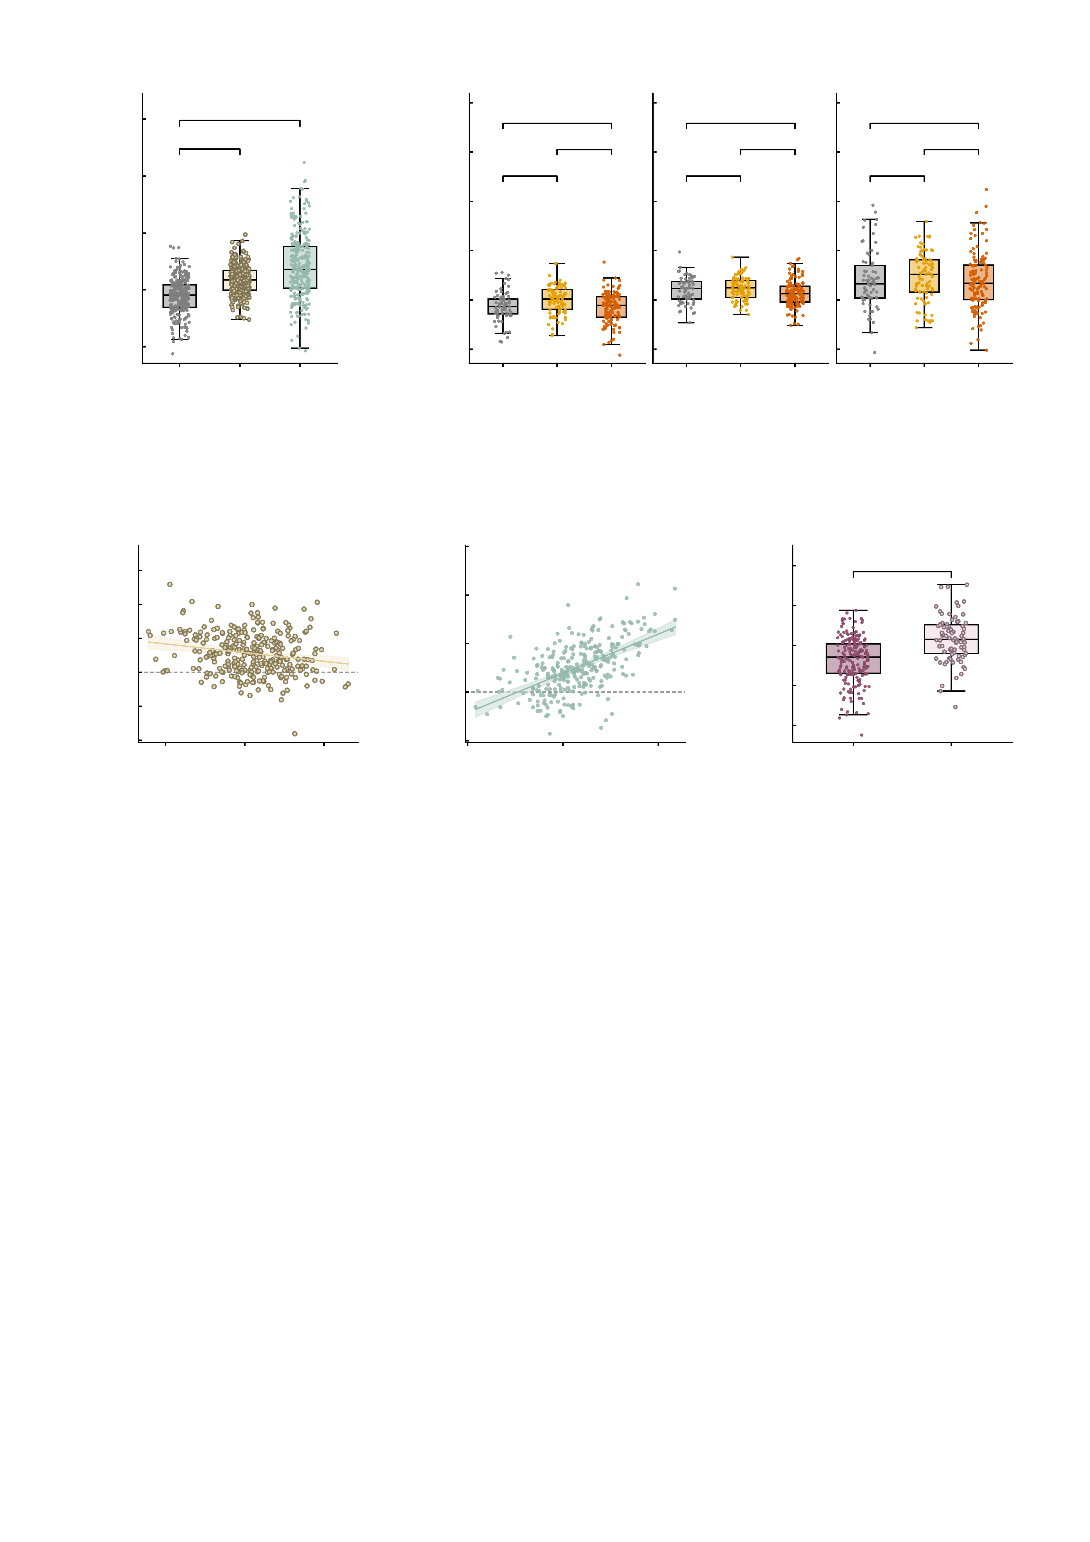
a
8
b
10
***
8
Baseline
n.s.
After AMPA
After GABA-A
6
***
***
n.s.
*
n.s.
n.s.
4
6
**
n.s.
n.s.
MID summed FC
4
2
MID summed FC
2
0
0
-2
-2
Baseline
+AMPA
-4
HC
Patient
HC
Patient
HC
Patient
-4
+GABA-A
High-symptom
High-symptom
High-symptom
c
d
8
e
3
4
AMPA
r = −0.20
6
GABA−A
r = 0.57
2
***
3
4
2
1
1
Change in MID summed FC
Change in MID summed FC
Baseline MID summed FC
0
2
0
-1
0
-1
-2
-2
-2
-2
-1
0
1
-4
2
-2
0
2
4
-3
both up
any down
Mean of baseline and
perturbed MID summed FC
Mean of baseline and
perturbed MID summed FC
-3
-4

