Slide 1
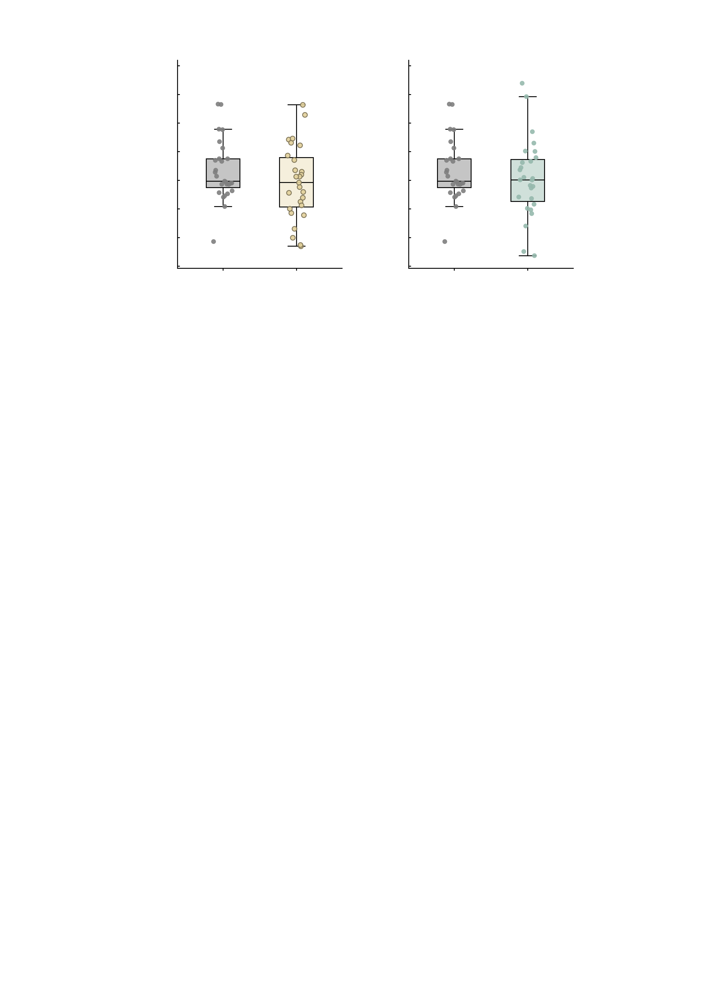
a
3.0
b
3.0
Placebo versus ketamine (n = 27)
Placebo versus midazolam (n = 27)
2.5
P = 0.105
2.5
P = 0.181
2.0
2.0
1.5
1.5
1.0
1.0
Summed MID FC
0.5
0.5
0.0
0.0
-0.5
-0.5
-1.0
Placebo
Ketamine
-1.0
Placebo
Midazolam
-1.5
-1.5
Supplementary Fig. S11 | Neither ketamine nor midazolam shifts the summed NP-related MID connectivity in the paired placebo comparison. Box plots show the median and interquartile range with whiskers at 1.5 times the interquartile range; every one of the 27 healthy volunteers is plotted as a point, jittered horizontally. Both panels share the y axis, and the plotted quantity is the RAW sum of the six NP-related MID edges (Fisher z). The design is a randomised within-subject cross-over with three infusion sessions, so each participant contributes a point to placebo and to the drug; the paired structure is carried by the test rather than by connecting lines. Because head motion is not balanced across sessions, the statistic printed in each heading band is the motion-adjusted one: the intercept of the paired FC difference (drug - placebo) regressed on the paired framewise-displacement difference, which adjusts for motion without removing the condition mean. All tests are two-sided and uncorrected. a, placebo versus ketamine. Placebo mean 0.664, ketamine mean 0.465; unadjusted paired difference -0.199 (95% CI -0.443 to +0.045), t(26) = -1.675, P = 0.106, Wilcoxon P = 0.141, Cohen's dz = -0.322, 11 of 27 participants higher on ketamine. Head motion: mean framewise displacement -0.003 mm relative to placebo, t(26) = -0.236, P = 0.815; the motion-adjusted test printed in the panel gives -0.202 (-0.450 to +0.045), t(25) = -1.683, P = 0.105, and the pooled-residual version -0.198, t(26) = -1.666, P = 0.108. b, placebo versus midazolam. Placebo mean 0.664, midazolam mean 0.534; unadjusted paired difference -0.130 (95% CI -0.465 to +0.205), t(26) = -0.797, P = 0.432, Wilcoxon P = 0.361, Cohen's dz = -0.153, 10 of 27 participants higher on midazolam. Head motion: mean framewise displacement +0.079 mm relative to placebo, t(26) = 2.659, P = 0.0132; the motion-adjusted test printed in the panel gives -0.248 (-0.619 to +0.123), t(25) = -1.375, P = 0.181, and the pooled-residual version -0.145, t(26) = -0.898, P = 0.378. Neither drug moves the summed NP-related MID connectivity away from placebo, whether the comparison is unadjusted (P = 0.106 and P = 0.432) or motion-adjusted (P = 0.105 and P = 0.181), and the split of participants moving up versus down is close to even in both (11/27 and 10/27 higher on drug). Midazolam is the session with the higher head motion (+0.079 mm, P = 0.0132), which is why the adjusted test is the one reported; ketamine is balanced on motion (P = 0.815). The composite score used in Fig. 5 is not plotted here: it is this sum residualised on framewise displacement and then standardised separately WITHIN each condition, so its paired placebo-versus-drug difference is identically zero by construction (verified: paired t = 0, P = 1 in both comparisons) and a between-condition mean contrast on it is not interpretable. Source values, including the unadjusted, motion-adjusted and pooled-residual tests for both drugs, are in midpaired_placebo_vs_drug_n27.csv; the subject-level and edgewise inputs are in midpaired_subject_level_n27.csv and midpaired_edgewise_source_n27.csv.

