Slide 1
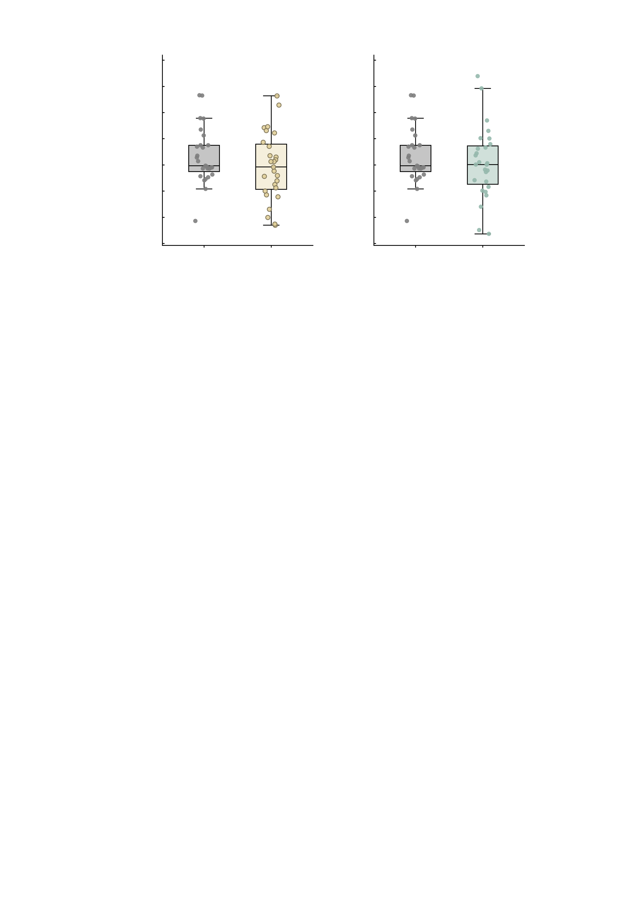
a
3.0
b
3.0
Placebo versus ketamine (n = 27)
Placebo versus midazolam (n = 27)
2.5
P = 0.105
2.5
P = 0.181
2.0
2.0
1.5
1.5
1.0
1.0
Summed MID FC
0.5
0.5
0.0
0.0
-0.5
-0.5
-1.0
Placebo
Ketamine
-1.0
Placebo
Midazolam
-1.5
-1.5

