Slide 1
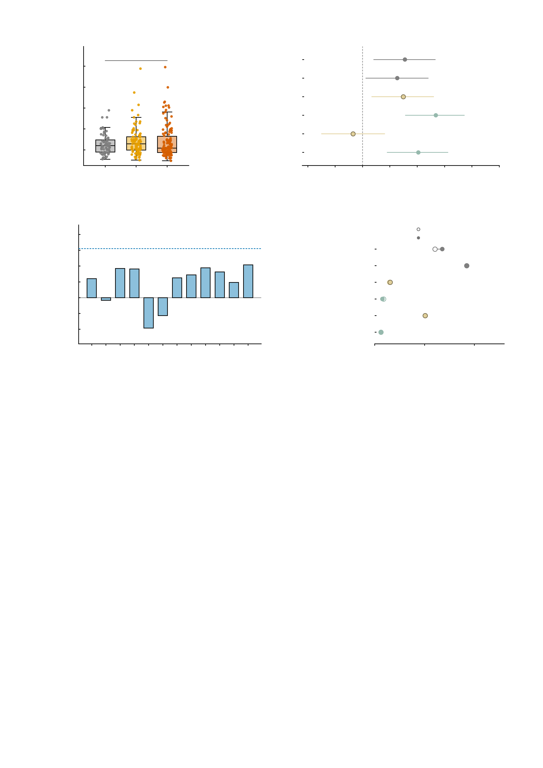
a
0.6
b
0.5
n.s.
Empirical NP factor
*
0.4
Simulated NP
n.s.
Mean framewise
displacement (mm)
Manipulated NP (AMPA)
n.s.
0.3
Manipulated NP (GABA-A)
***
0.2
Delta NP (AMPA)
n.s.
0.1
Delta NP (GABA-A)
**
0.0
HC
n = 69
High-sym.
n = 89
Patient
n = 130
-0.3
-0.2
-0.1
0.0
0.1
0.2
0.3
0.4
0.5
Pearson r with mean FD
c
0.25
d
group only
0.20
12-edge sum
+ mean FD as covariate
0.15
Empirical NP factor
***
0.10
Simulated NP
***
0.05
Manipulated NP (AMPA)
n.s.
Pearson r with mean FD
0.00
Manipulated NP (GABA-A)
n.s.
-0.05
no edge survives
Bonferroni (12 edges)
Delta NP (AMPA)
**
-0.10
Delta NP (GABA-A)
n.s.
-0.15
e1
e2
e3
e4
e5
e6
e7
e8
e9
e10
e11
e12
0
5
10
15
Empirical NP edge
Group effect, partial eta^2 (%)
Supplementary Fig. S5 | Head motion does not differ across diagnostic groups and does not account for the group effects, but it is weakly associated with some of the NP measures. All panels use the n = 288 twins retained by the mean-FD < 0.5 mm inclusion threshold (69 healthy controls, 89 high-symptom participants, 130 patients). Motion is summarised as mean framewise displacement (FD, mm) over the run, and the unit of observation is one subject. Panels carry only the significance symbol (*** P < 0.001, ** P < 0.01, * P < 0.05, n.s. not significant); every coefficient, interval and P value is given below. All tests are two-sided; P values are Bonferroni-corrected across the six NP measures in b and d and across the 12 edges in c. a, FD by diagnostic group, box with all individual subjects: healthy controls 0.128 ± 0.049 mm (median 0.120), high-symptom 0.142 ± 0.070 (0.129), patients 0.138 ± 0.076 (0.109). One-way ANOVA F(2, 285) = 0.844, P = 0.431; Kruskal-Wallis chi-squared(2) = 2.276, P = 0.320; Levene's test of equal variances F(2, 285) = 1.671, P = 0.190; healthy controls against all others Welch t = -1.478, P = 0.141 (Cohen d = -0.17), Mann-Whitney P = 0.772. Motion does not differ across groups on any of these tests. b, Pearson correlation of FD with each of the six NP outcomes, point estimate with 95% confidence interval: empirical np factor r = +0.155 (95% CI +0.041 to +0.266, P = 0.0082, P_Bonferroni = 0.049, 2.4% of variance); simulated np r = +0.127 (95% CI +0.012 to +0.240, P = 0.031, P_Bonferroni = 0.184, 1.6% of variance); manipulated np (ampa) r = +0.149 (95% CI +0.034 to +0.260, P = 0.011, P_Bonferroni = 0.067, 2.2% of variance); manipulated np (gaba-a) r = +0.268 (95% CI +0.157 to +0.372, P < 0.001, P_Bonferroni < 0.001, 7.2% of variance); delta np (ampa) r = -0.035 (95% CI -0.150 to +0.081, P = 0.554, P_Bonferroni = 1.000, 0.1% of variance); delta np (gaba-a) r = +0.204 (95% CI +0.090 to +0.312, P < 0.001, P_Bonferroni = 0.003, 4.2% of variance). Three of the six survive correction. The measure behind the main inferences - the AMPA-induced change in NP - is the one with no motion association at all, whereas the measured NP factor is weakly but detectably motion-associated and sits just below the corrected threshold, so that conclusion is sensitive to how the correction family is defined and is reported here as such. c, the same test edge by edge for the 12 empirical NP edges (n = 288), with the 12-edge sum marked by the dashed line (r = +0.155). No single edge is motion-related: the largest absolute correlation is 0.104, the smallest uncorrected P is 0.078 (edge 12) and the smallest Bonferroni-corrected P is 0.94. Only the sum reaches significance, and only marginally (b). d, the group effect on each NP measure as partial eta-squared, in a one-way model (open marker, df = 2, 285) and in the same model with FD added as a covariate (filled marker, df = 2, 284): empirical np factor 6.04% to 6.78%; simulated np 9.23% to 9.27%; manipulated np (ampa) 1.48% to 1.54%; manipulated np (gaba-a) 0.88% to 0.77%; delta np (ampa) 5.08% to 5.06%; delta np (gaba-a) 0.62% to 0.61%. The largest shift is 0.74 percentage points and no effect changes its significance status, so adjusting for motion leaves the group effects as they were. Taken together, motion is balanced across the diagnostic groups (a) and adjusting for it does not change the group effects (d), while the cross-sectional association between motion and the NP measures is small but not uniformly zero (b, c). Source values are in motion_subject_level_n288.csv, motion_group_tests.csv, TableS25_motion_np_correlations_corrected_n288.csv, motion_per_edge_correlations.csv and TableS26_group_effect_motion_adjustment_corrected_n288.csv.

