Slide 1
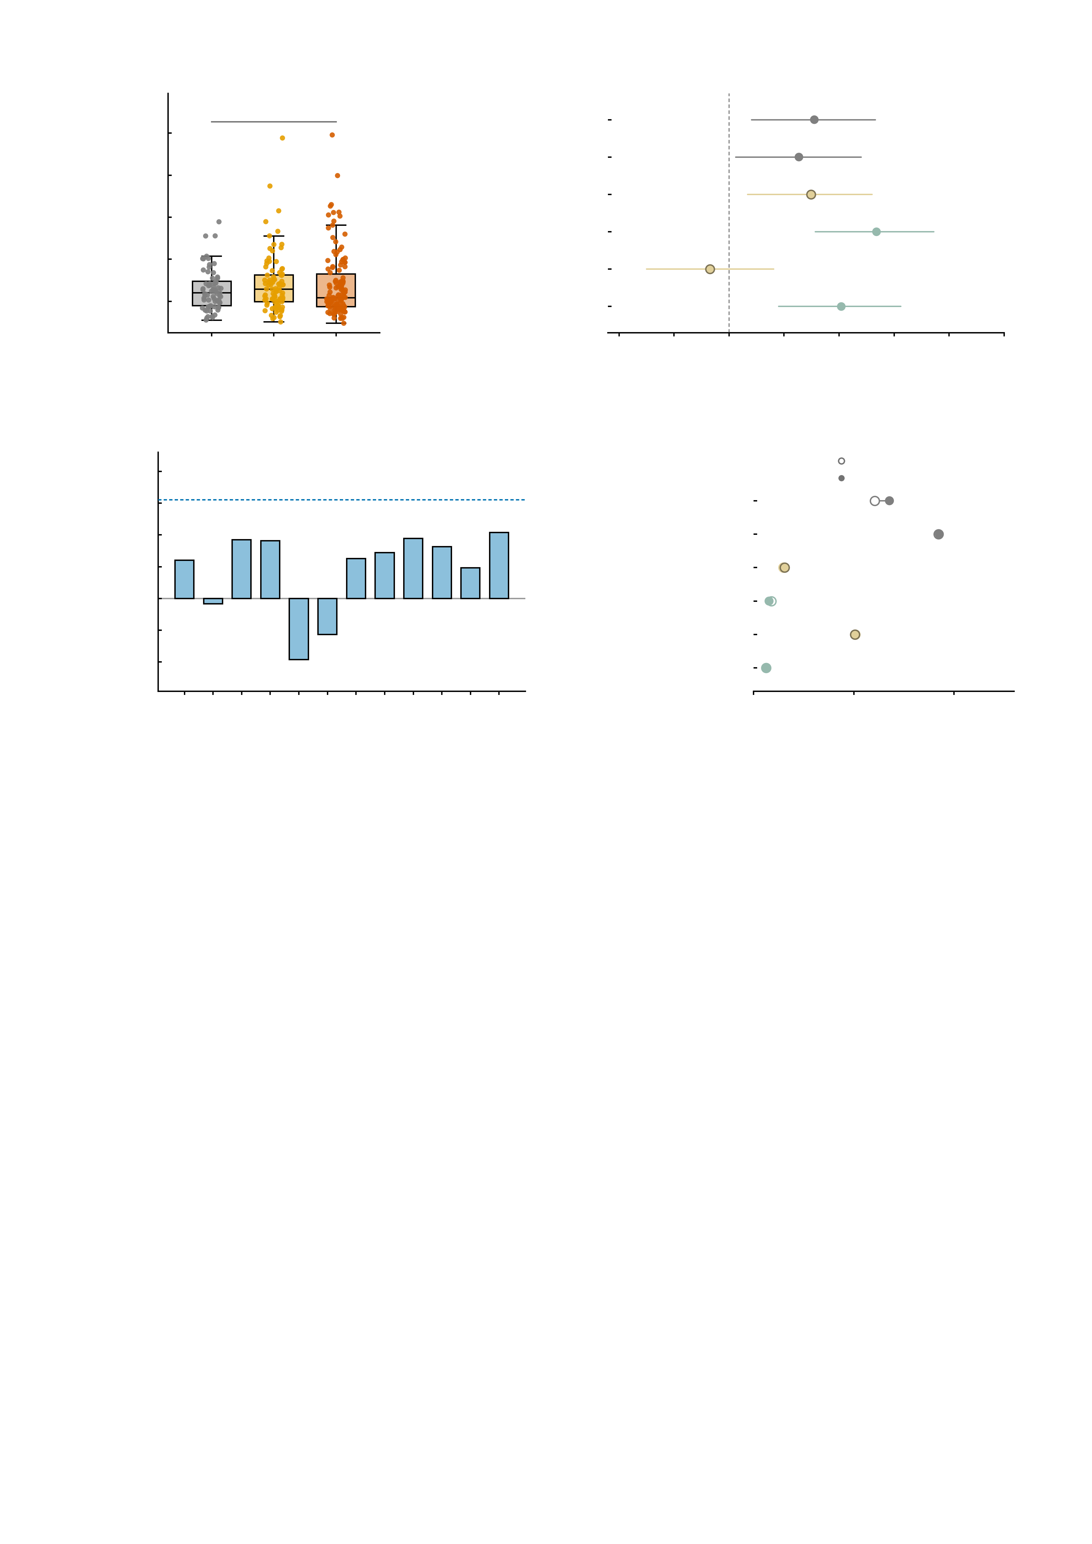
a
0.6
b
0.5
n.s.
Empirical NP factor
*
0.4
Simulated NP
n.s.
Mean framewise
displacement (mm)
Manipulated NP (AMPA)
n.s.
0.3
Manipulated NP (GABA-A)
***
0.2
Delta NP (AMPA)
n.s.
0.1
Delta NP (GABA-A)
**
0.0
HC
n = 69
High-sym.
n = 89
Patient
n = 130
-0.3
-0.2
-0.1
0.0
0.1
0.2
0.3
0.4
0.5
Pearson r with mean FD
c
0.25
d
group only
0.20
12-edge sum
+ mean FD as covariate
0.15
Empirical NP factor
***
0.10
Simulated NP
***
0.05
Manipulated NP (AMPA)
n.s.
Pearson r with mean FD
0.00
Manipulated NP (GABA-A)
n.s.
-0.05
no edge survives
Bonferroni (12 edges)
Delta NP (AMPA)
**
-0.10
Delta NP (GABA-A)
n.s.
-0.15
e1
e2
e3
e4
e5
e6
e7
e8
e9
e10
e11
e12
0
5
10
15
Empirical NP edge
Group effect, partial eta^2 (%)

