Slide 1
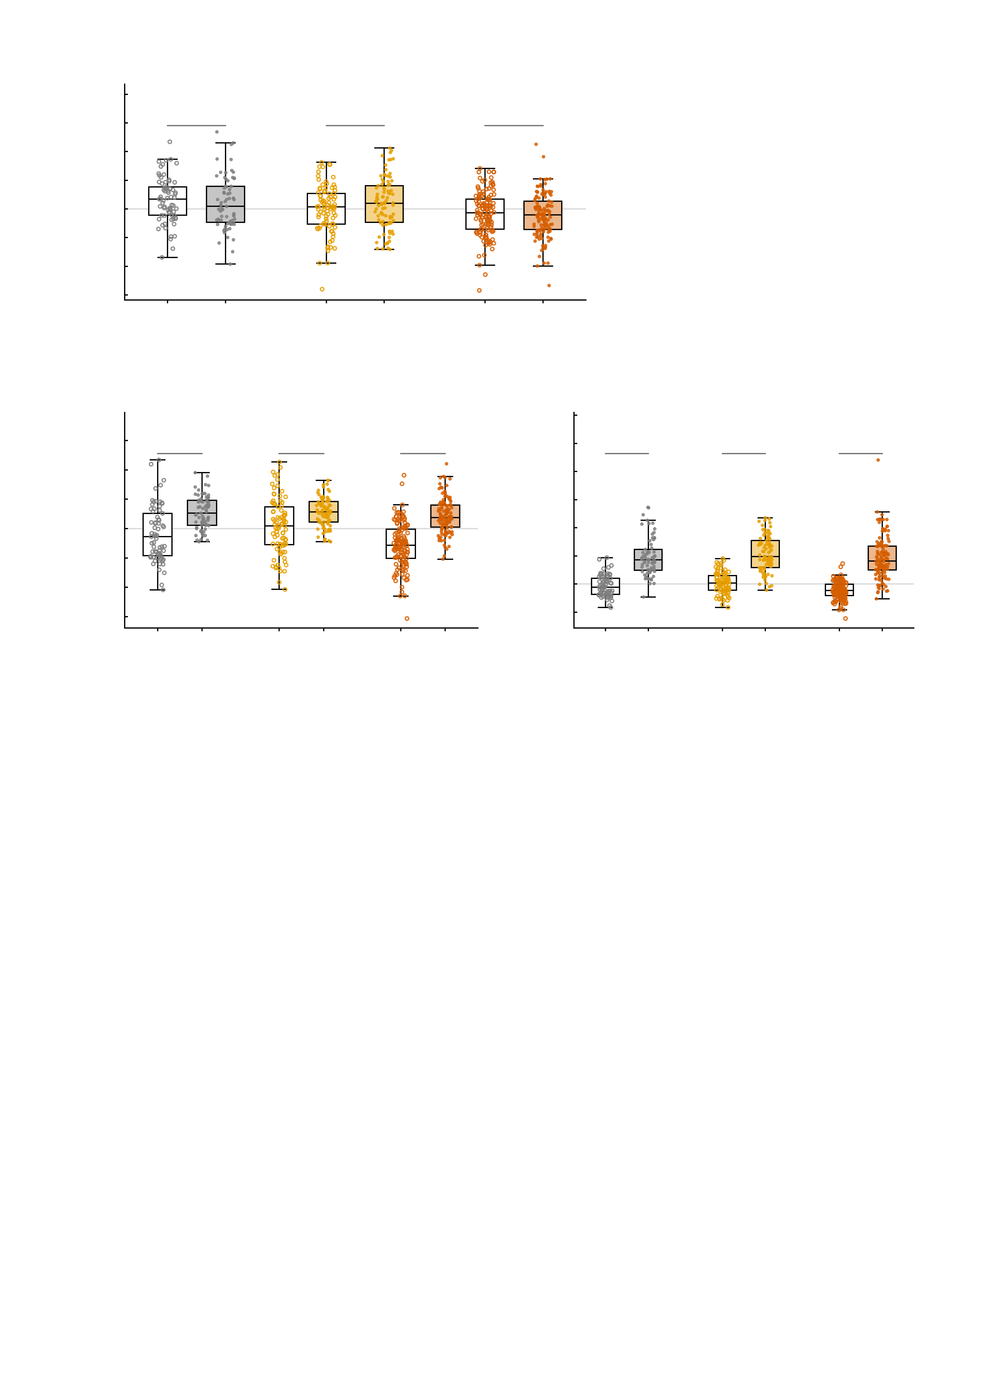
a
5
4
n.s.
n.s.
n.s.
3
2
1
NP factor (residualised)
0
-1
-2
-3
emp.
sim.
emp.
sim.
emp.
sim.
-4
Healthy controls
n = 69
High-symptom
n = 89
Patients
n = 130
b
4
c
17.5
3
15.0
2
***
***
***
12.5
***
***
***
1
10.0
NP factor (simulated)
7.5
NP factor (simulated)
0
5.0
-1
2.5
-2
0.0
-3
-2.5
-4
base
AMPA
base
AMPA
base
AMPA
-5.0
base
GABA-A
base
GABA-A
base
GABA-A
Healthy controls
n = 69
High-symptom
n = 89
Patients
n = 130
Healthy controls
n = 69
High-symptom
n = 89
Patients
n = 130
Supplementary Fig. S14 | The NP factor score within each diagnostic group: simulated against empirical, and simulated baseline against the perturbed state. All panels show the same n = 288 twins (69 healthy controls, 89 high-symptom participants, 130 patients), one box per condition per diagnostic group with every individual observation plotted beside it; boxes give the median and interquartile range with whiskers at 1.5 times that range. The open box is the reference condition and the filled box the model state compared against it, group identity is carried by colour, and because every comparison is within subject each bracket carries a two-sided paired t test. The bracket shows only the significance symbol (*** P < 0.001, ** P < 0.01, * P < 0.05, n.s. not significant); every t, P, confidence interval and effect size is given below. a asks whether the model reproduces the observed score; b and c ask whether the virtual perturbation moves that score. a, empirical against simulated scores after residualisation (age, sex, site and mean framewise displacement regressed out, each measure centred separately) - the specification used in the manuscript: healthy controls (n = 69) empirical +0.312 versus simulated +0.197, difference -0.115 (95% CI -0.412 to +0.182), t(68) = -0.773, P = 0.442, dz = -0.093; high-symptom (n = 89) empirical -0.003 versus simulated +0.187, difference +0.190 (95% CI -0.051 to +0.431), t(88) = 1.568, P = 0.120, dz = +0.166; patients (n = 130) empirical -0.164 versus simulated -0.233, difference -0.069 (95% CI -0.248 to +0.111), t(129) = -0.759, P = 0.449, dz = -0.067. Simulated and empirical scores do not differ in any group. The subject-wise correlation between the two measures is nonetheless weak (Pearson r = -0.06, +0.12, +0.07 for the three groups), so agreement of the group distributions should not be read as agreement twin by twin. On the raw, unresidualised scores the simulated values carry a downward offset in healthy controls and in patients (empsim_paired_tests_n288.csv), which is a constant of the measure rather than a group effect and is removed by construction here. b, simulated baseline against the AMPA-perturbed state: healthy controls (n = 69) -0.188 to +0.552, change +0.740 (95% CI +0.507 to +0.974), t(68) = 6.325, P = 2.3e-08, dz = +0.761, 52 of 69 twins (75.4%) increased; high-symptom (n = 89) +0.071 to +0.571, change +0.499 (95% CI +0.293 to +0.705), t(88) = 4.825, P = 5.8e-06, dz = +0.511, 63 of 89 twins (70.8%) increased; patients (n = 130) -0.559 to +0.428, change +0.987 (95% CI +0.843 to +1.131), t(129) = 13.551, P = 1.5e-26, dz = +1.189, 119 of 130 twins (91.5%) increased. c, simulated baseline against the GABA-A-perturbed state: healthy controls (n = 69) -0.188 to +2.410, change +2.598 (95% CI +2.196 to +3.001), t(68) = 12.879, P = 6.6e-20, dz = +1.550, 67 of 69 twins (97.1%) increased; high-symptom (n = 89) +0.071 to +2.698, change +2.626 (95% CI +2.276 to +2.977), t(88) = 14.900, P = 8.6e-26, dz = +1.579, 88 of 89 twins (98.9%) increased; patients (n = 130) -0.559 to +2.324, change +2.883 (95% CI +2.576 to +3.189), t(129) = 18.615, P = 2.3e-38, dz = +1.633, 127 of 130 twins (97.7%) increased. Read together: the model's resting score is statistically indistinguishable from the measured one within every group once nuisance variables are removed (a), while both virtual perturbations raise the score in every group (b, c) - the AMPA effect is largest in patients and the GABA-A effect is large and near-universal everywhere. No multiple-comparison correction is applied across the panels. Source values are in empsim_subject_level_n288.csv and empsim_paired_tests_n288.csv (a) and in fig4_paired_np_mid_n288.csv (b, c); the within-group paired tests for b and c are tabulated in npscores_baseline_vs_perturbed_by_group_n288.csv.

