Slide 1
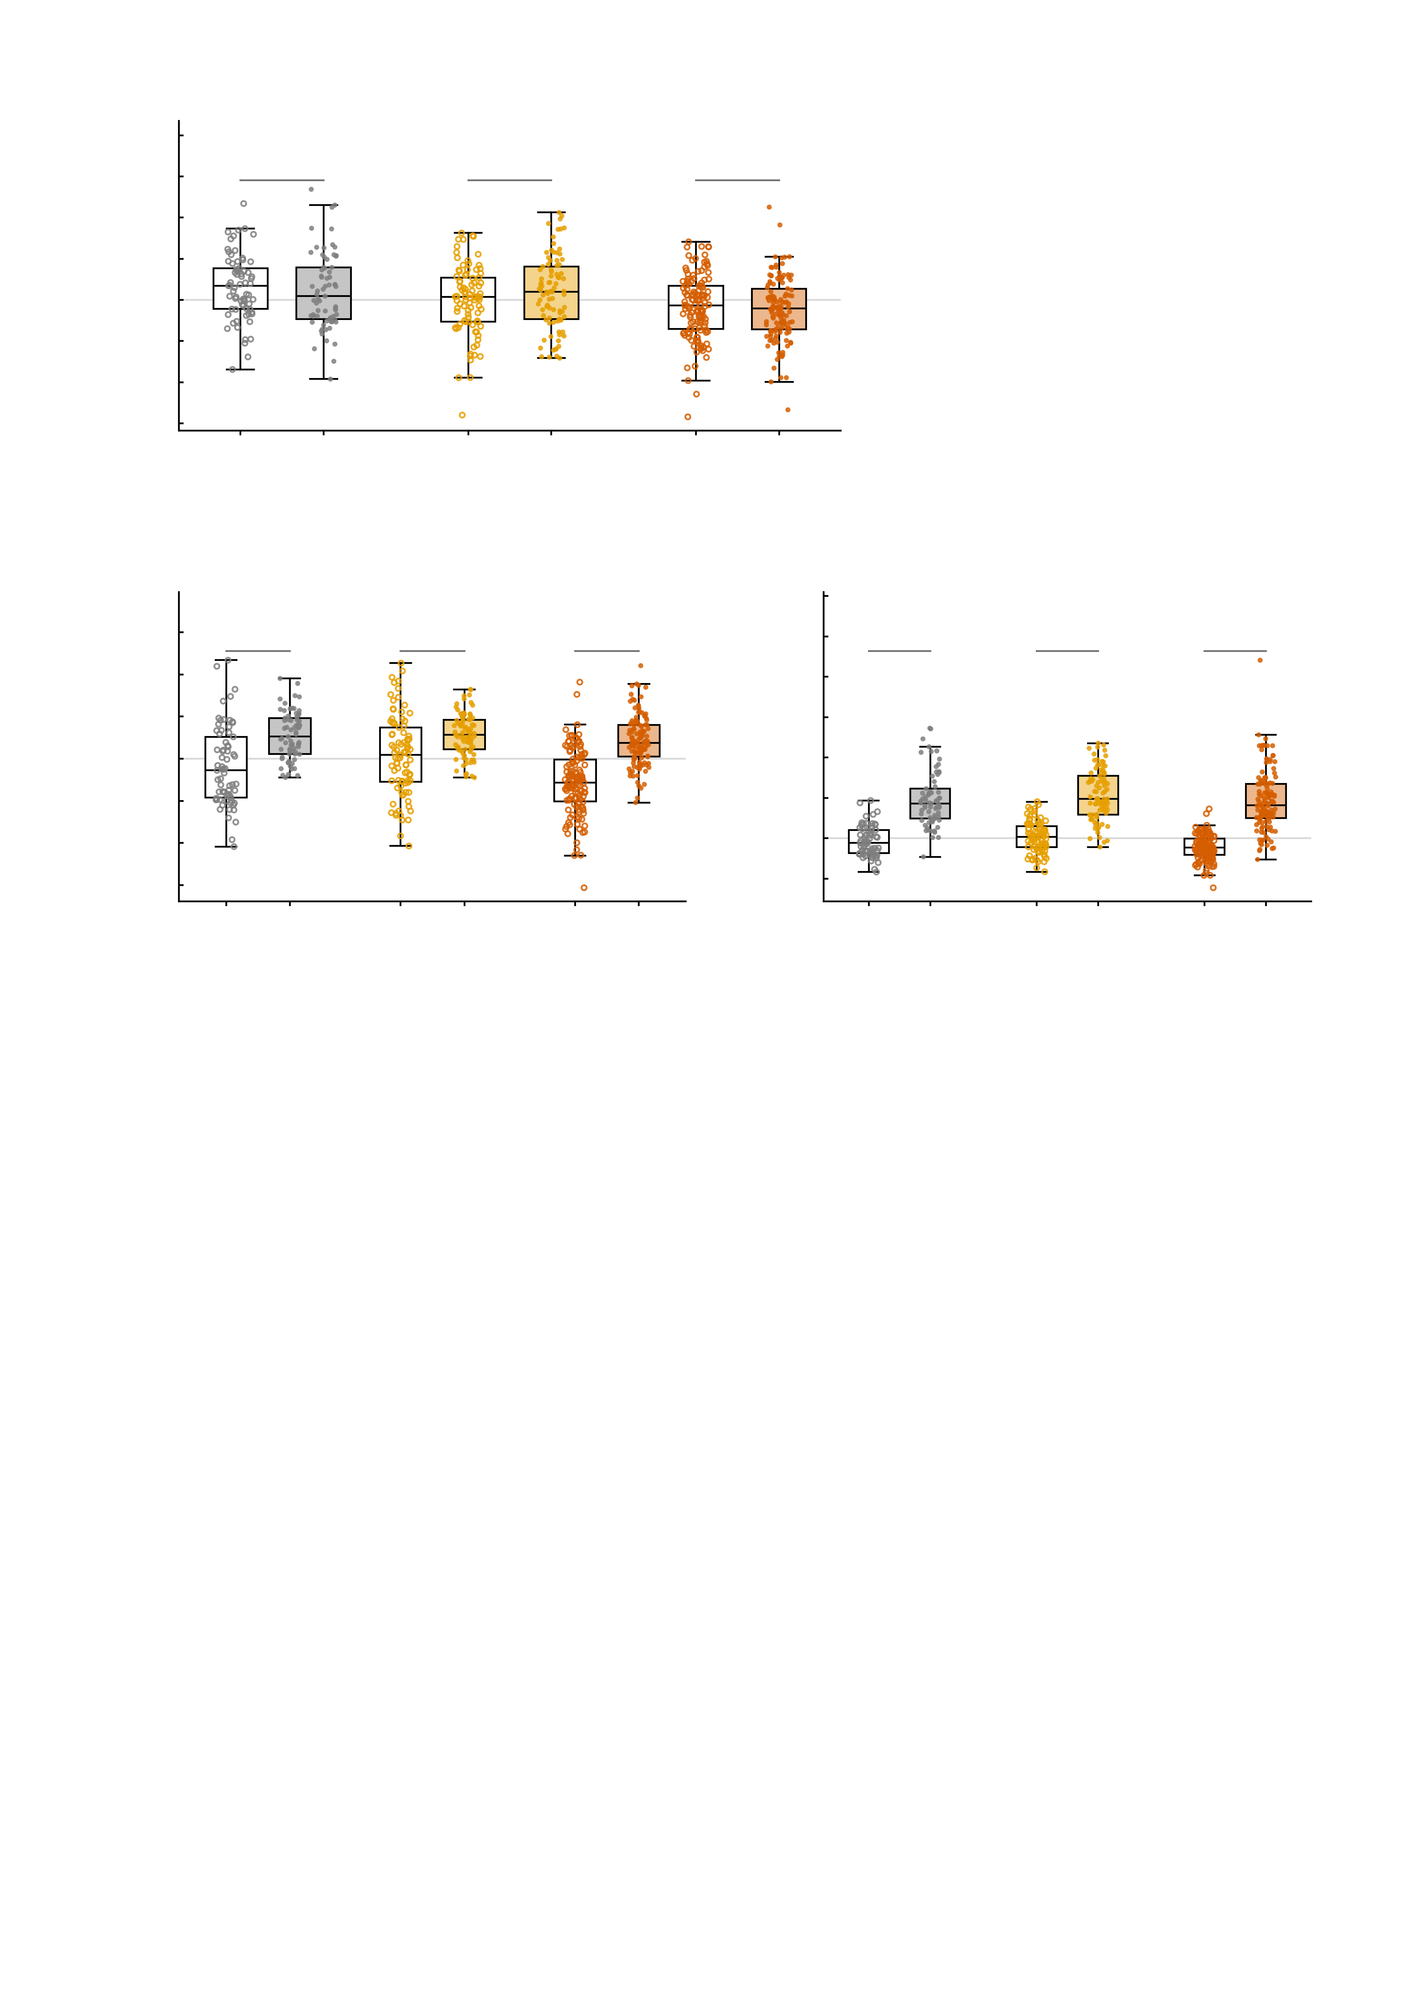
a
5
4
n.s.
n.s.
n.s.
3
2
1
NP factor (residualised)
0
-1
-2
-3
emp.
sim.
emp.
sim.
emp.
sim.
-4
Healthy controls
n = 69
High-symptom
n = 89
Patients
n = 130
b
4
c
17.5
3
15.0
2
***
***
***
12.5
***
***
***
1
10.0
NP factor (simulated)
7.5
NP factor (simulated)
0
5.0
-1
2.5
-2
0.0
-3
-2.5
-4
base
AMPA
base
AMPA
base
AMPA
-5.0
base
GABA-A
base
GABA-A
base
GABA-A
Healthy controls
n = 69
High-symptom
n = 89
Patients
n = 130
Healthy controls
n = 69
High-symptom
n = 89
Patients
n = 130

