Slide 1
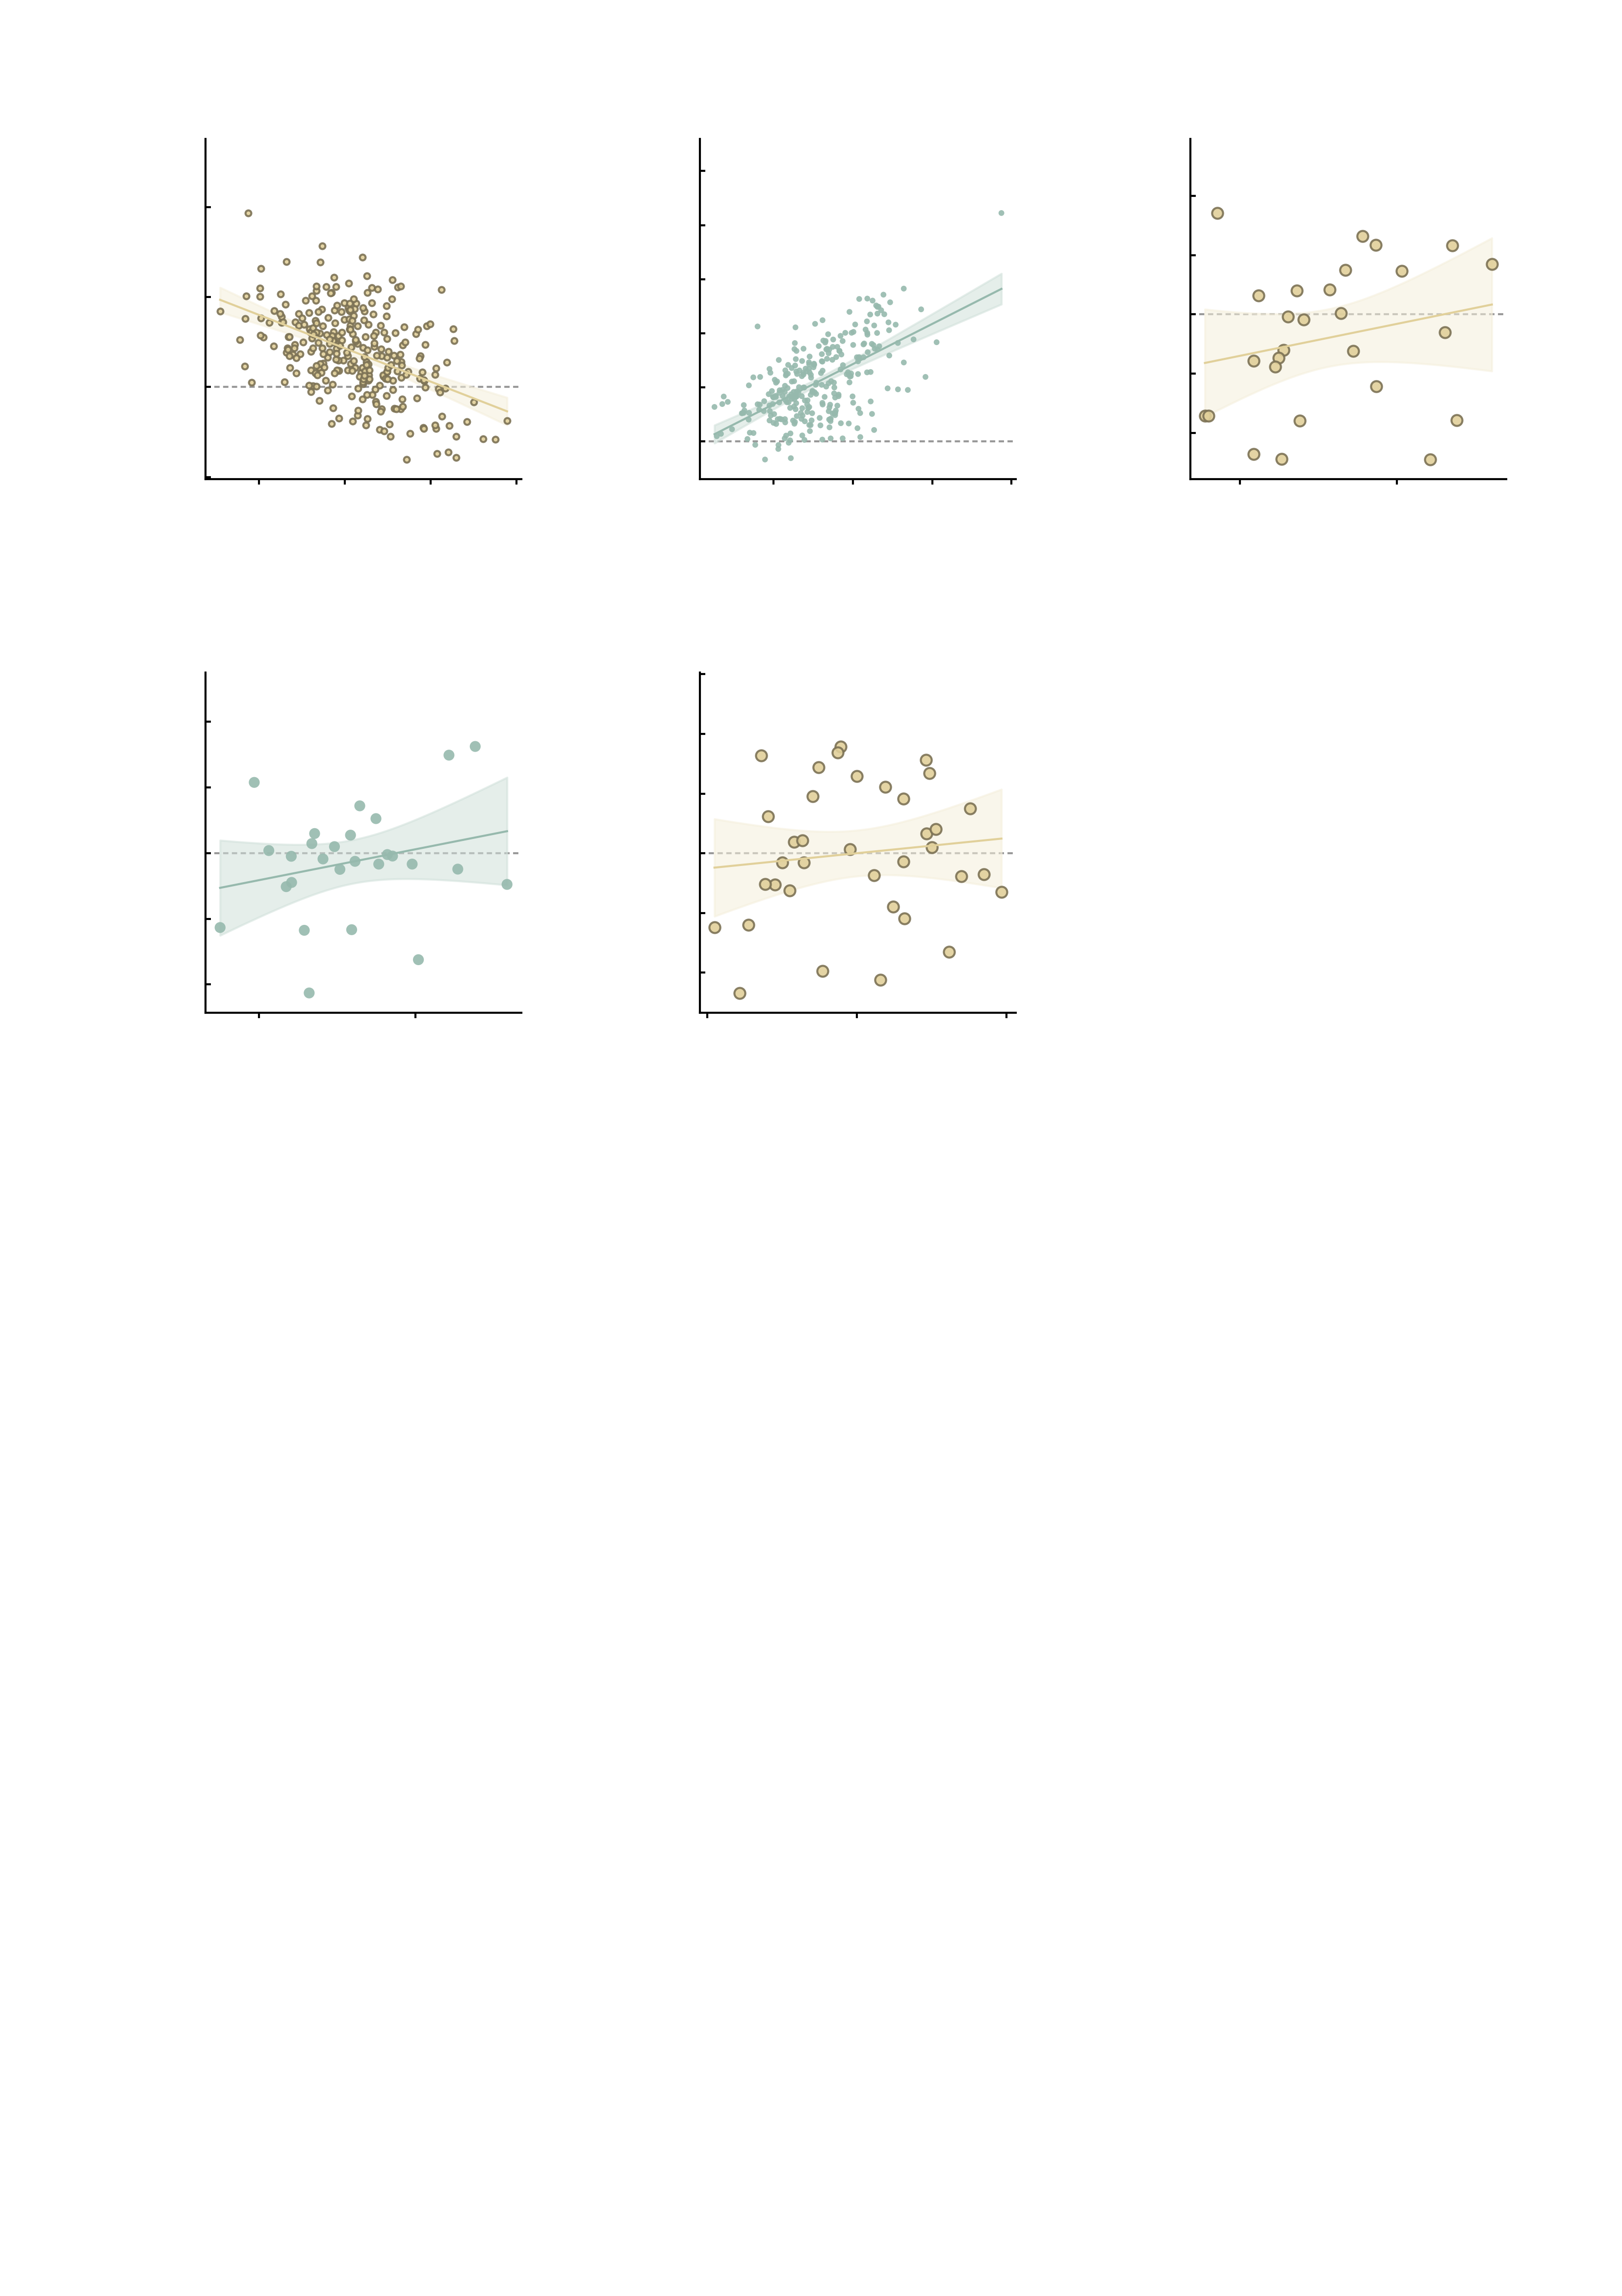
a
6
Simulation
r = −0.47
b
15.0
Simulation
r = 0.59
c
1.5
Healthy
r = 0.22
4
12.5
1.0
10.0
0.5
2
7.5
AMPA state − baseline
GABA-A state − baseline
Ketamine − placebo
5.0
0.0
0
2.5
-0.5
-2
0.0
-1.0
-2
-1
0
1
2
3
-2.5
-1.5
-2
0
2
4
6
-1
Mean of baseline
and AMPA state
Mean of baseline
and GABA-A state
8
0
1
2
-4
Mean of placebo
and ketamine
d
3
e
8
Healthy
r = 0.25
6
Clinical
r = 0.12
2
4
1
2
Midazolam − placebo
Ketamine − placebo
0
0
-1
-2
-2
-4
-1
-3
0
1
-4
2
-6
-2
0
2
4
Mean of placebo
and midazolam
Mean of placebo
and ketamine
Supplementary Fig. S12 | Oldham's test for baseline dependence, in the model and in both drug datasets. Each panel plots the change against the AVERAGE of the two measurements rather than against the baseline (Oldham's method), which removes the mathematical coupling that makes a plain baseline-versus-change correlation negative even when nothing depends on the baseline; the method is shift-invariant, so it is unaffected by the per-condition mean-centring of the pharmacology scores. Points are individual subjects or twins, the line is the ordinary-least-squares fit with its 95% confidence band, the dashed line marks no change, and the coefficient in the heading band is Oldham's r itself; its confidence interval, t, P and n are given below. Colour pairs each drug with its model counterpart: ketamine with the AMPA perturbation (a, c, e) and midazolam with GABA-A (b, d). What the test answers: because cov(mean, difference) = [var(post) - var(pre)] / 2 exactly, the sign of Oldham's r is determined by the variance ratio and the test is algebraically the paired variance-equality (Pitman-Morgan) test. It therefore asks whether the perturbation compressed or expanded between-subject spread, NOT whether subjects with a high baseline changed more. All correlations are two-sided Pearson and uncorrected. a, the digital twins of the Fig. 4 cohort, simulated baseline to the AMPA-perturbed state. This is the one contrast in which spread CONTRACTS, so Oldham's r is negative. Oldham r = -0.467 (95% CI -0.553 to -0.371), t = -8.93, df = 286, P = 5.4e-17, n = 288; s.d. 0.905 before and 0.554 after, variance ratio 0.37. The naive baseline-versus-change correlation for the same data is -0.819 (P = 7.4e-71) and the slope of the perturbed value on the baseline is 0.156 (0.087 to 0.225). b, the same twins, baseline to the GABA-A state (oldham_tests.csv contrast "baseline -> GABA-A"), where spread expands and the sign reverses. Oldham r = +0.589 (95% CI +0.507 to +0.659), t = 12.31, df = 286, P = 3.1e-28, n = 288; s.d. 0.905 before and 1.734 after, variance ratio 3.68. The naive baseline-versus-change correlation for the same data is -0.240 (P = 3.9e-05) and the slope of the perturbed value on the baseline is 0.546 (0.332 to 0.760). c, the healthy cohort, placebo to ketamine, raw summed FC over the six NP-related MID edges. Oldham r = +0.223 (95% CI -0.172 to +0.556), t = 1.14, df = 25, P = 0.264, n = 27; s.d. 0.533 before and 0.651 after, variance ratio 1.49. The naive baseline-versus-change correlation for the same data is -0.365 (P = 0.0611) and the slope of the perturbed value on the baseline is 0.578 (0.135 to 1.021). d, the healthy cohort, placebo to midazolam, same measure. Oldham r = +0.247 (95% CI -0.147 to +0.573), t = 1.28, df = 25, P = 0.214, n = 27; s.d. 0.533 before and 0.686 after, variance ratio 1.66. The naive baseline-versus-change correlation for the same data is -0.587 (P = 0.00129) and the slope of the perturbed value on the baseline is 0.069 (-0.461 to 0.598). e, the clinical cohort, placebo session to the ketamine session, all 36 participants (MDD 22 and HC 14). Oldham r = +0.116 (95% CI -0.221 to +0.428), t = 0.68, df = 34, P = 0.5, n = 36; s.d. 1.438 before and 1.615 after, variance ratio 1.26. The naive baseline-versus-change correlation for the same data is -0.701 (P = 2.0e-06) and the slope of the perturbed value on the baseline is -0.099 (-0.489 to 0.291). In none of the three drug contrasts does Oldham's r differ from zero (P = 0.264, P = 0.214 and P = 0.5), while the naive baseline-versus-change correlation is large and negative in all of them (-0.37, -0.59 and -0.70): the apparent baseline dependence in the drug data is what the coupling alone produces. The motion-residualised versions of c and d and the MDD-only subgroup of e are tabulated in oldham_tests.csv and lead to the same conclusion.

