Slide 1
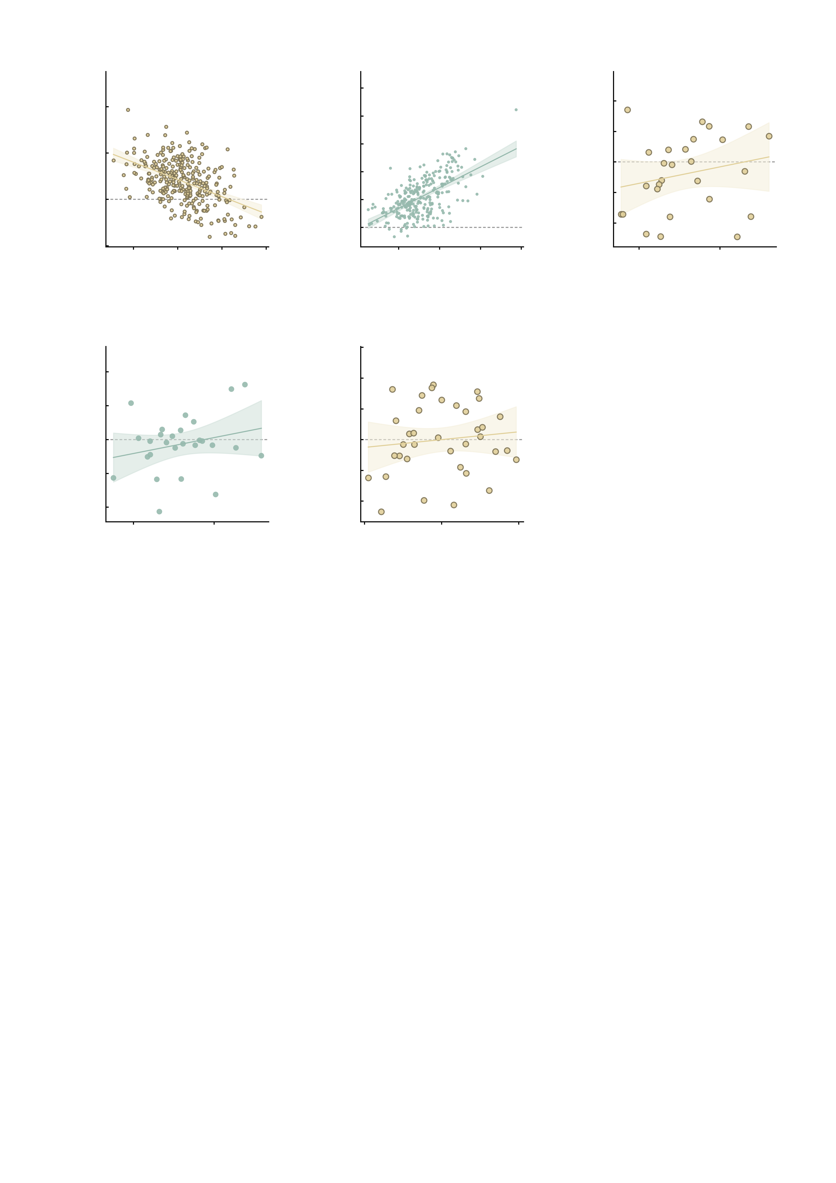
a
6
Simulation
r = −0.47
b
15.0
Simulation
r = 0.59
c
1.5
Healthy
r = 0.22
4
12.5
1.0
10.0
0.5
2
7.5
AMPA state − baseline
GABA-A state − baseline
Ketamine − placebo
5.0
0.0
0
2.5
-0.5
-2
0.0
-1.0
-2
-1
0
1
2
3
-2.5
-1.5
-2
0
2
4
6
-1
Mean of baseline
and AMPA state
Mean of baseline
and GABA-A state
8
0
1
2
-4
Mean of placebo
and ketamine
d
3
e
8
Healthy
r = 0.25
6
Clinical
r = 0.12
2
4
1
2
Midazolam − placebo
Ketamine − placebo
0
0
-1
-2
-2
-4
-1
-3
0
1
-4
2
-6
-2
0
2
4
Mean of placebo
and midazolam
Mean of placebo
and ketamine

