Slide 1
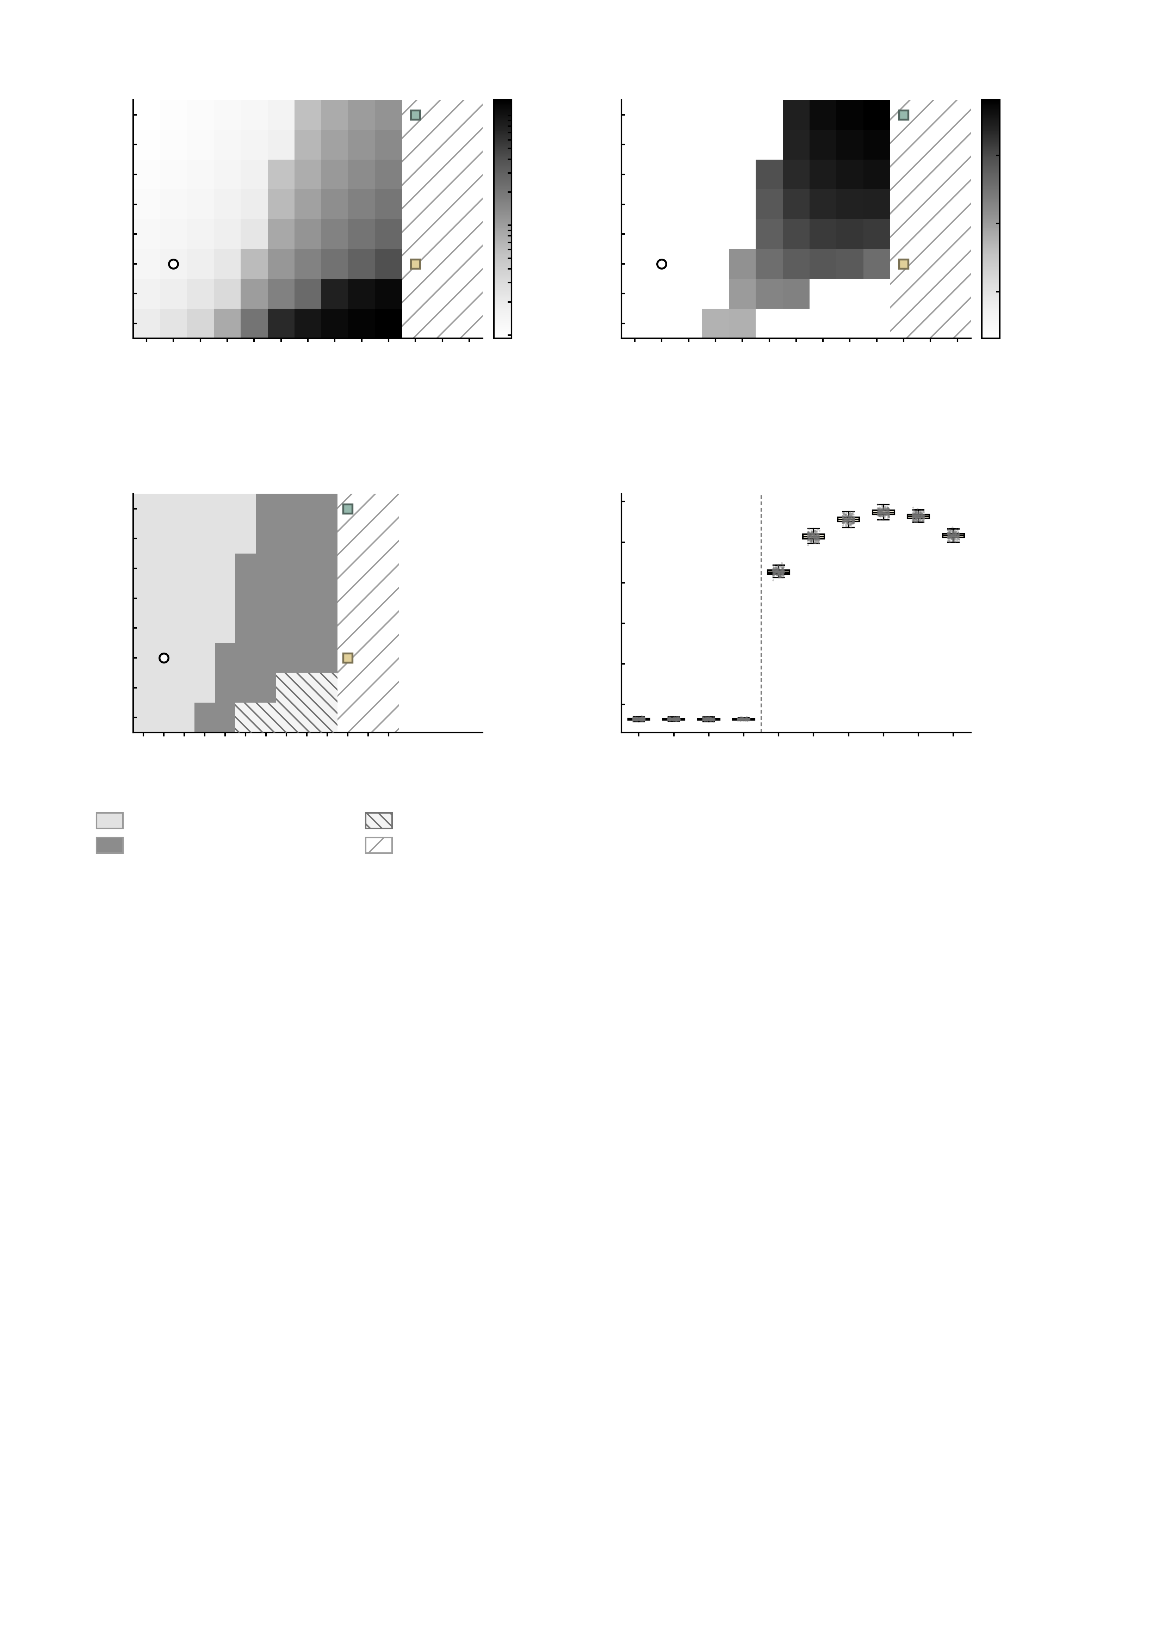
a
Mean firing rate
mathdefault{10^{2}}
b
Mean coherence
0.8
40
40
35
35
0.6
30
30
25
25
g_{rm GABA}-A (10^{-4} S cm^{-2})
g_{rm GABA}-A (10^{-4} S cm^{-2})
Coherence
Firing rate (Hz)
20
mathdefault{10^{1}}
20
0.4
15
15
0.2
10
10
5
4
8
12
16
20
24
28
32
36
40
44
48
52
mathdefault{10^{0}}
5
4
8
12
16
20
24
28
32
36
40
44
48
52
g_{rm AMPA} (10^{-4} S cm^{-2})
g_{rm AMPA} (10^{-4} S cm^{-2})
0.0
c
0.7
d
Dynamical regime
GABA-A
0.0040
Across regions at g_{rm GABA}-A = 0.0015
40
0.6
transition to
synchrony
35
0.5
30
0.4
25
g_{rm GABA}-A (10^{-4} S cm^{-2})
Regional coherence
20
baseline
AMPA
0.0044
0.3
15
0.2
10
0.1
5
4
8
12
16
20
24
28
32
36
40
44
48
52
0.0
4
8
12
16
20
24
28
32
36
40
g_{rm AMPA} (10^{-4} S cm^{-2})
g_{rm AMPA} (10^{-4} S cm^{-2})
Asynchronous, resting-like
Excessive firing
Synchronised
Not in this grid
SupplementaryFig.S18|Two-dimensionalAMPA/GABA-Aconductancesweepusedtoplacethebaselineandtheperturbationendpoints.Eachcellisonesimulationofthedigitaltwinbrainatafixedpairofglobalconductances(n=80simulations;unitofobservation,oneconductancepair;g_AMPA0.0004-0.0040Scm-2instepsof0.0004andg_GABA-A0.0005-0.0040Scm-2instepsof0.0005,externalinput0).Onerunpercell,sonoerrorindicatorandnostatisticaltestisshown;allfourpanelsaredescriptivemapsofthemodel'sdynamicalregimes.Columnshatchedinwhitewerenotsimulatedinthisgridandareshownonlysothattheconductancesettingsusedinthemainanalysescanbemarkedinplace.a,Meanpopulationfiringrate(logarithmiccolourscale,0.93-138.81Hz).b,Meancoherenceacrossregions,whichseparatesasynchronousfromsynchronisedactivity.c,Regimeclassification.Coherenceisbimodalacrossthegrid-46cellslieatthe0.0629-0.0654floorand34cellsat0.348-0.763,withnocellinbetween-andthefloorcellsseparatebyratejustascleanly,sotheboundariesarereadoffthesegapsratherthansetbyhand:asynchronous(upto3.42Hz,38cells),synchronised(5.28-39.86Hz,34cells)andexcessivefiring(from69.67Hz,8cells),thelastexcludedfromuse.Theopencirclemarksthebaseline(g_AMPA=0.0008,g_GABA-A=0.0015Scm-2;1.54Hz,coherence0.0636),choseninthelow-firing,low-coherenceresting-likeregime;thearrowstracetheprotocolactuallyused,AMPAraisedfirstto0.0044Scm-2(goldsquare)andGABA-Athenraisedto0.0040Scm-2ontopofit(tealsquare),eachvaluehavingbeenselectedastheoneproducingthelargestincreaseinthesummedNPfactoroverthecalibratedrange(Methods).d,Coherenceofeachofthe217regionsalongtheAMPAaxisatthebaselineinhibitionlevel(g_GABA-A=0.0015Scm-2),thelinealongwhichAMPAwasswept:boxesshowthemedianandinterquartilerangeacrossregionswithwhiskersat1.5xIQRandeveryregionplotted(n=217regionsperbox;unitofobservation,oneregion).Regionsmoveintosynchronytogetherratherthanoneatatime,andthespreadacrossregionswidensoncethenetworksynchronises(medianinterquartilerange0.0028belowthetransitionversus0.010aboveit);goldfillmarksthesynchronisedsettings.Descriptive;notest.

