Slide 1
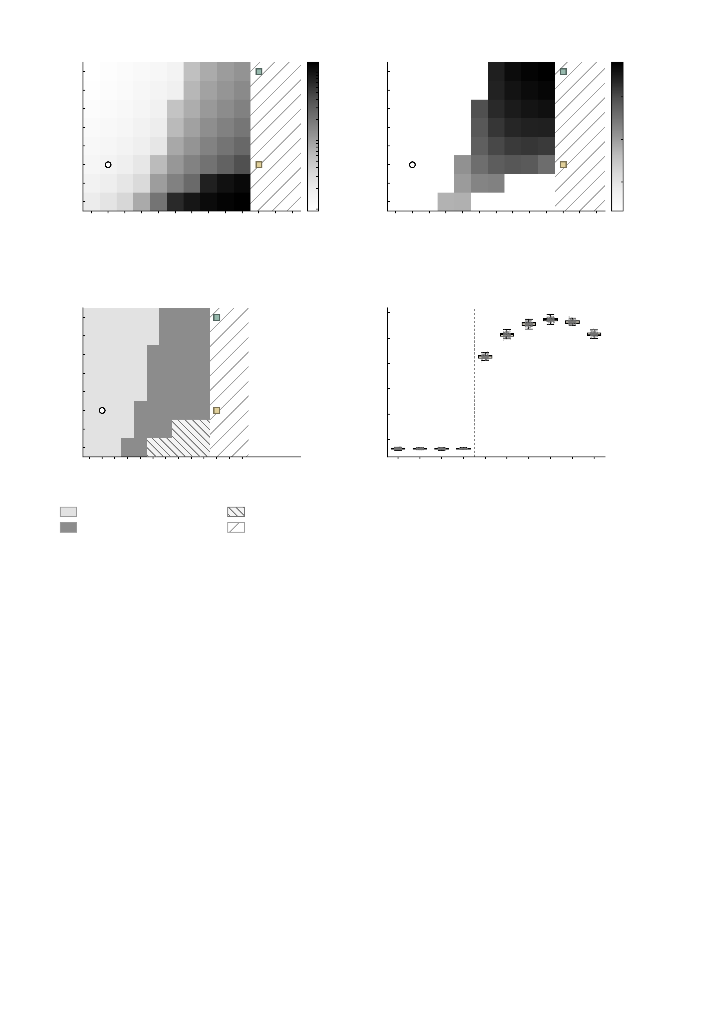
a
Mean firing rate
mathdefault{10^{2}}
b
Mean coherence
0.8
40
40
35
35
0.6
30
30
25
25
g_{rm GABA}-A (10^{-4} S cm^{-2})
g_{rm GABA}-A (10^{-4} S cm^{-2})
Coherence
Firing rate (Hz)
20
mathdefault{10^{1}}
20
0.4
15
15
0.2
10
10
5
4
8
12
16
20
24
28
32
36
40
44
48
52
mathdefault{10^{0}}
5
4
8
12
16
20
24
28
32
36
40
44
48
52
g_{rm AMPA} (10^{-4} S cm^{-2})
g_{rm AMPA} (10^{-4} S cm^{-2})
0.0
c
0.7
d
Dynamical regime
GABA-A
0.0040
Across regions at g_{rm GABA}-A = 0.0015
40
0.6
transition to
synchrony
35
0.5
30
0.4
25
g_{rm GABA}-A (10^{-4} S cm^{-2})
Regional coherence
20
baseline
AMPA
0.0044
0.3
15
0.2
10
0.1
5
4
8
12
16
20
24
28
32
36
40
44
48
52
0.0
4
8
12
16
20
24
28
32
36
40
g_{rm AMPA} (10^{-4} S cm^{-2})
g_{rm AMPA} (10^{-4} S cm^{-2})
Asynchronous, resting-like
Excessive firing
Synchronised
Not in this grid

