Slide 1
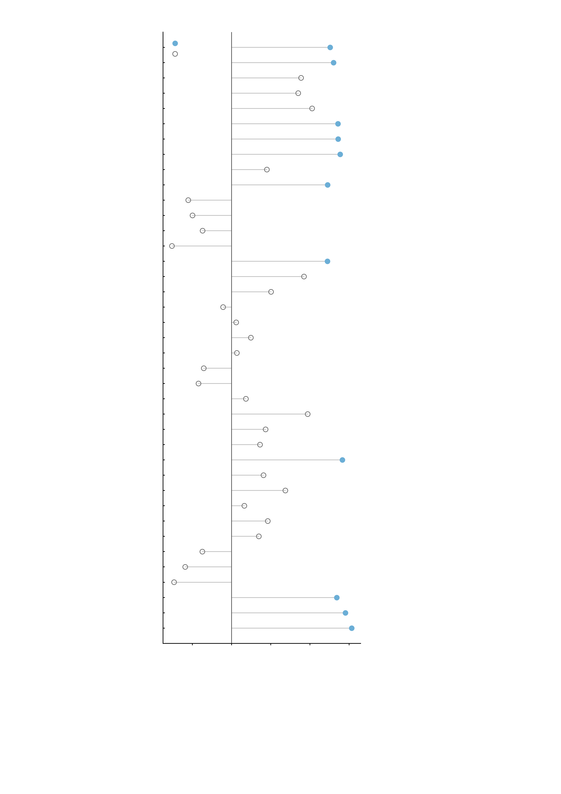
5-HT1a · cumi · beliveau
q < 0.05
5-HT1a · way · savli
n.s.
5-HT1b · az · beliveau
5-HT1b · p943 · savli
5-HT1b · p943 · gallezot
5-HT2a · alt · savli
5-HT2a · cimbi · beliveau
5-HT2a · mdl · talbot
5-HT4 · sb20 · beliveau
5-HT6 · gsk · radhakrishnan
5-HTT · dasb · beliveau
5-HTT · dasb · savli
5-HTT · madam · fazio
A4B2 · flubatine · hillmer
CB1 · FMPEPd2 · laurikainen
CB1 · omar · normandin
D1 · SCH23390 · kaller
D2 · fallypride · jaworska
D2 · flb457 · smith
D2 · flb457 · sandiego
D2 · raclopride · alakurtti
DAT · fepe2i · sasaki
DAT · fpcit · spect
FDOPA · fluorodopa · gomez
GABA-A · flumazenil · dukart
GABA-A (bz) · flumazenil · norgaard
H3 · cban · gallezot
M1 · lsn · naganawa
MU · carfentanil · kantonen
MU · carfentanil · turtonen
NAT · MRB · hesse
NAT · MRB · ding
NMDA · ge179 · galovic
VAChT · feobv · aghourian
VAChT · feobv · tuominen
VAChT · feobv · bedard
mGluR5 · abp · rosaneto
mGluR5 · abp · dubois
mGluR5 · abp · smart
-0.4
-0.2
0.0
0.2
0.4
0.6
0.8
Hedges' g (negative profile − other regions)
Supplementary Fig. S10 | Receptor and transporter availability in the negative-profile regions, across 39 PET maps. Each row is one PET map from the neuromaps collection. The unit of observation is one Shen-268 region: the 32 regions plotted as the negative profile are the nodes of its 29 edges, a superset of the 19 nodes of the 12-edge NP factor, and are compared with the remaining 236 regions. x, Hedges' g for the difference in mean regional value (negative profile minus other regions); a filled marker marks a map that survives correction, an open one a map that does not; the map name is printed in black or grey to match. The test is a permutation test on the difference in means: the region labels are reassigned at random 10,000 times with the group sizes held at 32 and 236, and the two-sided P value is (#|null| >= |observed| + 1) / (10,000 + 1). P values are corrected across all 39 maps with the Benjamini-Hochberg FDR, and 11 maps reach q < 0.05, all of them in the direction of higher availability in the negative-profile regions: 5-HT1a way savli (g = 0.52, q = 0.030), 5-HT2a alt savli (g = 0.54, q = 0.030), 5-HT2a cimbi beliveau (g = 0.54, q = 0.030), 5-HT2a mdl talbot (g = 0.55, q = 0.030), M1 lsn naganawa (g = 0.57, q = 0.030), mGluR5 abp rosaneto (g = 0.54, q = 0.030), mGluR5 abp dubois (g = 0.58, q = 0.030), mGluR5 abp smart (g = 0.61, q = 0.030), 5-HT1a cumi beliveau (g = 0.50, q = 0.039), CB1 FMPEPd2 laurikainen (g = 0.49, q = 0.039), 5-HT6 gsk radhakrishnan (g = 0.49, q = 0.041). Every map is shown, so the selection is visible: the effect sizes of the maps that do not survive run from -0.30 to +0.41. The region set carries the negative-profile colour rather than the NP-factor blue of the main figures because it is defined on the 29-edge profile; repeating the test on the 19 NP-factor nodes alone leaves 6 maps below q = 0.05.

