Slide 1
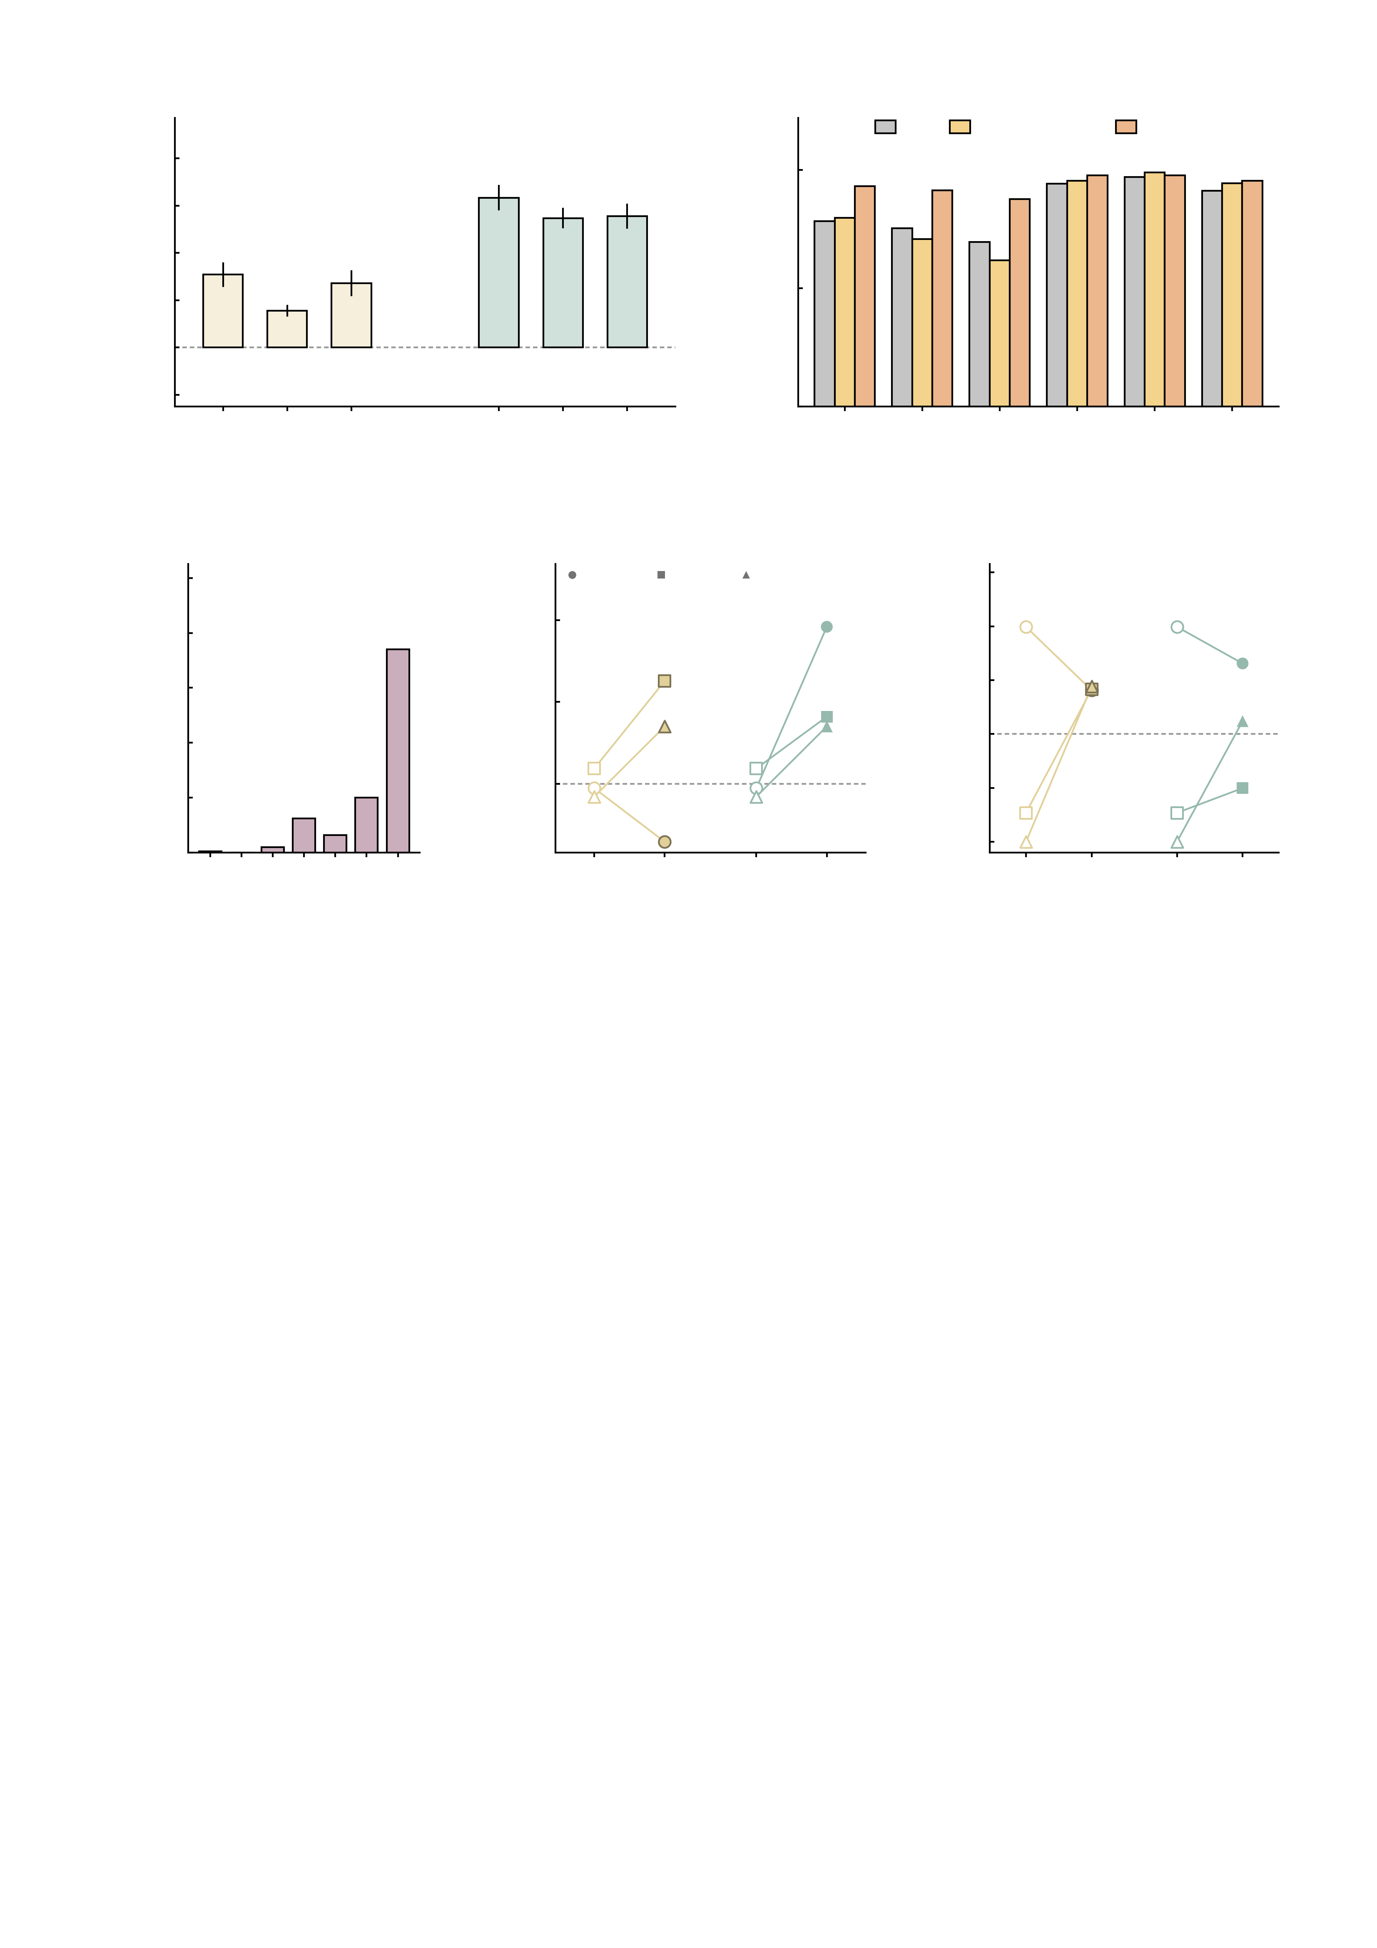
a
5
b
HC
High-symptom
Patient
4
d = 1.47
d = 1.60
d = 1.29
100
3
d = 0.83
2
d = 0.73
d = 0.61
Mean Δ NP (95% CI)
Twins with increased NP (%)
1
50
0
used in
main text
used in
main text
-1
0.0040
0.0044
0.0048
0.0035
0.0040
0.0045
0
0.0040
weaker
0.0044
original
0.0048
stronger
0.0035
weaker
0.0040
original
0.0045
stronger
-2
AMPA (S cm^{-2})
GABA-A (S cm^{-2})
AMPA
GABA-A
c
300
d
3
e
2.0
250
185/288 = 64.2%
increased under all six
HC01
MDD
AUD
1.5
200
185
2
1.0
150
1
0.5
Twins
Summed EFT NP FC
Summed NP FC (12 edges)
100
0.0
50
31
16
50
0
-0.5
0
1
5
-1
-1.0
0
1
2
3
4
5
6
baseline
AMPA
baseline
baseline
AMPA
baseline
Settings with increased NP (of 6)
GABA-A
-1.5
GABA-A
Supplementary Fig. S3 | Virtual perturbational sensitivity analysis: parameter stability at the group level and response validation across task context. The two halves of the figure ask whether the virtual perturbation result depends on how the perturbation was set up. a-c test the CONDUCTANCE at which each receptor knob is driven, at the group level in all n = 288 twins: every knob was re-run at a weaker and a stronger setting around the value used in the main analysis (AMPA 0.0040 / 0.0044 / 0.0048, GABA-A 0.0035 / 0.0040 / 0.0045 S cm-2), giving six settings per twin. d-e test the TASK CONTEXT at the individual level, in three twins calibrated at the 100-million-neuron scale and perturbed at the main-analysis conductances (AMPA 0.0044, GABA-A 0.0040 S cm-2): the same twins are shown in the emotional face task, which the model was not tuned on, and on the 12-edge NP profile of the reward and inhibition tasks. HC02 is excluded from d-e for the same reason as in the model sweeps. a, group mean change in NP at each setting, bars with 95% confidence intervals and Cohen's d above each bar. AMPA: 0.0040 S cm-2 (weaker) +1.54 (95% CI +1.30 to +1.78, d = 0.73, P = 1.4e-28, 85.4% of twins in the same direction); 0.0044 S cm-2 (original) +0.78 (95% CI +0.67 to +0.88, d = 0.83, P = 8.4e-35, 81.2% of twins in the same direction); 0.0048 S cm-2 (stronger) +1.36 (95% CI +1.10 to +1.62, d = 0.61, P = 1.2e-21, 75.3% of twins in the same direction). GABA-A: 0.0035 S cm-2 (weaker) +3.17 (95% CI +2.92 to +3.42, d = 1.47, P = 8.1e-74, 96.2% of twins in the same direction); 0.0040 S cm-2 (original) +2.74 (95% CI +2.54 to +2.93, d = 1.60, P = 4.0e-81, 97.9% of twins in the same direction); 0.0045 S cm-2 (stronger) +2.78 (95% CI +2.53 to +3.03, d = 1.29, P = 3.7e-63, 94.1% of twins in the same direction). Every setting of both knobs raises NP. In both sweeps the setting used in the main text gives the SMALLEST raw mean change and at the same time the LARGEST standardised effect (AMPA d = 0.83 against 0.73 and 0.61; GABA-A d = 1.60 against 1.47 and 1.29), because the weaker and stronger settings spread the twins more: the main-text choice is therefore the conservative one on the raw scale, not the one that maximises the reported difference. b, the same six settings resolved by diagnostic group, as the percentage of twins whose NP increased, with the chi-squared P for a difference between groups above each setting (2 d.f.). Under AMPA the patient group responds most often at all three settings (93.1%, 91.5% and 87.7%, against 78.3%, 75.4% and 69.6% in healthy controls; P = 0.00364, P = 0.0002 and P = 3.2e-05), whereas under GABA-A almost every twin responds and the groups are indistinguishable (96.2%, 97.9% and 94.1% overall; P = 0.437, P = 0.719 and P = 0.504). c, the number of the six settings under which each twin's NP increased: 185 of 288 twins (64.2%) increased under all six, so the direction of a twin's response is a property of the twin rather than of the setting. Across settings the twin-wise changes correlate r = 0.39-0.55 within the AMPA sweep and r = 0.69-0.90 within the GABA-A sweep, against r = -0.05-0.31 between knobs, so the two knobs remain distinct manipulations. d, the three 100 M twins in the emotional face task, baseline against the perturbed state, one line per twin: AMPA 2 up / 1 down (HC01 -0.66, MDD +1.07, AUD +0.86); GABA-A 3 up / 0 down (HC01 +1.97, MDD +0.63, AUD +0.86). e, the same twins on the reward / inhibition NP profile used in the main analysis: AMPA 2 up / 1 down (MDD +1.15, AUD +1.44, HC01 -0.59); GABA-A 2 up / 1 down (MDD +0.23, AUD +1.12, HC01 -0.34). The two halves support different claims and should be read as such: a-c establish that the group-level result is not an artefact of the conductance chosen, in the full sample; d-e show that an individual twin's response is bidirectional and reproduces in a task the model was not calibrated on, in three twins only - a validation of individual response, not a population estimate. No multiple-comparison correction is applied and all tests are two-sided. Source values are in conductance_grid_summary_n288.csv, conductance_responder_by_group_n288.csv, conductance_subject_level_n288.csv, conductance_across_setting_correlations.csv, eft_3subs.csv and np_task_3subs.csv.

