Slide 1
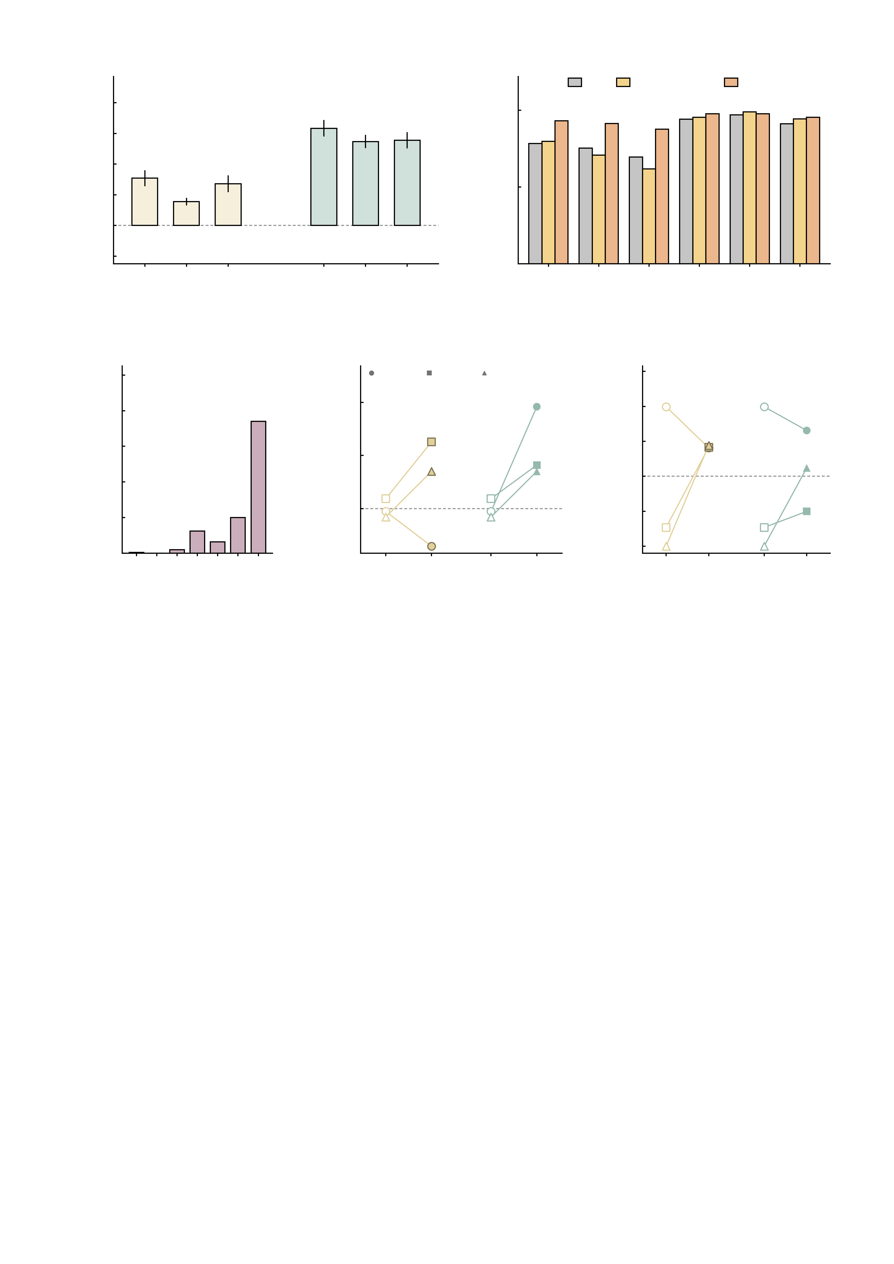
a
5
b
HC
High-symptom
Patient
4
d = 1.47
d = 1.60
d = 1.29
100
3
d = 0.83
2
d = 0.73
d = 0.61
Mean Δ NP (95% CI)
Twins with increased NP (%)
1
50
0
used in
main text
used in
main text
-1
0.0040
0.0044
0.0048
0.0035
0.0040
0.0045
0
0.0040
weaker
0.0044
original
0.0048
stronger
0.0035
weaker
0.0040
original
0.0045
stronger
-2
AMPA (S cm^{-2})
GABA-A (S cm^{-2})
AMPA
GABA-A
c
300
d
3
e
2.0
250
185/288 = 64.2%
increased under all six
HC01
MDD
AUD
1.5
200
185
2
1.0
150
1
0.5
Twins
Summed EFT NP FC
Summed NP FC (12 edges)
100
0.0
50
31
16
50
0
-0.5
0
1
5
-1
-1.0
0
1
2
3
4
5
6
baseline
AMPA
baseline
baseline
AMPA
baseline
Settings with increased NP (of 6)
GABA-A
-1.5
GABA-A

