Slide 1
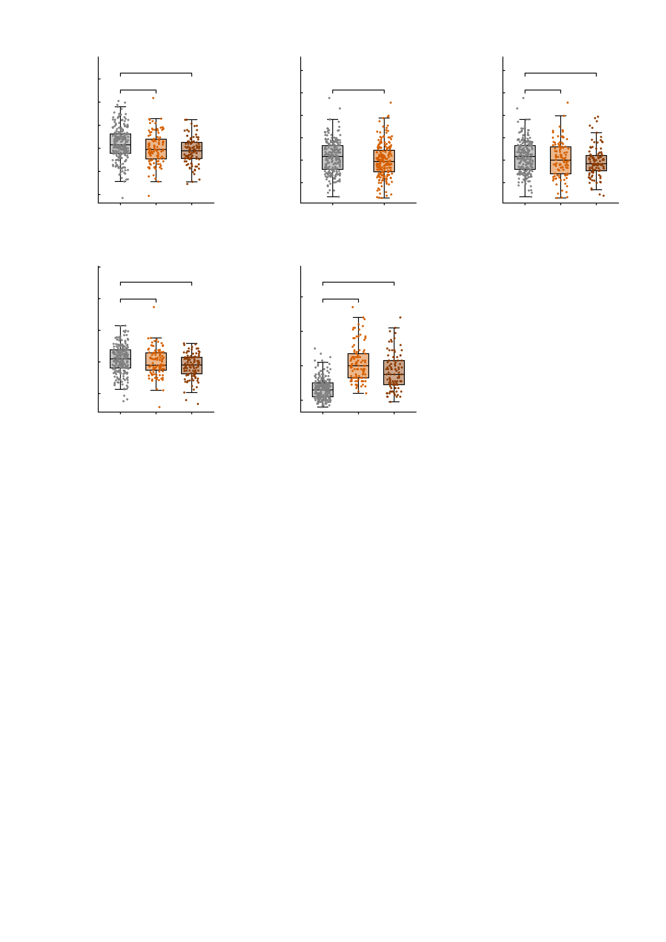
a
8
b
12.5
c
12.5
6
n.s.
***
10.0
n.s.
10.0
n.s.
*
4
7.5
7.5
Negative-profile score
(residual)
5.0
5.0
2
Positive-profile score
(residual)
Positive-profile score
(residual)
0
2.5
2.5
-2
0.0
0.0
-4
-2.5
-2.5
-6
HC
MDD
AUD
-5.0
HC
Patients
-5.0
HC
MDD
AUD
d
8
e
6
***
80
***
4
n.s.
60
***
NP factor score
(residual)
2
40
Summed DAWBA band score
0
20
-2
0
-4
HC
MDD
AUD
-20
HC
MDD
AUD
Supplementary Fig. S9 | Negative and positive profiles, the NP factor and symptom severity by diagnosis in the STRATIFY validation cohort. STRATIFY is an independent clinical cohort recruited at the IMAGEN sites. Of the 434 participants assessed, the 427 with no diagnosis, major depressive disorder (MDD) or alcohol use disorder (AUD) enter these panels (healthy controls n = 225, MDD n = 104, AUD n = 98); the 7 patients with another diagnosis (psychosis 6, ADHD 1) are in no panel. The patient box of b is therefore exactly the union of the MDD and AUD boxes of c (n = 202). Fig. 2c,e pool the diagnoses this way for the negative profile and the NP factor; here those two measures are separated by diagnosis (a, d) and the pooled contrast is given for the positive profile (b). Profile and factor scores are residuals after regressing out sex, site and mean framewise displacement. Box plots show the median, 25th-75th percentiles and 1.5 x IQR whiskers with every participant overplotted. Brackets test each patient group against the controls; *P < 0.05, **P < 0.01, ***P < 0.001; n.s., not significant. Every panel uses the two-sided Welch unequal-variance t test, because the patient groups are much smaller than the control group (MDD n = 104 and AUD n = 98 against n = 225 controls) and the equal-variance test is robust to unequal variances only when the groups are of comparable size. Every P below is Bonferroni-corrected over the three contrasts within that measure (controls versus MDD, versus AUD, and versus all patients -- the pooled contrast being the one drawn in b for the positive profile and in Fig. 2c,e for the other two measures). For the negative profile and the NP factor the pooled Welch contrast reproduces Fig. 2c,e exactly (t = 3.85, df = 425.0 and t = 3.40, df = 424.5; uncorrected there, as a single pre-specified comparison). a, negative-profile score: controls +0.38 versus 0.00 in MDD (t = 2.36, df = 205.1, P = 0.057, Hedges' g = 0.28), versus -0.23 in AUD (t = 4.14, df = 224.9, P = 0.00015, Hedges' g = 0.46). b, positive-profile score: controls +0.36 versus -0.04 in all patients (t = 2.25, df = 415.1, P = 0.074, Hedges' g = 0.22). c, positive-profile score by diagnosis: controls +0.36 versus +0.07 in MDD (t = 1.27, df = 181.5, P = 0.62, Hedges' g = 0.16), versus -0.16 in AUD (t = 2.45, df = 190.7, P = 0.046, Hedges' g = 0.29). d, NP factor score: controls +0.14 versus -0.03 in MDD (t = 1.64, df = 206.2, P = 0.308, Hedges' g = 0.19), versus -0.26 in AUD (t = 4.10, df = 210.9, P = 0.00018, Hedges' g = 0.47). e, summed DAWBA band score over six domains (ADHD, conduct, eating, depression, anxiety, phobia) in the subset with a symptom assessment (controls n = 215, MDD n = 103, AUD n = 96): 6.8 +/- 6.2 versus 21.9 +/- 10.7 in MDD (t = 13.38, df = 136.1, P = 4.3e-26, Hedges' g = 1.91) and 16.4 +/- 10.4 in AUD (t = 8.44, df = 126.1, P = 1.9e-13, g = 1.24), mean +/- s.d. Welch's test is required here in particular: the summed band score is a right-skewed count whose variance scales with its mean (variance ratio 2.8-3.0; Levene F = 33-37, both P < 1e-7), while in a-d it is 1.05-1.52 and the Welch and equal-variance t differ by 0.01-0.32. Controls are scored at their own designated assessment wave only, with no substitution across waves.

