Slide 1
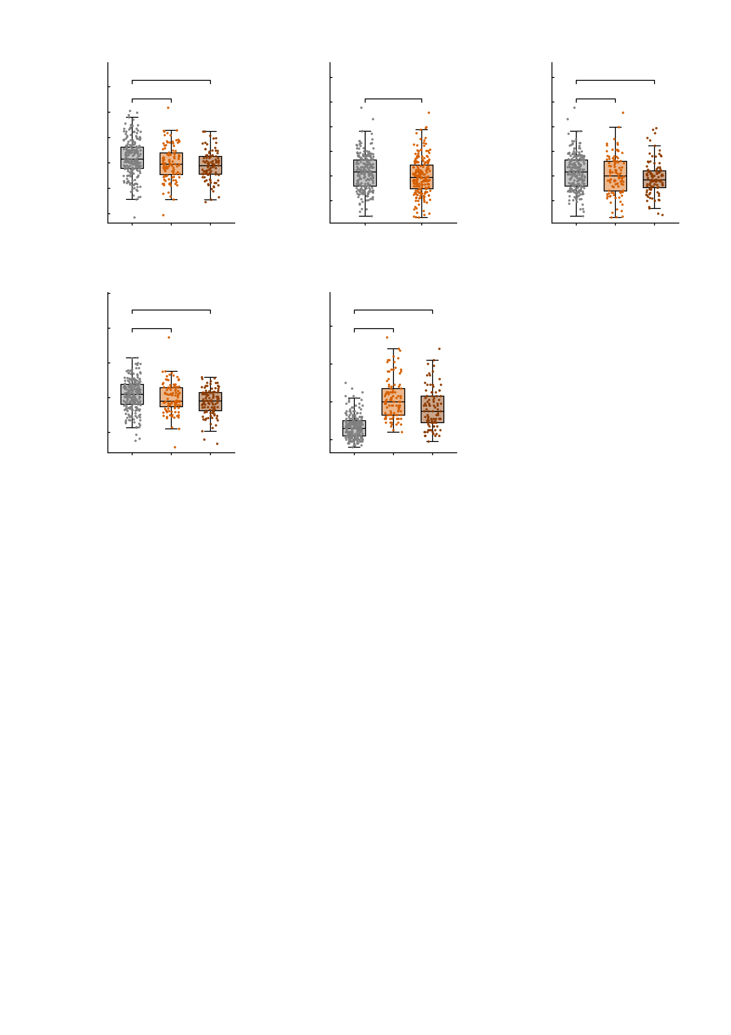
a
8
b
12.5
c
12.5
6
n.s.
***
10.0
n.s.
10.0
n.s.
*
4
7.5
7.5
Negative-profile score
(residual)
5.0
5.0
2
Positive-profile score
(residual)
Positive-profile score
(residual)
0
2.5
2.5
-2
0.0
0.0
-4
-2.5
-2.5
-6
HC
MDD
AUD
-5.0
HC
Patients
-5.0
HC
MDD
AUD
d
8
e
6
***
80
***
4
n.s.
60
***
NP factor score
(residual)
2
40
Summed DAWBA band score
0
20
-2
0
-4
HC
MDD
AUD
-20
HC
MDD
AUD

