Slide 1
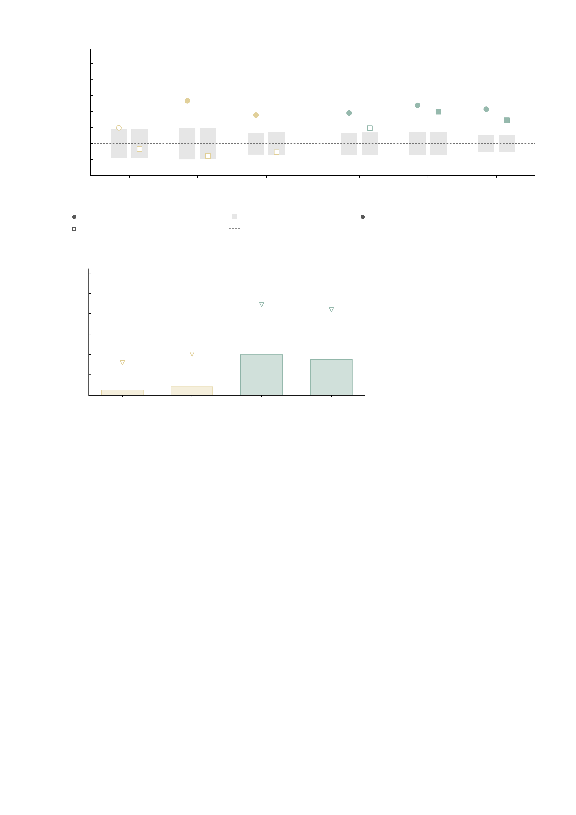
a
Pharmacologically matched pairings
100
Ketamine
Midazolam
90
20/26
80
37/50
73/102
Edges with matching
direction (%)
38/56
36/52
70
18/30
35/50
66/102
60
31/52
50
14/30
25/56
40
11/26
30
MID
anticipation
MID
feedback
pooled
MID
anticipation
MID
feedback
pooled
task-matched (MID) prediction
±1 s.d. of the sign-flip null
filled = P < 0.05 vs the sign-flip null
task-mismatched (SST) prediction
chance (50%)
b
0.7
Reliability of the empirical maps at n = 27
0.6
max attainable
r = 0.45
0.5
max attainable
r = 0.42
0.4
Split-half reliability of the
empirical drug-effect map
0.3
max attainable
r = 0.16
max attainable
r = 0.20
0.2
0.1
0.041
0.198
0.176
0.0
0.025
Ketamine
MID anticipation
Ketamine
MID feedback
Midazolam
MID anticipation
Midazolam
MID feedback
Supplementary Fig. S13 | Simulated and empirical whole-brain drug effects agree in direction for the task-matched model, within the ceiling set by the reliability of the empirical maps. Directional concordance between the whole-brain drug effect measured in the pharmacological cohort (27 healthy volunteers, three within-subject sessions, MID task, Shen-268 functional connectivity) and the corresponding perturbation of the digital twin brain. Edges entering each test are those with a nominal drug-versus-placebo effect at P < 0.001, so the number of edges differs between drugs and MID conditions and is printed beside every marker as matching/total. Circles are predictions from the task-matched (MID) model, squares from the task-mismatched (SST) model; a filled marker is significant against the node-level sign-flip null (999 permutations), the grey band is ±1 s.d. of that null and the dashed line is chance (50%). The binomial test is given below for reference only — it ignores the dependence between edges that share a node. a, pharmacologically matched pairings: the AMPA perturbation against ketamine and the AMPA+GABA-A perturbation against midazolam. Ketamine (AMPA vs baseline): pooled over both MID conditions 38 of 56 edges match in direction (67.9%, P = 0.005), against 44.6% (25/56, P = 0.782) for the task-mismatched SST prediction; MID anticipation 60.0% (P = 0.19) and MID feedback 76.9% (P = 0.00899). Midazolam (AMPA+GABA-A vs baseline): pooled over both MID conditions 73 of 102 edges match in direction (71.6%, P = 0.001), against 64.7% (66/102, P = 0.003) for the task-mismatched SST prediction; MID anticipation 69.2% (P = 0.004) and MID feedback 74.0% (P = 0.003). b, split-half reliability (Spearman-Brown) of the empirical drug-effect maps themselves, computed by splitting the 27 volunteers into halves: Ketamine MID anticipation 0.025 (max attainable r = 0.16); Ketamine MID feedback 0.041 (max attainable r = 0.20); Midazolam MID anticipation 0.198 (max attainable r = 0.45); Midazolam MID feedback 0.176 (max attainable r = 0.42). The triangle marks the highest correlation any model could attain against a map of this reliability, the square root of the reliability. Task specificity holds: in the matched pairing the task-matched model beats its task-mismatched counterpart for both drugs (a), pooled over both MID conditions 67.9% versus 71.6% for ketamine and midazolam respectively. The ceiling on any such agreement is low: at n = 27 the empirical maps reproduce themselves only weakly (b), which is why the analysis is reported on the sign of each edge and not on the magnitude of the effect. All tests are two-sided and uncorrected. Source values are in wbdrug_direction_agreement_n288.csv, which also holds the cross-receptor pairings that are not plotted here, and in wbdrug_map_reliability.csv; wbdrug_direction_agreement_pooled_prior.csv holds the pooled-prior variant of the same test.

