Slide 1
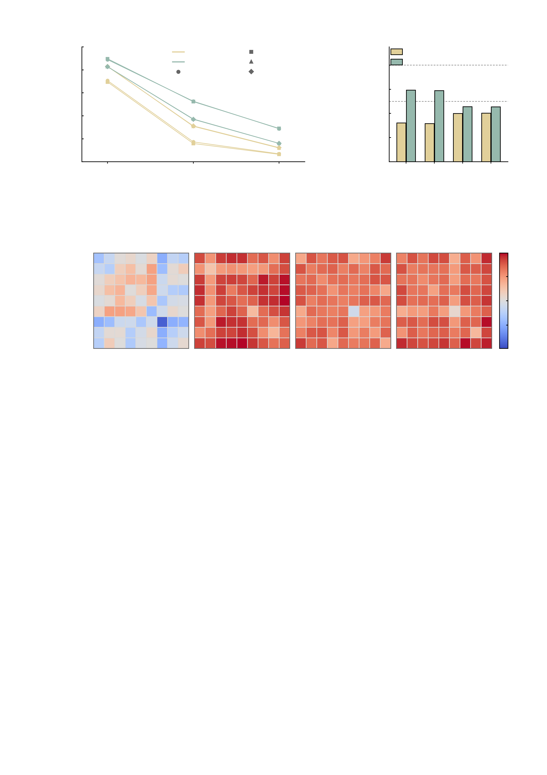
a
100
b
1.0
AMPA
Stop-failure
AMPA
large
80
GABA-A
Feedback
0.8
GABA-A
Stop-success
Anticipation
60
0.6
Edges of 23,436 (%)
Median |d_z|
(significant edges)
medium
40
0.4
20
0.2
0
FDR
q < 0.05
|d_z| > 0.5
|d_z| > 0.8
0.0
MID feedback
SST stop-failure
MID anticipation
SST stop-success
c
SST stop-success
AMPA
SST stop-success
GABA-A
MID feedback
AMPA
MID feedback
GABA-A
DMN
100
FPN
50
Limbic
Motor
Net signed change (%)
SMF
0
Sub
Visual Asso
-50
Visual I
Visual II
FPN
SMF
Sub
FPN
SMF
Sub
FPN
SMF
Sub
FPN
SMF
Sub
-100
DMN
Motor
DMN
Motor
DMN
Motor
DMN
Motor
Limbic
Visual I
Limbic
Visual I
Limbic
Visual I
Limbic
Visual I
Visual II
Visual II
Visual II
Visual II
Visual Asso
Visual Asso
Visual Asso
Visual Asso
Supplementary Fig. S7 | Whole-brain extent of the virtual perturbations at n = 288. All three panels are computed on the same edge set: the 23,436 upper-triangular edges among 217 nodes, in each of four task conditions (SST stop-success, SST stop-failure, MID feedback, MID anticipation), for the 288 digital twins of the Fig. 4 cohort. Unit of observation is one subject; every edge is tested with a two-sided paired t test (df = 287) and the 23,436 tests of a condition are corrected together by Benjamini-Hochberg FDR. Colour separates the two contrasts throughout: AMPA versus baseline and GABA-A versus baseline, where the GABA-A perturbation is applied on top of AMPA as everywhere else in this work (the source table names this contrast "AMPA+GABA-A vs baseline"). a, the proportion of edges that survives as the criterion is tightened from FDR significance alone to an effect-size floor. Marker shape gives the task condition (stop-success and stop-failure are SST, feedback and anticipation are MID). Under AMPA, 69.5-83.2% of edges pass FDR, but only 15.9-31.2% reach |d_z| > 0.5 and 6.5-12.3% reach |d_z| > 0.8; under GABA-A, 82.8-89.7% pass FDR and 37.0-52.7% reach |d_z| > 0.5. The large number of significant edges therefore reflects the power available at n = 288 rather than a large per-edge effect, and an effect-size floor should be stated whenever the extent is described in words. b, the median |d_z| among the significant edges of each condition; the dashed lines mark the conventional medium (0.5) and large (0.8) benchmarks. AMPA: 0.315-0.402. GABA-A: 0.454-0.592. The typical significant edge is thus a small-to-medium effect, and no condition reaches the large benchmark on the median. c, spatial organisation of the response: the net signed percentage of significantly changed edges for each of the 45 canonical network pairs (9 networks, within and between), for two of the four conditions x the two contrasts. All four matrices share one colour scale, symmetric about zero at +/-98.2%, and the values shown run from -88.9% to 98.2%; the matrices are symmetric by construction. Red is a net increase in connectivity, blue a net decrease. This panel is descriptive and carries no test; the per-pair counts for all four conditions and all three contrasts (540 rows) are tabulated in SuppTable_WB_network_pair_summary_n288.csv. The direction of the response is also asymmetric between the two contrasts: of the significant edges under GABA-A, 88.8-91.2% increase, against 53.0-88.1% under AMPA alone. The incremental GABA-A versus AMPA contrast is not plotted here and is given in SuppTable_WB1_wholebrain_modulation_n288.csv.

