Slide 1
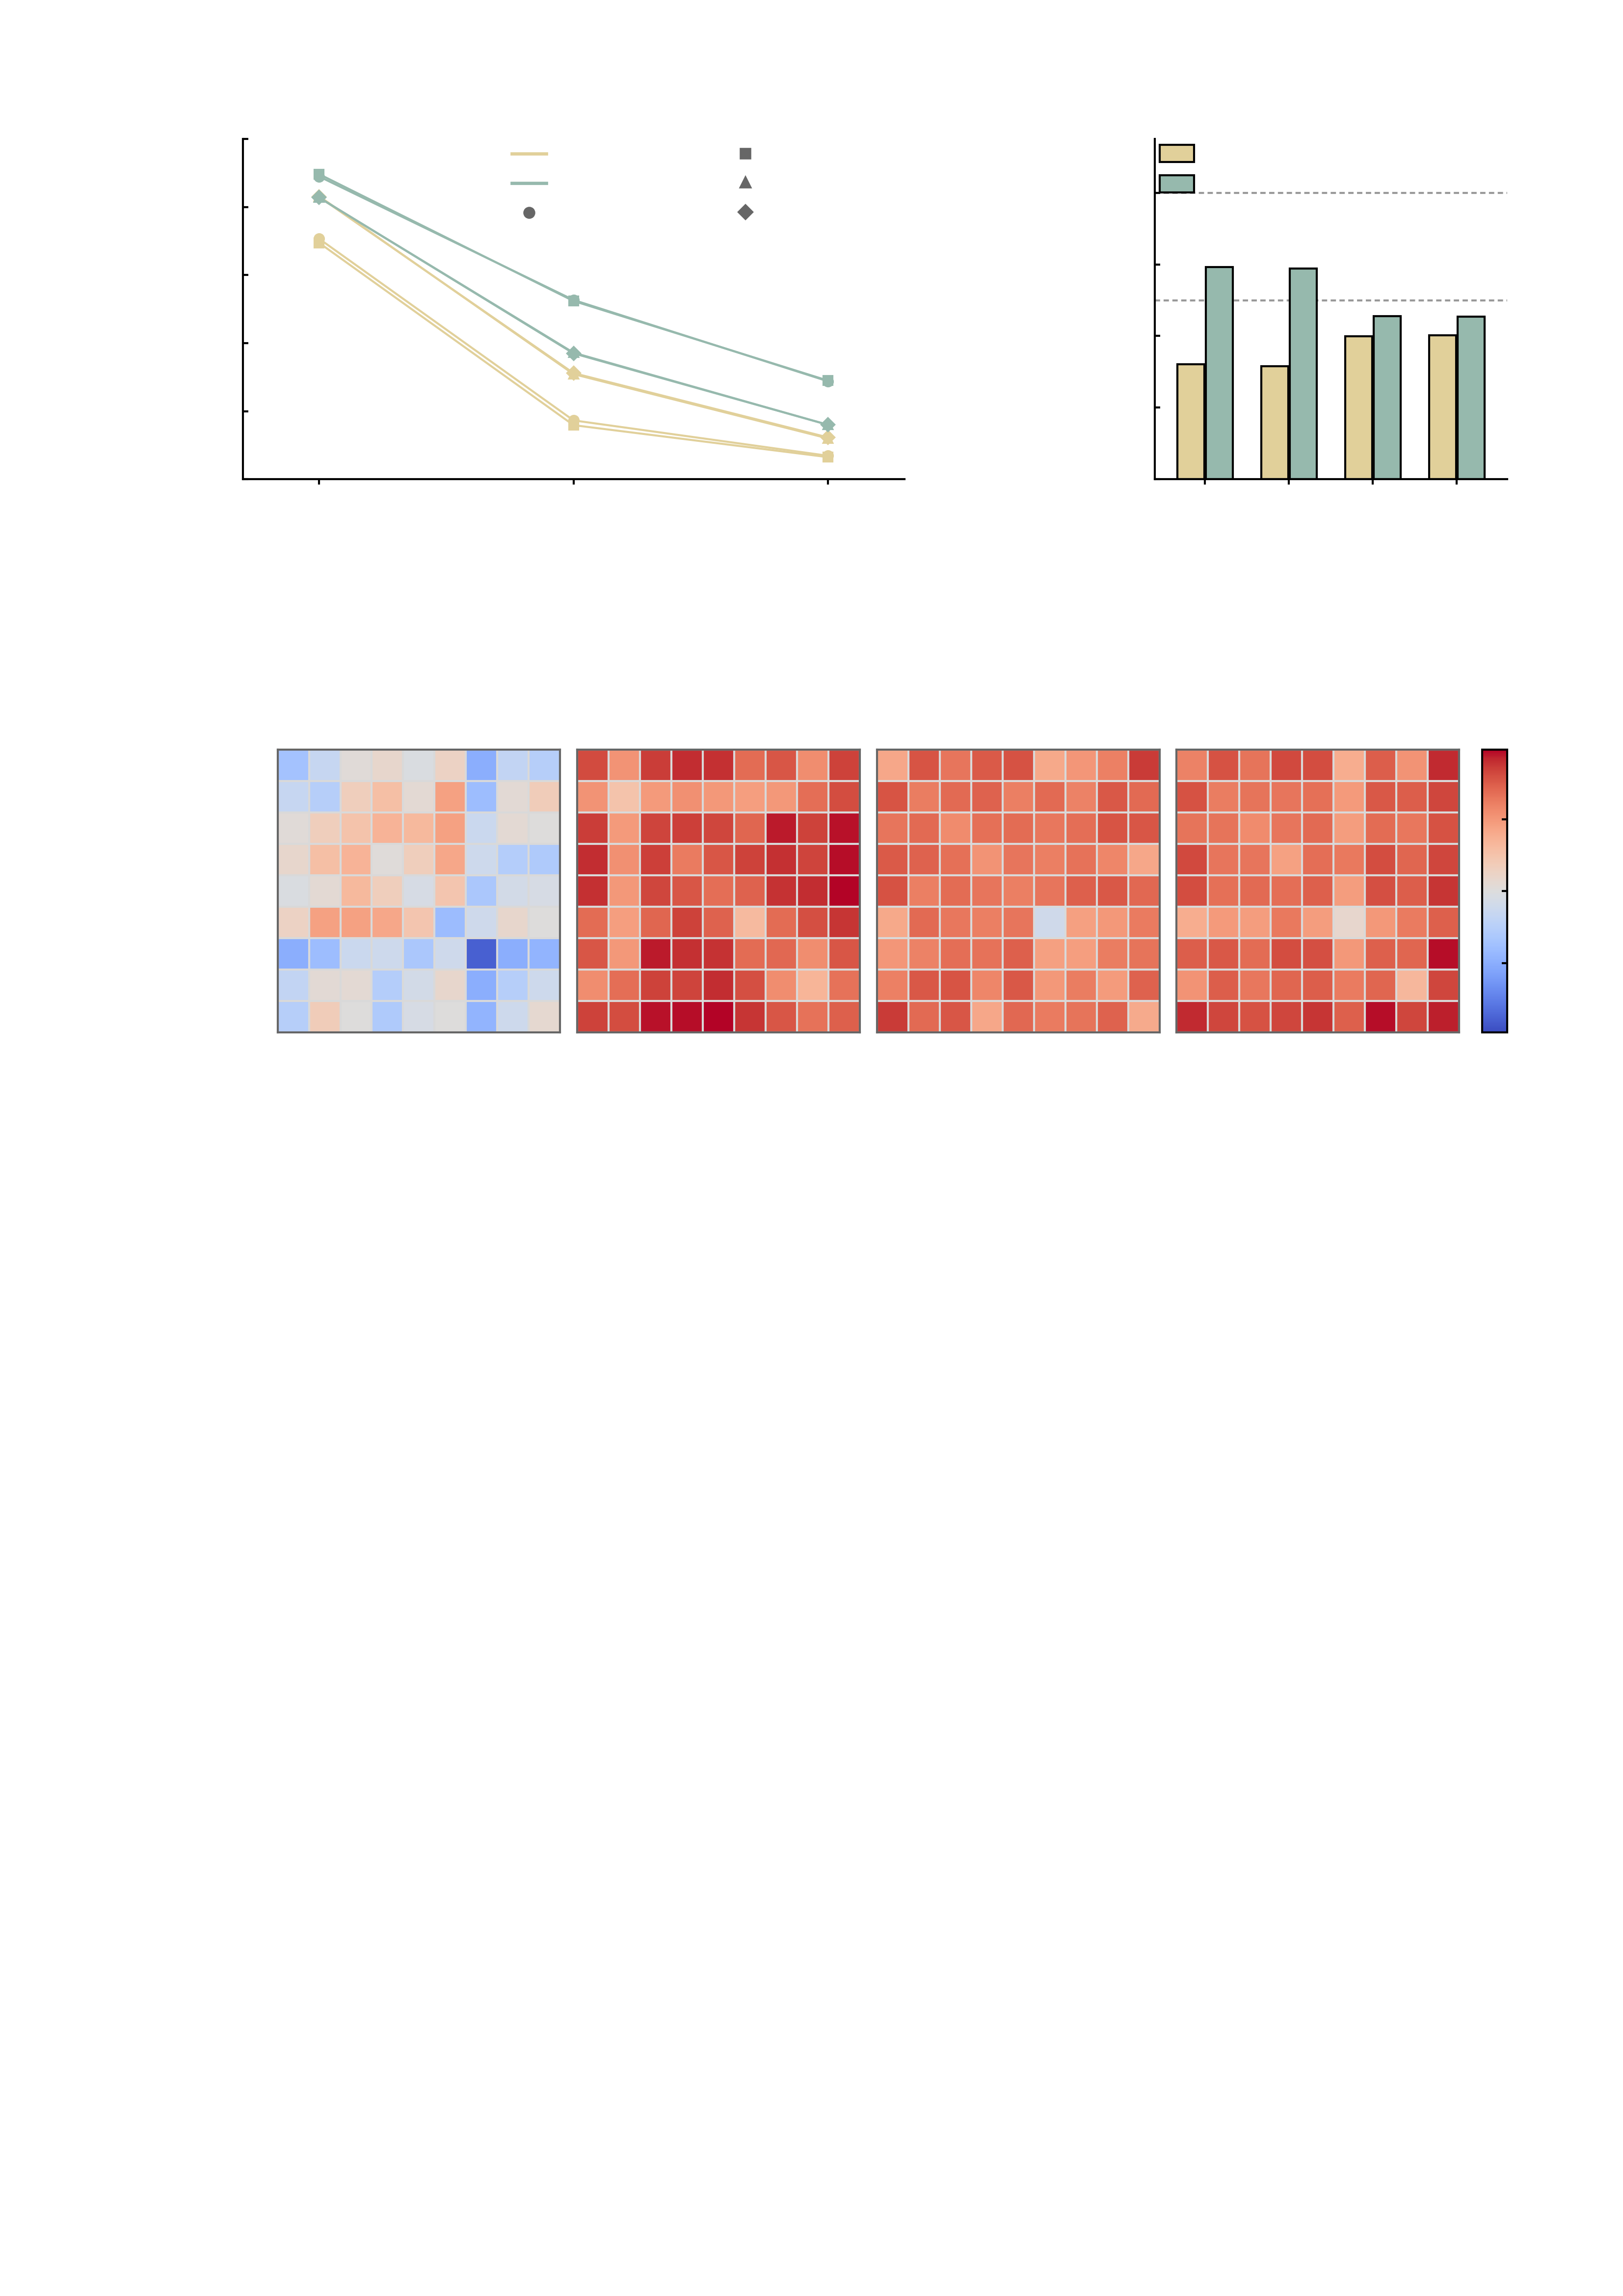
a
100
b
1.0
AMPA
Stop-failure
AMPA
large
80
GABA-A
Feedback
0.8
GABA-A
Stop-success
Anticipation
60
0.6
Edges of 23,436 (%)
Median |d_z|
(significant edges)
medium
40
0.4
20
0.2
0
FDR
q < 0.05
|d_z| > 0.5
|d_z| > 0.8
0.0
MID feedback
SST stop-failure
MID anticipation
SST stop-success
c
SST stop-success
AMPA
SST stop-success
GABA-A
MID feedback
AMPA
MID feedback
GABA-A
DMN
100
FPN
50
Limbic
Motor
Net signed change (%)
SMF
0
Sub
Visual Asso
-50
Visual I
Visual II
FPN
SMF
Sub
FPN
SMF
Sub
FPN
SMF
Sub
FPN
SMF
Sub
-100
DMN
Motor
DMN
Motor
DMN
Motor
DMN
Motor
Limbic
Visual I
Limbic
Visual I
Limbic
Visual I
Limbic
Visual I
Visual II
Visual II
Visual II
Visual II
Visual Asso
Visual Asso
Visual Asso
Visual Asso

