Slide 1
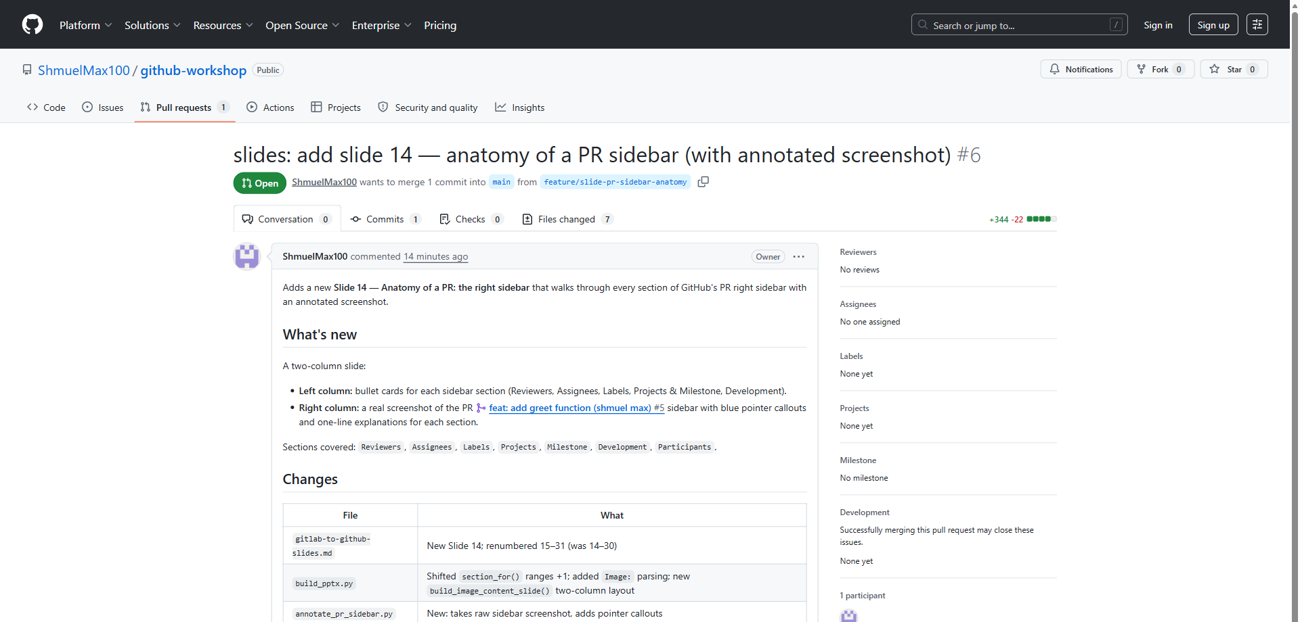
👆
Conversation — The unified PR thread — description, comments, reviews, and event log.

Slide 2
👆
Commits — Browse the individual commits in this PR. Useful for stacked-diff reviews.

Slide 3
👆
Checks — Status of every CI run for this PR: tests, linters, security scans, deploys.

Slide 4
👆
Files changed — The full diff. Leave inline comments, suggested changes, and approvals here.

Slide 5
👉
Reviewers — Request review from people or teams. CODEOWNERS auto-fills here.

Slide 6
👉
Assignees — Who is responsible for landing this PR. Often the author, sometimes a shepherd.

Slide 7
👉
Labels — Categorise the PR: bug, feature, area/api, needs-triage. Drives filters & automation.

Slide 8
👉
Projects — Add to a GitHub Project board — Kanban, roadmap, or sprint tracking.

Slide 9
👉
Milestone — Group PRs by release or iteration (e.g. v1.2.0, Sprint 14).

Slide 10
👉
Development — Link issues. "Closes #123" in the description auto-closes them on merge.

