Slide 1
Algorithms
Dynamic Programming
Notes:
Dynamic programming

Slide 2
Algorithm design techniques
Iterative (brute-force) algorithms
  Example: insertion sort
Algorithms that use efficient data structures
  Example: heap sort
Divide-and-conquer algorithms
  Example: Binary search, merge sort, quick sort
Dynamic programming
  Example: Fibonacci numbers, Matrix multiplication optimization, Longest Common Subsequence
Greedy algorithms
  Example: Huffman coding, Minimum Spanning Tree, Dijkstara
Graph Algorithms
  Example: BFS (Robot moving, Path Finding), DFS( Topological Sorting, Strongly Connected Component)
Algorithms
Dynamic Programming→<number>
Notes:
Dynamic programming

Slide 3
Fibonacci Numbers
Leonardo Fibonacci (1202):
  A rabbit starts producing offspring during the second year after its birth and produces one child each generation
  How many rabbits will there be after n generations?
F(3)=1
F(1)=1
F(2)=1
F(3)=2
+1
F(4)=2
F(5)=3
+2
F(6)=5
+3
F(4)=3
+1
F(5)=5
F(6)=8
Algorithms
Dynamic Programming→<number>
Notes:
Dynamic programming

Slide 4
…Fibonacci Numbers
F(n)= F(n-1)+ F(n-2)
F(0) =0, F(1) =1
  0, 1, 1, 2, 3, 5, 8, 13, 21, 34 …
Straightforward recursive procedure is slow!
FibonacciR(n)
01 if n ≤ 1 then return n
02 else return FibonacciR(n-1) + FibonacciR(n-2)
Algorithms
Dynamic Programming→<number>
Notes:
Dynamic programming

Slide 5
…Fibonacci Numbers
F(6) = 8
F(5)
F(4)
F(4)
F(3)
F(3)
F(2)
F(3)
F(2)
F(2)
F(1)
F(2)
F(1)
F(1)
F(0)
F(2)
F(1)
F(1)
F(0)
F(1)
F(0)
F(1)
F(0)
F(1)
F(0)
We keep calculating the same value over and over!
  Subproblems are overlapping – they share sub-subproblems
Algorithms
Dynamic Programming→<number>
Notes:
Dynamic programming

Slide 6
…Fibonacci Numbers
How many summations are there in F(n)?
  F(n) = F(n – 1) + F(n – 2) + 1
  F(n) ≥ 2F(n – 2) +1 and F(1) = F(0) = 0
  Solving the recurrence we get
  F(n) ≥ 2^{n/2} – 1 ≈ 1.4^{n}
Running time is exponential!
Algorithms
Dynamic Programming→<number>
Notes:
Dynamic programming

Slide 7
…Fibonacci Numbers
We can calculate F(n) in linear time by remembering solutions to the solved subproblems (= dynamic programming).
Compute solution in a bottom-up fashion
Trade space for time!
Fibonacci(n)
01 F[0]←0
02 F[1]←1
03 for i ← 2 to n do
04 F[i] ← F[i-1] + F[i-2]
05 return F[n]
Algorithms
Dynamic Programming→<number>
Notes:
Dynamic programming

Slide 8
…Fibonacci Numbers
In fact, only two values need to be remembered at any time!
FibonacciImproved(n)
01 if n ≤ 1 then return n
02 Fim2 ←0
03 Fim1 ←1
04 for i ← 2 to n do
05 Fi ← Fim1 + Fim2
06 Fim2 ← Fim1
07 Fim1 ← Fi
05 return Fi
Algorithms
Dynamic Programming→<number>
Notes:
Dynamic programming

Slide 9
History
Dynamic programming
  Invented in the 1957 by Richard Bellman as a general method for optimizing multistage decision processes
  The term “programming” refers to a tabular method.
  Often used for optimization problems.
Algorithms
Dynamic Programming→<number>
Notes:
Dynamic programming

Slide 10
Dynamic Programming
Solves problems by combining the solutions to subproblems that contain common sub-sub-problems.
Difference between DP and Divide-and-Conquer
  Using Divide and Conquer to solve these problems is inefficient as the same common sub-sub-problems have to be solved many times.
  DP will solve each of them once and their answers are stored in a table for future reference.
Algorithms
Dynamic Programming→<number>
Notes:
Dynamic programming

Slide 11
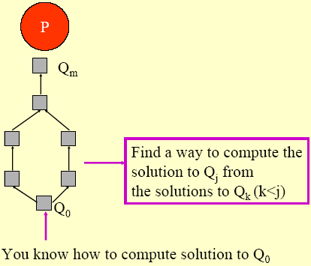
Intuitive Explanation
Given a problem P, obtain a sequence of problems Q₀, Q₁, …., Q_{m}, where:
  You have a solution to Q₀
  The solution to a problem Q_{j}, j > 0, can be obtained from solutions to problems Q₀...Q_{k}, k < j, that appear earlier in the “sequence”.
Algorithms
Dynamic Programming→<number>
Notes:
Dynamic programming

Slide 12
Elements of Dynamic Programming
DP is used to solve problems with the following characteristics:
  Optimal sub-structure (Principle of Optimality)
    an optimal solution to the problem contains within it optimal solutions to sub-problems.
  Overlapping subproblems
    there exist some places where we solve the same subproblem more than once
Algorithms
Dynamic Programming→<number>
Notes:
Dynamic programming

Slide 13
Example: Fibonacci Numbers
F(6) = 8
F(5)
F(4)
F(4)
F(3)
F(3)
F(2)
F(3)
F(2)
F(2)
F(1)
F(2)
F(1)
F(1)
F(0)
F(2)
F(1)
F(1)
F(0)
F(1)
F(0)
F(1)
F(0)
F(1)
F(0)
We keep calculating the same value over and over!
  Subproblems are overlapping – they share sub-subproblems
Algorithms
Dynamic Programming→<number>
Notes:
Dynamic programming

Slide 14
Steps to Designing a
Dynamic Programming Algorithm
Characterize optimal sub-structure
Recursively define the value of an optimal solution
Compute the value bottom up
(if needed) Construct an optimal solution
Algorithms
Dynamic Programming→<number>
Notes:
Dynamic programming

Slide 15
1.Optimal Sub-Structure
An optimal solution to the problem contains optimal solutions to sub-problems
  Solution to a problem:
    Making a choice out of a number of possibilities (look what possible choices there can be)
    Solving one or more sub-problems that are the result of a choice (characterize the space of sub-problems)
  Show that solutions to sub-problems must themselves be optimal for the whole solution to be optimal.
Algorithms
Dynamic Programming→<number>
Notes:
Dynamic programming

Slide 16
2. Recursive Solution
Write a recursive solution for the value of an optimal solution.
Show that the number of different instances of sub-problems is bounded by a polynomial.
Algorithms
Dynamic Programming→<number>
Notes:
Dynamic programming

Slide 17
3. Bottom Up
Compute the value of an optimal solution in a bottom-up fashion, so that you always have the necessary sub-results pre-computed (or use memoization)
Check if it is possible to reduce the space requirements, by “forgetting” solutions to sub-problems that will not be used any more
Algorithms
Dynamic Programming→<number>
Notes:
Dynamic programming

Slide 18

4. Construct Optimal Solution
Construct an optimal solution from computed information (which records a sequence of choices made that lead to an optimal solution)
Algorithms
Dynamic Programming→<number>
Notes:
Dynamic programming

Slide 19
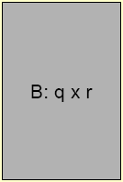

Review: Matrix Multiplication
Matrix-Multiply(A,B):
1 if columns[A] != rows[B] then
2 error "incompatible dimensions"
3 else{
5 for i = 1 to rows[A] do
6 for j = 1 to columns[B] do{
7 C[i,j] = 0
8 for k = 1 to columns[A] do
9 C[i,j] = C[i,j]+A[i,k]*B[k,j]
10 }
11 }
12 return C
Time complexity = O(pqr),
  where |A|=p×q and |B|=q×r
Algorithms
Dynamic Programming→<number>
Notes:
Dynamic programming

Slide 20
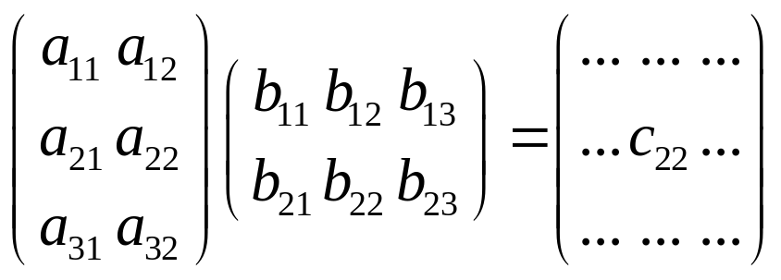
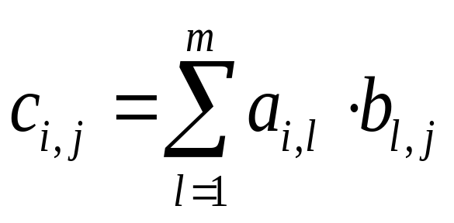
Multiplying Matrices
Two matrices, A – n×m matrix and B – m×k matrix, can be multiplied to get C with dimensions n×k, using n×m×k scalar multiplications
Problem: Compute a product of many matrices efficiently
Algorithms
Dynamic Programming→<number>
Notes:
Dynamic programming

Slide 21
Matrix Chain Multiplication [MCM]:
The Problem
Input: Matrices T₁,T₂,…, T_{n}, each T_{i} of size d_{i-1} x d_{i}
Output: Fully parenthesized product T₁T₂…T_{n} that minimizes the number of scalar multiplications.
A product of matrices is fully parenthesized if it is either
  a) a single matrix, or
  b) the product of 2 fully parenthesized matrix products surrounded by parentheses.
Example: T₁ T₂ T₃ T₄ can be fully parenthesized as:
1. (T₁ (T₂ (T₃ T₄ ))) 4. ((T₁ (T₂ T₃ ))T₄ )
2. (T₁ ((T₂ T₃ )T₄ )) 5. (((T₁ T₂ )T₃ )T₄ )
3. ((T₁ T₂ )(T₃ T₄ ))
Algorithms
Dynamic Programming→<number>
Notes:
Dynamic programming

Slide 22
Matrix Chain Multiplication [MCM]:
The Problem
Suppose size of A_{i} is p_{i-1} by p_{i}.
(A₁ ( A₂ ( A₃ A₄ ) )) : p₂ p₃ p₄ + p₁p₂p₄ + p₀p₁p₄
(((A₁ A₂) A₃) A₄ ) : p₀ p₁ p₂ + p₀p₂p₃ + p₀p₃p₄
p₁
p₂
p₃
p₄
A₁
A₂
A₃
A₄
p₀
Algorithms
Dynamic Programming→<number>
Notes:
Dynamic programming

Slide 23
Matrix Chain Multiplication [MCM]:
(A₁(A₂(A₃ A₄)))
p₁
p₂
p₃
p₄
p₁
p₂
p₄
A₁
A₂
A₃
A₄
A₁
A₂
A₃ A₄
p₀
p₀
(A₃ A₄)
p₂p₃p₄ multiplications
(A₂(A₃ A₄))
p₁p₂p₄ multiplications
Total: p₂p₃p₄ + p₁p₂p₄ + p₀p₁p₄
p₄
p₁
p₄
A₁( A₂(A₃A₄))
A₁
A₂(A₃A₄)
p₀
p₀
(A₁(A₂(A₃ A₄)))
p₀p₁p₄ multiplications
Algorithms
Dynamic Programming→<number>
Notes:
Dynamic programming

Slide 24
Matrix Chain Multiplication [MCM]:
(((A₁ A₂)A₃)A₄)
p₁
p₂
p₃
p₄
p₂
p₃
p₄
A₁
A₂
A₃
A₄
(A₁A₂)
A₃
A₄
p₀
p₀
(A₁ A₂)
p₀p₁p₂ multiplications
((A₁ A₂)A₃)
p₀p₂p₃ multiplications
Total: p₀p₁p₂ + p₀p₂p₃ + p₀p₃p₄
p₄
p₃
p₄
((A₁A₂)A₃)A₄
(A₁A₂)A₃
A₄
p₀
p₀
(((A₁ A₂)A₃)A₄)
p₀p₃p₄ multiplications
Algorithms
Dynamic Programming→<number>
Notes:
Dynamic programming

Slide 25
MCM: Parenthesization
Some Preliminaries
Matrix multiplication is associative
  (AB)C = A(BC)
The parenthesization matters
Consider A×B×C×D, where
  A is 30×1, B is 1×40,
  C is 40×10, D is 10×25
Costs:
  (((AB)C)D)
A=30 x 1
B=1 x 40
30x1x40
(AB)=30x40
C=40x10
30x40x10
((AB)C)=30x10
D=10x25
  =1200
  +
  12000
  +
  7500
  = 20700
30x10x25
(((AB)C)D)=30x25
Algorithms
Dynamic Programming→<number>
Notes:
Dynamic programming

Slide 26
MCM: Parenthesization
Some Preliminaries
Matrix multiplication is associative
  (AB)C = A(BC)
The parenthesization matters
Consider A×B×C×D, where
  A is 30×1, B is 1×40,
  C is 40×10, D is 10×25
Costs:
  (((AB)C)D)
  = 1200 + 12000 + 7500 = 20700
  ((AB)(CD))
A=30 x 1
B=1 x 40
C=40x10
D=10x25
30x1x40
40x10x25
(AB)=30x40
(CD)=40x25
30x40x25
  =1200
  +
  10000
  +
  30000
  = 41200
((AB)(CD))=30x25
Algorithms
Dynamic Programming→<number>
Notes:
Dynamic programming

Slide 27
MCM: Parenthesization
Some Preliminaries
Matrix multiplication is associative
  (AB)C = A(BC)
The parenthesization matters
Consider A×B×C×D, where
  A is 30×1, B is 1×40,
  C is 40×10, D is 10×25
Costs:
  (((AB)C)D)
  = 1200 + 12000 + 7500 = 20700
  ((AB)(CD))
  = 1200 + 10000 + 30000 = 41200
  (A((BC)D))
B=1 x40
C=40x10
1x40x10
(BC)=1 x10
D=10x25
1x10x25
A=30 x 1
((BC)D)=1x25
30x1x25
(A((BC)D))=30x25
  =400
  +
  = 1400
  +
  250
  750
Algorithms
Dynamic Programming→<number>
Notes:
Dynamic programming

Slide 28
MCM: Parenthesization
Some Preliminaries
Matrix multiplication is associative
  (AB)C = A(BC)
The parenthesization matters
Consider A×B×C×D, where
  A is 30×1, B is 1×40,
  C is 40×10, D is 10×25
Costs:
  (((AB)C)D)
  = 1200 + 12000 + 7500 = 20700
  ((AB)(CD))
  = 1200 + 10000 + 30000 = 41200
  (A((BC)D))
  = 400 + 250 + 750 = 1400
We need to optimally parenthesize
T₁ x T₂ x…T_{n}, where T_{i} is a d_{i-1} x d_{i} matrix.
According to the given example
  d = {30, 1, 40, 10, 25 }
  T₁ x T₂ x T₃ x T₄ where
    T₁ = d₁₋₁ x d₁ = d₀ x d₁ = 30 x 1
    T₂ = d₂₋₁ x d₂ = d₁ x d₂ = 1 x 40
    T₃ = d₃₋₁ x d₃ = d₂ x d₃ = 40 x 10
    T₄ = d₄₋₁ x d₄ = d₃ x d₄ = 10 x 25
Costs:
  ((T₁ T₂) T₃) T₄ = 20700
  (T₁ T₂) (T₃ T₄) = 41200
  T₁ ((T₂ T₃) T₄) = 1400
Algorithms
Dynamic Programming→<number>
Notes:
Dynamic programming

Slide 29
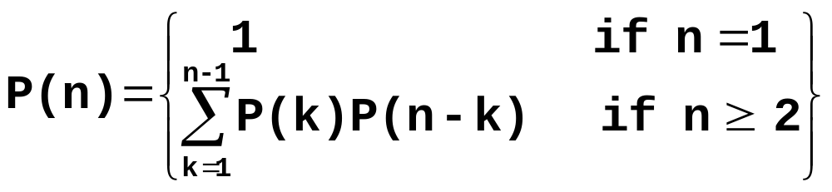
MCM: Parenthesization
Let the number of different parenthesizations, P(n).
Then,
Using Generating Function we have,
  P(n) = C(n-1), the (n-1)^{th} Catalan Number where
Exhaustively checking all possible parenthesizations take exponential time!
Algorithms
Dynamic Programming→<number>

Slide 30
MCM :: Step 1: Characterize Optimal Sub-structure
Let M(i, j) be the minimum number of multiplications necessary to compute T_{i..j} = T_{i} x … x T_{j}
Key observations
  The outermost parenthesis partitions the chain of matrices (i, j) at some k, (i ≤ k < j): (T_{i}…T_{k})(T_{k+1}…T_{j})
  The optimal parenthesization of matrices (i, j) is also optimal on either side of k; i.e., for matrices (i, k) and (k+1, j)
  Within the optimal parenthesization of T_{i..j},
  (a) the parenthesization of T_{i..k} must be optimal
  (b) the parenthesization of T_{k+1..j} must be optimal
    Why?
Algorithms
Dynamic Programming→<number>
Notes:
Dynamic programming

Slide 31
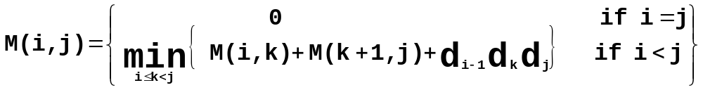
MCM :: Step 2: Recursive (Recurrence) Formulation
Need to find T_{1..n}
Let M(i, j) = minimum # of scalar multiplications needed to compute T_{i..j}
Since T_{i..j} can be obtained by breaking it into T_{i..k} & T_{k+1..j} , we have
Note: The sizes of T_{i..k} is d_{i-1} x d_{k} and T_{k+1..j} is d_{k} x d_{j} ,
and T_{i..k} T_{k+1..j} is d_{i-1} x d_{j} after d_{i-1} d_{k} d_{j} scalar multiplications.
Let s(i, j) be the value k where the optimal split occurs
A direct recursive implementation is exponential – a lot of duplicated work.
But there are only few different subproblems (i, j): one solution for each choice of i and j (i < j).
Algorithms
Dynamic Programming→<number>
Notes:
Dynamic programming

Slide 32
MCM::Step 2: Recursive (Recurrence) Formulation
Recursive-Matrix-Chain(d, i, j)
1 if i = j then
2 return 0;
3 M[i, j] = ∞;
4 for k = i to j-1 do
5 q = Recursive-Matrix-Chain(d, i, k) +
Recursive-Matrix-Chain(d, k+1, j) +
d_{i-1}d_{k}d_{j}
6 if q < M[i, j] then
M[i, j] = q ;
S[i, j] = k ;
8 return M[i, j] ;
Algorithms
Dynamic Programming→<number>
Notes:
Dynamic programming

Slide 33
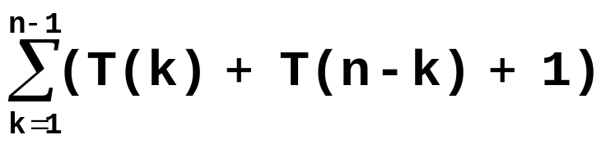
MCM :: Step 2: Recursive (Recurrence) Formulation
Overlapping Subproblems
Let T(n) be the time complexity of Recursive-Matrix-Chain(d, 1, n)
For n > 1, we have
  T(n)= 1 +
  a) 1 is used to cover the cost of lines 1-3, and 8
  b) 1 is used to cover the cost of lines 6-7
Using substitution, we can show that T(n) ≥ 2^{n-1}
Hence T(n) = Ω(2^{n})
Algorithms
Dynamic Programming→<number>
Notes:
Dynamic programming

Slide 34
MCM :: Step 3: Computing Optimal Costs
To compute T_{i..j} we need only values for subproblems of length<i-j.
Solve subproblems in the increasing length of subproblems: first subproblems of length 2, then of length 3 and so on.
Length = 4
Length = 3
Length = 2
Length = 1
T_{1..4}
An Example:
(T₂(T₃T₄))
T₂T₃T₄ =
((T₂T₃)T₄)
T_{2..2} T_{3..4}
T_{2..4} =
T_{2..3} T_{4..4}
T_{1..3}
T_{2..4}
T_{1..2}
T_{2..3}
T_{3..4}
T_{1..1}
T_{2..2}
T_{3..3}
T_{4..4}
Algorithms
Dynamic Programming→<number>

Slide 35
MCM :: Step 3: Computing the Optimal Costs
Idea: store the optimal cost M(i, j) for each subproblem in a 2d array M[1..n,1..n]
  Trivially M(i, i) = 0, 1≤ i ≤ n
  To compute M(i, j), where i – j = L, we need only values of M for subproblems of length < L.
  Thus we have to solve subproblems in the increasing length of subproblems: first subproblems of length 2, then of length 3 and so on.
To reconstruct an optimal parenthesization for each pair (i, j) we record in s[i, j] = k the optimal split into two subproblems (i, k) and (k+1, j)
Algorithms
Dynamic Programming→<number>
Notes:
Dynamic programming

Slide 36
MCM :: Step 3: Computing the Optimal Costs
Matrix-Chain-Order( d )
01 n = length[d]-1 //d is the array of matrix sizes
02 for i = 1 to n do
03 M[i,i] = 0 // no multiplication for 1 matrix
04 for len = 2 to n do // len is length of sub-chain
05 for i = 1 to n-len+1 do // i: start of sub-chain
06 j =i+len-1 // j: end of sub-chain
07 M[i,j] = ∞
08 for k = i to j-1 do
09 q = M[i,k]+M[k+1,j]+d_{i-1}d_{k}d_{j}
10 if q < M[i,j] then
11 M[i,j] = q
12 s[i,j] = k
13 return M and s
Time complexity = O(n3 )
Algorithms
Dynamic Programming→<number>
Notes:
Dynamic programming

Slide 37
MCM :: Step 3: Computing the Optimal Costs
After the execution: M [1,n] contains the value of an optimal solution and s contains optimal subdivisions (choices of k) of any subproblem into two sub-subproblems
Let us run the algorithm on the six matrices:
d={ 30, 35, 15, 5, 10, 20, 25 }
See CLRS Figure 15.3
Matrix | Dimension
T1 | 30 X 35
T2 | 35 X 15
T3 | 15 X 5
T4 | 5 X 10
T5 | 10 X 20
T6 | 20 X 25
Algorithms
Dynamic Programming→<number>
Notes:
Dynamic programming

Slide 38
Simulation-MCM
 | 0 | 1 | 2 | 3 | 4 | 5 | 6
d | 30 | 35 | 15 | 5 | 10 | 20 | 25
Matrix-Chain-Order( d )
01 n = length[d]-1
02 for i = 1 to n do
03 M[i,i] = 0
04 for len = 2 to n do
05 for i = 1 to n-len+1 do
06 j =i+len-1
07 M[i,j] = ∞
08 for k = i to j-1 do
09 q = M[i,k]+M[k+1,j]+d_{i-1}d_{k}d_{j}
10 if q < M[i,j] then
11 M[i,j] = q
12 s[i,j] = k
13 return M and s
M | 1 | 2 | 3 | 4 | 5 | 6
1
2
3
4
5
6
S | 1 | 2 | 3 | 4 | 5 | 6
1
2
3
4
5
6
Algorithms
Dynamic Programming→<number>

Slide 39
Simulation-MCM
 | 0 | 1 | 2 | 3 | 4 | 5 | 6
d | 30 | 35 | 15 | 5 | 10 | 20 | 25
Matrix-Chain-Order( d )
01 n = length[d]-1
02 for i = 1 to n do
03 M[i,i] = 0
04 for len = 2 to n do
05 for i = 1 to n-len+1 do
06 j =i+len-1
07 M[i,j] = ∞
08 for k = i to j-1 do
09 q = M[i,k]+M[k+1,j]+d_{i-1}d_{k}d_{j}
10 if q < M[i,j] then
11 M[i,j] = q
12 s[i,j] = k
13 return M and s
M | 1 | 2 | 3 | 4 | 5 | 6
1 | 0
2 |  | 0
3 |  |  | 0
4 |  |  |  | 0
5 |  |  |  |  | 0
6 |  |  |  |  |  | 0
S | 1 | 2 | 3 | 4 | 5 | 6
1
2
3
4
5
6
Algorithms
Dynamic Programming→<number>

Slide 40
Simulation-MCM
 | 0 | 1 | 2 | 3 | 4 | 5 | 6
d | 30 | 35 | 15 | 5 | 10 | 20 | 25
Matrix-Chain-Order( d )
01 n = length[d]-1
02 for i = 1 to n do
03 M[i,i] = 0
04 for len = 2 to n do
05 for i = 1 to n-len+1 do
06 j =i+len-1
07 M[i,j] = ∞
08 for k = i to j-1 do
09 q = M[i,k]+M[k+1,j]+d_{i-1}d_{k}d_{j}
10 if q < M[i,j] then
11 M[i,j] = q
12 s[i,j] = k
13 return M and s
M | 1 | 2 | 3 | 4 | 5 | 6
1 | 0 | 15750
2 |  | 0 | 2625
3 |  |  | 0 | 750
4 |  |  |  | 0 | 1000
5 |  |  |  |  | 0 | 5000
6 |  |  |  |  |  | 0
S | 1 | 2 | 3 | 4 | 5 | 6
1 |  | 1
2 |  |  | 2
3 |  |  |  | 3
4 |  |  |  |  | 4
5 |  |  |  |  |  | 5
6
len=2, [i,j]=[1,2] to [5,6], k = 1 to 5
M[1,2] = M[1,1]+M[2,2]+d₀*d₁*d₂ = 0+0+30*35*15 = 15750;
M[2,3] = M[2,2]+M[3,3]+d₁*d₂*d₃ = 0+0+35*15* 5 = 2625;
M[3,4] = M[3,3]+M[4,4]+d₂*d₃*d₄ = 0+0+15* 5*10 = 750;
M[4,5] = M[4,4]+M[5,5]+d₃*d₄*d₅ = 0+0+ 5*10*20 = 1000;
M[5,6] = M[5,5]+M[6,6]+d₄*d₅*d₆ = 0+0+10*20*25 = 5000;
Mashiour Rahman
AIUB::CSC2105::Algorithms
Algorithms
Dynamic Programming→<number>
Dynamic Programming→<number>

Slide 41
Simulation-MCM
 | 0 | 1 | 2 | 3 | 4 | 5 | 6
d | 30 | 35 | 15 | 5 | 10 | 20 | 25
Matrix-Chain-Order( d )
01 n = length[d]-1
02 for i = 1 to n do
03 M[i,i] = 0
04 for len = 2 to n do
05 for i = 1 to n-len+1 do
06 j =i+len-1
07 M[i,j] = ∞
08 for k = i to j-1 do
09 q = M[i,k]+M[k+1,j]+d_{i-1}d_{k}d_{j}
10 if q < M[i,j] then
11 M[i,j] = q
12 s[i,j] = k
13 return M and s
M | 1 | 2 | 3 | 4 | 5 | 6
1 | 0 | 15750
2 |  | 0 | 2625
3 |  |  | 0 | 750
4 |  |  |  | 0 | 1000
5 |  |  |  |  | 0 | 5000
6 |  |  |  |  |  | 0
S | 1 | 2 | 3 | 4 | 5 | 6
1 |  | 1
2 |  |  | 2
3 |  |  |  | 3
4 |  |  |  |  | 4
5 |  |  |  |  |  | 5
6
Len=
[i, j]=[ |  | , |  | ] to [ |  | , |  | ]
k=
M[ |  | , |  | ]= | M[ |  | , |  | ]+ | M[ |  | , |  | ]+ | d |  | * | d |  | * | d
 |  |  |  | = |  |  |  |  | + |  |  |  |  | + |  |  | * |  |  | * |  |  | =
Mashiour Rahman
AIUB::CSC2105::Algorithms
Algorithms
Dynamic Programming→<number>
Dynamic Programming→<number>

Slide 42
MCM :: Step 4: Constructing Optimal Solution
To get the optimal solution T_{1..6}, s[] is used as follows:
T_{1..6}
= (T_{1..3} T_{4..6}) ;since s[1,6] = 3
= ((T_{1..1} T_{2..3} )(T_{4..5} T_{6..6} ))
;since s[1,3] =1 and s[4,6]=5
=((T₁ (T₂ T₃ ))((T₄ T₅ )T₆ ))
MCM can be solved in O(n3) time
Algorithms
Dynamic Programming→<number>
Notes:
Dynamic programming

Slide 43
Matrix Chain Multiplication Problem
Running time
  It is easy to see that it is O(n³)
  (three nested loops)
  It turns out it is also Ω(n³)
Thus, a reduction from exponential time to polynomial time.
Algorithms
Dynamic Programming→<number>
Notes:
Dynamic programming

Slide 44
Memoization
Memoization is one way to deal with overlapping subproblems
  After computing the solution to a subproblem, store it in a table
  Subsequent calls just do a table lookup
Can modify recursive algorithm to use memoziation
If we prefer recursion we can structure our algorithm as a recursive algorithm:
Initialize all elements to ∞ and call MemoMCM(i,j)
MemoMCM(i,j)
if i = j then return 0
else if M[i,j] < ∞ then return M[i,j]
else for k := i to j-1 do
q := MemoMCM(i,k)+ MemoMCM(k+1,j) + d_{i-1}d_{k}d_{j}
if q < M[i,j] then
M[i,j] := q
return M[i,j]
Algorithms
Dynamic Programming→<number>
Notes:
Dynamic programming

Slide 45
Memoization
Memoization:
  Solve the problem in a top-down fashion, but record the solutions to subproblems in a table.
Pros and cons:
  ☹ Recursion is usually slower than loops and uses stack space
  ☺ Easier to understand
  ☺ If not all subproblems need to be solved, you are sure that only the necessary ones are solved  
Algorithms
Dynamic Programming→<number>
Notes:
Dynamic programming

Slide 46
Longest Common Subsequence
The Problem
Given two sequences
  X = < x₁, x₂, … , x_{m} >
  Z = < z₁, z₂, … , z_{k} >
Z is a subsequence of X if
  z_{j} = x_{i( j )} for all j = 1, … , k
  where <i(1),i(2),…,i(k)> is strictly increasing (but not required to be consecutive)
Examples:
  Let X = < A, B, C, B, D, A, B >
  < A >, < B >, < C >, and < D > are subsequences.
  < C, A >, < C, B >, < C, B, A, B > are subsequences.
  How many possible subsequences for a n-element sequence?
Algorithms
Dynamic Programming→<number>
Notes:
Dynamic programming

Slide 47
Longest Common Subsequence Problem
Z is a common subsequence of sequences X and Y if Z is a subsequence of both X and Y.
Example:
  Let X = < A, B, C, B, D, A, B > and Y = < B, D, C, A, B, A >
  < A >, <B>, <C>, and <D> are common subsequences.
  < C, A > is, but < A, C > is not.
  < B, C, A> is a common subsequence
  < B, C, B, A > is the longest common subsequence.
Example:
  x = “sariempiolcewe”
  y = “westigmupsalrte”
Algorithms
Dynamic Programming→<number>
Notes:
Dynamic programming

Slide 48
Longest Common Subsequence Problem
LCS:
Input: two sequences x[1..m] and y[1..n]
Output: longest common subsequence of x and y (denoted LCS(x,y))
Brute-force algorithm:
  For every subsequence of x, check if it is a subsequence of y
  2^{m} subsequences of x to check against n elements of y : O(n 2^{m})
Algorithms
Dynamic Programming→<number>
Notes:
Dynamic programming

Slide 49
LCS: Optimal Sub-structure
The i^{th} prefix of X = < x₁,x₂,…,x_{m} > is denoted X_{i} = < x₁,x₂,…,x_{i} >
  X₀ is the empty sequence
  X_{m} is the whole sequence X
Theorem 15.1 (Optimal Sub-structure of LCS)
Let X=<x₁,x₂,…,x_{m}>, Y=<y₁,y₂,…,y_{n}>, and Z=<z₁,z₂,…,z_{k}> be LCS(X,Y).
  (1) If x_{m}= y_{n}, then z_{k} = x_{m} = y_{n} and Z_{k-1} is LCS(X_{m-1},Y_{n-1})
  (2) if x_{m} ≠ y_{n}, then z_{k} ≠ x_{m} implies Z is LCS(X_{m-1},Y)
  (3) if x_{m} ≠ y_{n}, then z_{k} ≠ y_{n} implies Z is LCS(X,Y_{n-1})
Algorithms
Dynamic Programming→<number>
Notes:
Dynamic programming

Slide 50
LCS: Optimal Substructure
We make Z to be empty and proceed from the ends of X_{m}=“x₁ x₂ …x_{m}” and Y_{n}=“y₁ y₂ …y_{n}”
  If x_{m}=y_{n}, append this symbol to the beginning of Z, and find optimally LCS(X_{m-1}, Y_{n-1})
  If x_{m}≠y_{n},
    Skip either a letter from X
    or a letter from Y
    Decide which decision to do by comparing
    LCS(X_{m}, Y_{n-1}) and LCS(X_{m-1}, Y_{n})
  Starting from beginning is equivalent.
Algorithms
Dynamic Programming→<number>
Notes:
Dynamic programming

Slide 51
LCS: Optimal Substructure
LCS has an optimal sub-structure defined by prefixes of X and Y
The sub-problems of finding LCS(X_{m-1},Y_{n}) and LCS(X_{m},Y_{n-1}) share a common sub-sub-problem of finding LCS(X_{m-1},Y_{n-1}). They are overlapping.
Simplify: just worry about LCS length for now
  Define c[i, j] = length of LCS(X_{i}, Y_{j})
  So c[m, n] = length of LCS(X, Y)
Algorithms
Dynamic Programming→<number>
Notes:
Dynamic programming

Slide 52
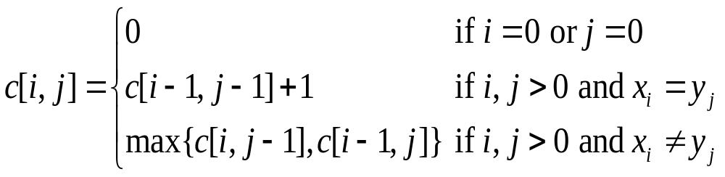
LCS: Recurrence
Define c[i, j] = length of LCS of x[1..i], y[1..j]
Note that the conditions in the problem restrict sub-problems (if x_{i} = y_{i} we consider x_{i-1} and y_{i-1}, etc)
Use b[i, j] to remember where to extract an element of an LCS.
Algorithms
Dynamic Programming→<number>
Notes:
Dynamic programming

Slide 53
LCS: Recurrence
int lcsRec(int i, int j) {
if (i==0 || j==0) return 0;
else if (x[i] == y[j])
return lcsRec(i-1,j-1) + 1;
else
return max(lcsRec(i-1,j),lcsRec(i,j-1));
}
Recurrence for time complexity:
T(2n)=T(2n-2)+1 if x[n]=y[n]
T(2n)=2T(2n-1) if x[n]!=y[n]
T(2n)=1 if n=0
T(2n)=2T(2n-1)
=2(2T(2n-2))
=4T(2n-2)
=4(2T(2n-3))
=8T(2n-3)
=2^{i}T(2n-i)
= 2^{2n} = 4^{n}
Algorithms
Dynamic Programming→<number>
Notes:
Dynamic programming

Slide 54
LCS: Recurrence
int lcsMemo(int i, int j) {
if (c[i][j] != -1) return c[i][j]
else if (x[i] == y[j]) {
c[i][j] = lcsMemo(i-1,j-1) + 1
return c[i][j]
}
else {
c[i][j]=max(lcsMemo(i-1,j),lcsMemo(i,j-1))
return c[i][j]
}
}
c String x
T(n) = O(n²)
String y
Algorithms
Dynamic Programming→<number>
Notes:
Dynamic programming

Slide 55
LCS: Computing Length
LCS-Length(X, Y, m, n)
1 for i←1 to m do
2 c[i,0] ← 0
3 for j←0 to n do
4 c[0,j] ← 0
5 for i←1 to m do
6 for j←1 to n do
7 if x_{i} = y_{j} then
c[i,j] ← c[i-1,j-1]+1
9 b[i,j] ← ”copy”
10 else if c[i-1,j] ≥ c[i,j-1] then
c[i,j] ← c[i-1,j]
b[i,j] ← ”skipX”
13 else
c[i,j] ← c[i,j-1]
b[i,j] ← ”skipY”
16 return c, b
Algorithms
Dynamic Programming→<number>
Notes:
Dynamic programming

Slide 56
LCS: Example
0, if i=0, j=0
c[i,j] = c[i-1,j-1]+1 if i,j>0 and x_{i} = y_{j}
max ( c[i,j-1], c[i-1,j] ) if i,j>0 and x_{i} ≠ y_{i}
X
a
b
b
c
a
a
c
Y
0
0
0
0
0
0
0
0
a
0
c
0
c
0
b
0
c
0
c
0
a
0
Algorithms
Dynamic Programming→<number>
Notes:
Dynamic programming

Slide 57
LCS: Example
0, if i=0, j=0
c[i,j] = c[i-1,j-1]+1 if i,j>0 and x_{i} = y_{j}
max ( c[i,j-1], c[i-1,j] ) if i,j>0 and x_{i} ≠ y_{i}
a
b
b
c
a
a
c
0
0
0
0
0
0
0
0
a
0
c
0
c
0
b
0
c
0
c
0
a
0
Algorithms
Dynamic Programming→<number>
Notes:
Dynamic programming

Slide 58
LCS: Example
0, if i=0, j=0
c[i,j] = c[i-1,j-1]+1 if i,j>0 and x_{i} = y_{j}
max ( c[i,j-1], c[i-1,j] ) if i,j>0 and x_{i} ≠ y_{i}
a
b
b
c
a
a
c
0
0
0
0
0
0
0
0
a
0
c
0
c
0
b
0
c
0
c
0
a
0
Algorithms
Dynamic Programming→<number>
Notes:
Dynamic programming

Slide 59
LCS: Example
0, if i=0, j=0
c[i,j] = c[i-1,j-1]+1 if i,j>0 and x_{i} = y_{j}
max(c[i,j-1],c[i-1,j]) if i,j>0 and x_{i} ≠ y_{i}
a
b
b
c
a
a
c
0
0
0
0
0
0
0
0
a
0
1
1
1
1
1
1
1
c
0
1
1
1
2
2
2
2
c
0
1
1
1
2
2
2
3
b
0
1
2
2
2
2
2
3
c
0
1
2
2
3
3
3
3
c
0
1
2
2
3
3
3
4
a
0
1
2
2
3
4
4
4
Algorithms
Dynamic Programming→<number>
Notes:
Dynamic programming

Slide 60
Constructing an LCS
Print-LCS(b, X, i, j)
1 if i = 0 or j = 0 then
2 return
3 if b[i,j] = “copy" then
4 Print-LCS(b,X,i-1,j-1)
5 print x[i]
6 elseif b[i,j]=“skipX" then
7 Print-LCS(b,X,i-1,j)
8 else
Print-LCS(b,X,i,j-1)
length[X] = m, length[Y] = n,
Call Print-LCS(b, X, n, m) to construct LCS
Time complexity: O(m+n).
Algorithms
Dynamic Programming→<number>
Notes:
Dynamic programming

Slide 61
LCS: Example
0, if i=0, j=0
c[i,j] = c[i-1,j-1]+1 if i,j>0 and x_{i} = y_{j}
max(c[i,j-1],c[i-1,j]) if i,j>0 and x_{i} ≠ y_{i}
a
b
b
c
a
a
c
0
0
0
0
0
0
0
0
a
0
1
1
1
1
1
1
1
c
0
1
1
1
2
2
2
2
c
0
1
1
1
2
2
2
3
b
0
1
2
2
2
2
2
3
c
0
1
2
2
3
3
3
3
c
0
1
2
2
3
3
3
4
a
0
1
2
2
3
4
4
4
Algorithms
Dynamic Programming→<number>
Notes:
Dynamic programming

Slide 62
Longest Common Subsequence
There is a need to quantify how similar they are:
  Comparing DNA sequences in studies of evolution of different species
  Spell checkers
  Editing
Algorithms
Dynamic Programming→<number>
Notes:
Dynamic programming

Slide 63
References & Readings
CLRS:
  15.2, 15.3, 15.4
  Exercises: 15.2-1, 15.2-2, 15.2-3, 15.3-2, 15.4-1, 15.4-3, 15.4-5, 15.4-6.
  Problems: 15-3.
HSR:
  5.6
Algorithms
Dynamic Programming→<number>

