Slide 1
CSC2105: Algorithms
Graph - Introduction

Slide 2
Graph - Introduction
Reference:
  • CLRS Appendix B.4, Chapters 22, 24-26
Objectives:
  • To learn several significant graph algorithms and their applications
    a. Graph search (BFS, DFS)
    b. Bellman/Ford and Dijkstra’s shortest path algorithms (Greedy)
    c. Floyd’s algorithm (Dynamic Programming)
    d. Network flows
Algorithms
Graph Introduction → <number>

Slide 3
Motivation
State-space search in Artificial Intelligence
Geographical information systems, electronic street directory
Logistics and supply chain management
Telecommunications network design
Many more industry applications
Algorithms
Graph Introduction → <number>

Slide 4
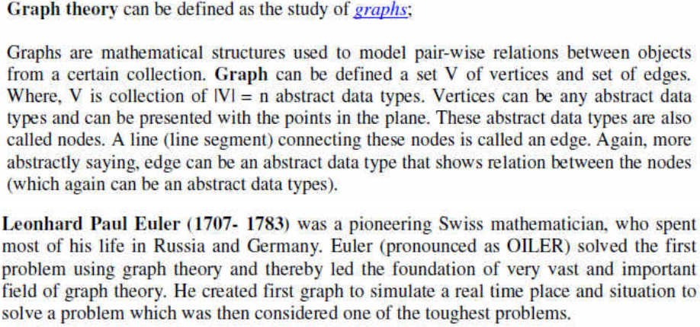
What is Graph
Algorithms
Graph Introduction → <number>

Slide 5
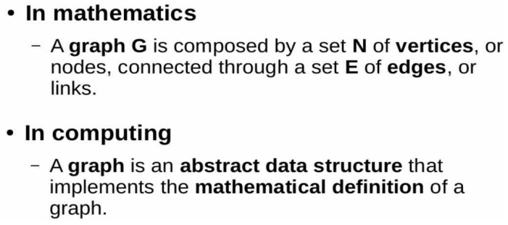
What is Graph(Cont…)
Algorithms
Graph Introduction → <number>

Slide 6
Review: Graphs
Graph G = (V, E)
  V = {1,…n} = set of vertices, E = set of e edges
  Undirected graph:
    edge (u, v) = edge (v, u)
    no self-loops
  Directed graph (digraph):
    edge (u, v) goes from vertex u to vertex v
  Sparse graph:
    e = O(n), dense otherwise
  A weighted graph associates weights with either the edges or the vertices
  Degree of a vertex v:
    deg(v) = number of edges adjacent on v (in-degree and out-degree for directed graphs)
Algorithms
Graph Introduction → <number>

Slide 7
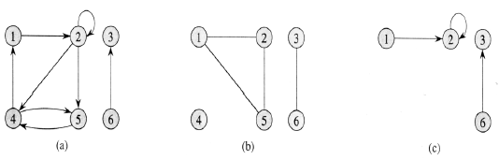
Examples of Graphs
Directed & Undirected graphs.
  A directed graph G= (V, E), where V = {1,2,3,4,5,6} and E={(1,2),(2,2),(2,4),(2,5),(4,1),(4,5),(5,4),(3,6)}. The edge (2,2) is self loop.
  An undirected graph G = (V,E), where V = {1,2,3,4,5,6} and E = {(1,2),(1,5),(2,5),(3,6)}. The vertex 4 is isolated.
  The subgraph of the graph in part (a) induced by vertex set {1,2,3,6}
Algorithms
Graph Introduction → <number>

Slide 8
Review: Graphs
Acyclic : if a graph contains no cycles
DAG : Directed acyclic graphs
Connected : if every vertex of a graph can reach every other vertex, i.e., every pair of vertices is connected by a path
Connected Components : equivalence classes of vertices under “is reachable from” relation
Strongly connected : every 2 vertices are reachable from each other (in a digraph)
Algorithms
Graph Introduction → <number>

Slide 9
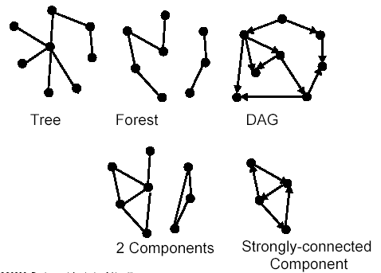
Forests, DAG, Components
Algorithms
Graph Introduction → <number>

Slide 10
Review: Representing Graphs
Adjacency matrix: represents a graph as n x n matrix A:
  A[i, j] = 1 if edge (i, j) E (or weight of edge)
  = 0 if edge (i, j) E
  Storage requirements: O(n²)
    A dense representation
    But, can be very efficient for small graphs
      Especially if store just one bit/edge
      Undirected graph: only need half of matrix
Adjacency list: list of adjacent vertices
  For each vertex v V, store a list of vertices adjacent to v
  Storage requirements: O(n+e)
    Good for large, sparse graphs (e.g., planar maps)
Algorithms
Graph Introduction → <number>

Slide 11
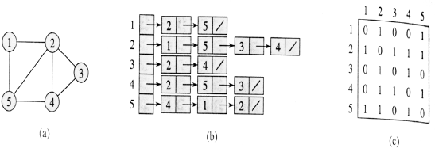
Review: Representing Graphs
Two representations of an undirected graph.
  An undirected graph G having five vertices and seven edges.
  An adjacency-list representation of G.
  The adjacency-matrix representation of G.
Algorithms
Graph Introduction → <number>

Slide 12
Graph Searching
Given: a graph G = (V, E), directed or undirected
Goal: methodically explore every vertex and edge
Ultimately: build a tree on the graph
  Pick a vertex as the root
  Choose certain edges to produce a tree
  Note: might also build a forest if graph is not connected
Breadth-first search
Depth-first search
Other variants: best-first, iterated deepening search, etc.
Algorithms
Graph Introduction → <number>

Slide 13
Depth-First Search (DFS)
Explore “deeper” in the graph whenever possible
  Edges are explored out of the most recently discovered vertex v that still has unexplored edges (LIFO)
  When all of v’s edges have been explored, backtrack to the vertex from which v was discovered
  computes 2 timestamps: d[ ] (discovered) and f[ ] (finished)
  builds one or more depth-first tree(s) (depth-first forest)
Algorithm colors each vertex
  WHITE: undiscovered
  GRAY: discovered, in process
  BLACK: finished, all adjacent vertices have been discovered
Algorithms
Graph Introduction → <number>

Slide 14
Depth-First Search: The Code
DFS(G)
{
  for each vertex u V
    color[u] = WHITE;
  time = 0;
  for each vertex u V
    if (color[u] == WHITE)
      DFS_Visit(u);
}
DFS_Visit(u)
{
  color[u] = GREY;
  time = time+1;
  d[u] = time; // compute d[]
  for each v adjacent to u
    if (color[v] == WHITE)
      p[v]= u // build tree
      DFS_Visit(v);
  color[u] = BLACK;
  time = time+1;
  f[u] = time; // compute f[]
}
Algorithms
Graph Introduction → <number>

Slide 15
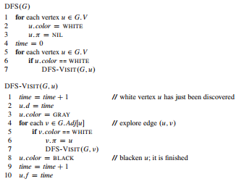
DFS
Algorithms
Graph Introduction → <number>

Slide 16
DFS Analysis
Running time of DFS = O(n+e)
DFS (excluding DFS_Visit) takes O(n) time
DFS_Visit:
  DFS_Visit( v ) is called exactly once for each vertex v
  During DFS_Visit( v ), adjacency list of v is scanned once
  sum of lengths of adjacency lists = O(e)
This type of aggregate analysis is an informal example of amortized analysis
Algorithms
Graph Introduction → <number>

Slide 17
DFS Classification of Edges
DFS can be used to classify edges of G:
  Tree edges: edges in the depth-first forest.
  Back edges: edges (u, v) connecting a vertex u to an ancestor v in a depth-first tree.
  Forward edges: non-tree edges (u, v) connecting a vertex u to a descendant v in a depth-first tree.
  Cross edges: all other edges.
DFS yields valuable information about the structure of a graph.
Algorithms
Graph Introduction → <number>

Slide 18
Operations of DFS
u
v
w
Undiscovered
Discovered, On Process
Finished, all adjacent vertices have been discovered
x
y
z
Discover time/ Finish time
Algorithms
Graph Introduction → <number>

Slide 19
Operations of DFS
u
u
v
v
w
w
Undiscovered
1/
Discovered, On Process
Finished, all adjacent vertices have been discovered
x
x
y
y
z
z
Discover time/ Finish time
Algorithms
Graph Introduction → <number>

Slide 20
Operations of DFS
u
u
u
v
v
v
w
w
w
Undiscovered
1/
1/
2/
Discovered, On Process
Finished, all adjacent vertices have been discovered
x
x
x
y
y
y
z
z
z
Tree edge
Discover time/ Finish time
Algorithms
Graph Introduction → <number>

Slide 21
Operations of DFS
u
u
u
u
v
v
v
v
w
w
w
w
Undiscovered
1/
1/
1/
2/
2/
Discovered, On Process
Finished, all adjacent vertices have been discovered
3/
x
x
x
x
y
y
y
y
z
z
z
z
Tree edge
Discover time/ Finish time
Algorithms
Graph Introduction → <number>

Slide 22
Operations of DFS
u
u
u
u
u
v
v
v
v
v
w
w
w
w
w
Undiscovered
1/
1/
1/
1/
2/
2/
2/
Discovered, On Process
4/
3/
Finished, all adjacent vertices have been discovered
3/
x
x
x
x
x
y
y
y
y
y
z
z
z
z
z
Tree edge
Discover time/ Finish time
Algorithms
Graph Introduction → <number>

Slide 23
Operations of DFS
u
u
u
u
u
u
v
v
v
v
v
v
w
w
w
w
w
w
Undiscovered
1/
1/
1/
1/
1/
2/
2/
2/
2/
Discovered, On Process
4/
3/
4/
3/
Finished, all adjacent vertices have been discovered
3/
x
y
z
x
x
x
x
x
y
y
y
y
y
z
z
z
z
z
Tree edge
Back Edge
Discover time/ Finish time
Algorithms
Graph Introduction → <number>

Slide 24
Operations of DFS
u
u
u
u
u
u
u
v
v
v
v
v
v
v
w
w
w
w
w
w
w
Undiscovered
1/
1/
1/
1/
1/
1/
2/
2/
2/
2/
2/
Discovered, On Process
4/
3/
4/
4/5
3/
3/
Finished, all adjacent vertices have been discovered
3/
x
y
z
x
x
x
x
x
x
y
y
y
y
y
y
z
z
z
z
z
z
Tree edge
Back Edge
Discover time/ Finish time
Algorithms
Graph Introduction → <number>

Slide 25
Operations of DFS
u
u
u
u
u
u
u
u
v
v
v
v
v
v
v
v
w
w
w
w
w
w
w
w
Undiscovered
1/
1/
1/
1/
1/
1/
1/
2/
2/
2/
2/
2/
2/
Discovered, On Process
4/
3/
4/
4/5
4/5
3/
3/
3/
Finished, all adjacent vertices have been discovered
3/6
x
y
z
x
x
x
x
x
x
x
y
y
y
y
y
y
y
z
z
z
z
z
z
z
Tree edge
Back Edge
Discover time/ Finish time
Algorithms
Graph Introduction → <number>

Slide 26
Operations of DFS
u
u
u
u
u
u
u
u
u
v
v
v
v
v
v
v
v
v
w
w
w
w
w
w
w
w
w
Undiscovered
1/
1/
1/
1/
1/
1/
1/
1/
2/
2/
2/
2/
2/
2/
2/7
Discovered, On Process
4/
3/
4/
4/5
4/5
4/5
3/
3/
3/
3/6
Finished, all adjacent vertices have been discovered
3/6
x
y
z
x
x
x
x
x
x
x
x
y
y
y
y
y
y
y
y
z
z
z
z
z
z
z
z
Tree edge
Back Edge
Discover time/ Finish time
Algorithms
Graph Introduction → <number>

Slide 27
Operations of DFS
u
u
u
u
u
u
u
u
u
u
u
v
v
v
v
v
v
v
v
v
v
v
w
w
w
w
w
w
w
w
w
w
w
Undiscovered
1/
1/
1/
1/
1/
1/
1/
1/
1/8
1/
2/
2/
2/
2/
2/
2/
2/7
2/7
2/7
Discovered, On Process
4/
3/
4/5
3/6
4/
4/5
4/5
4/5
4/5
3/
3/
3/
3/6
3/6
Finished, all adjacent vertices have been discovered
3/6
x
y
z
x
y
z
x
x
x
x
x
x
x
x
x
y
y
y
y
y
y
y
y
y
z
z
z
z
z
z
z
z
z
Tree edge
Back Edge
Discover time/ Finish time
Forward Edge
Algorithms
Graph Introduction → <number>

Slide 28
Operations of DFS
u
u
u
u
u
u
u
u
u
u
u
v
v
v
v
v
v
v
v
v
v
v
w
w
w
w
w
w
w
w
w
w
w
Undiscovered
1/
1/
1/
1/
1/
1/
1/
1/
1/8
1/8
2/
2/
2/
2/
2/
2/
2/7
2/7
2/7
Discovered, On Process
4/
3/
4/5
3/6
4/
4/5
4/5
4/5
4/5
3/
3/
3/
3/6
3/6
Finished, all adjacent vertices have been discovered
3/6
x
y
z
x
y
z
x
x
x
x
x
x
x
x
x
y
y
y
y
y
y
y
y
y
z
z
z
z
z
z
z
z
z
Tree edge
Back Edge
Discover time/ Finish time
Forward Edge
Algorithms
Graph Introduction → <number>

Slide 29
Operations of DFS
u
u
u
u
u
u
u
u
u
u
u
u
v
v
v
v
v
v
v
v
v
v
v
v
w
w
w
w
w
w
w
w
w
w
w
w
Undiscovered
1/
1/
1/
1/
1/
1/
1/
1/
1/8
1/8
1/8
2/
2/
2/
2/
2/
2/
2/7
2/7
2/7
2/7
9/
Discovered, On Process
4/
3/
4/5
3/6
4/
4/5
4/5
4/5
4/5
4/5
3/
3/
3/
3/6
3/6
3/6
Finished, all adjacent vertices have been discovered
3/6
x
y
z
x
y
z
x
x
x
x
x
x
x
x
x
x
y
y
y
y
y
y
y
y
y
y
z
z
z
z
z
z
z
z
z
z
Tree edge
Back Edge
Discover time/ Finish time
Forward Edge
Algorithms
Graph Introduction → <number>

Slide 30
Operations of DFS
u
u
u
u
u
u
u
u
u
u
u
u
u
v
v
v
v
v
v
v
v
v
v
v
v
v
w
w
w
w
w
w
w
w
w
w
w
w
w
Undiscovered
1/
1/
1/
1/
1/
1/
1/
1/
1/8
1/8
1/8
1/8
2/
2/
2/
2/
2/
2/
2/7
2/7
2/7
2/7
2/7
9/
9/
Discovered, On Process
4/
3/
4/5
3/6
4/
4/5
4/5
4/5
4/5
4/5
4/5
3/
3/
3/
3/6
3/6
3/6
3/6
Finished, all adjacent vertices have been discovered
3/6
x
y
z
x
y
z
x
x
x
x
x
x
x
x
x
x
x
y
y
y
y
y
y
y
y
y
y
y
z
z
z
z
z
z
z
z
z
z
z
Tree edge
Back Edge
Discover time/ Finish time
Forward Edge
Cross Edge
Algorithms
Graph Introduction → <number>

Slide 31
Operations of DFS
u
u
u
u
u
u
u
u
u
u
u
u
u
u
v
v
v
v
v
v
v
v
v
v
v
v
v
v
w
w
w
w
w
w
w
w
w
w
w
w
w
w
Undiscovered
1/
1/
1/
1/
1/
1/
1/
1/
1/8
1/8
1/8
1/8
1/8
2/
2/
2/
2/
2/
2/
2/7
2/7
2/7
2/7
2/7
2/7
9/
9/
9/
Discovered, On Process
4/
3/
4/5
3/6
4/
4/5
4/5
4/5
4/5
4/5
4/5
4/5
3/
3/
3/
3/6
3/6
3/6
3/6
3/6
Finished, all adjacent vertices have been discovered
3/6
10/
x
y
z
x
y
z
x
x
x
x
x
x
x
x
x
x
x
x
y
y
y
y
y
y
y
y
y
y
y
y
z
z
z
z
z
z
z
z
z
z
z
z
Tree edge
Back Edge
Discover time/ Finish time
Forward Edge
Cross Edge
Algorithms
Graph Introduction → <number>

Slide 32
Operations of DFS
u
u
u
u
u
u
u
u
u
u
u
u
u
u
u
v
v
v
v
v
v
v
v
v
v
v
v
v
v
v
w
w
w
w
w
w
w
w
w
w
w
w
w
w
w
Undiscovered
1/
1/
1/
1/
1/
1/
1/
1/
1/8
1/8
1/8
1/8
1/8
1/8
2/
2/7
2/
2/
2/
2/
2/
2/7
2/7
2/7
2/7
2/7
2/7
9/
9/
9/
9/
Discovered, On Process
4/
3/
4/5
4/5
3/6
4/
3/6
10/
4/5
4/5
4/5
4/5
4/5
4/5
4/5
3/
3/
3/
3/6
3/6
3/6
3/6
3/6
Finished, all adjacent vertices have been discovered
3/6
10/
x
y
z
x
x
y
y
z
x
z
x
x
x
x
x
x
x
x
x
x
x
y
y
y
y
y
y
y
y
y
y
y
y
z
z
z
z
z
z
z
z
z
z
z
z
Tree edge
Back Edge
Discover time/ Finish time
Forward Edge
Cross Edge
Algorithms
Graph Introduction → <number>

Slide 33
Operations of DFS
u
u
u
u
u
u
u
u
u
u
u
u
u
u
u
u
v
v
v
v
v
v
v
v
v
v
v
v
v
v
v
v
w
w
w
w
w
w
w
w
w
w
w
w
w
w
w
w
Undiscovered
1/
1/
1/
1/
1/
1/
1/
1/
1/8
1/8
1/8
1/8
1/8
1/8
1/8
2/
2/7
2/7
2/
2/
2/
2/
2/
2/7
2/7
2/7
2/7
2/7
2/7
9/
9/
9/
9/
9/
Discovered, On Process
4/
3/
4/5
4/5
4/5
3/6
3/6
3/6
10/
4/
10/11
4/5
4/5
4/5
4/5
4/5
4/5
4/5
3/
3/
3/
3/6
3/6
3/6
3/6
3/6
Finished, all adjacent vertices have been discovered
3/6
10/
x
y
z
x
x
x
y
y
y
z
z
x
z
x
x
x
x
x
x
x
x
x
x
x
y
y
y
y
y
y
y
y
y
y
y
y
z
z
z
z
z
z
z
z
z
z
z
z
Tree edge
Back Edge
Discover time/ Finish time
Forward Edge
Cross Edge
Algorithms
Graph Introduction → <number>

Slide 34
Operations of DFS
u
u
u
u
u
u
u
u
u
u
u
u
u
u
u
u
u
v
v
v
v
v
v
v
v
v
v
v
v
v
v
v
v
v
w
w
w
w
w
w
w
w
w
w
w
w
w
w
w
w
w
Undiscovered
1/
1/
1/
1/
1/
1/
1/
1/
1/8
1/8
1/8
1/8
1/8
1/8
1/8
1/8
2/
2/7
2/7
2/7
2/
2/
2/
2/
2/
2/7
2/7
2/7
2/7
2/7
2/7
9/
9/
9/12
9/
9/
9/
Discovered, On Process
4/
3/
4/5
4/5
4/5
4/5
3/6
3/6
3/6
3/6
10/
10/11
4/
10/11
4/5
4/5
4/5
4/5
4/5
4/5
4/5
3/
3/
3/
3/6
3/6
3/6
3/6
3/6
Finished, all adjacent vertices have been discovered
3/6
10/
x
y
z
x
x
x
x
y
y
y
y
z
z
z
x
z
x
x
x
x
x
x
x
x
x
x
x
y
y
y
y
y
y
y
y
y
y
y
y
z
z
z
z
z
z
z
z
z
z
z
z
Tree edge
Back Edge
Discover time/ Finish time
Forward Edge
Cross Edge
Algorithms
Graph Introduction → <number>

Slide 35
Cycle Detection
Theorem: An undirected graph is acyclic iff a DFS yields no back edges
Proof
  If acyclic, no back edges by definition (because a back edge implies a cycle)
  If no back edges, acyclic
    No back edges implies only tree edges (Why?)
    Only tree edges implies we have a tree or a forest
    Which by definition is acyclic
Thus, can run DFS to find whether a graph has a cycle. How would you modify the code to detect cycles?
Algorithms
Graph Introduction → <number>

Slide 36
Directed Acyclic Graph (DAG)
Arises in many applications where there are precedence or ordering constraints (e.g. scheduling problems)
  if there are a series of tasks to be performed, and certain tasks must precede other tasks
In general, a precedence constraint graph is a DAG, in which vertices are tasks and edge (u, v) means that task u must be completed before task v begins
Algorithms
Graph Introduction → <number>

Slide 37
Topological Sort
Find a linear ordering of all vertices of the DAG such that if G contains an edge (u, v), u appears before v in the ordering.
In general, there may be many legal topological orders for a given DAG.
Idea:
  Call DFS(G) to compute finishing time f[ ]
  Insert vertices onto a linked list according to decreasing order of f[ ]
How to modify DFS to perform Topological Sort in O(n+e) time?
Algorithms
Graph Introduction → <number>

Slide 38
Strongly Connected Components
Digraphs are often used to model communication and transportation networks
People want to know that the networks are complete in the sense that from any location it is possible to reach another location in the digraph
How to find strongly connected components (SCC) of a digraph?
Algorithms
Graph Introduction → <number>

Slide 39
Algorithm (SCC)
Strongly-Connected-Components(G)
  call DFS(G) to compute finish times f[]
  compute G^{T}
  call DFS(G^{T}) and consider vertices in decreasing f[] computed in step 1
  output vertices of each tree in DFS(GT) as separate strongly connected component
Total running time ΘT(n + e)
Algorithms
Graph Introduction → <number>

Slide 40
Breadth-First Search (BFS)
Given source vertex s,
  systematically explore the breadth of the frontier to
  discover every vertex reachable from s
  computes the distance d[ ] from s to all reachable vertices builds a breadth-first tree rooted at s
Algorithm
  colors each vertex:
    WHITE : undiscovered
    GRAY: discovered, in process
    BLACK: finished, all adjacent vertices have been discovered
Algorithms
Graph Introduction → <number>

Slide 41

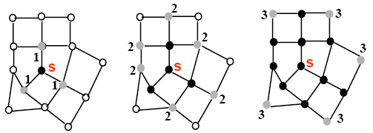
BFS (Intuition)
Algorithms
Graph Introduction → <number>

Slide 42
BFS: The Code
BFS(G, s) {
initialize vertices;
Q = {s};
while (Q not empty) {
u = Dequeue(Q);
for each v adjacent to u do {
if (color[v] == WHITE) {
color[v] = GRAY;
d[v] = d[u] + 1;// compute d[]
p[v] = u; // build BFS tree
Enqueue(Q, v);
}
}
color[u] = BLACK;
}
}
Algorithms
Graph Introduction → <number>

Slide 43
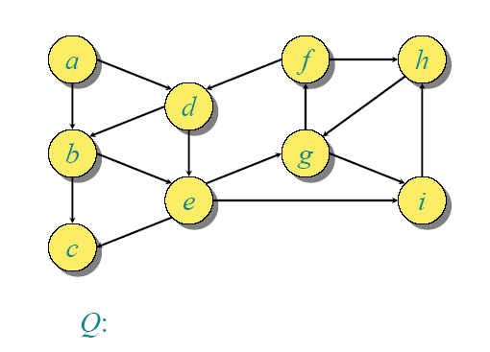
BFS Example
Algorithms
Graph Introduction → <number>

Slide 44
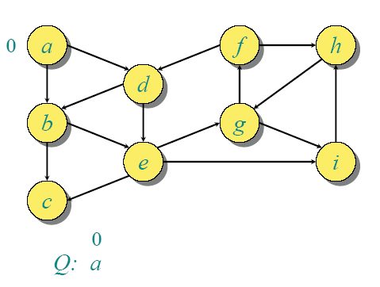
BFS Example
Algorithms
Graph Introduction → <number>

Slide 45
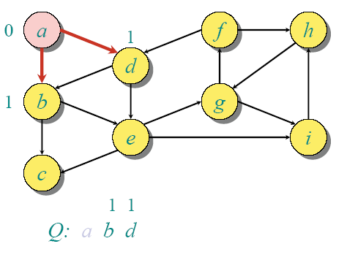
BFS Example
Algorithms
Graph Introduction → <number>

Slide 46
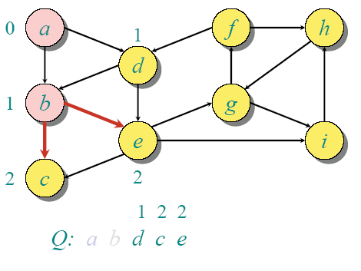
BFS Example
Algorithms
Graph Introduction → <number>

Slide 47
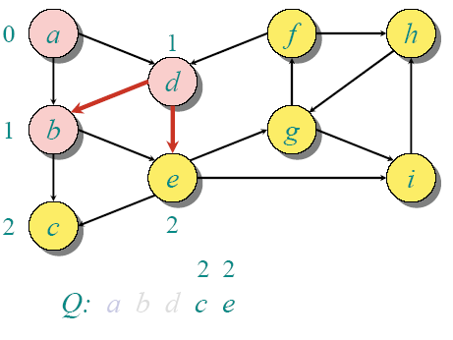
BFS Example
Algorithms
Graph Introduction → <number>

Slide 48
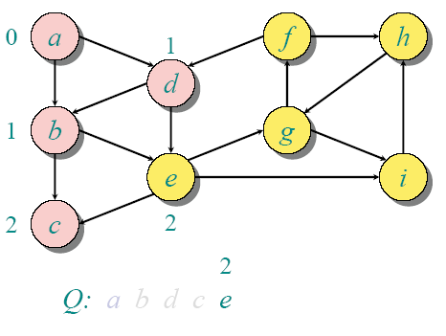
BFS Example
Algorithms
Graph Introduction → <number>

Slide 49
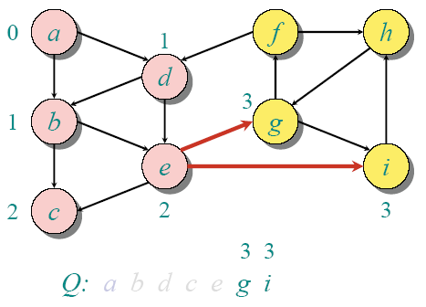
BFS Example
Algorithms
Graph Introduction → <number>

Slide 50
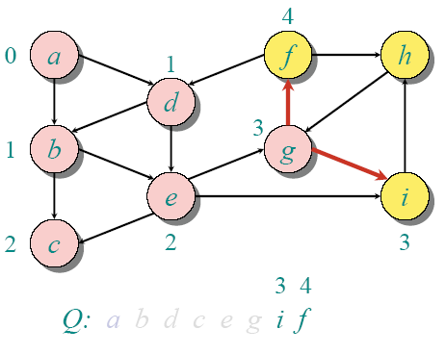
BFS Example
Algorithms
Graph Introduction → <number>

Slide 51
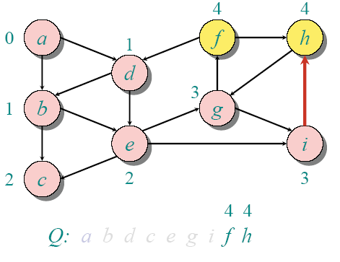
BFS Example
Algorithms
Graph Introduction → <number>

Slide 52
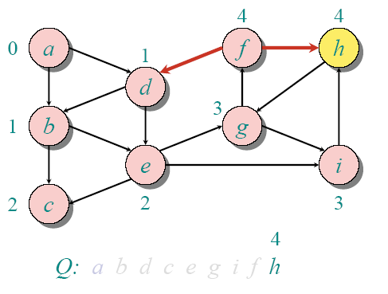
BFS Example
Algorithms
Graph Introduction → <number>

Slide 53
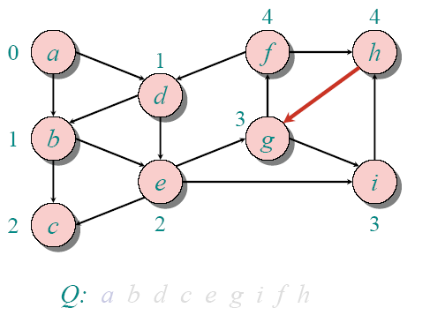
BFS Example
Algorithms
Graph Introduction → <number>

Slide 54
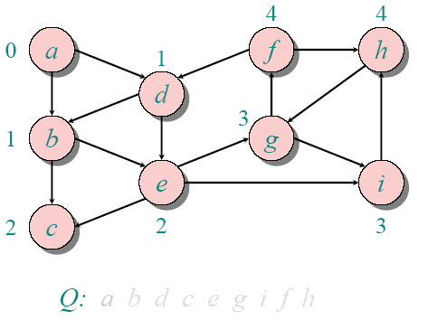
BFS Example
Algorithms
Graph Introduction → <number>

Slide 55
BFS Analysis
initialize : O(n)
Loop: Queue operations and Adjacency checks
Queue operations
  each vertex is enqueued/dequeued at most once. Why?
  each operation takes O(1) time, hence O(n)
Adjacency checks
  adjacency list of each vertex is scanned at most once
  sum of lengths of adjacency lists = O(e)
Total run time of BFS = O(n+e)
Algorithms
Graph Introduction → <number>

Slide 56
Breadth-First Search: Properties
What do we get the end of BFS?
d[v] = shortest-path distance from s to v, i.e. minimum number of edges from s to v, or ∞ if v not reachable from s
  Proof : refer CLRS
a breadth-first tree, in which path from root s to any vertex v represent a shortest path
  Thus can use BFS to calculate shortest path from one vertex to another in O(n+e) time, for unweighted graphs.
Algorithms
Graph Introduction → <number>

Slide 57
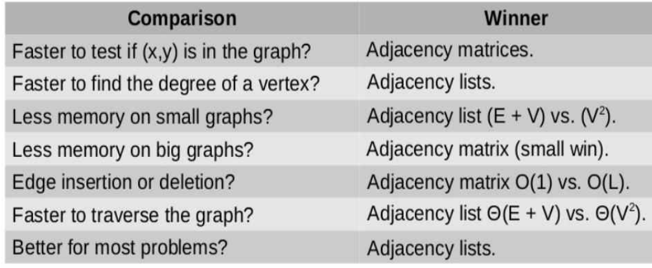
Algorithms
Graph Introduction → <number>

