Slide 1
CSC2105: Algorithms
Greedy Method

Slide 2
Optimization Problem
An optimization problem is one in which you want to find, not just a solution, but the best solution
A “greedy algorithm” sometimes works well for optimization problems
A greedy algorithm works in phases. At each phase:
  You take the best you can get right now, without regard for future consequences
  You hope that by choosing a local optimum at each step, you will end up at a global optimum
Greedy → <number>

Slide 3
The Greedy Method
The greedy method is a general algorithm design paradigm, built on the following elements:
  configurations: different choices, collections, or values to find
  an objective function: a score assigned to configurations, which we want to either maximize or minimize
It is usually used for optimization problem. That is, problem that required to find a best solution. In making a decision, a greedy algorithm always chooses the option that looks best at the moment.
It works best when applied to problems with the greedy-choice property: A globally-optimal solution can always be found by a series of local improvements from a starting configuration.
Greedy → <number>

Slide 4
Greedy Steps
On each step in the algorithm, the choice must be:
  Feasible - i.e. it satisfies the problems constraints.
  Locally optimal – i.e. it has to be the best local choice among all feasible choices available at the step.
  Irrevocable – i.e. once made, it cannot be changed on subsequent steps of the algorithm.
“Greed, for lack of a better word, is good! Greed is right! Greed works!”
Greedy → <number>

Slide 5
Designing Greedy Algorithm
Cast the optimization problem as one in which we make a choice and are left with one subproblem to solve
Prove that there is always an optimal solution to the original problem that makes the greedy choice, so that the greedy choice is always safe.
Demonstrate optimal substructure by showing that, having made the greedy choice, what remains is a subproblem with the property that if we combine an optimal solution to the subproblem with the greedy choice we have made, we
arrive at an optimal solution to the original problem.
Greedy-choice property and optimal substructure are the two key ingredients to ensure solution to optimization problem
Greedy → <number>

Slide 6
General form of Greedy Method
In general, a greedy algorithm is in the form:
    Let A be the empty set;
    Repeat
      Choose the “best” c such that
      A +{c} is a feasible solution;
      Insert c into A;
    Until A is a solution.
We call c a candidate.
If a set of candidate A could be extended to a solution, then we say that A is feasible.
A feasible set is promising if it could be extended to the optimal solution.
Greedy → <number>

Slide 7
Some Greedy Algorithms
Activity Selection Problem
Fractional knapsack algorithm
Huffman codes
Kruskal's MST algorithm
Prim's MST algorithm
Dijkstra's SSSP algorithm
Greedy → <number>

Slide 8
An Activity Selection Problem
(Conference Scheduling Problem)
Input: A set of activities S = {a₁,…, a_{n}}
Each activity has start time and a finish time
  a_{i}=(s_{i}, f_{i})
Two activities are compatible if and only if their time does not overlap
Output: a maximum-size subset of mutually compatible activities

Slide 9
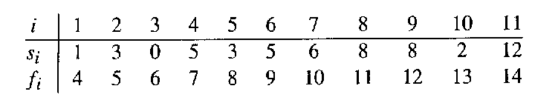
The Activity Selection Problem
Here are a set of start and finish times
What is the maximum number of activities that can be completed?
  {a₃, a₉, a₁₁} can be completed
  But so can {a₁, a₄, a_{8’} a₁₁} which is a larger set
  But it is not unique, consider {a₂, a₄, a_{9’} a₁₁}

Slide 10
Interval Representation

Slide 11
0 1 2 3 4 5 6 7 8 9 10 11 12 13 14 15

Slide 12
0 1 2 3 4 5 6 7 8 9 10 11 12 13 14 15

Slide 13
Early Finish Greedy
Select the activity with the earliest finish
Eliminate the activities that could not be scheduled
Repeat!

Slide 14
0 1 2 3 4 5 6 7 8 9 10 11 12 13 14 15

Slide 15
0 1 2 3 4 5 6 7 8 9 10 11 12 13 14 15

Slide 16
0 1 2 3 4 5 6 7 8 9 10 11 12 13 14 15

Slide 17
0 1 2 3 4 5 6 7 8 9 10 11 12 13 14 15

Slide 18
0 1 2 3 4 5 6 7 8 9 10 11 12 13 14 15

Slide 19
0 1 2 3 4 5 6 7 8 9 10 11 12 13 14 15

Slide 20
0 1 2 3 4 5 6 7 8 9 10 11 12 13 14 15

Slide 21
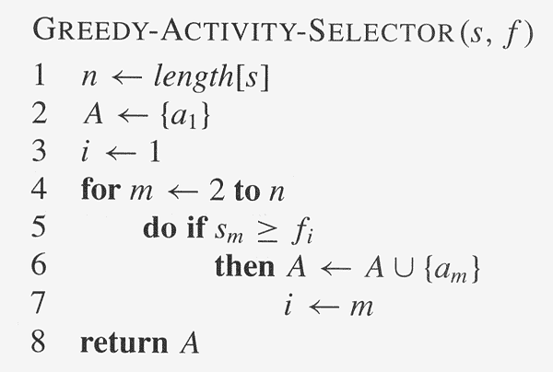
Assuming activities are sorted by finish time

Slide 22
Why it is Greedy?
Greedy in the sense that it leaves as much opportunity as possible for the remaining activities to be scheduled
The greedy choice is the one that maximizes the amount of unscheduled time remaining

Slide 23
Why this Algorithm is Optimal?
We will show that this algorithm uses the following properties
  The problem has the optimal substructure property
  The algorithm satisfies the greedy-choice property
Thus, it is Optimal

Slide 24
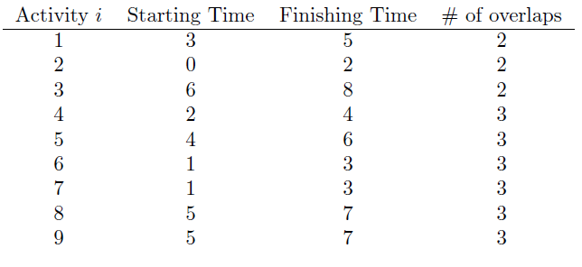
Exercise
{2, 3, 4, 5}

Slide 25
Making Change
Problem: A dollar amount to reach and a collection of coin amounts to use to get there.
Configuration:
Input: Given an integer S. A solution is a set of coins such that the total is equal S. The coins must be drawn from { 1, 5, 10, 25} cents.
Output: The solution which has minimum number of coins.
Objective function: Minimize number of coins returned.
Greedy solution:
  Let A be the empty set.
  Repeat
  let c be the highest valued coin such that
  c + total_amount (A) <= S.
  Insert c into A.
  Until total_amount ( A ) = S.
S=36 {25,10,1}
S=24 {10,10,1,1,1,1}
Greedy → <number>

Slide 26
Claim: in the greedy algorithm, the set A is always promising.
Proof by induction.
First note that A is always feasible. This is because we can always use the 1-cent coin to top-up.
basis: A= ø is promising.
hypo: A is promising.
step:
Suppose A is promising. Let c be the highest candidate. We want to show by contradiction that A+{c} is promising. If A +{c} is not promising,
since A is promising, then there exist a set B of coins, such that
  (a) A+B is promising;
  (b) all coins in B is smaller than c, and
  (c) total value of B is larger or equal to c.
Suppose c=5, then from (b) & (c), the only possible B is
  {1,1,1,1,1}, {1,1,1,1,1,1},.......
  In each case, we can replace a number of coins by a 5-cents coin.
  This contradict the fact that A+B is promising.
Greedy → <number>

Slide 27
Claim: in the greedy algorithm, the set A is always promising.
(a) A+B is promising;
(b) all coins in B is smaller than c, and
(c) total value of B is larger or equal to c.
  Suppose c=10, then from (b) & (c) the only possible B is
  {5,5}, {5,1,1,1,1,1}, {5,5,5,...}
  In each case, we can replace a number of coins by a 10-cents coin.
  This contradict the fact that A+B is promising.
Suppose c=25, then from (b) & (c) the only possible B is
  {10,10,5}, {10,10,10}, {10,5,5,5},....
  If B contains at most two 10-cents, then by (c), there must be sufficient coins in B to sum more than or equal to 25 cents. In fact, there are coins to make up exactly 25 cents. These coins can be replaced by a single 25-cents coin.
  This contradicts the fact that A+B is promising.
  If B contains three or more 10-cents coins, we can replace 3 of them with 2 coins: 25-cents and 5-cents.
  Thus contradicting the fact that A+B is promising.
Greedy → <number>

Slide 28
Greedy Algorithm Failure
In some (fictional) monetary system, “krons” come in 1 kron, 7 kron, and 10 kron coins
Using a greedy algorithm to count out 15 krons, you would get
  A 10 kron piece
  Five 1 kron pieces, for a total of 15 krons
  This requires six coins
A better solution would be to use two 7 kron pieces and one 1 kron piece
  This only requires three coins
The greedy algorithm results in a solution, but not in an optimal solution
Notes:
4

Slide 29
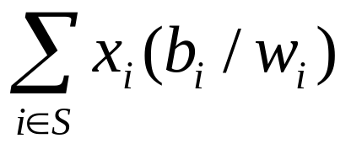
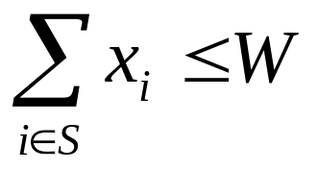
The Fractional Knapsack Problem
Given: A set S of n items, with each item i having
  b_{i} - a positive benefit
  w_{i} - a positive weight
Goal: Choose items with maximum total value but with weight at most W.
  The value of an item is its benefit/weight ratio.
If we are allowed to take fractional amounts, then this is the fractional knapsack problem.
  let x_{i} denote the amount we take of item i, 0 ≤ x_{i} ≤ w_{i}
  Objective: maximize
  Constraint:
Greedy → <number>

Slide 30

Knapsack Problem
There are n different items in a store
Item i :
  weighs w_{i} pounds
  worth $v_{i}
A thief breaks in
Can carry up to W pounds in his knapsack
What should he take to maximize the value?

Slide 31
0-1 vs. Fractional Knapsack
0-1 Knapsack Problem:
  the items cannot be divided
  thief must take entire item or leave it behind
  Greedy strategy does not work for the 0-1 knapsack problem
Fractional Knapsack Problem:
  thief can take partial items
  for instance, items are liquids or powders
  solvable with a greedy algorithm

Slide 32

Example
Given: A set S of n items, with each item i having
  b_{i} - a positive benefit
  w_{i} - a positive weight
Goal: Choose items with maximum total value but with weight at most W.
“knapsack”
Solution:
1 ml of 5
2 ml of 3
6 ml of 4
1 ml of 2
Items:
1
2
3
4
5
Weight:
4 ml
8 ml
2 ml
6 ml
1 ml
Benefit:
$12
$32
$40
$30
$50
10 ml
Value:
3
4
20
5
50
($ per ml)
Greedy → <number>

Slide 33
The Fractional Knapsack Algorithm
Algorithm fractionalKnapsack(S, W)
Input: set S of items with benefit b_{i} and weight w_{i}; maximum weight W
Output: amount x_{i} of each item i to maximize benefit with weight at most W
for each item i in S
  x_{i} ← 0
  v_{i} ← b_{i} / w_{i} {value}
  w ← 0 {total weight}
  while w < W
  remove item i with highest v_{i}
  x_{i} ← min{w_{i} , W - w}
  w ← w + min{w_{i} , W - w}
Greedy choice: Keep taking item with highest value (benefit / weight ratio b_{i} / w_{i} )
Run time: O(n log n). Why?
Use a max-heap priority queue
Greedy → <number>

Slide 34
Example
Item | Weight | Benefit
A | 12 | 60
B | 25 | 100
C | 15 | 90
Capacity = 35

Slide 35
Task Scheduling
Given: a set T of n tasks, each having:
  A start time, s_{i}
  A finish time, f_{i} (where s_{i} < f_{i})
Goal: Perform all the tasks using a minimum number of “machines.”
Machine 3
Machine 2
Machine 1
1
2
3
4
5
6
7
8
9
Greedy → <number>

Slide 36
Example
Given: a set T of n tasks, each having:
  A start time, s_{i}
  A finish time, f_{i} (where s_{i} < f_{i})
  [1,4], [1,3], [2,5], [3,7], [4,7], [6,9], [7,8] (ordered by start)
Goal: Perform all tasks on minimum number of machines
Machine 3
Machine 2
Machine 1
1
2
3
4
5
6
7
8
9
Greedy → <number>

Slide 37
Task Scheduling Algorithm
Algorithm taskSchedule(T)
Input: set T of tasks with start time s_{i} and finish time f_{i}
Output: non-conflicting schedule with minimum number of machines
m ← 0 {no. of machines}
  while T is not empty do
  remove task i with smallest s_{i}
  if there’s a machine j for i then
  schedule i on machine j
  else
  m ← m + 1
  schedule i on machine m
Greedy choice: consider tasks by their start time and use as few machines as possible with this order.
  Run time: O(n lg n). Why?
Correctness: Suppose there is a better schedule.
  We can use k-1 machines
  The algorithm uses k
  Let i be first task scheduled on machine k
  Machine i must conflict with k-1 other tasks
  But that means there is no non-conflicting schedule using k-1 machines
Greedy → <number>

