Slide 1
Impact of tweets over stock market
Project Group 2 - Team members
Shonit Gangoly
Mehul Vishal Sadh
Xinsheng Li
Shraddha Ingale
Shivani Shivanand

Slide 2
PROBLEM DEFINITION
Analyzing tweet sentiments of influential celebrities.
Determining the correlation between those tweets and stock market trends.
2

Slide 3
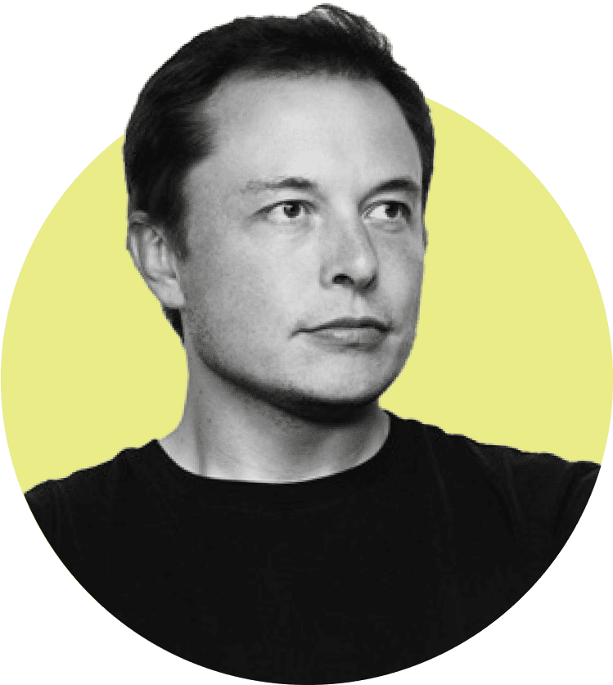

Gamestonk!!
- Elon Musk
This tweet by Elon Musk had a great impact on people’s stock trading behaviour.
It led GameStop’s stock price jump up to 92.7% in a single day.

Slide 4
TOOLS
DATA COLLECTION
Tweets: twint API (Twitter Intelligence)
Yahoo Finance API: Stock Market Data
EXPLORATORY DATA ANALYSIS
Data Preprocessing: numpy, pandas
Data Visualization: plotly
Sentiment Analysis: NLTK VaderSentiment

Slide 5
MEASURING INFLUENCE
Correlating stock trading behaviour

Slide 6
METHODOLOGY
DATA PREPROCESSING
Processing data to fit in data structures
EDA
Exploratory Data Analysis (EDA) to find insights in the collected data.
DATA MODEL
Building Machine Learning models to find correlation in data
RESULTS
Generating inferences from the data models

Slide 7
DATA PREPROCESSING
Tweet Data
Processing Text Data of accumulated tweet data to fit in our data frames.
Ordering tweets according to time of being posted.
Stock Data
Processing Stock Data and dropping unwanted columns from data frames.
Ordering Stock data based on time.

Slide 8
EXPLORATORY DATA ANALYSIS
Tweet Sentiment Analysis
Determining most tweeted words
Generating WordCloud

Slide 9
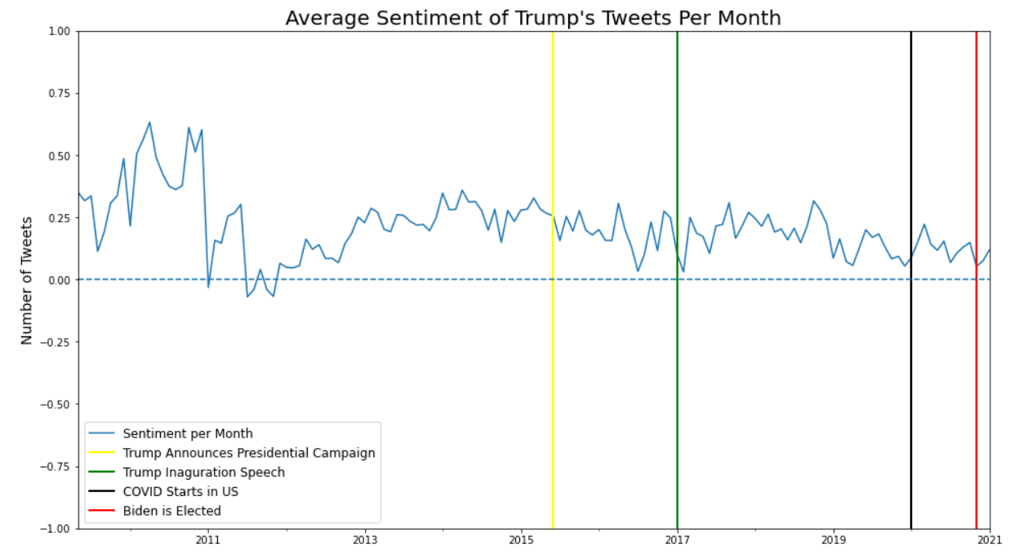
TWEET SENTIMENT ANALYSIS

Slide 10
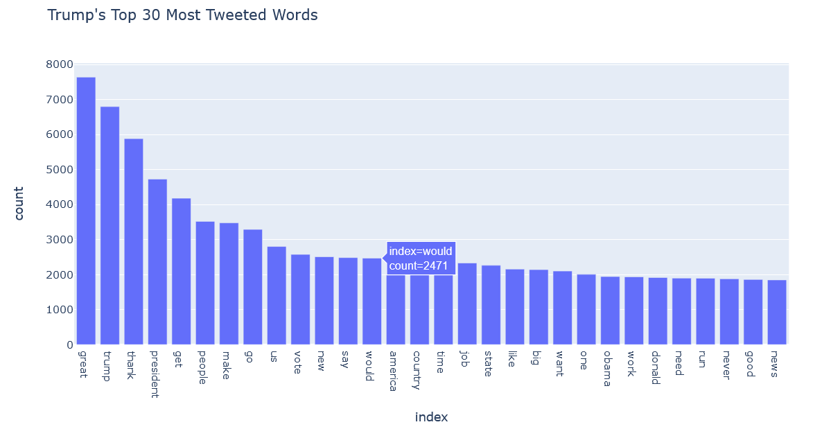
FREQUENTLY TWEETED WORDS

Slide 11
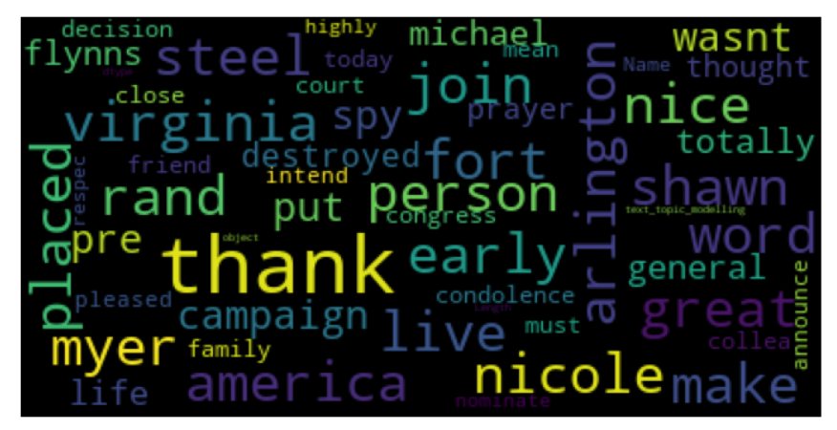
WORD CLOUD

Slide 12

DATA MODELS
Long Short Term Memory Regression
LSTM Regression with word vectors + 30 min Price History inputs
Naïve Bayes Classifier
Support Vector Machine
Random Forest Regression

Slide 13
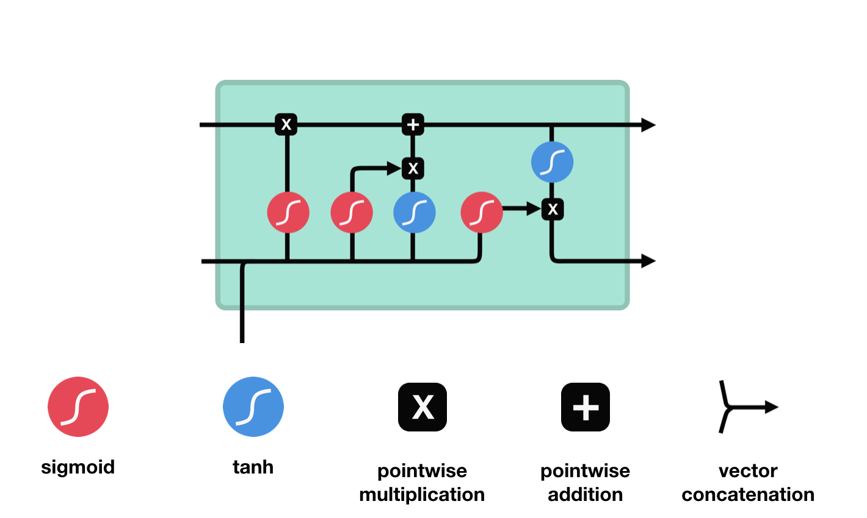
LONG SHORT TERM MEMORY
Fig. Illustrated Guide to LSTM’s and GRU’s: A step by step explanation
https://towardsdatascience.com/illustrated-guide-to-lstms-and-gru-s-a-step-by-step-explanation-44e9eb85bf21

Slide 14
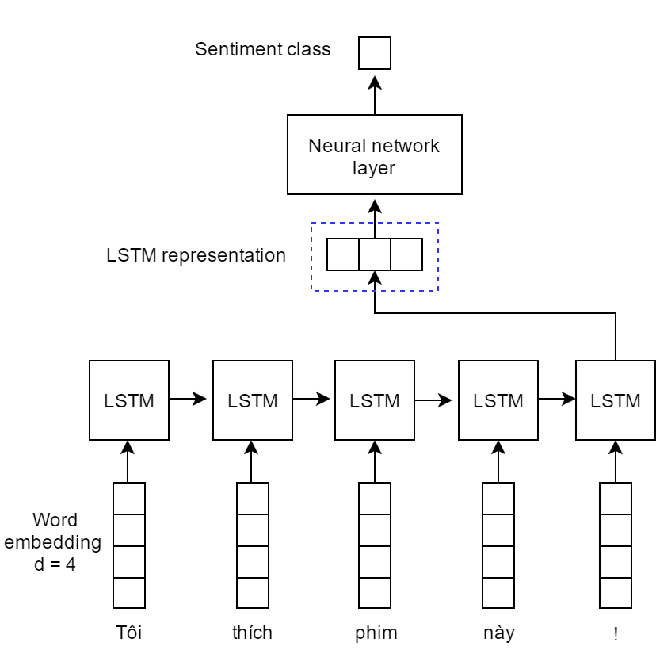
LSTM WITH WORD VECTORS
Fig. Illustration of our LSTM model for sentiment classification.
https://www.researchgate.net/figure/Illustration-of-our-LSTM-model-for-sentiment-classification-Each-word-is-transfered-to-a_fig2_321259272

Slide 15
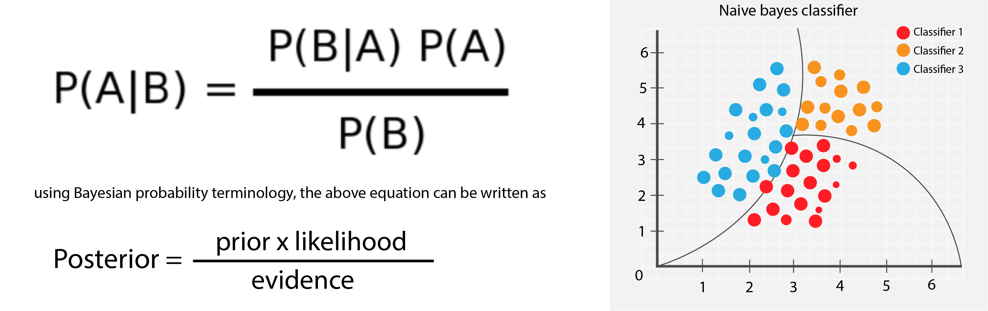
NAÏVE BAYES CLASSIFIER
Fig. An Introduction to Naïve Bayes Classifier
https://towardsdatascience.com/introduction-to-na%C3%AFve-bayes-classifier-fa59e3e24aaf

Slide 16
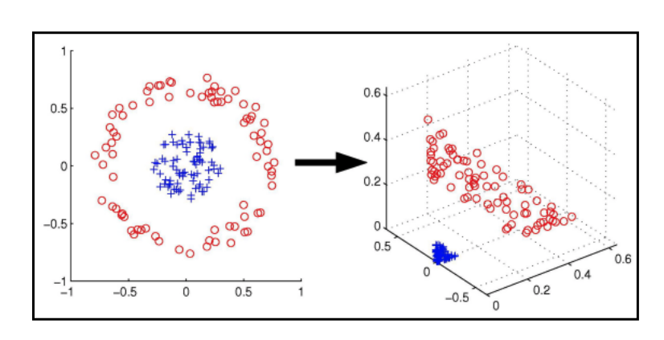
SUPPORT VECTOR MACHINE
Fig. Support Vector Machines Explained
https://medium.com/@zachary.bedell/support-vector-machines-explained-73f4ec363f13

Slide 17

RANDOM FOREST REGRESSION
Fig. Diagram of a random decision forest https://en.wikipedia.org/wiki/Random_forest

Slide 18
PERFORMANCE COMPARISON OF DATA MODELS
Model | Precision Score | Recall Score | F1 Score | Final Accuracy
LSTM Regression | 0.39 | 0.40 | 0.39 | 39.94%
LSTM Vector Input | 0.38 | 0.33 | 0.34 | 33.11%
Naïve Bayes | 0.38 | 0.41 | 0.37 | 41.05%
SVM | 0.36 | 0.40 | 0.35 | 40.22%
Random Forest | 0.31 | 0.39 | 0.31 | 39.11%

Slide 19
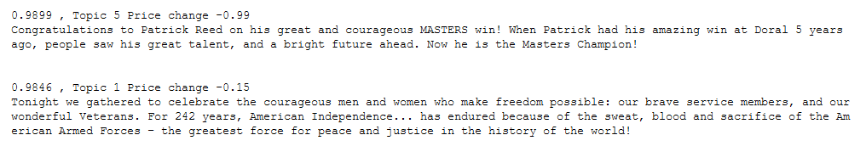
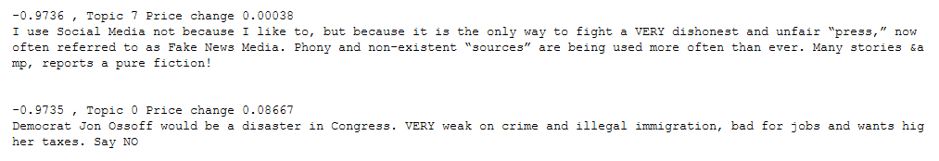
RESULTS
Top tweets with positive sentiment value and correlation with stock price (Output)
Sentiment Score
Stock Price Change
Top tweets with negative sentiment value and correlation with stock price (Output)

Slide 20
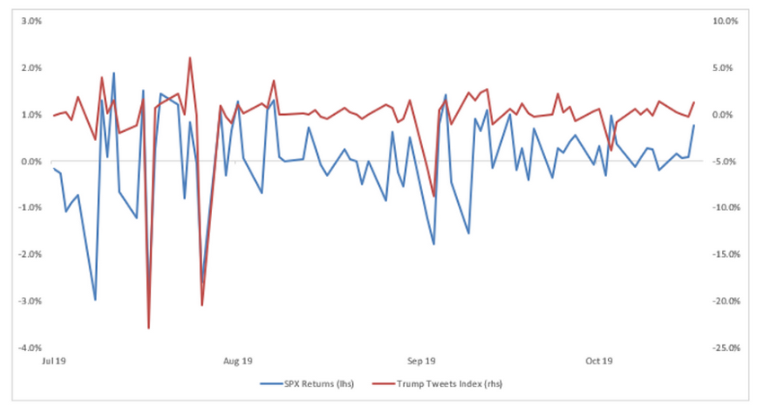
RESULTS

Slide 21
THANKS!
Any questions?

