Slide 1
Introduction to HTML
Activities adapted from msuweb.montclair.edu/~maciakl/labs/HTML LAB.pdf

Slide 2
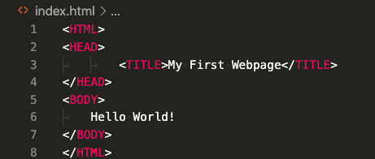
Your First Website
Insert the following text:

Slide 3
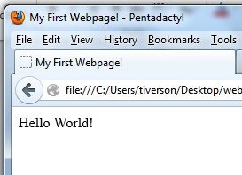
View the Site
Open your favorite browser
I’ll use Firefox
In the browser
File > Open File > Desktop > website.html
Title
Contents of Body

Slide 4
Main Parts of a Page
<HTML></HTML>
Starts and ends the page
<TITLE></TITLE>
Page title
Must be in the header
<HEAD></HEAD>
Contains meta-info about the page
<BODY></BODY>
Page content

Slide 5
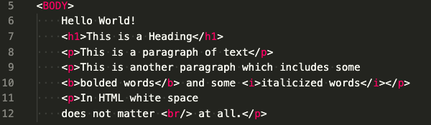
More HTML

Slide 6
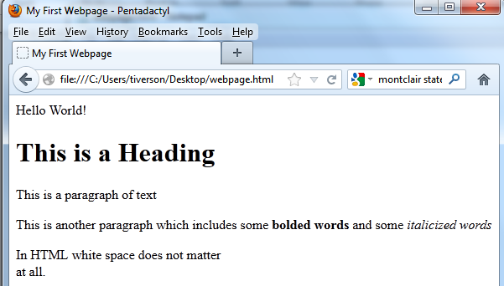

Slide 7
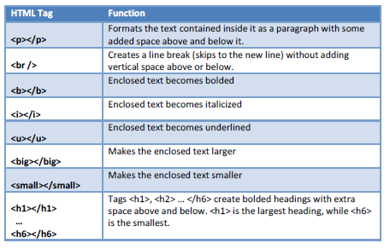
Types of Effects

Slide 8
Important Points
HTML tags come in pairs
“open” and “close”
like parentheses
All tags are a single word
Upper/lower case doesn’t matter
Sometimes extra information is included in tag!

Slide 9
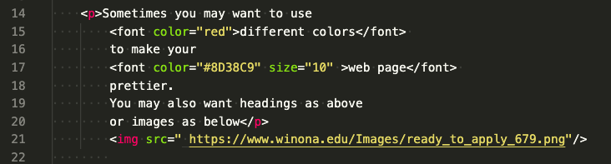
Example: Extra Information
Insert the following into the body:

Slide 10
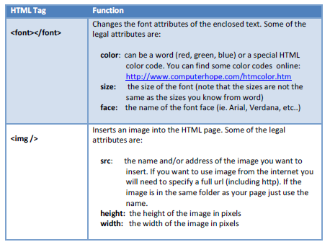
Extra Information for Font and IMG

Slide 11

Links
Add the following lines to the body of your page
Address
Text

Slide 12
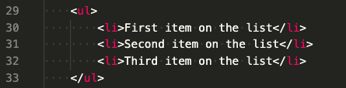
Bulleted Lists
Add the following to your page
Starts List
List Item
Ends List

Slide 13
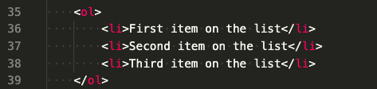
Numbered List
Add the following to your page

Slide 14
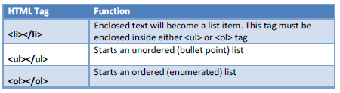
List Info

Slide 15
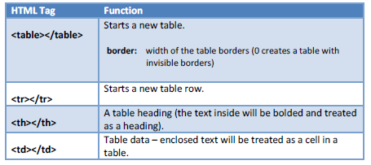
Table Information

Slide 16
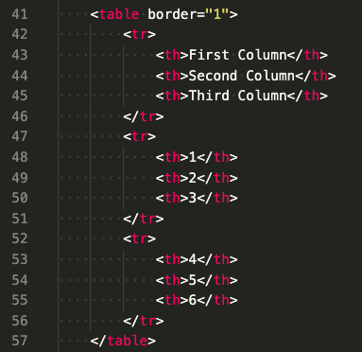
Table Example
Add the following to your page

