Slide 1
Best Priced Indian Stocks
Dec 15, 2022, 8PM

Slide 2
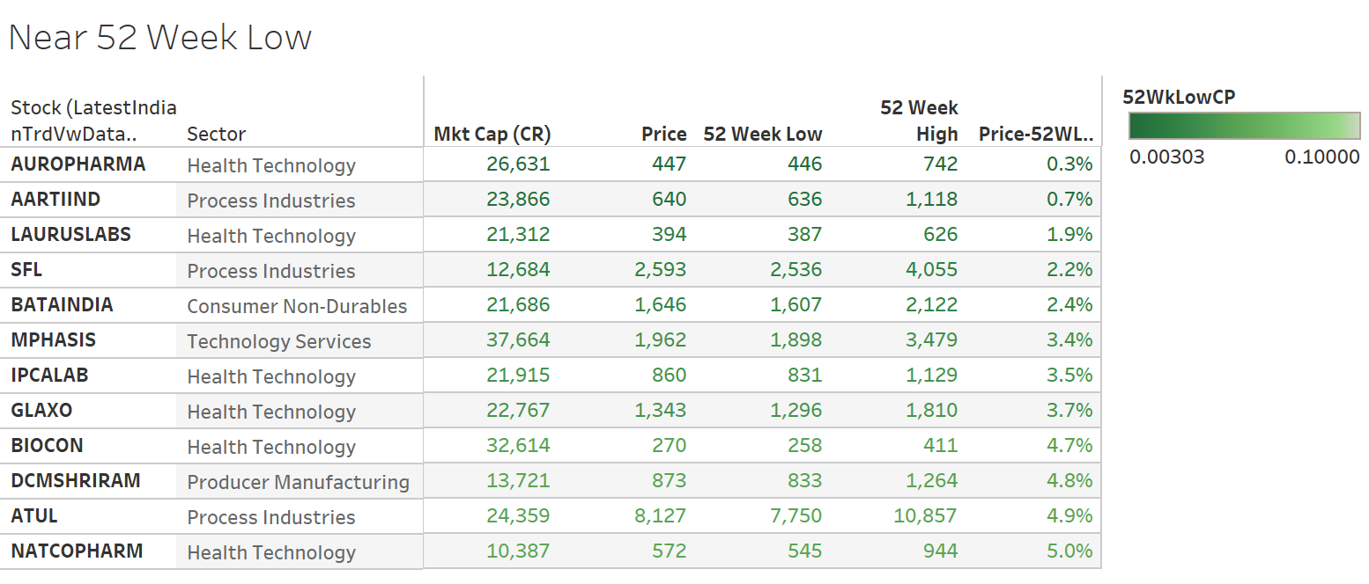

Slide 3
