Slide 1
Explainable deep learning models for Classification of Ventriculomegaly using Fetal Brain MRI Images
Team Number:CB1
AMENU4CSE20163 : SHOAIB AKHTAR
AMENU4CSE20222 : DEVU PAWAN ASHUTOSH
AMENU4CSE20225 : G YESHWANTH REDDY
AMENU4CSE20232 : HARDIK KUMAR SINGH
Guide : Dr. Simi S.
Amrita School of Computing | Amrita Vishwa Vidyapeetham | Amritapuri

Slide 2
Introduction
Ventriculomegaly is a medical condition characterized by the enlargement of the fluid-filled cavities (ventricles) within the brain. These ventricles are a part of the brain's natural anatomy and are responsible for producing and circulating cerebrospinal fluid (CSF), which helps protect and nourish the brain.
It can be challenging to accurately diagnose mild cases of ventriculomegaly, and even experienced radiologists might make unforced errors.
This project would help reduce the number of false positives and false negatives in the case of ventriculomegaly.

Slide 3
Motivation
Detecting ventriculomegaly early allows for prompt intervention and treatment. Depending on the underlying cause and severity of the condition, healthcare professionals can implement appropriate measures to address the issues, such as surgical interventions, shunt placement, or other medical therapies.
A pregnant woman is having a routine ultrasound scan. The radiologist notices that the baby's lateral ventricles are slightly enlarged. However, the enlargement is mild, and the radiologist is unsure whether it is significant.
The radiologist uses an explainable deep learning model to help with the diagnosis. The model analyzes the ultrasound images and predicts that the baby has a high risk of ventriculomegaly highlighting the specific features of the ultrasound images that are most predictive of ventriculomegaly.
In this scenario, the explainable deep learning model helped the radiologist to make a more accurate and timely diagnosis of fetal ventriculomegaly. This could lead to better outcomes for the baby and the family.

Slide 4
Background Study/Related Work
Title &year | Problem | Contributions | Limitations | Open problems/Future work
Using deep‐learning algorithms to classify fetal brain ultrasound images as normal or abnormal Year - 2020 | Fetal ventriculomegaly is a condition in which the lateral ventricles of the brain are enlarged. It can be challenging to accurately diagnose ventriculomegaly. Develop explainable deep learning models that can accurately and classify fetal ventriculomegaly from ultrasound images. | The authors propose a deep learning method to classify fetal brain ultrasound images as normal or abnormal. Their method is based on a convolutional neural network. The authors trained their CNN on a dataset of over 29,000 fetal brain ultrasound images. Their method achieved an accuracy of 96.3%. | It was conducted on a single-center dataset. This means that the method may not perform as well on data from other medical centers. the method does not yet support other diagnostic planes. | Future work should focus on developing multicenter datasets and expanding the algorithm to support other diagnostic planes. Investigate the use of transfer learning to improve the performance of the model on multicenter datasets.
Explainable Deep Learning for Fetal Brain Ventriculomegaly Classification Year - 2021 | Develop an explainable deep learning model that can accurately and reliably classify fetal brain ventriculomegaly from ultrasound images, while also providing insights into its predictions. This model could be used to improve the accuracy and reliability of diagnosis, and to help clinicians make better decisions about the care of their patients. | The authors evaluated their model on a held-out test set of over 2,500 images. Their model achieved an accuracy of 97.3%. The authors also evaluated the explainability of their model. They found that the model was able to provide accurate and informative explanations for its predictions. | it was conducted on a single-center dataset. This means that the model may not perform as well on data from other medical centers. It is not trained to classify other fetal brain abnormalities | Investigate the use of transfer learning to improve the performance of the model on multicenter datasets. Develop a method to evaluate the explainability of the model on real-world clinical data. Develop a prototype system that can be used by clinicians in a clinical setting.

Slide 5
Background Study/Related Work
Title &year | Problem | Contributions | Limitations | Open problems/Future work
Fetal Ventriculomegaly and Hydrocephalus What Shouldn't be Missed on Imaging Year - 2021 | Developing an accurate and reliable deep learning model for the classification of fetal brain ventriculomegaly from ultrasound images However, existing deep learning models are often complex and difficult to interpret, making it difficult for clinicians to understand why the model makes the predictions that it does. | The authors highlight the importance of using a standardized approach to measuring the lateral ventricles on ultrasound images. The authors discuss the various differential diagnoses of fetal ventriculomegaly, including choroid plexus cysts, Dandy-Walker malformation, and Chiari II malformation. | The paper is focused on imaging findings, so it does not discuss the clinical aspects of fetal ventriculomegaly in detail. It does not discuss the challenges of diagnosing fetal ventriculomegaly in preterm fetuses and fetuses with multiple gestation. | Develop new imaging techniques for the diagnosis and assessment of fetal ventriculomegaly, such as diffusion tensor imaging (DTI) and tractography. Develop explainable deep learning models that can provide insights into their predictions
U-Net and Its Variants for Medical Image Segmentation: A Review of Theory and Applications Year - 2021 | Medical image segmentation is the task of identifying and labeling different anatomical structures in medical images. This task is essential. However, manual image segmentation is time-consuming and labor-intensive, and it can be difficult to achieve high accuracy and reproducibility. | U-Net models can generalize well to new data. They can segment small and rare lesions, which can be difficult to segment using traditional methods. U-Net models can be used to segment multiple anatomical structures simultaneously. | The paper is a review article, so it does not present any new original research. Additionally, the paper does not discuss the limitations of U-Net such as its sensitivity to hyperparameters and their need for large amounts of training data. | Develop U-Net variants that are more explainable, so that clinicians can better understand why the model makes the predictions that it does. It that can be used to segment multiple anatomical structures simultaneously.

Slide 6
Background Study/Related Work
Title &year | Problem | Contributions | Limitations | Open problems/Future work
Detecting and Classifying Fetal Brain Abnormalities Using Machine Learning Techniques Year - 2018 | Fetal brain abnormalities can have serious consequences for the development and well-being of the child. Early detection and diagnosis of these abnormalities is essential for ensuring the best possible outcomes. However, traditional methods of fetal brain imaging, such as ultrasound, can be difficult to interpret, and even experienced radiologists can make mistakes. | The paper proposes a machine learning method for detecting and classifying fetal brain abnormalities using ultrasound images. The method is based on a convolutional neural network. The authors trained their CNN on a dataset of near to 30,000 fetal brain ultrasound images, including both normal and abnormal images. The images were collected from a single medical center. | The method was trained on a single-center dataset. This means that the method may not perform as well on data from other medical centers. The method does not yet support other diagnostic planes. In addition to the axial plane, fetal brain ultrasounds are also acquired in the coronal and sagittal planes. | In addition, future work could investigate the use of transfer learning to improve the performance of the model on multicenter datasets. Finally, future work could evaluate the method on a dataset of fetal brain ultrasound images with a wider range of abnormalities, such as microcephaly, encephalocele, and agenesis of the corpus callosum.

Slide 7
Project Contributions
Accurate Classification for Early Detection:
Objective: The primary goal of the project is to develop an automated classification system for ventriculomegaly using deep learning algorithms trained on human brain MRI images.
Outcome: The system achieves high accuracy and sensitivity in identifying ventriculomegaly in its early stages, enabling timely intervention and treatment. The automated classification contributes to efficient and precise diagnosis, reducing the reliance on manual interpretation and potentially improving patient outcomes.
2. Explainable AI (XAI) Models for Interpretability:
Objective: The project incorporates Explainable AI (XAI) models to enhance the interpretability of the classification results. The objective is to provide healthcare professionals and end-users with transparent insights into the decision-making process of the algorithm.
Outcome: The XAI models, such as LIME (Local Interpretable Model-agnostic Explanations) generate human-understandable explanations for the classification decisions. This ensures that the model's predictions are not treated as a "black box," allowing clinicians to trust and validate the results. Interpretability is crucial for gaining insights into the features contributing to the classification, aiding in both diagnosis and treatment planning.

Slide 8
Improvements Based on First Review(If any)
Based on the feedback received during the first review, our team was suggested to shift our focus from classification and segmentation to XAI implementation.
Based on this, we implemented a basic CNN model which was simple yet efficient in classification and we started with the implementation of 2 XAI models namely LIME (Local Interpretable Model-Agnostic Explanations.) and GRADCAM (gradient-weighted class activation mapping) .

Slide 9
Progress After First Review
XAI model was implemented on the created CNN classification model.
XAI will help indicate using image data that why a certain decision in classification was taken and the areas which were critical in the decision-making process.
LIME works by perturbing input instances, training a simplified model on these perturbed instances, and using that model to provide interpretable explanations for specific predictions.
Grad-CAM highlights the important regions in an input image that contribute the most to a neural network's decision. It does this by leveraging the gradients of the target class with respect to the final convolutional layer of the neural network.

Slide 10
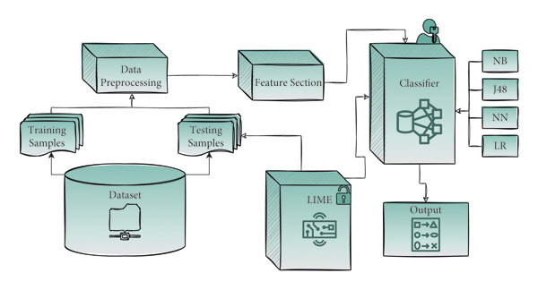
High Level Design : LIME

Slide 11
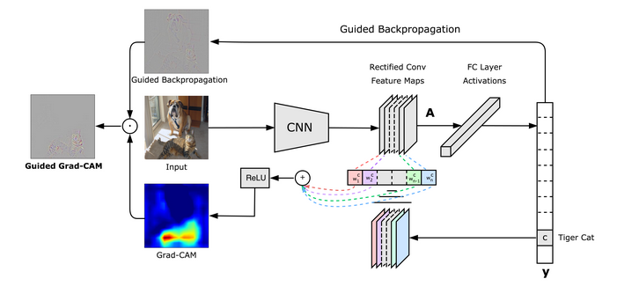
High Level Design : GRADCAM

Slide 12
Algorithm 1 : LIME
When applying LIME (Local Interpretable Model-agnostic Explanations) to a Convolutional Neural Network (CNN) image classifier model, the process involves creating interpretable approximations for the decision boundaries of the CNN. Here's a step-by-step explanation of how LIME works in the context of a CNN image classifier:
Selecting an Image Instance:
Choose a specific image from your dataset for which you want an explanation. This is the image that the CNN has processed and made a prediction on.
Perturbation and Sampling:
Perturb the pixels of the selected image to create a dataset of perturbed images. Introduce small changes to the pixel values to generate a diverse set of images that capture local variations in the data.
Model Prediction:
Pass each perturbed image through the CNN image classifier to obtain predictions. The model's predictions (probability scores for each class) for the perturbed images serve as the labels for the next step.
Building an Interpretable Proxy Model:
Choose a simple, interpretable model (e.g., linear regression) and train it on the perturbed images using the model predictions as labels. This interpretable proxy model is intended to approximate the behavior of the black-box CNN locally.

Slide 13
Algorithm 1 : LIME
5. Feature Importance Weights:
Extract the coefficients or feature importance weights from the trained interpretable proxy model. In the context of images, these weights may correspond to the importance of different regions or pixels in the image.
6. Generating Explanations:
Use the feature importance weights to generate an explanation for the selected image in the context of CNN image classification. Higher weights indicate more influential regions in the image that contributed to the model's decision.
7. Local Interpretability:
The generated explanation provides local interpretability for the CNN image classifier's prediction on the chosen image. It helps users understand which regions or features of the image played a crucial role in the specific decision, making the model's behavior more transparent.
8. Visualizing Explanations:
In the case of images, the explanation is often visualized as a colourmap overlaid on the original image. The colourmap highlights regions that had a significant impact on the model's decision.
In summary, LIME enables the interpretation of individual predictions made by a CNN image classifier by approximating the local decision boundary. It does so by perturbing images, training interpretable proxy models, extracting feature importance weights, and generating explanations that enhance the understanding of the model's behavior on a specific image.

Slide 14
Algorithm 2 : GRADCAM
Grad-CAM (Gradient-weighted Class Activation Mapping) is a technique used to visualize the regions of an input image that are important for the prediction made by a convolutional neural network (CNN). It provides insights into which parts of the input image contribute the most to the model's decision.
Here's a step-by-step explanation of how Grad-CAM works:
Forward Pass:
You start with the forward pass of your CNN, where the input image is passed through the network layer by layer until the final prediction is obtained.
Keep track of the intermediate feature maps generated by convolutional layers.
Gradient Calculation:
Calculate the gradient of the predicted class score with respect to the final convolutional layer's feature maps.
The gradient represents the sensitivity of the predicted score to changes in each feature map.
Global Average Pooling (GAP):
Calculate the average value for each feature map using global average pooling. This reduces the spatial dimensions to 1x1 while retaining the number of channels.
Weighted Sum:
Multiply each channel in the final convolutional layer by its corresponding gradient.
Sum up these weighted feature maps to get a weighted combination.

Slide 15
Algorithm 2 : GRADCAM
5. ReLU Activation:
Apply ReLU activation to the weighted sum. This step ensures that only positive contributions are considered.
6. Weighted Sum with Original Feature Maps:
Multiply each element in the weighted sum by the corresponding element in the original feature map. This step emphasizes the important regions and suppresses the less relevant ones.
7. Visualization:
Resize the obtained heatmap to match the dimensions of the input image.
Overlay the heatmap on the input image to visualize which regions are activated for the predicted class.
In the context of binary image classifiers, Grad-CAM can be applied similarly. The key difference is that in binary classification, there are two classes (positive and negative), and you'll visualize the regions that contribute to the prediction of one of these classes.
When applying Grad-CAM to a CNN for binary image classification, make sure to perform the steps described above for the class of interest. The resulting heatmap will highlight the regions of the input image that are crucial for the model to predict the specified class.

Slide 16
Experimental Setup
Dataset used – Custom Medical Video MRI Dataset comprising of two folders of manually segmented images [I.E.- VM/NOT-VM]
The types of experiments done – LIME-XAI / GRADCAM-XAI
The evaluation metrics used – AUC-ROC Curves

Slide 17
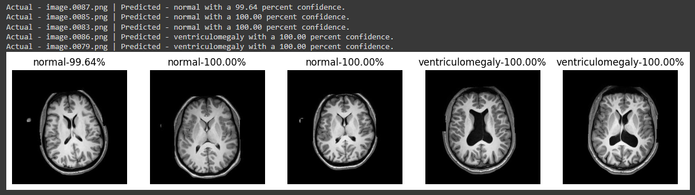
Experiments and Results
CNN classification model

Slide 18
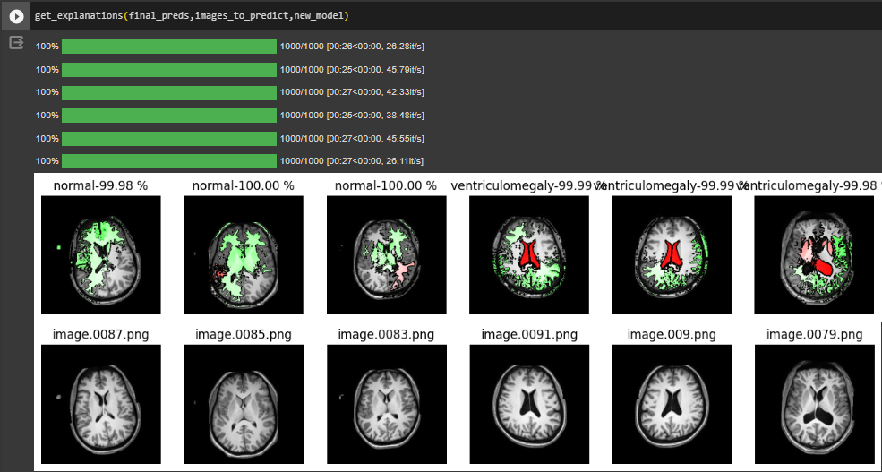
Experiments and Results
LIME-XAI model

Slide 19
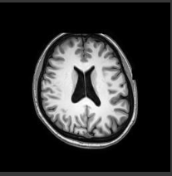
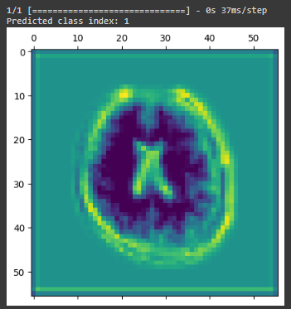
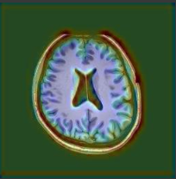
Experiments and Results
GRADCAM-XAI model
Original image Heatmap Superimposed image

Slide 20
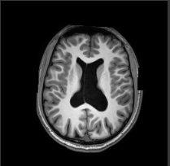
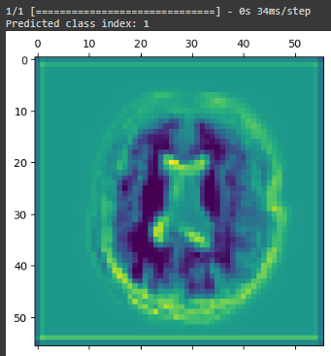
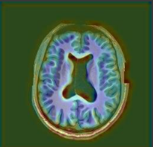
Experiments and Results
GRADCAM-XAI model
Original image Heatmap Superimposed image

Slide 21
Findings
Clearly state your findings/inferences from each of the experiments
LIME -
Finding – LIME may reveal biases in the model by showing which features the model relies on for predictions.
Inference - This can be important in ensuring that the model is not making predictions based on irrelevant information.
Finding - LIME generates local, instance-specific explanations. For each image, you'll get an explanation of why the model made a particular prediction.
Inference - This can be crucial for clinicians to verify whether the model is focusing on clinically relevant features.
Finding - LIME helps visualize the local decision boundaries around a particular instance.
Inference - Examining these boundaries can reveal how slight variations in the input features influence the model's output.
Finding - LIME often employs super-pixel segmentation to generate perturbed versions of the input image.
Inference – By analysing which pixels contribute the most to the model's prediction, you can identify the spatial regions in the image that are most relevant for predicting ventriculomegaly.

Slide 22
Findings
GRADCAM-
Finding - Quantify the contribution of different regions by analysing the pixel values in the Grad-CAM heatmap.
Inference - This can help prioritize and rank the importance of different areas in the image.
Finding - The attention maps generated by Grad-CAM visualize the intensity of the model's focus on different parts of the image
Inference - Examining these maps can reveal whether certain regions, such as the ventricles, are consistently attended to by the model
Finding - Grad-CAM helps distinguish between similar classes by emphasizing different regions.
Inference - The model can capture subtle differences between classes, enhancing its potential utility in nuanced medical classifications.
Finding - Grad-CAM consistently emphasizes regions corresponding to known diagnostic features.
Inference - The model is aligning with established medical knowledge, reinforcing the clinical relevance of its predictions.

Slide 23
State the practical implications
LIME :
Model Debugging:
Implication: LIME helps identify instances where a model might be making unexpected or incorrect predictions.
Application: Debugging models becomes more efficient, leading to improved overall performance.
User Trust and Adoption:
Implication: Providing understandable explanations for individual predictions enhances user trust in AI systems.
Application: Users, including clinicians and end-users, are more likely to adopt and trust models when they can comprehend and verify the reasoning behind predictions.
Model Selection and Validation:
Implication: LIME allows for the comparison of different models by providing interpretable insights into their decision-making.
Application: Researchers and practitioners can use LIME to choose models that align better with domain requirements or to validate the performance of existing models.
Bias Detection and Mitigation:
Implication: LIME helps uncover biases by highlighting features that significantly influence predictions.
Application: Detection of biased behaviour can prompt adjustments in the training data or model architecture to mitigate biases and enhance fairness.

Slide 24
State the practical implications
Grad-CAM :
Precision in Surgical Planning:
Implication: Grad-CAM helps surgeons precisely identify areas of interest in medical images.
Application: Surgeons can use Grad-CAM to plan procedures with a high degree of precision, focusing on specific regions that the model deems critical for diagnosis.
Personalized Treatment Strategies:
Implication: Grad-CAM can reveal patient-specific patterns in medical images.
Application: In healthcare, personalized treatment plans can be developed by understanding how a model interprets images for individual patients.
Quality Control in Imaging Devices:
Implication: Grad-CAM can be applied to assess the output of medical imaging devices.
Application: By highlighting regions of interest, it helps ensure the quality and accuracy of imaging equipment, contributing to better patient care.
Understanding Model Biases in Imaging:
Implication: Grad-CAM can reveal biases in the model's attention across different demographic groups.
Application: This understanding is critical for mitigating biases and promoting fairness in AI applications, particularly in healthcare.

Slide 25
Conclusion
Originality/Uniqueness of your project
Few times manual judgement might not be as accurate in detection and might go unnoticed leading to problems and deformities eventually in the baby. So, to get a better and unbiased opinion, our project acts as a toolkit for the doctor for faster and accurate detection of VM.
Introducing an explanation-centric AI approach in healthcare, where the AI not only makes predictions but also provides clear and understandable explanations, enhancing transparency.
Proposing innovative techniques for quantifying and mitigating biases in the model's attention mechanisms, ensuring fairness and ethical considerations are deeply embedded in the technical framework.

Slide 26
Conclusion
Current limitations in the work –
Dataset issue is persistent, due to the lack of availability of a proper dataset because of hospitals’ commitments to protect patient privacy and also due to the rarity of the disease.
Our classification model doesn’t have a deep learning algorithm to find the length of the ventricle size from the segmentation mask which can be more helpful and accurate in detecting VM.
Future scope –
Work on increasing the accuracy of both the XAI models and train it on a more discrete dataset to improve classification, segmentation as well as the explainability of the project.
Improve existing classification model to include masking and finding length of ventricle size.

Slide 27
References
Xie HN, Wang N, He M, Zhang LH, Cai HM, Xian JB, Lin MF, Zheng J, Yang YZ. Using deep-learning algorithms to classify fetal brain ultrasound images as normal or abnormal. Ultrasound Obstet Gynecol. 2020 Oct;56(4):579-587. doi: 10.1002/uog.21967. PMID: 31909548.
Vahedifard, F.; Ai, H.A.; Supanich, M.P.; Marathu, K.K.; Liu, X.; Kocak, M.; Ansari, S.M.; Akyuz, M.; Adepoju, J.O.; Adler, S.; et al. Automatic Ventriculomegaly Detection in Fetal Brain MRI: A Step-by-Step Deep Learning Model for Novel 2D-3D Linear Measurements. Diagnostics 2023, 13, 2355. https://doi.org/10.3390/diagnostics13142355
Sira LB, Kozyrev DA, Bashat DB, Constantini S, Roth J, Shiran SI. Fetal Ventriculomegaly and Hydrocephalus – What Shouldn't be Missed on Imaging?. Neurol India 2021;69, Suppl S2:298-304
N. Siddique, S. Paheding, C. P. Elkin and V. Devabhaktuni, "U-Net and Its Variants for Medical Image Segmentation: A Review of Theory and Applications," in IEEE Access, vol. 9, pp. 82031-82057, 2021, doi: 10.1109/ACCESS.2021.3086020.
O. Attallah, H. Gadelkarim and M. A. Sharkas, "Detecting and Classifying Fetal Brain Abnormalities Using Machine Learning Techniques," 2018 17th IEEE International Conference on Machine Learning and Applications (ICMLA), Orlando, FL, USA, 2018, pp. 1371-1376, doi: 10.1109/ICMLA.2018.00223.

Slide 28
Link to the Project Demo

