Slide 1
In Google chrome console –
Check if 5 is greater than 6
Check if 1 is greater than 9
Check if 5 is less than 9 and 5 is greater than 3
If 20 is greater than 11 or 20 is less than 30
If 2 is less than 8 and 2 is greater than 4
If 20 is greater than 11 or 20 is less than 19

Slide 2
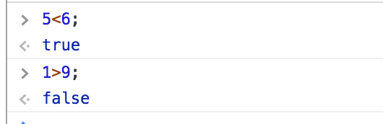

Slide 3
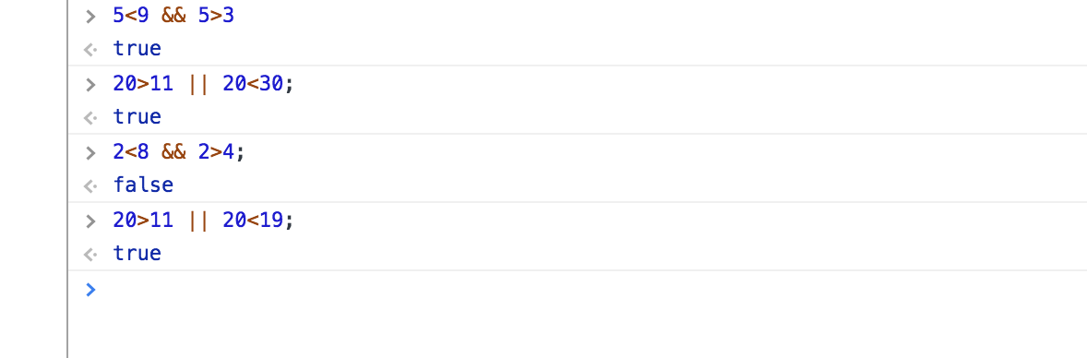

Slide 4
If else Statement

Slide 5
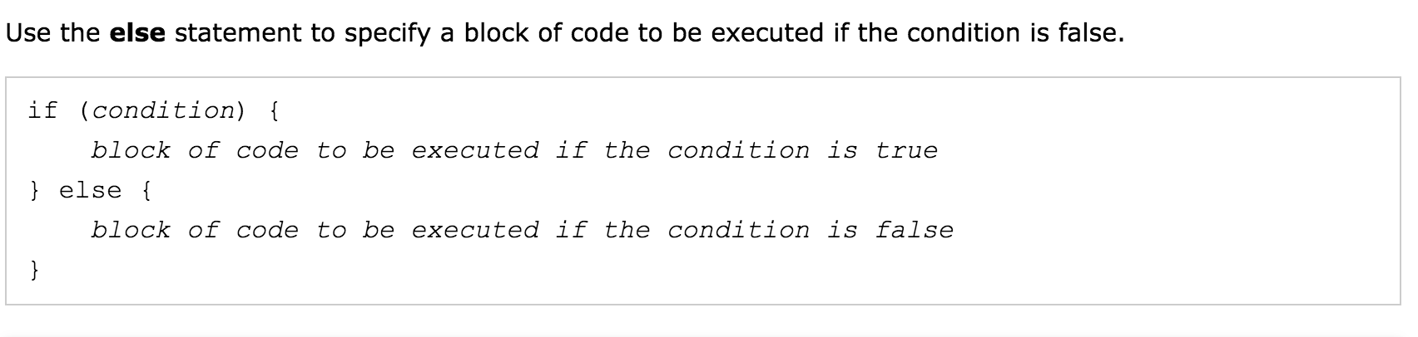
syntax

Slide 6
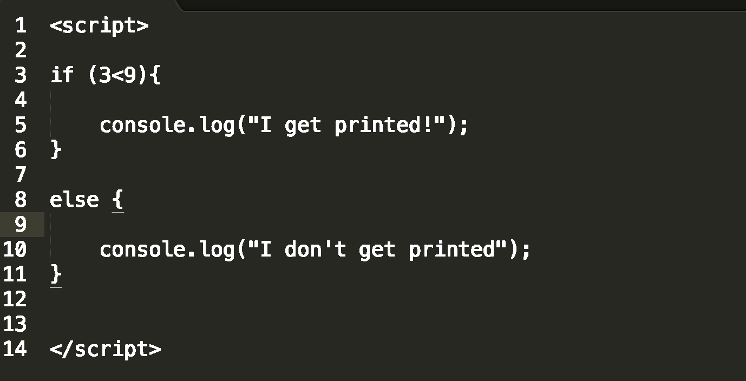
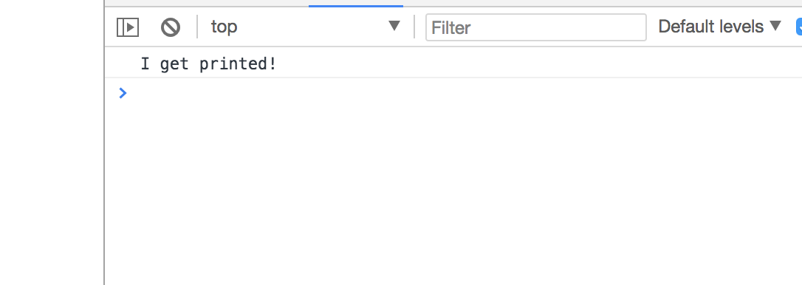

Slide 7
If , else if, else what’s the difference?

Slide 8
JS Function

Slide 9
Function Syntax
function name( parameter){
What should be executed
};

Slide 10
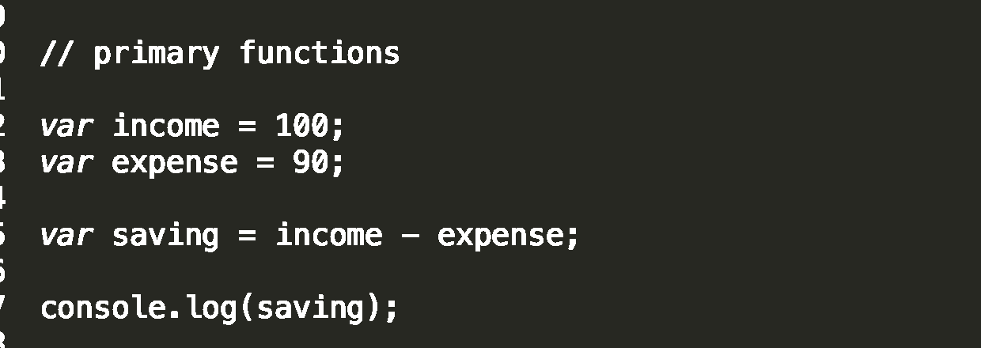
Function : calculating savings in a variable way

Slide 11
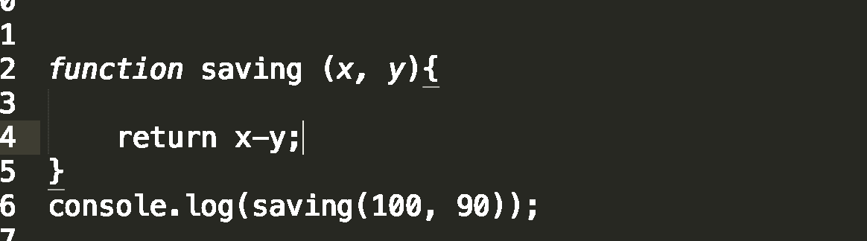
How to do the same job in a function?

Slide 12
What’s the benefit of JS functions
You can reuse your code
Less code more output

Slide 13
exercise
Create a function that takes Fahrenheit as input and gives Celsius as output.
Hint : Celsius = (Fahrenheit – 32) * (5/9)

Slide 14
How to get time in JS?

Slide 15
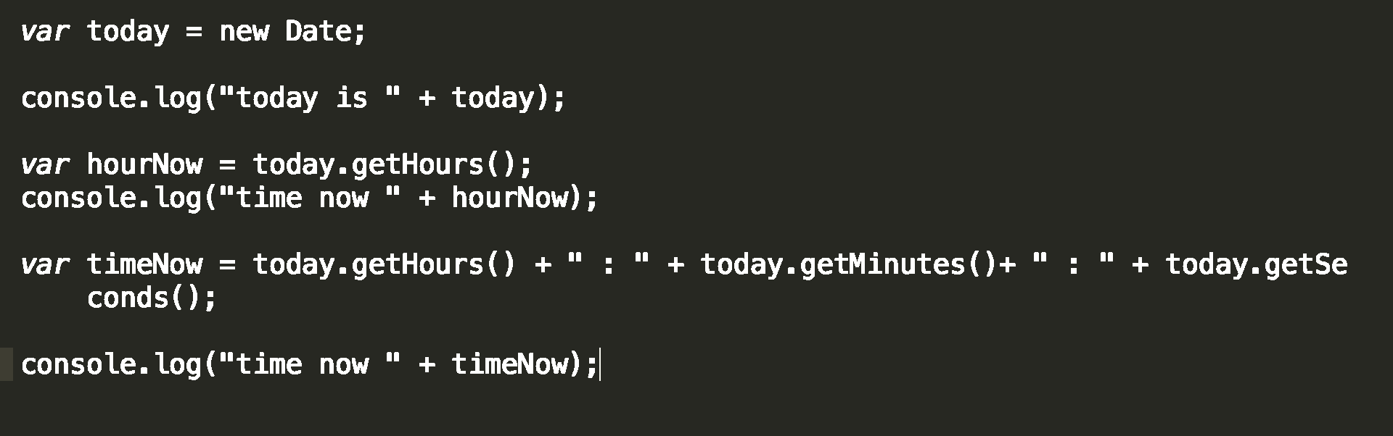

Slide 16
Write a JS function that greets user time wise
example : good morning or good afternoon or good evening
Hint : use JS built in Date object and getHours method
Hint: use if else statement

Slide 17
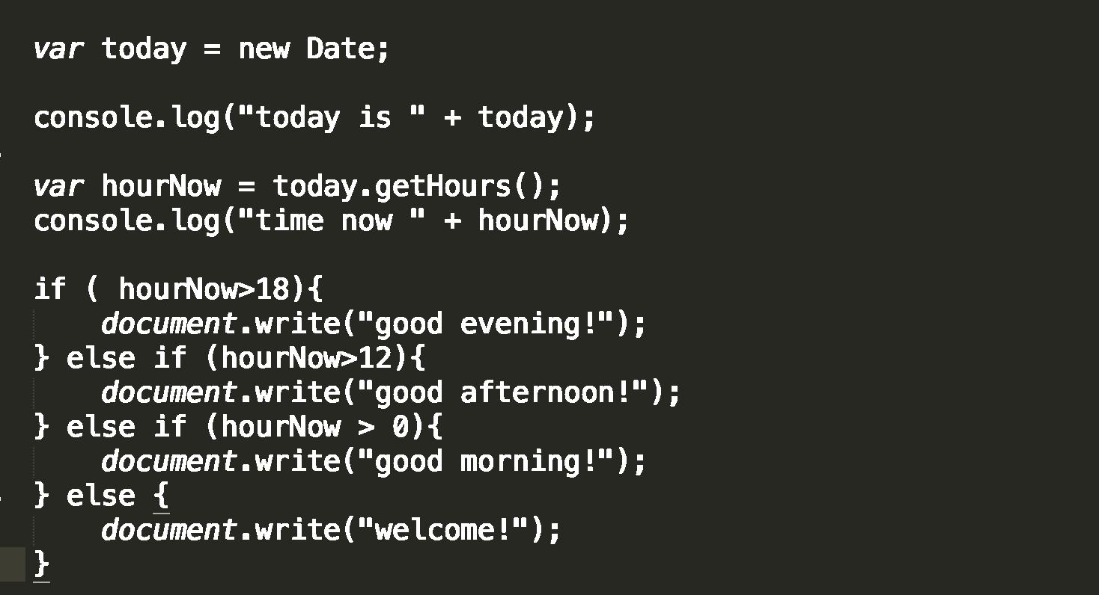
solutions

Slide 18
Linking external JS

Slide 19
JS libraries

