Slide 1
What You Should Already Know
Learning PHP requires having basic understanding of :
HTML
CSS
JavaScript

Slide 2
What is PHP?
PHP is an acronym for "PHP: Hypertext Preprocessor"
PHP is a widely-used, open source scripting language
PHP scripts are executed on the server
PHP is free to download and use

Slide 3
What is a PHP File?
PHP files can contain text, HTML, CSS, JavaScript, and PHP code
PHP code are executed on the server, and the result is returned to the browser as plain HTML
PHP files have extension ".php"

Slide 4
What Can PHP Do?
PHP can generate dynamic page content
PHP can create, open, read, write, delete, and close files on the server
PHP can collect form data
PHP can send and receive cookies
PHP can add, delete, modify data in your database
PHP can be used to control user-access
PHP can encrypt data

Slide 5
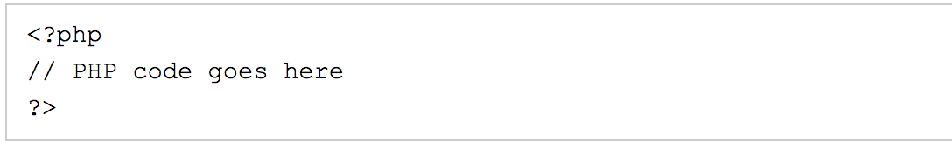
Basic PHP Syntax
A PHP script can be placed anywhere in the document.
A PHP script starts with <?php and ends with ?>:
The default file extension for PHP files is ".php".
A PHP file normally contains HTML tags, and some PHP scripting code.

Slide 6
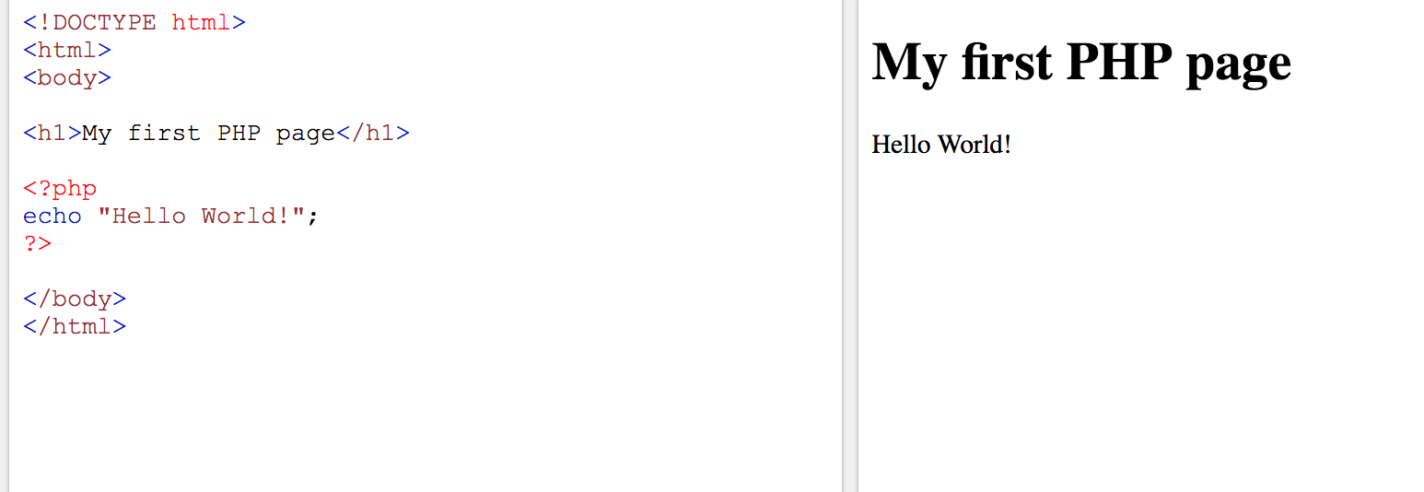
Sample php code

Slide 7
Comments in PHP
A comment in PHP code is a line that is not read/executed as part of the program. Its only purpose is to be read by someone who is looking at the code.
Comments can be used to:
Let others understand what you are doing
Remind yourself of what you did - Most programmers have experienced coming back to their own work a year or two later and having to re-figure out what they did. Comments can remind you of what you were thinking when you wrote the code

Slide 8
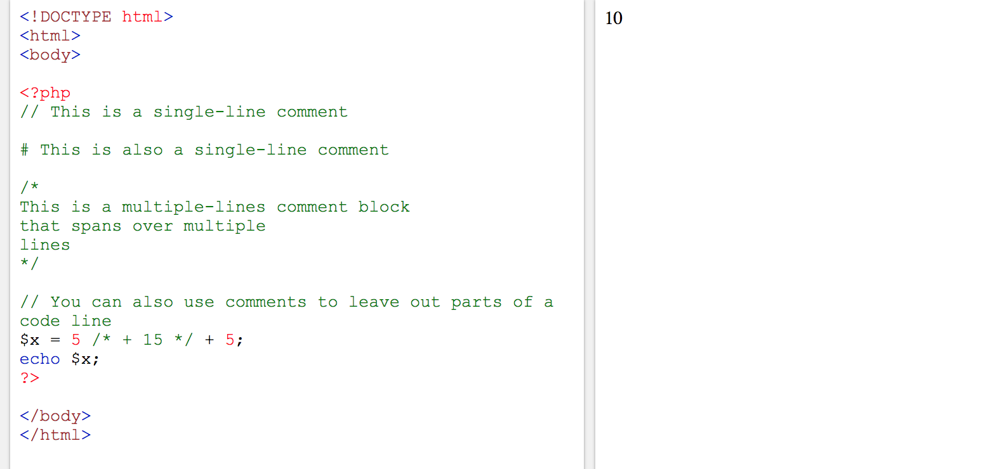
Example of php comment

Slide 9
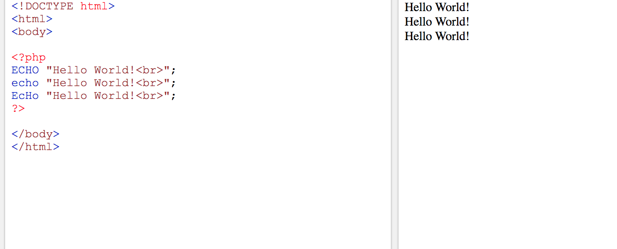
PHP Case Sensitivity
In PHP, all keywords (e.g. if, else, while, echo, etc.), classes, functions, and user-defined functions are NOT case-sensitive

Slide 10
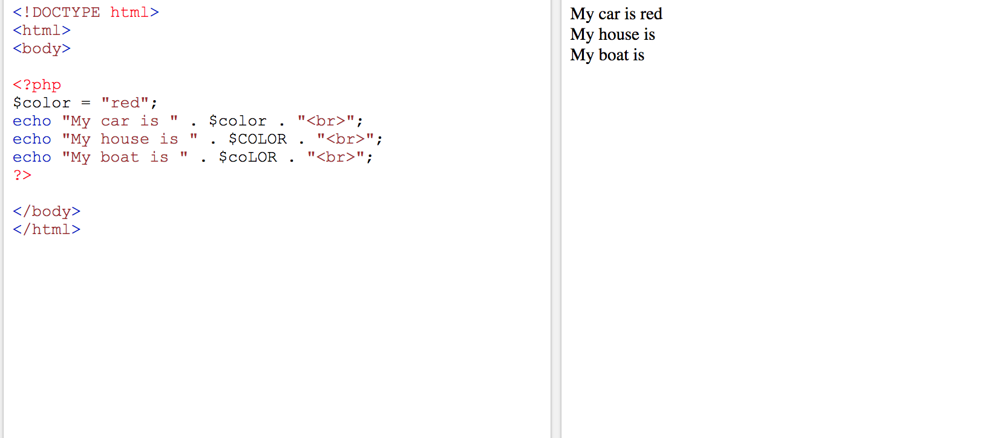
Important: all variable names are case-sensitive.

Slide 11
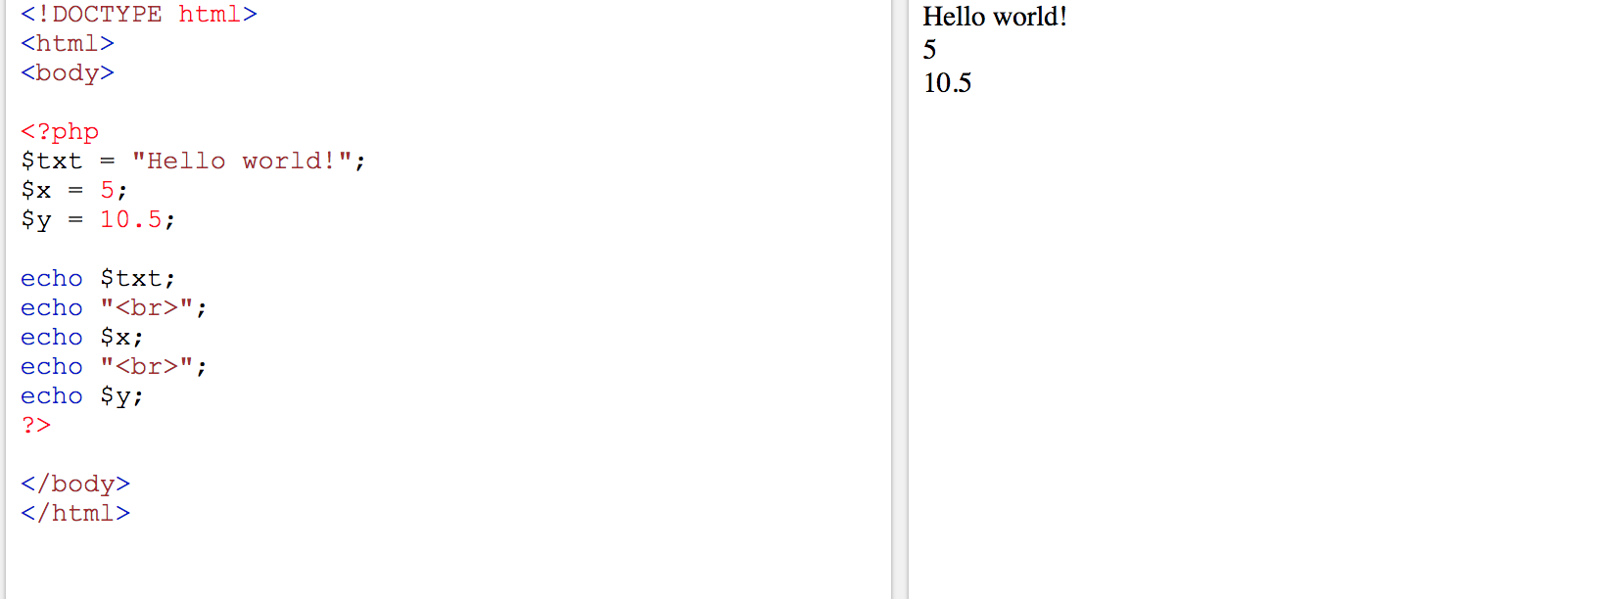
PHP 5 Variables
In PHP, a variable starts with the $ sign, followed by the name of the variable:

Slide 12
Rules related variables
A variable can have a short name (like x and y) or a more descriptive name (age, carname, total_volume).
A variable starts with the $ sign, followed by the name of the variable
A variable name must start with a letter or the underscore character
A variable name cannot start with a number
A variable name can only contain alpha-numeric characters and underscores (A-z, 0-9, and _ )
Variable names are case-sensitive ($age and $AGE are two different variables)

Slide 13
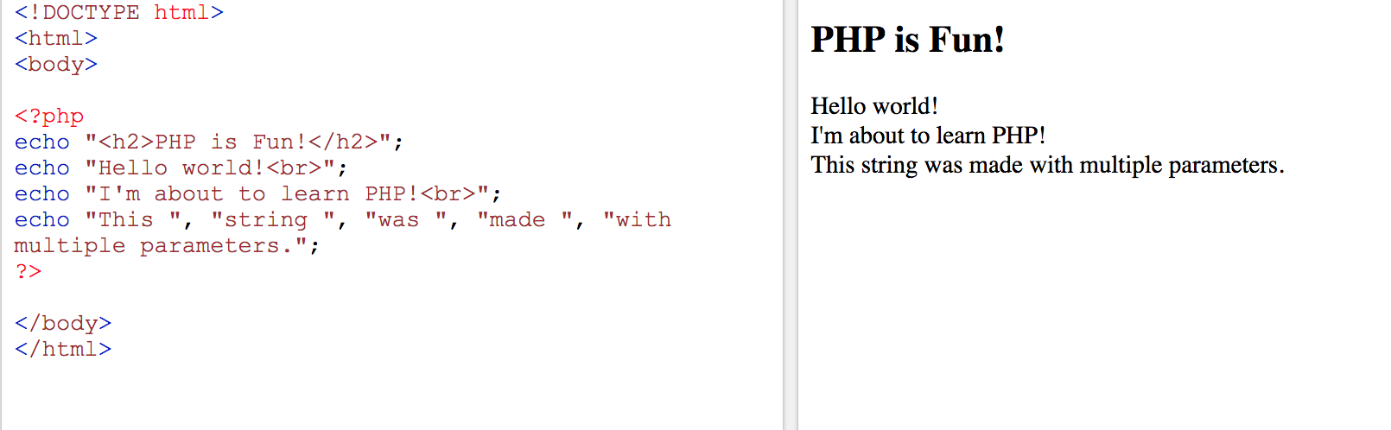
The PHP echo Statement
The echo statement can be used with or without parentheses: echo or echo().
The following example shows how to output text and variables with the echostatement:

Slide 14
PHP Data Types
Variables can store data of different types, and different data types can do different things.
PHP supports the following data types:
String
Integer
Float (floating point numbers - also called double)
Boolean
Array
Object
NULL

Slide 15
PHP Integer
An integer data type is a non-decimal number between -2,147,483,648 and 2,147,483,647.
Rules for integers:
An integer must have at least one digit
An integer must not have a decimal point
An integer can be either positive or negative
Integers can be specified in three formats: decimal (10-based), hexadecimal (16-based - prefixed with 0x) or octal (8-based - prefixed with 0)

Slide 16
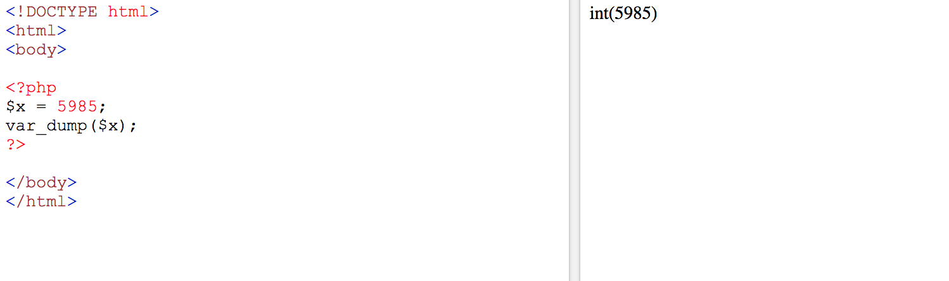
In the following example $x is an integer. The PHP var_dump() function returns the data type and value:

Slide 17
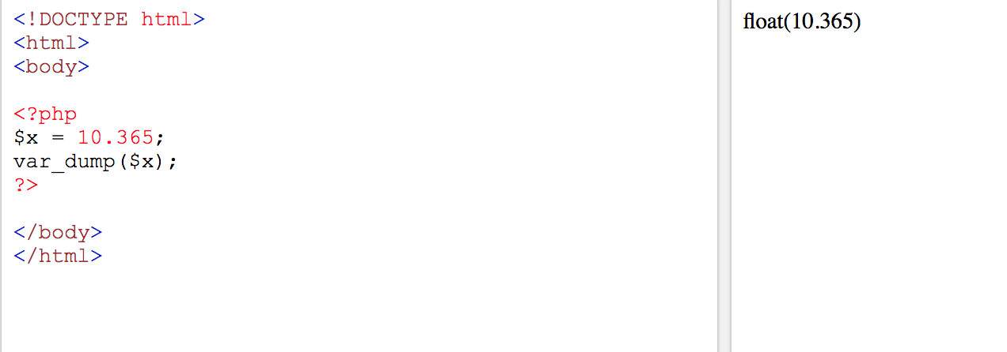
PHP Float
A float (floating point number) is a number with a decimal point or a number in exponential form.
In the following example $x is a float. The PHP var_dump() function returns the data type and value:

Slide 18
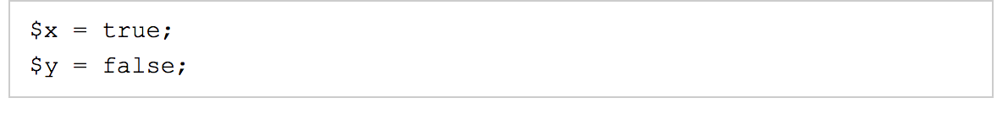
A Boolean represents two possible states: TRUE or FALSE.

Slide 19
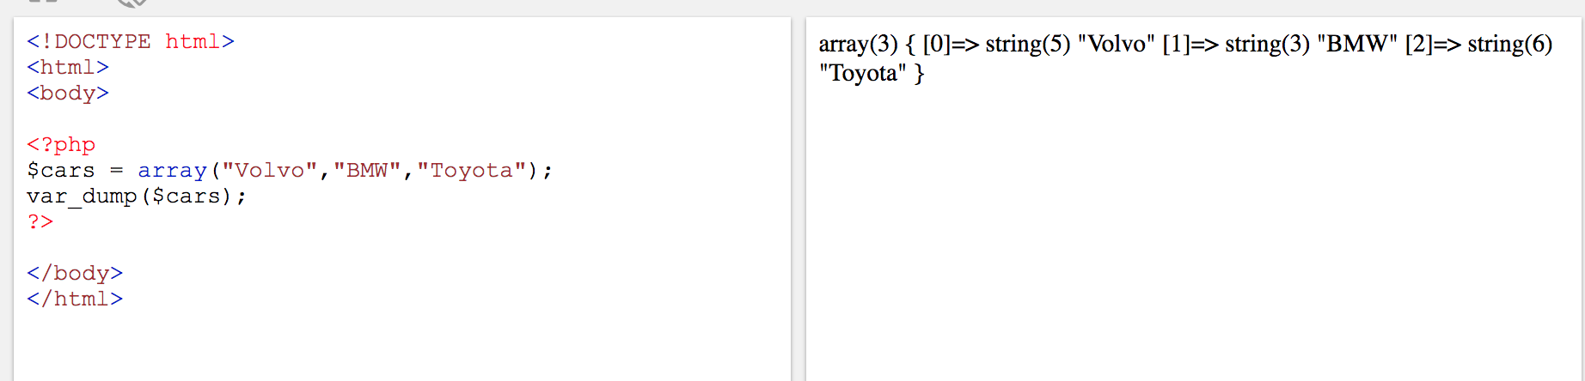
PHP Array
An array stores multiple values in one single variable.
In the following example $cars is an array. The PHP var_dump() function returns the data type and value:

Slide 20
PHP Object
An object is a data type which stores data and information on how to process that data.
In PHP, an object must be explicitly declared.
First we must declare a class of object. For this, we use the class keyword. A class is a structure that can contain properties and methods:

Slide 21
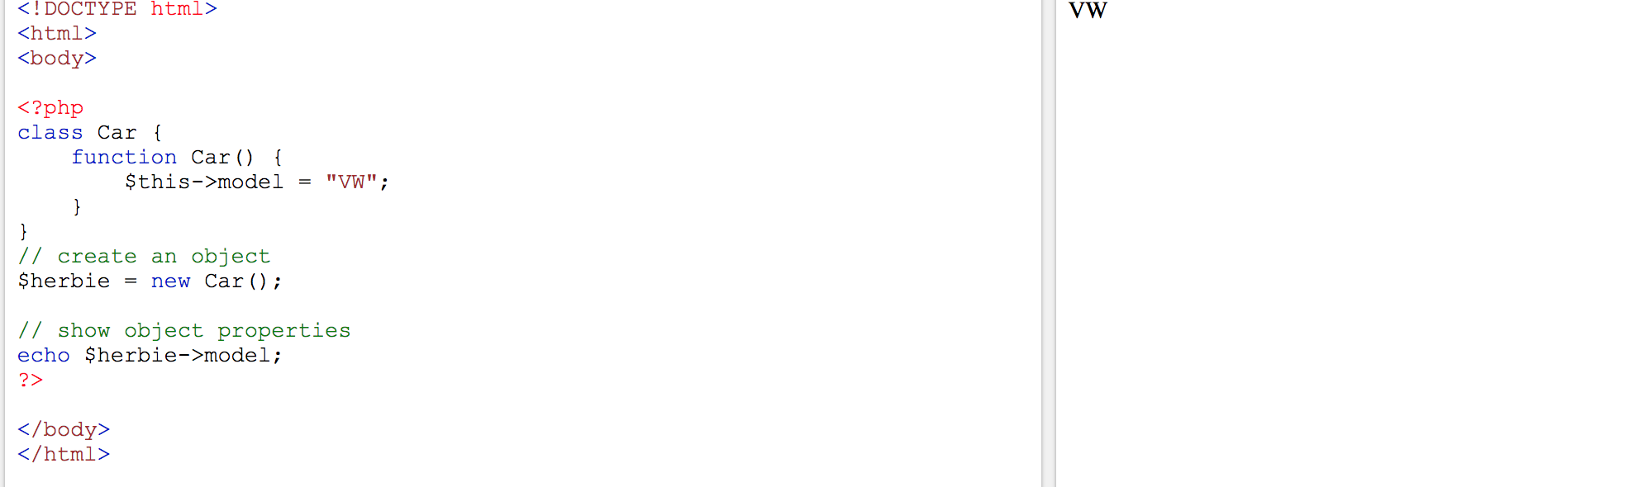
Example:

Slide 22
PHP NULL Value
Null is a special data type which can have only one value: NULL.
A variable of data type NULL is a variable that has no value assigned to it.
Tip: If a variable is created without a value, it is automatically assigned a value of NULL.
Variables can also be emptied by setting the value to NULL:

Slide 23
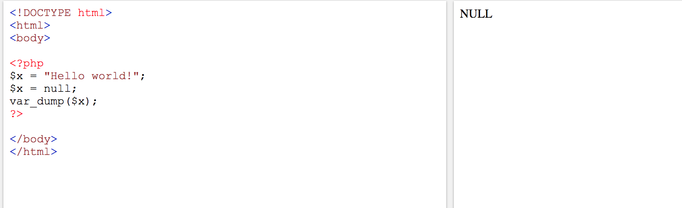

Slide 24
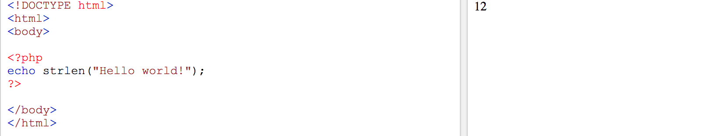
PHP String Functions : Get The Length of a String
The PHP strlen() function returns the length of a string.
The example below returns the length of the string "Hello world!":

Slide 25
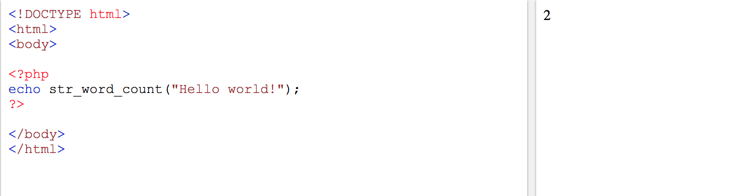
Count The Number of Words in a String
The PHP str_word_count() function counts the number of words in a string:

Slide 26
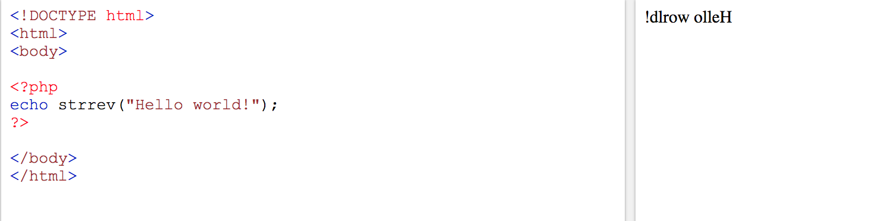
Reverse a String
The PHP strrev() function reverses a string:

Slide 27
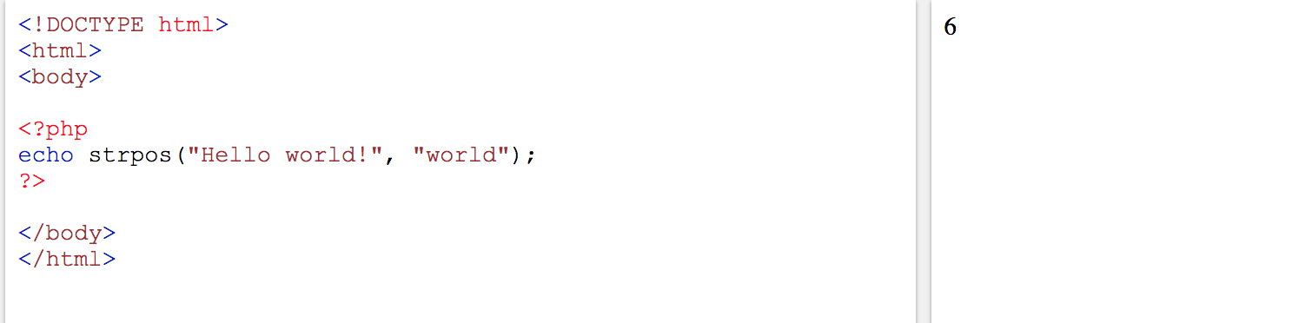
Search For a Specific Text Within a String
The PHP strpos() function searches for a specific text within a string.
If a match is found, the function returns the character position of the first match. If no match is found, it will return FALSE.
The example below searches for the text "world" in the string "Hello world!":

Slide 28
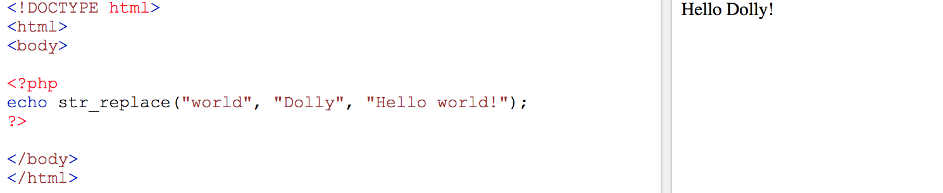
Replace Text Within a String
The PHP str_replace() function replaces some characters with some other characters in a string.
The example below replaces the text "world" with "Dolly":

Slide 29
PHP 5 Constants
Constants are like variables except that once they are defined they cannot be changed or undefined.
A constant is an identifier (name) for a simple value. The value cannot be changed during the script.
A valid constant name starts with a letter or underscore (no $ sign before the constant name).
Note: Unlike variables, constants are automatically global across the entire script.

Slide 30
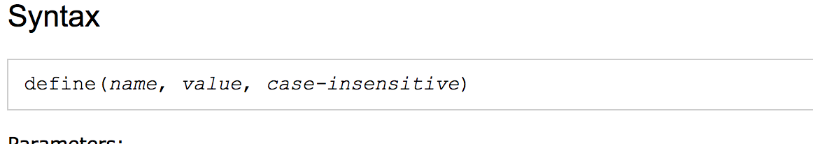
Create a PHP Constant
To create a constant, use the define() function.

Slide 31
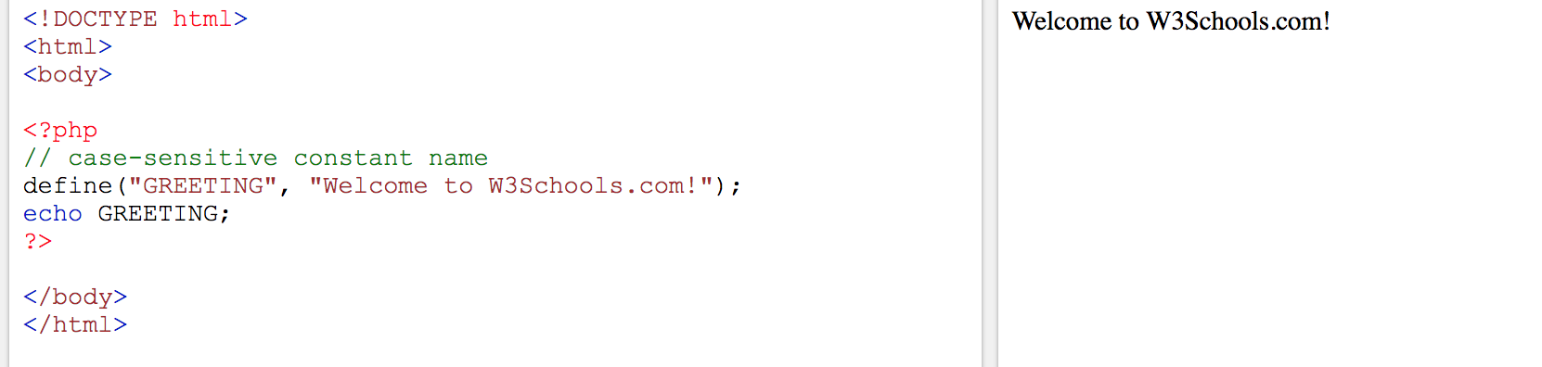
The example below creates a constant with a case-sensitive name:

Slide 32
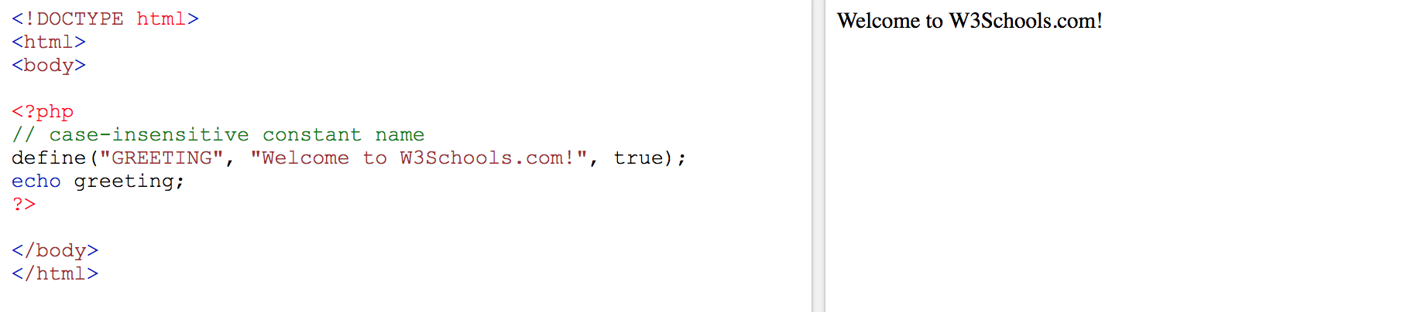
The example below creates a constant with a case-insensitive name:

Slide 33
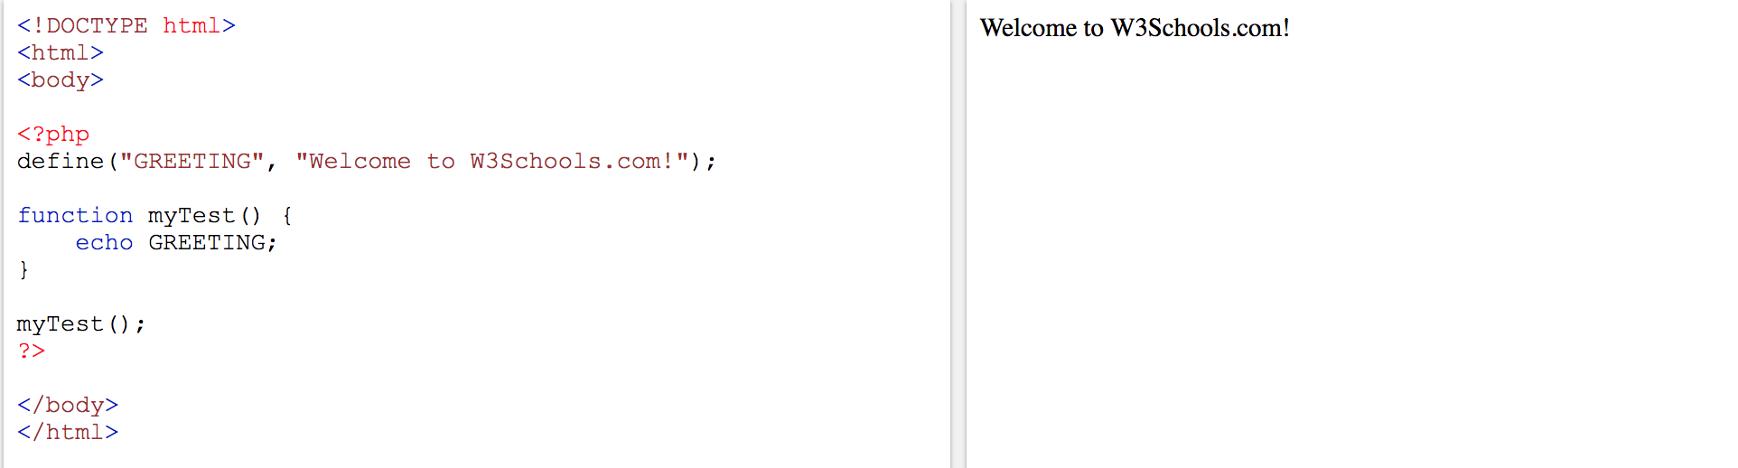
Constants are Global
Constants are automatically global and can be used across the entire script.
The example below uses a constant inside a function, even if it is defined outside the function:

