Slide 1
SQL – Session Three

Slide 2
SQL Aliases
SQL aliases are used to give a table, or a column in a table, a temporary name.
Aliases are often used to make column names more readable.
An alias only exists for the duration of the query.

Slide 3
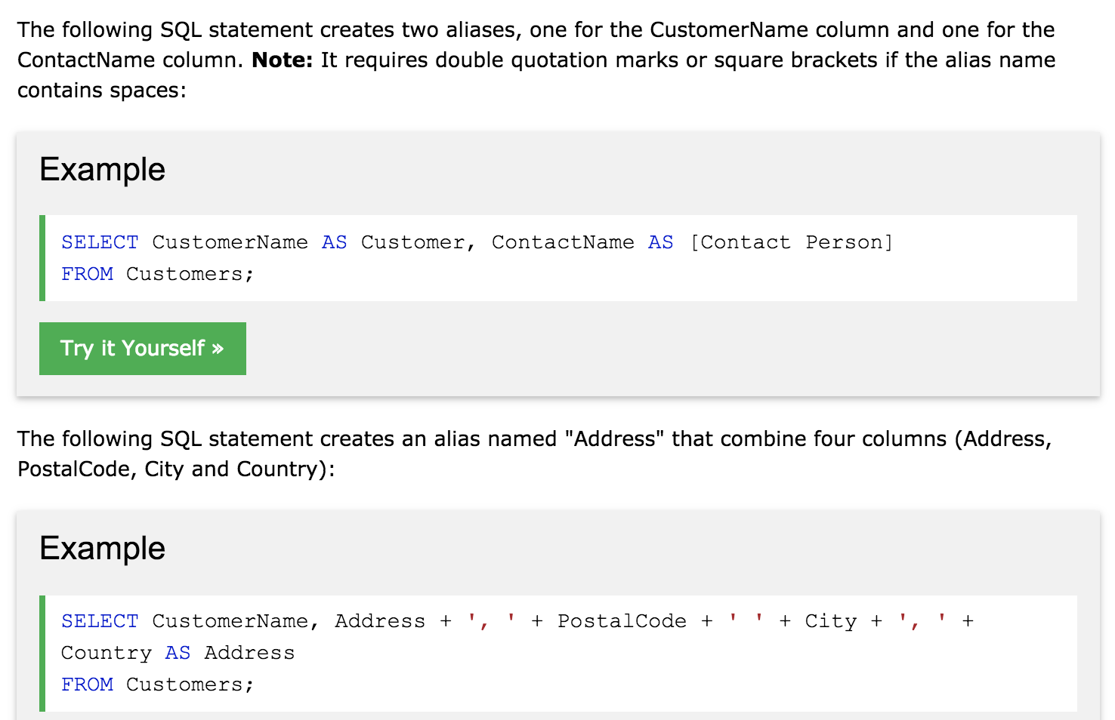

Slide 4
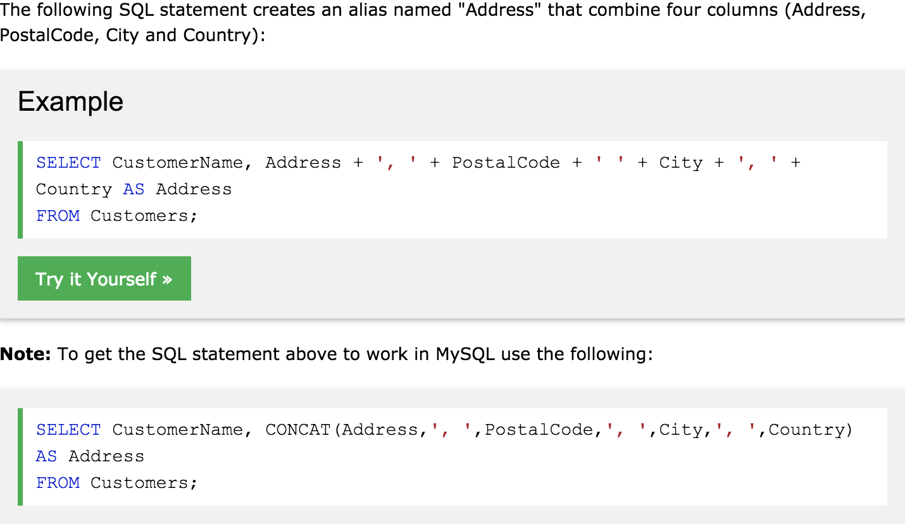
For Multiple columns :

