Slide 1
SQL
SQL is a standard language for accessing and manipulating databases.
Database link : https://www.w3schools.com/sql/trysql.asp?filename=trysql_select_all

Slide 2
SQL is a standard language for storing, manipulating and retrieving data in databases.
how to use SQL in: MySQL, SQL Server, MS Access, Oracle, Sybase, Informix, Postgres, and other database systems.

Slide 3
What is SQL?
SQL stands for Structured Query Language
SQL lets you access and manipulate databases
SQL became a standard of the American National Standards Institute (ANSI) in 1986, and of the International Organization for Standardization (ISO) in 1987

Slide 4
What Can SQL do?
SQL can execute queries against a database
SQL can retrieve data from a database
SQL can insert records in a database
SQL can update records in a database
SQL can delete records from a database
SQL can create new databases
SQL can create new tables in a database
SQL can create stored procedures in a database
SQL can create views in a database
SQL can set permissions on tables, procedures, and views

Slide 5
Using SQL in Your Web Site
To build a web site that shows data from a database, you will need:
An RDBMS database program (i.e. MS Access, SQL Server, MySQL)
To use a server-side scripting language, like PHP or ASP
To use SQL to get the data you want
To use HTML / CSS to style the page

Slide 6
RDBMS
RDBMS stands for Relational Database Management System.
RDBMS is the basis for SQL, and for all modern database systems such as MS SQL Server, IBM DB2, Oracle, MySQL, and Microsoft Access.
The data in RDBMS is stored in database objects called tables. A table is a collection of related data entries and it consists of columns and rows.

Slide 7
Example
From - https://www.w3schools.com/sql/trysql.asp?filename=trysql_select_all
Write SQL command - SELECT * FROM Customers;

Slide 8
What’s in the table?
Every table is broken up into smaller entities called fields. The fields in the Customers table consist of CustomerID, CustomerName, ContactName, Address, City, PostalCode and Country. A field is a column in a table that is designed to maintain specific information about every record in the table.
A record, also called a row, is each individual entry that exists in a table. For example, there are 91 records in the above Customers table. A record is a horizontal entity in a table.
A column is a vertical entity in a table that contains all information associated with a specific field in a table.

Slide 9
SQL Syntax : Database Tables
A database most often contains one or more tables. Each table is identified by a name (e.g. "Customers" or "Orders"). Tables contain records (rows) with data.
In this tutorial we will use the well-known Northwind sample database (included in MS Access and MS SQL Server).

Slide 10
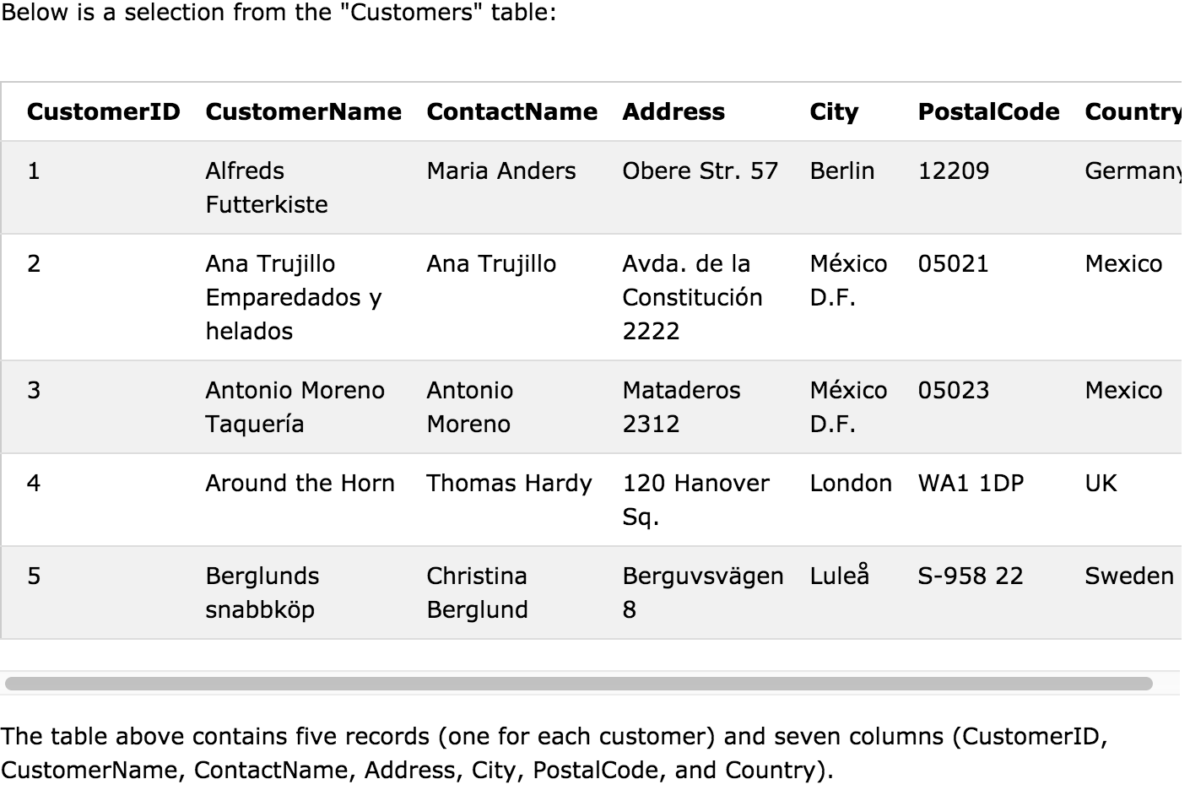

Slide 11
SQL Statements
Most of the actions you need to perform on a database are done with SQL statements.
The following SQL statement selects all the records in the "Customers" table:
SELECT * FROM Customers;
SQL keywords are NOT case sensitive: select is the same as SELECT

Slide 12
Semicolon after SQL Statements?
Some database systems require a semicolon at the end of each SQL statement.
Semicolon is the standard way to separate each SQL statement in database systems that allow more than one SQL statement to be executed in the same call to the server.
Usually we will use semicolon at the end of each SQL statement.

Slide 13
Some of The Most Important SQL Commands
SELECT - extracts data from a database
UPDATE - updates data in a database
DELETE - deletes data from a database
INSERT INTO - inserts new data into a database
CREATE DATABASE - creates a new database
ALTER DATABASE - modifies a database
CREATE TABLE - creates a new table
ALTER TABLE - modifies a table
DROP TABLE - deletes a table
CREATE INDEX - creates an index (search key)
DROP INDEX - deletes an index

Slide 14
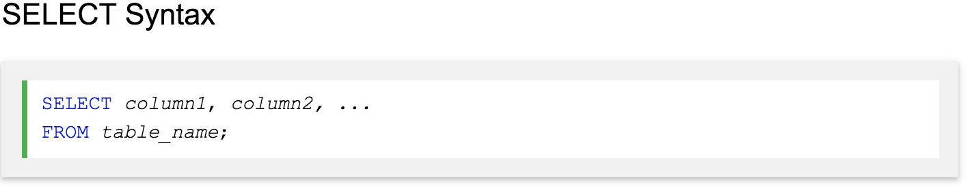
The SQL SELECT Statement
The SELECT statement is used to select data from a database.
The data returned is stored in a result table, called the result-set.
Here, column1, column2, ... are the field names of the table you want to select data from. If you want to select all the fields available in the table, use the following syntax:
SELECT * FROM table_name;

Slide 15
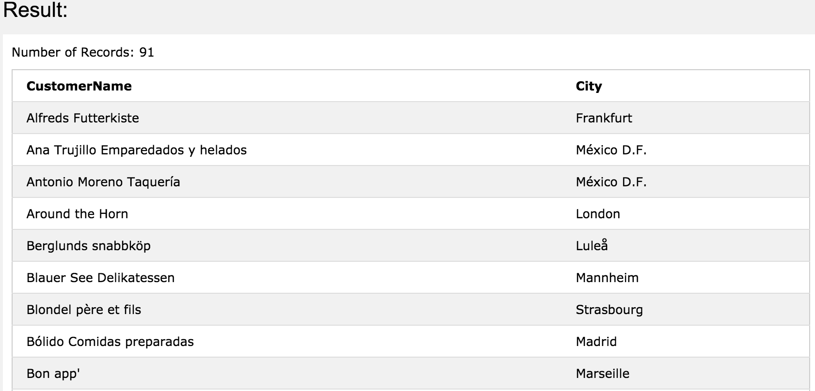
SELECT Column Example
The following SQL statement selects the "CustomerName" and "City" columns from the "Customers" table:
SELECT CustomerName, City FROM Customers;

Slide 16
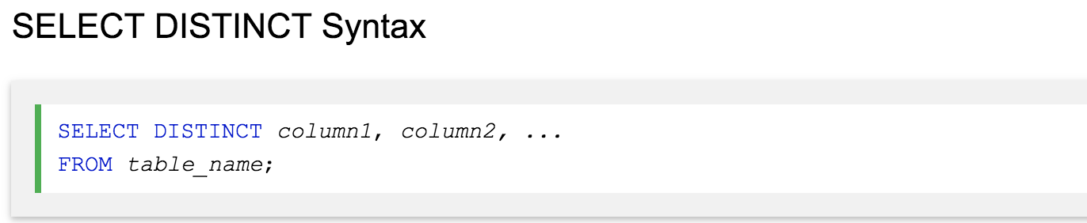
The SQL SELECT DISTINCT Statement
The SELECT DISTINCT statement is used to return only distinct (different) values.
Inside a table, a column often contains many duplicate values; and sometimes you only want to list the different (distinct) values.
The SELECT DISTINCT statement is used to return only distinct (different) values.

Slide 17
Example : SELECT Country FROM Customers;
SELECT DISTINCT Country FROM Customers;
What’s the difference?
The following SQL statement lists the number of different (distinct) customer countries:
SELECT COUNT(DISTINCT Country) FROM Customers;

Slide 18
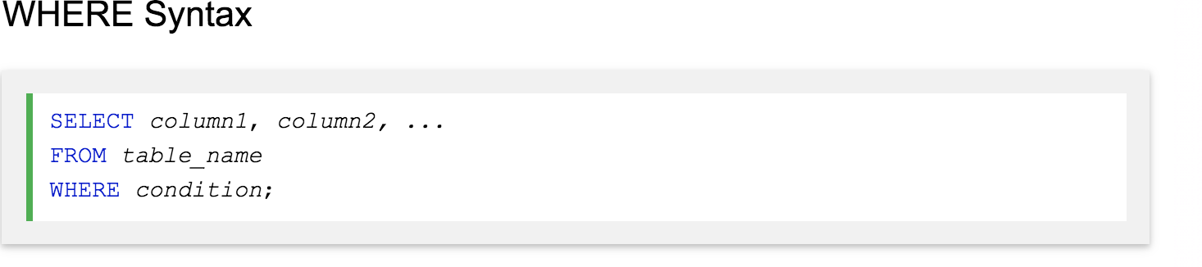
The SQL WHERE Clause
The WHERE clause is used to filter records.
The WHERE clause is used to extract only those records that fulfill a specified condition.

Slide 19
Example: The following SQL statement selects all the customers from the country "Mexico", in the "Customers" table:
SELECT * FROM Customers WHERE Country='Mexico';

Slide 20
Text Fields vs. Numeric Fields
SQL requires single quotes around text values (most database systems will also allow double quotes).
However, numeric fields should not be enclosed in quotes:
SELECT * FROM Customers WHERE CustomerID=1;

Slide 21
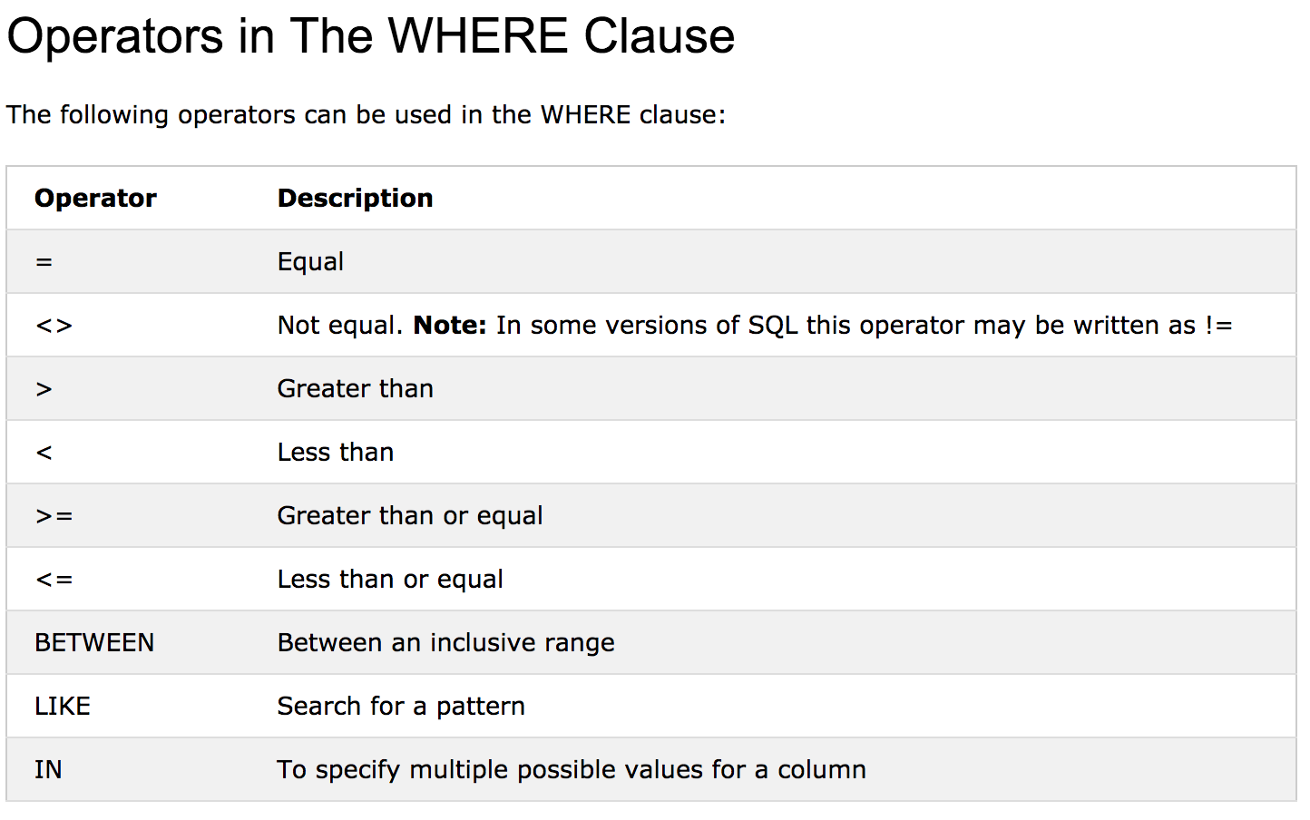

Slide 22
The SQL AND, OR and NOT Operators
The WHERE clause can be combined with AND, OR, and NOT operators.
The AND and OR operators are used to filter records based on more than one condition:
The AND operator displays a record if all the conditions separated by AND is TRUE.
The OR operator displays a record if any of the conditions separated by OR is TRUE.
The NOT operator displays a record if the condition(s) is NOT TRUE.

Slide 23
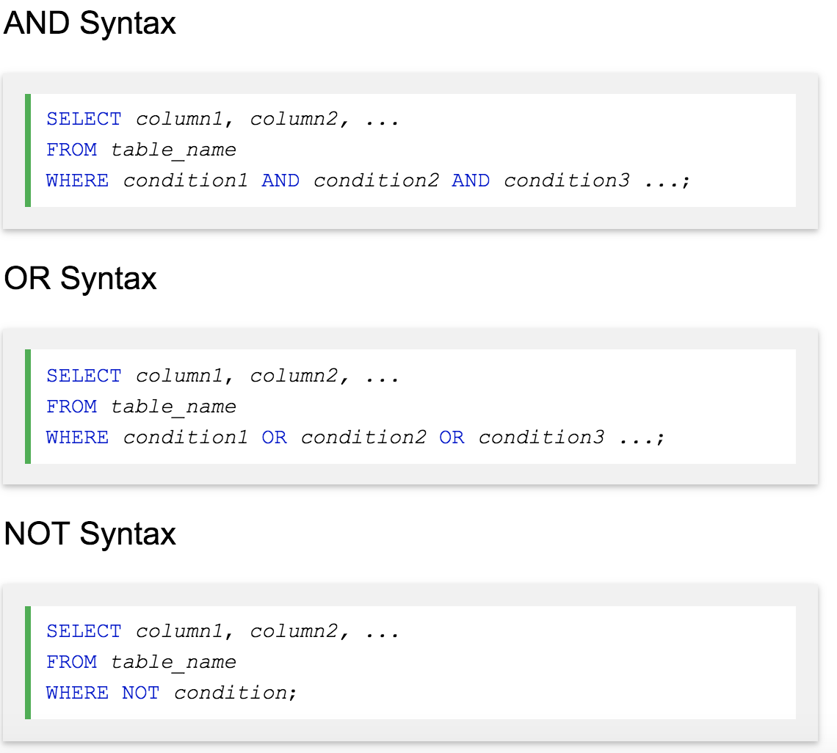

Slide 24
AND example:
SELECT * FROM Customers WHERE City='Berlin' OR City='München';
OR example:
SELECT * FROM Customers WHERE City='Berlin' OR City='München';
NOT example: SELECT * FROM Customers WHERE NOT Country='Germany';

Slide 25

Combining AND, OR and NOT
You can also combine the AND, OR and NOT operators.
The following SQL statement selects all fields from "Customers" where country is "Germany" AND city must be "Berlin" OR "München" (use parenthesis to form complex expressions):

Slide 26
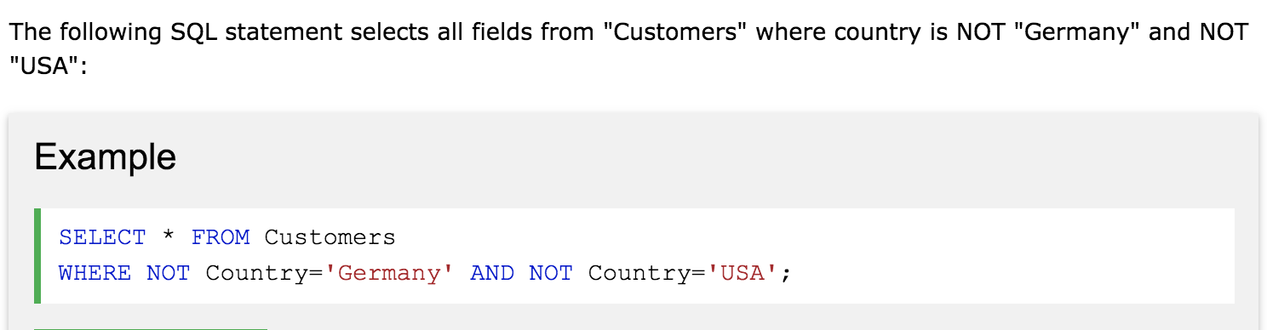

Slide 27
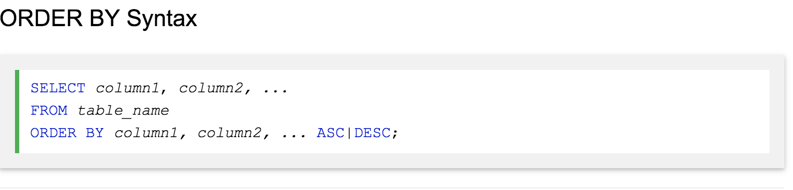
The SQL ORDER BY Keyword
The ORDER BY keyword is used to sort the result-set in ascending or descending order.
The ORDER BY keyword sorts the records in ascending order by default. To sort the records in descending order, use the DESC keyword.

Slide 28
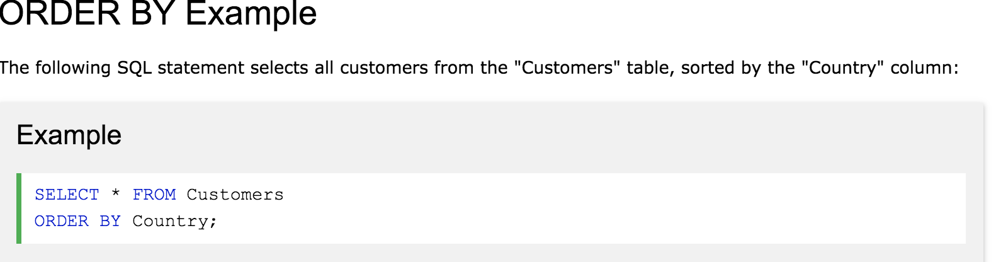

Slide 29
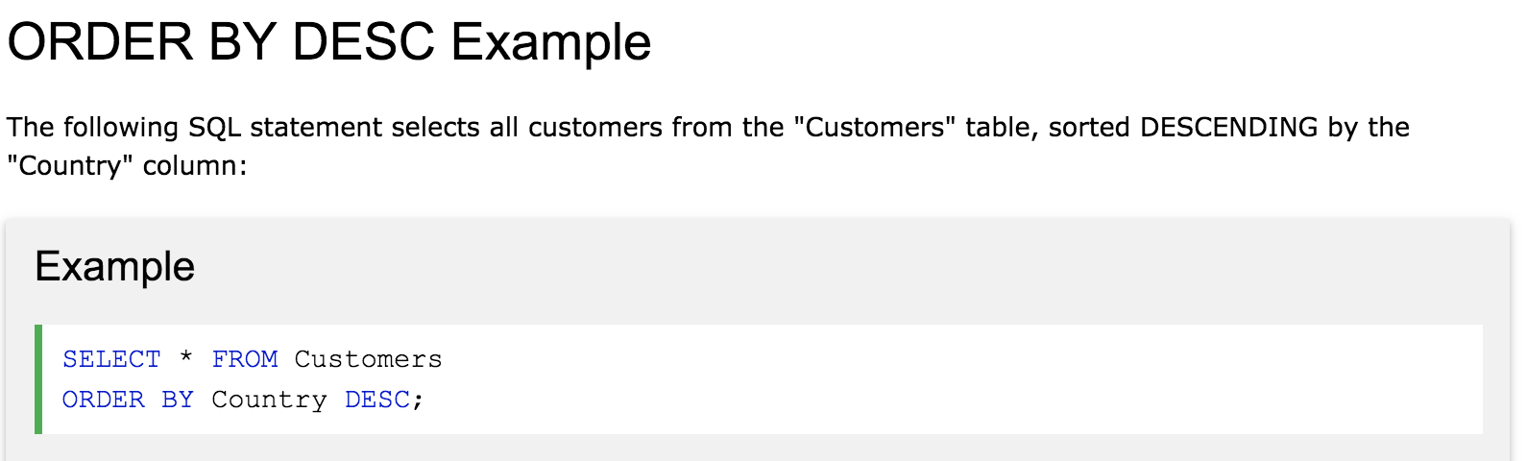

Slide 30
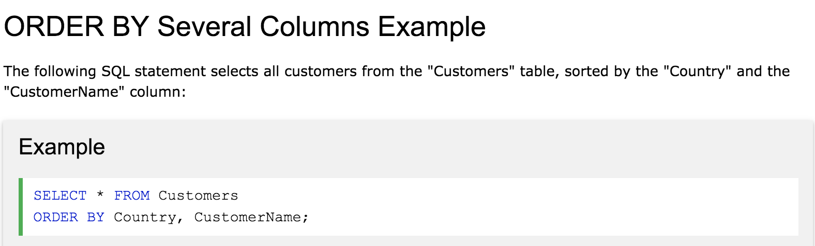

Slide 31
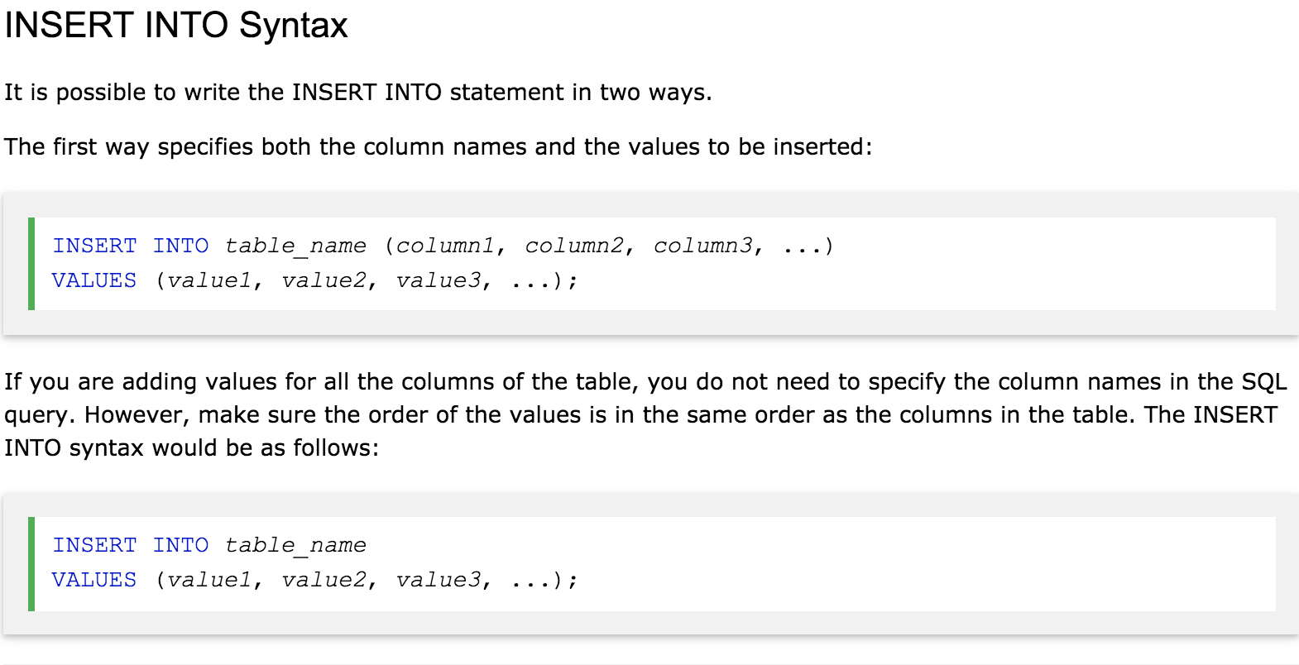
The SQL INSERT INTO Statement
The INSERT INTO statement is used to insert new records in a table.

Slide 32
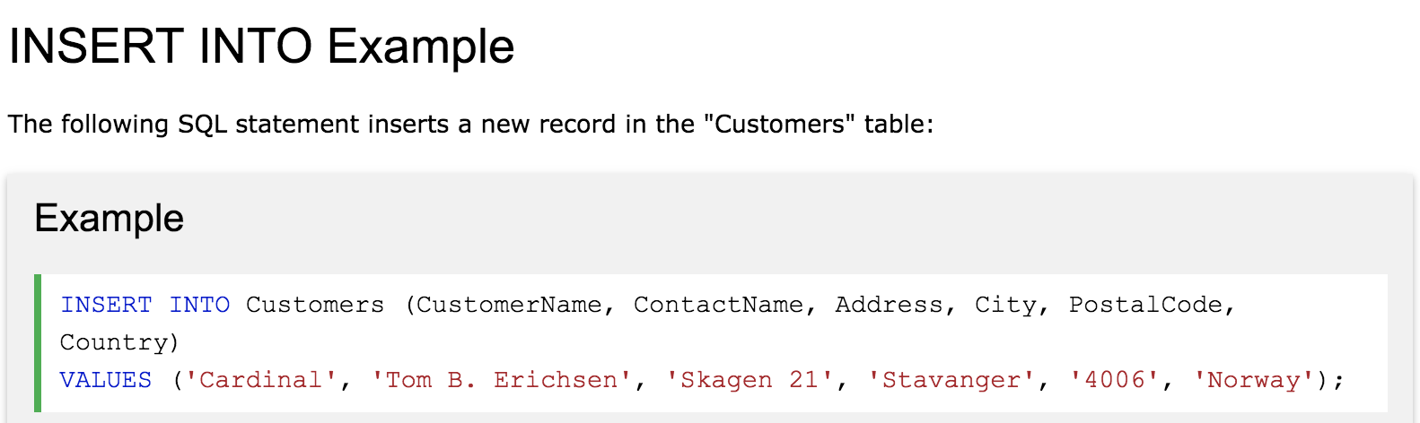

Slide 33
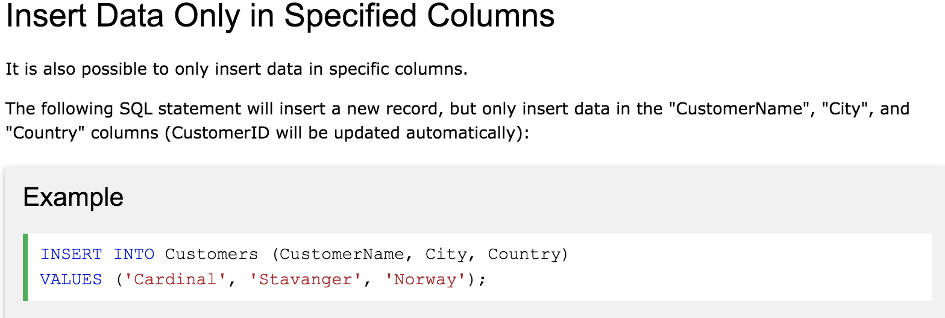
Insert Data Only in Specified Columns

Slide 34
What is a NULL Value?
A field with a NULL value is a field with no value.
If a field in a table is optional, it is possible to insert a new record or update a record without adding a value to this field. Then, the field will be saved with a NULL value.
Note: A NULL value is different from a zero value or a field that contains spaces. A field with a NULL value is one that has been left blank during record creation!

Slide 35
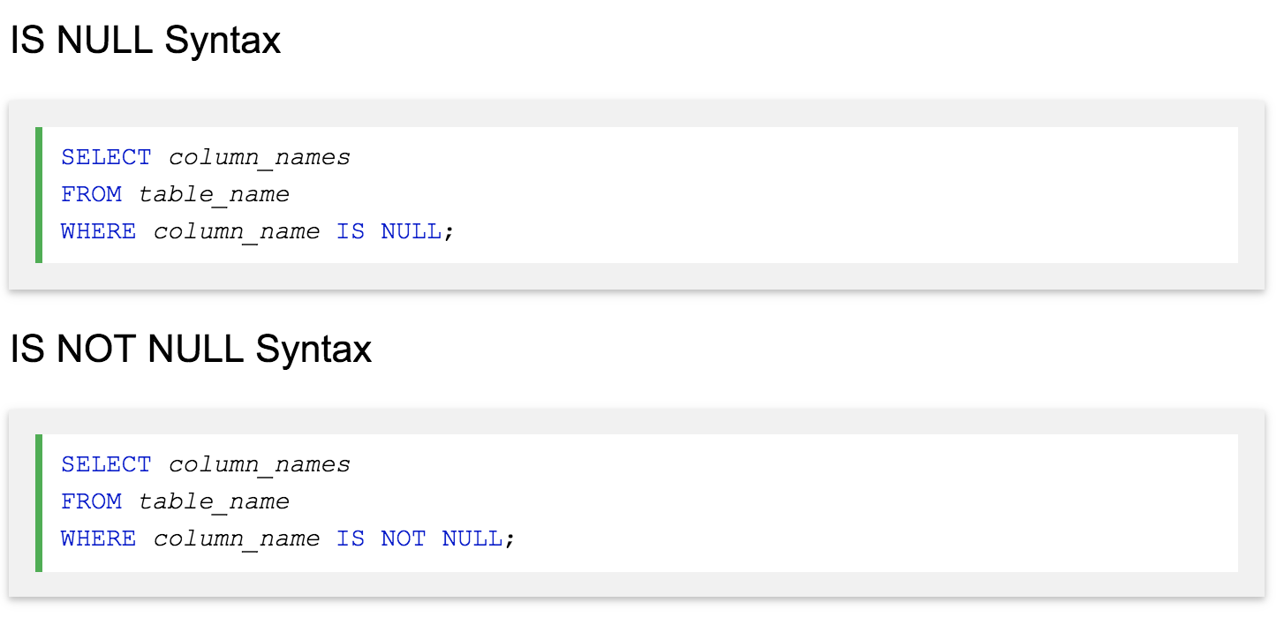
How to Test for NULL Values?
It is not possible to test for NULL values with comparison operators, such as =, <, or <>.
We will have to use the IS NULL and IS NOT NULL operators instead

Slide 36
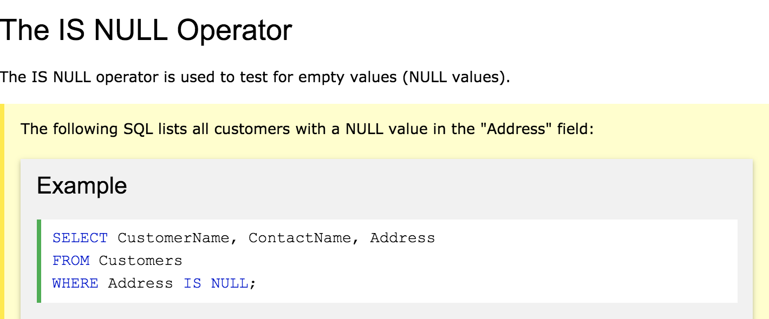
Tip: Always use IS NULL to look for NULL values.

Slide 37
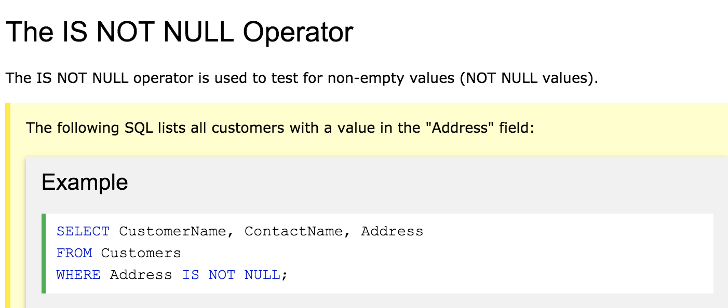

Slide 38
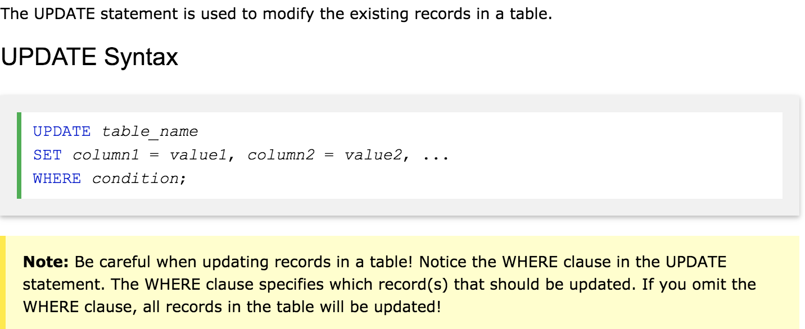
The SQL UPDATE Statement

Slide 39
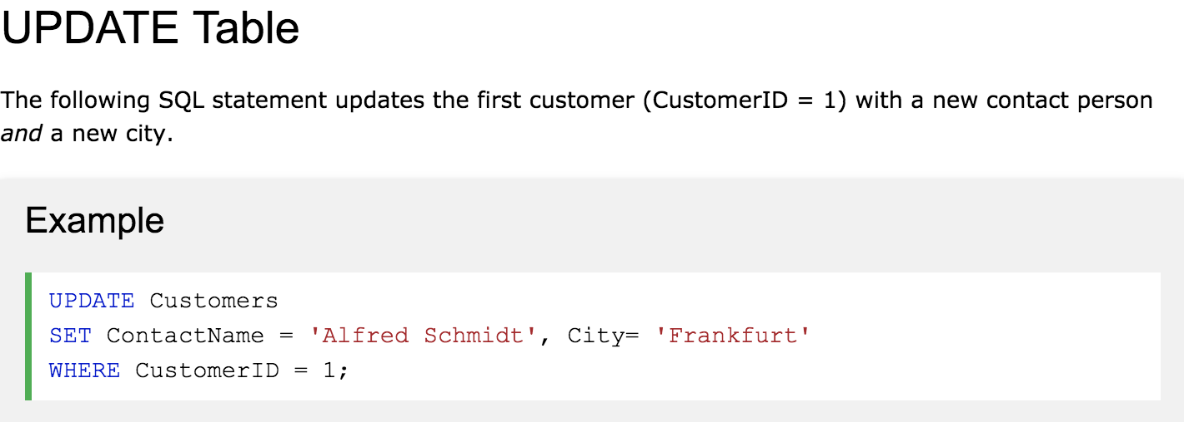

Slide 40
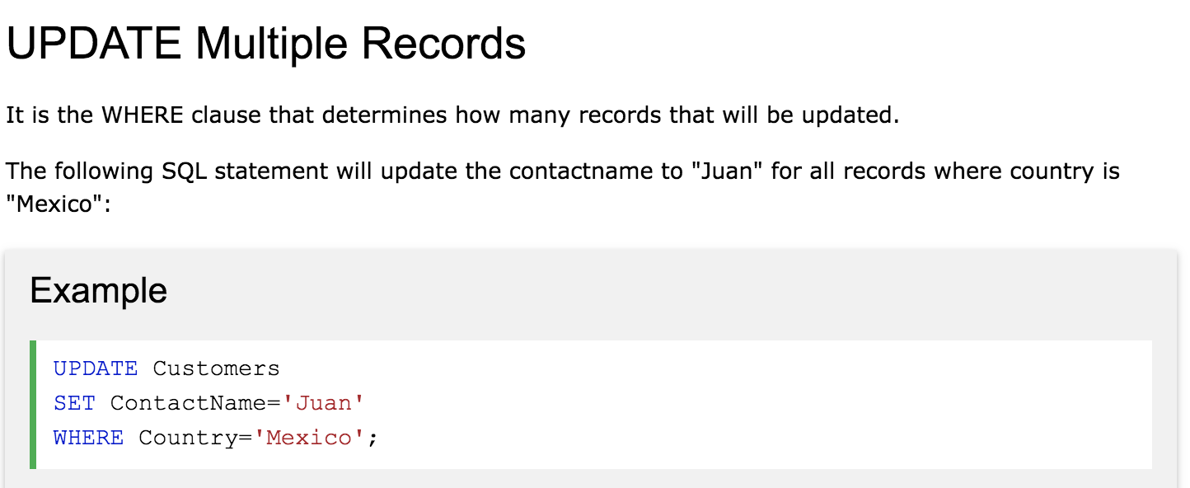
Be careful when updating records. If you omit the WHERE clause, ALL records will be updated!

Slide 41
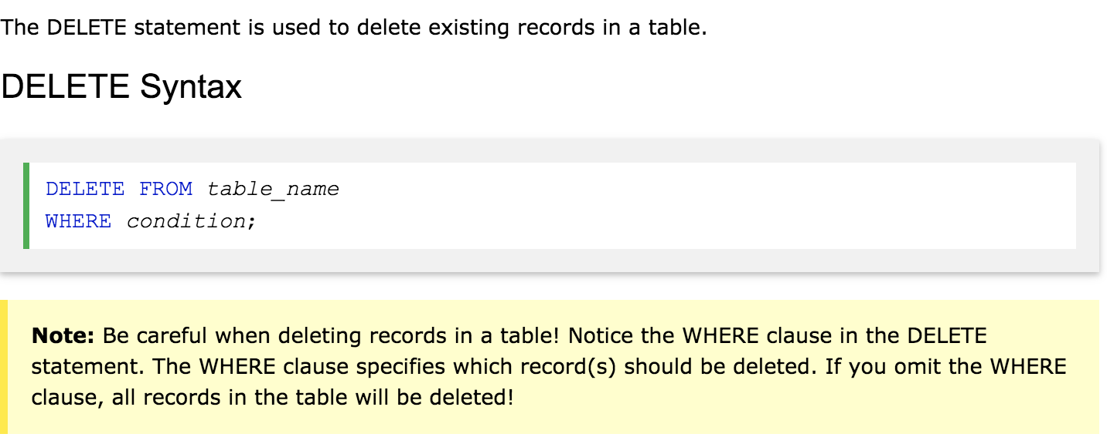
The SQL DELETE Statement

Slide 42
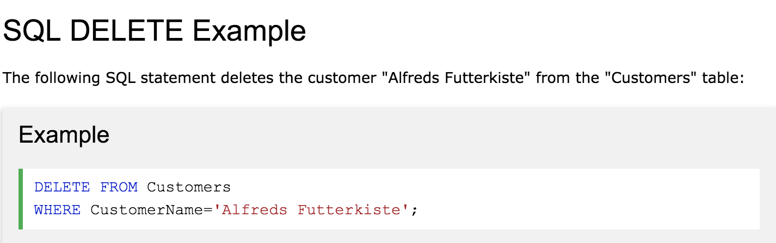

Slide 43
