Slide 1
SQL: Session-Two
https://www.w3schools.com/sql/trysql.asp?filename=trysql_select_all

Slide 2
The SQL SELECT TOP Clause
The SELECT TOP clause is used to specify the number of records to return.
The SELECT TOP clause is useful on large tables with thousands of records. Returning a large number of records can impact on performance.
Note: Not all database systems support the SELECT TOP clause. MySQL supports the LIMIT clause to select a limited number of records, while Oracle uses ROWNUM.

Slide 3
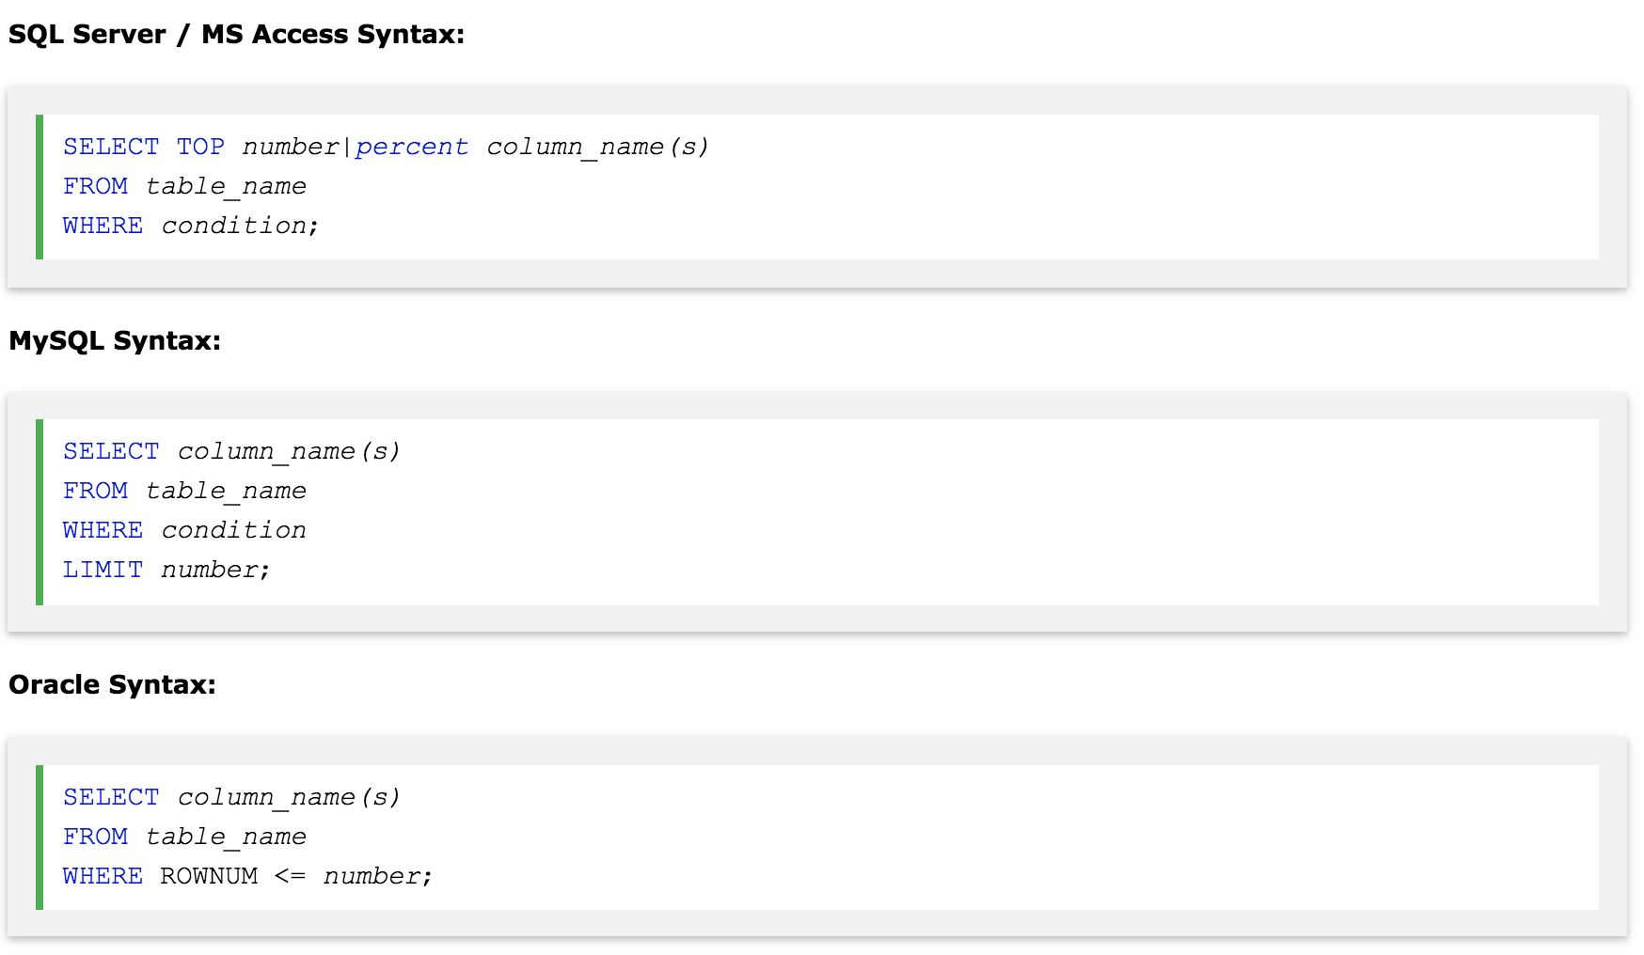

Slide 4
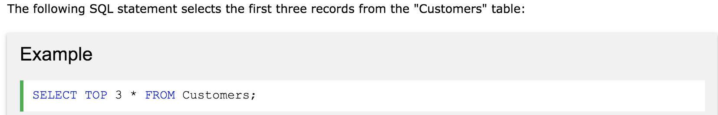
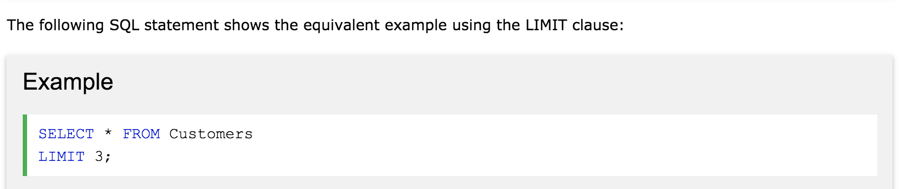
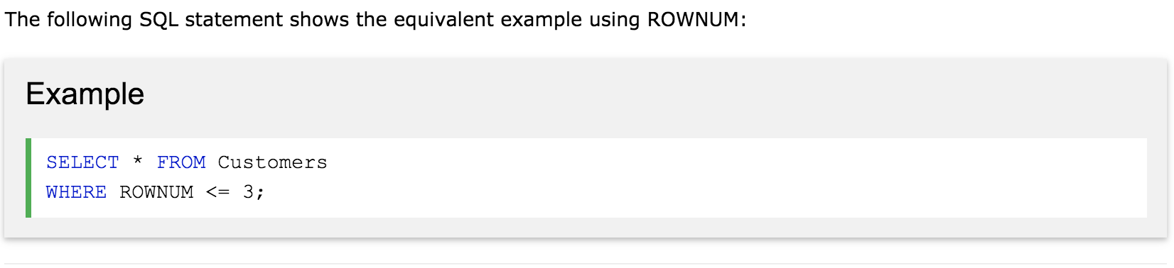
xx

Slide 5
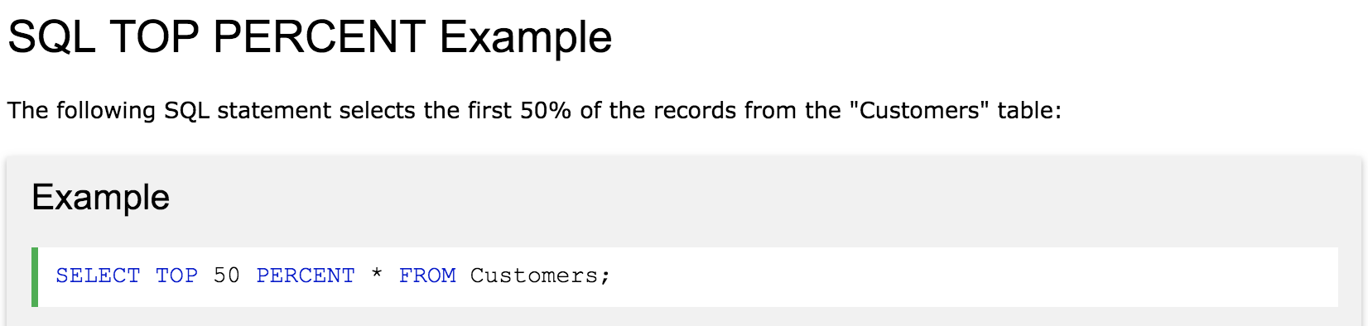
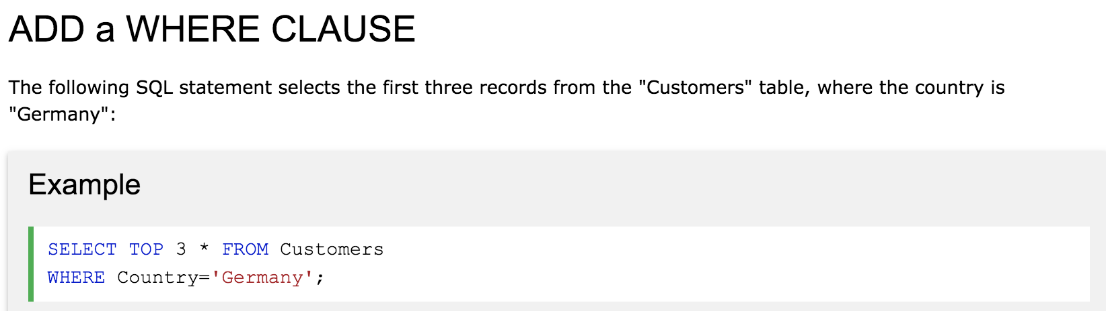

Slide 6
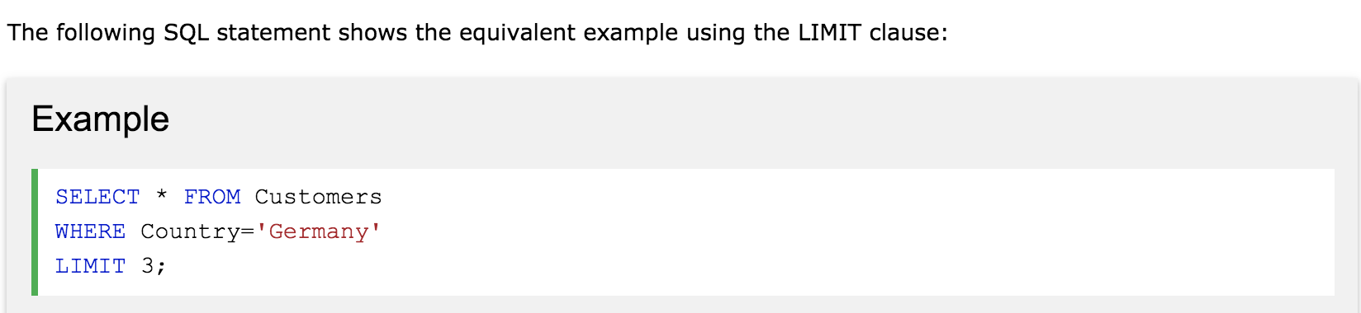
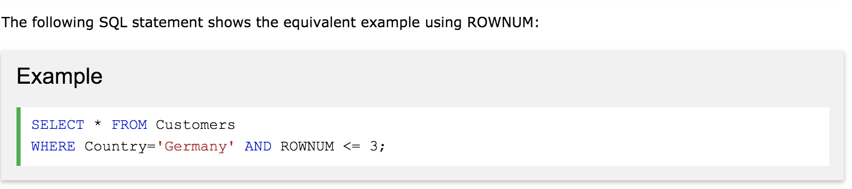

Slide 7
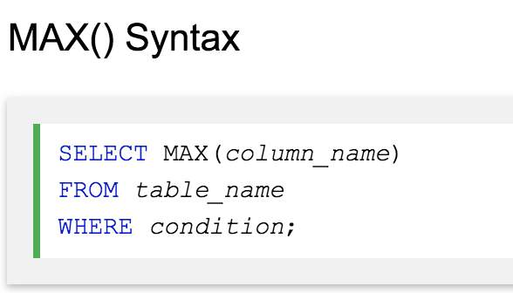
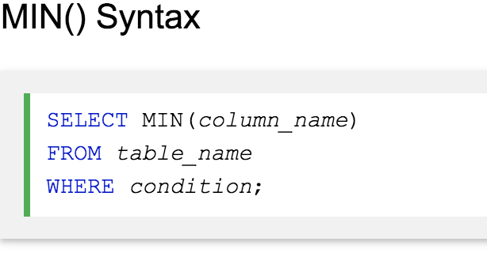
The SQL MIN() and MAX() Functions
The MIN() function returns the smallest value of the selected column.
The MAX() function returns the largest value of the selected column.

Slide 8
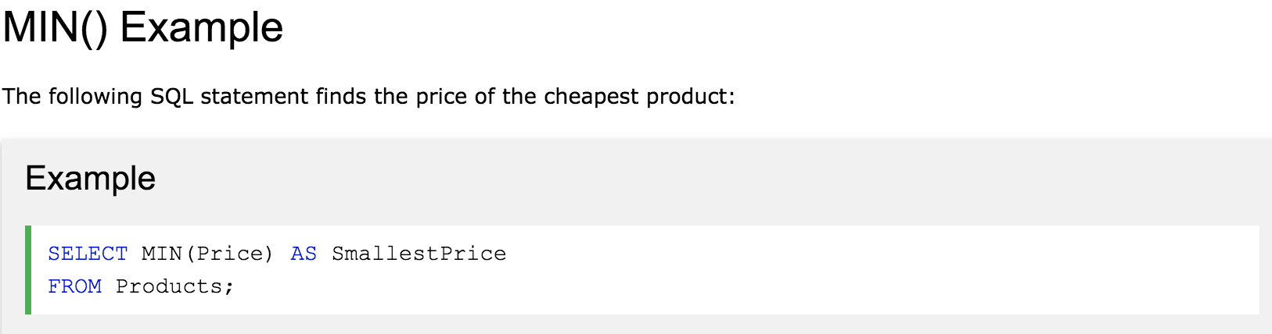
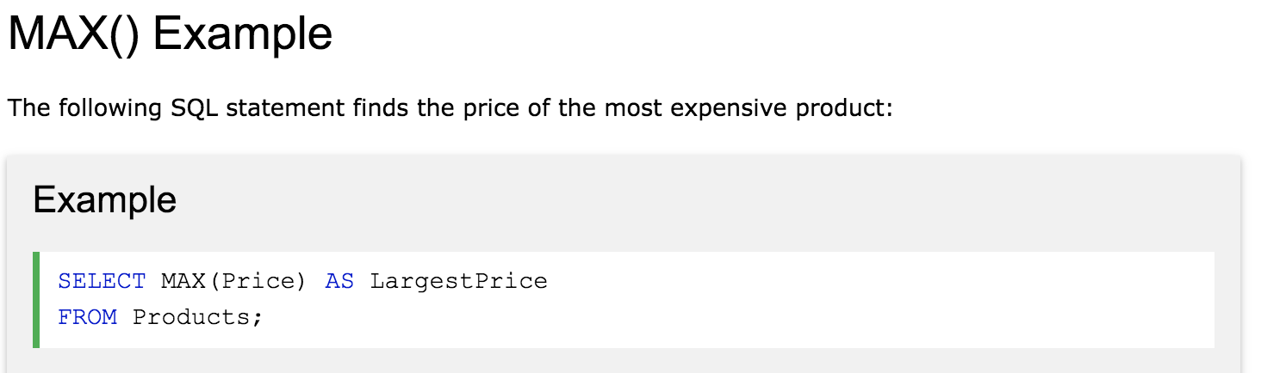

Slide 9
The SQL COUNT(), AVG() and SUM() Functions
The COUNT() function returns the number of rows that matches a specified criteria.
The AVG() function returns the average value of a numeric column.
The SUM() function returns the total sum of a numeric column.
Exercise: write a SQL query to see all the records from "OrderDetails" table in the Northwind sample database.

Slide 10
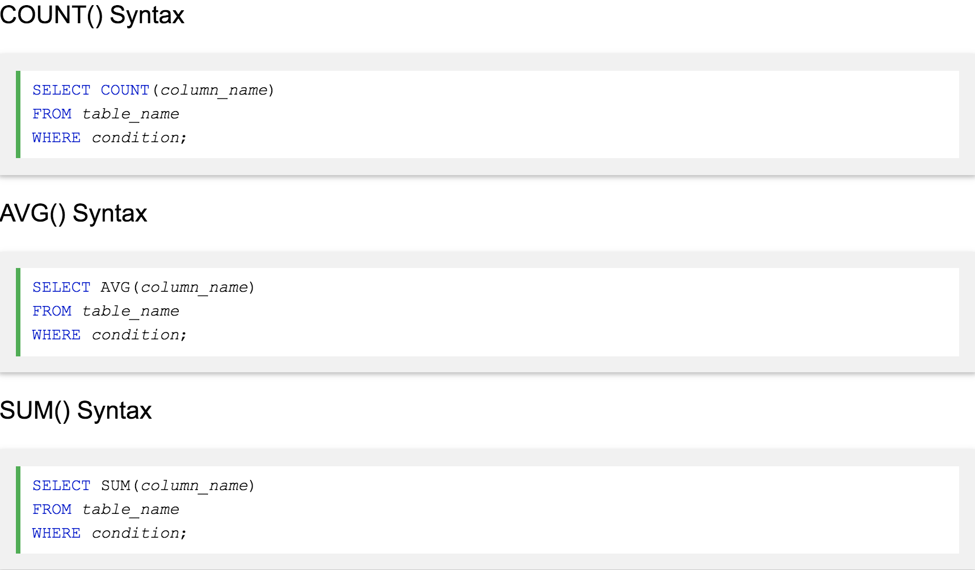

Slide 11
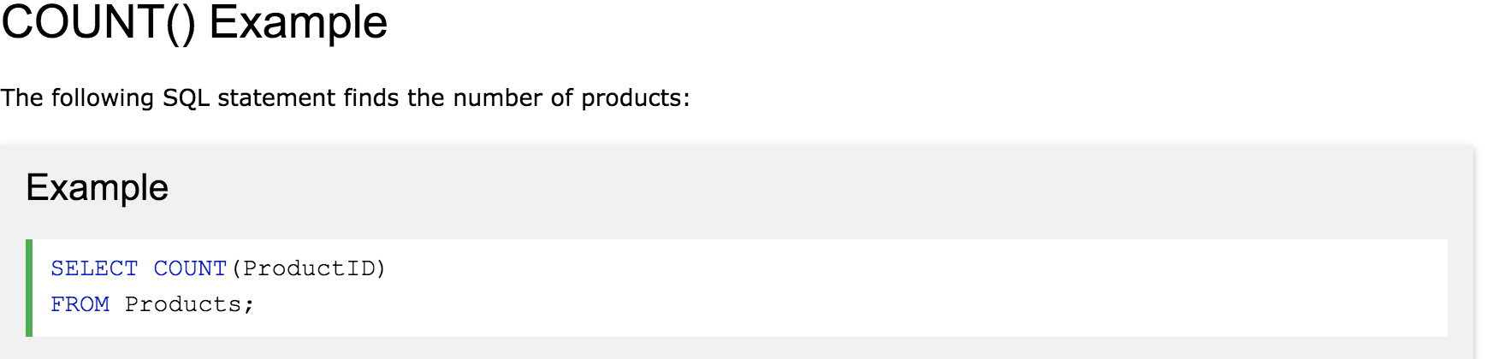
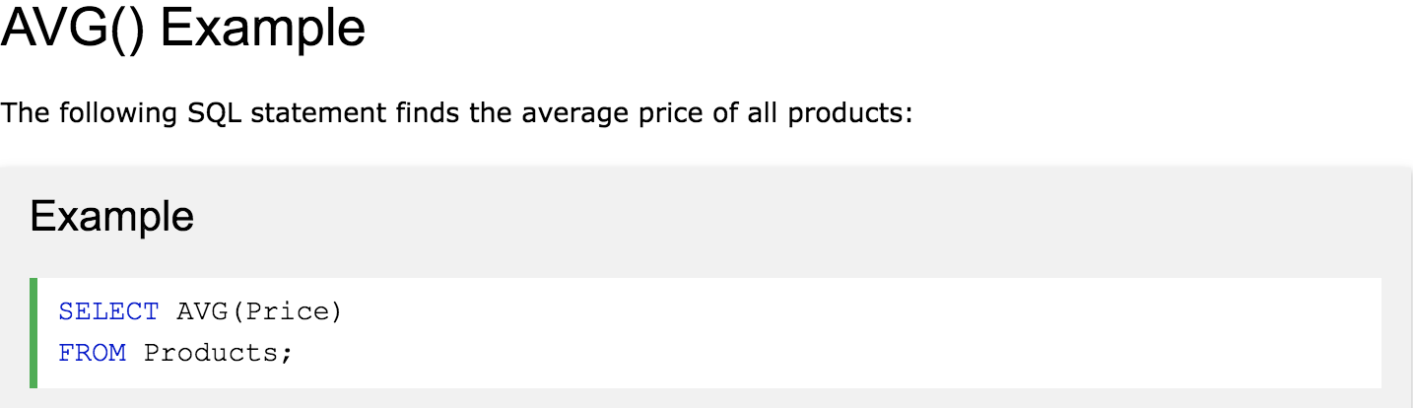

Slide 12
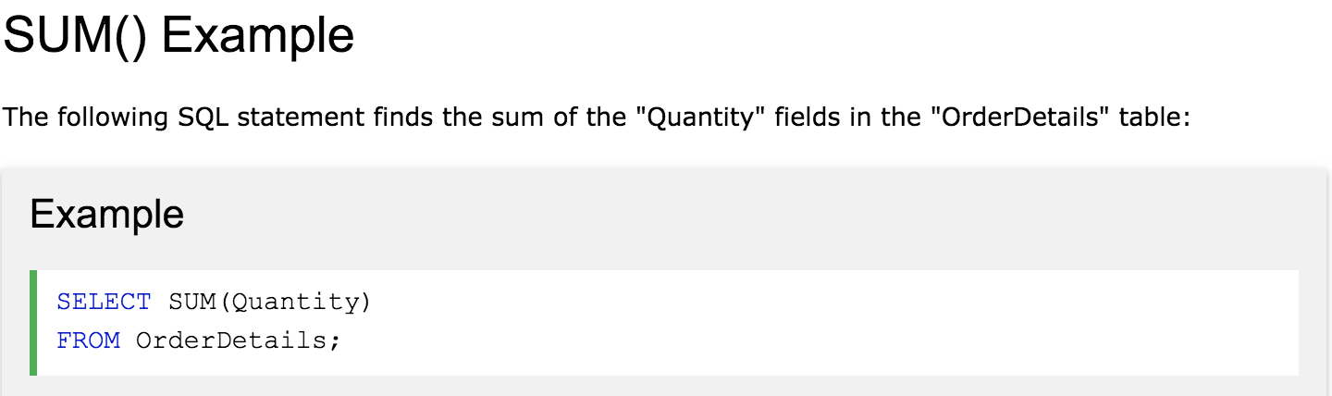

Slide 13
The SQL LIKE Operator
The LIKE operator is used in a WHERE clause to search for a specified pattern in a column.
There are two wildcards used in conjunction with the LIKE operator:
% - The percent sign represents zero, one, or multiple characters
_ - The underscore represents a single character
The percent sign and the underscore can also be used in combinations!

Slide 14
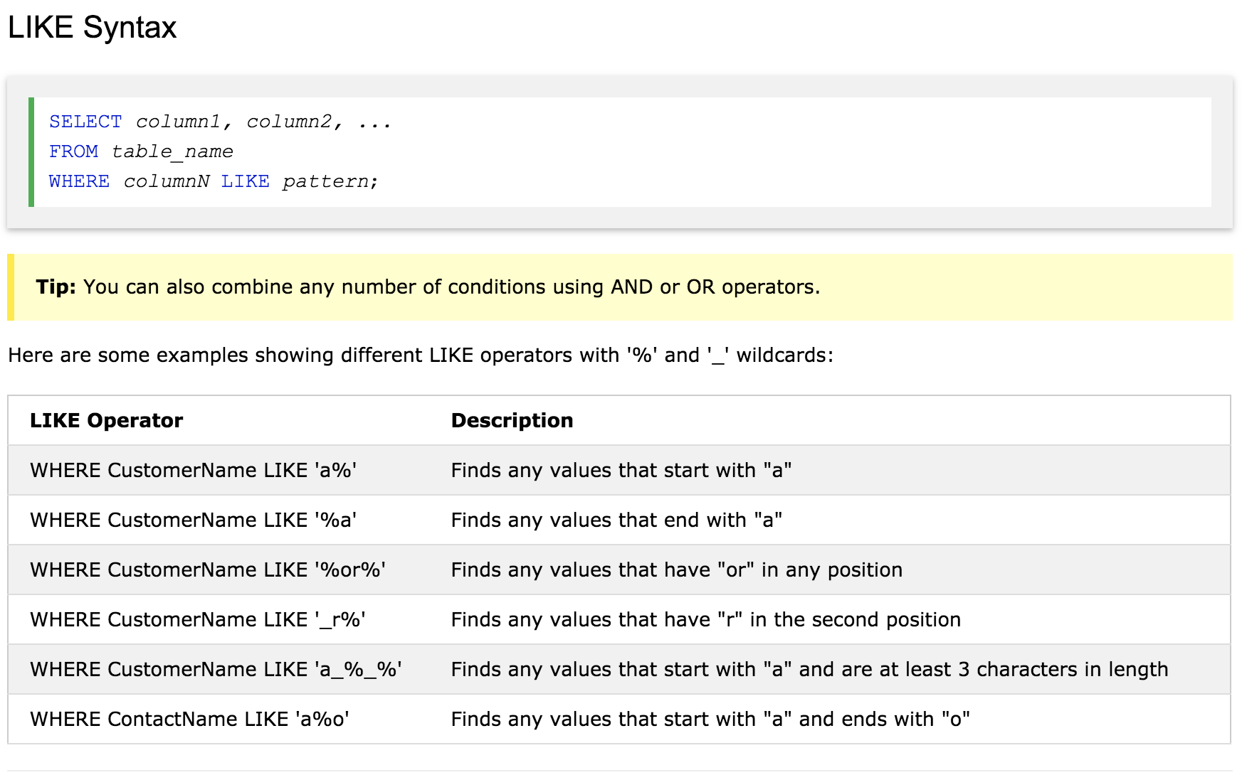

Slide 15
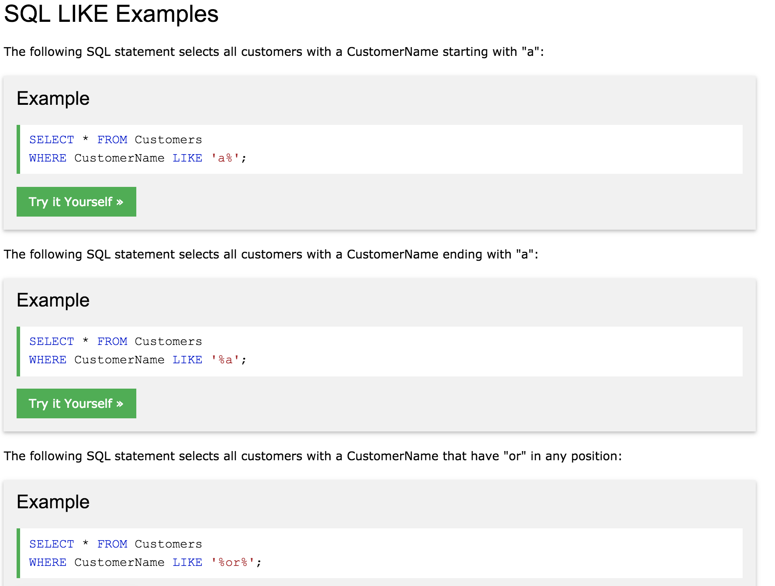

Slide 16
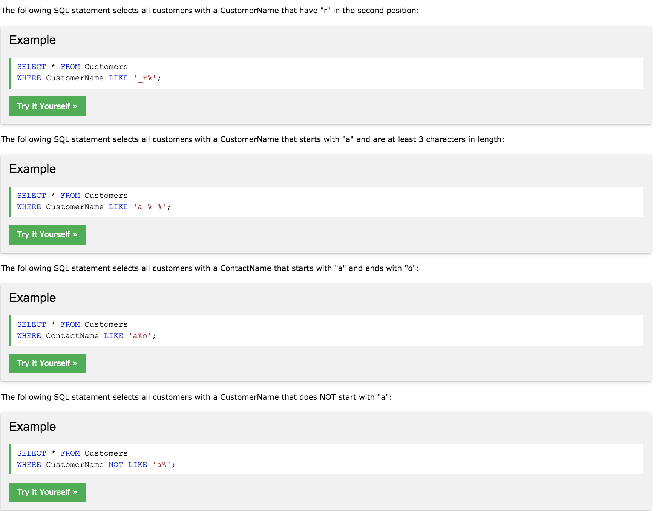

Slide 17
SQL Wildcard Characters
A wildcard character is used to substitute any other character(s) in a string.
Wildcard characters are used with the SQL LIKE operator. The LIKE operator is used in a WHERE clause to search for a specified pattern in a column.
There are two wildcards used in conjunction with the LIKE operator:
% - The percent sign represents zero, one, or multiple characters
_ - The underscore represents a single character

Slide 18
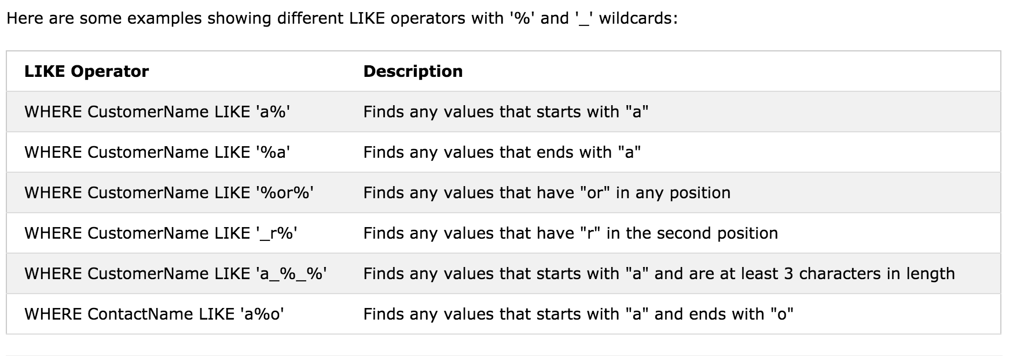

Slide 19
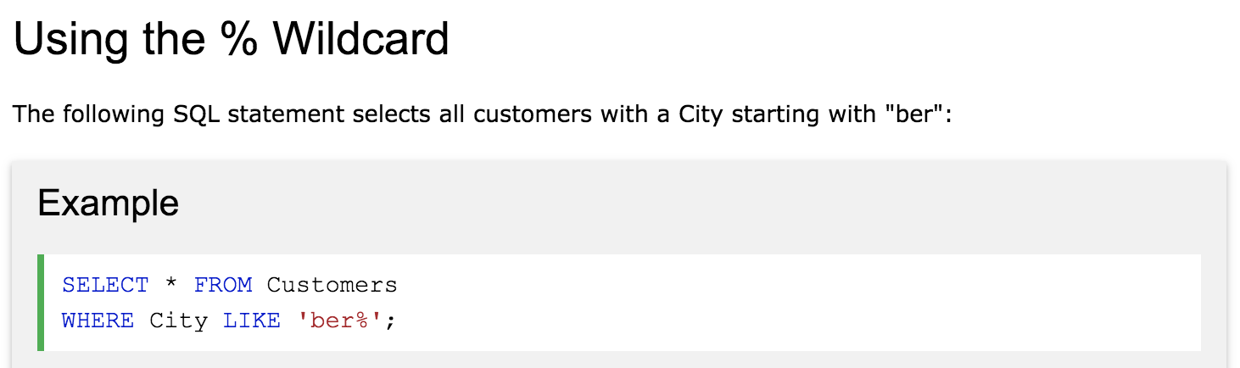

Slide 20
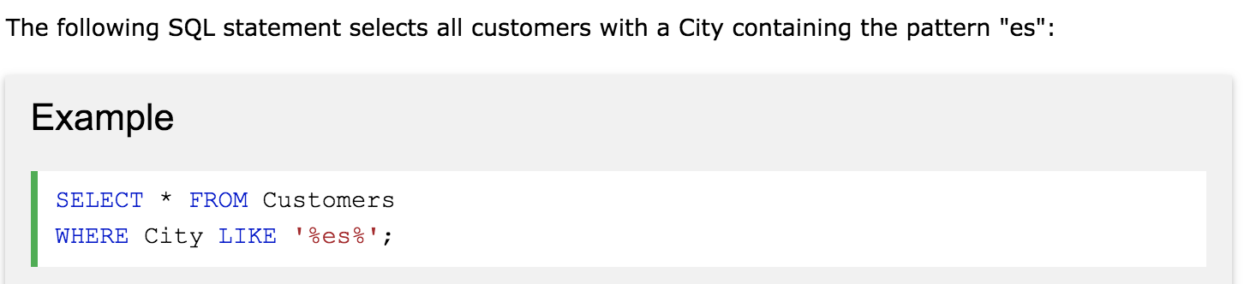

Slide 21
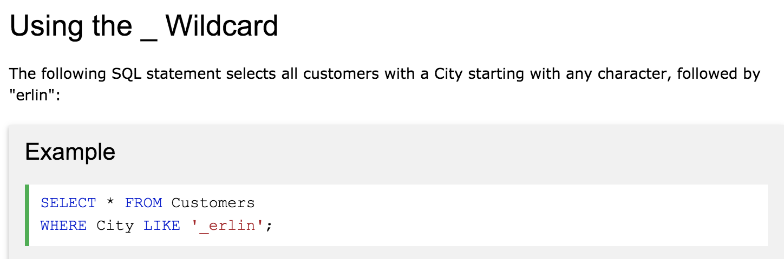

Slide 22
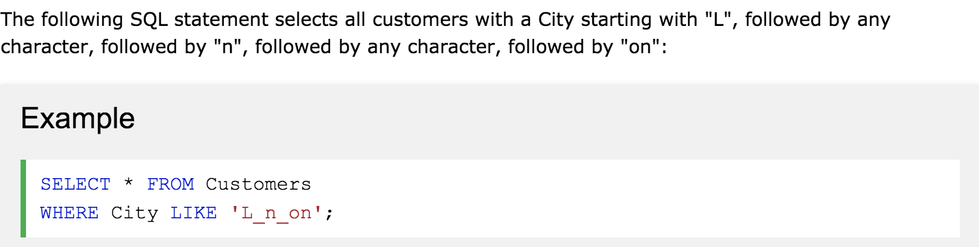

Slide 23
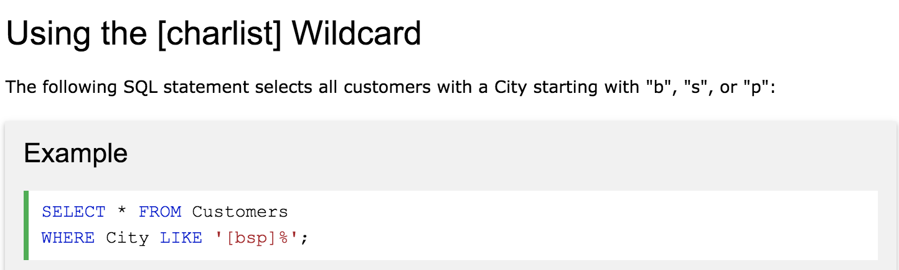

Slide 24
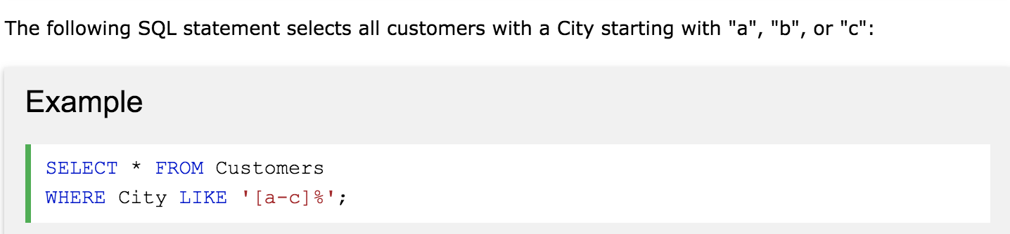

Slide 25
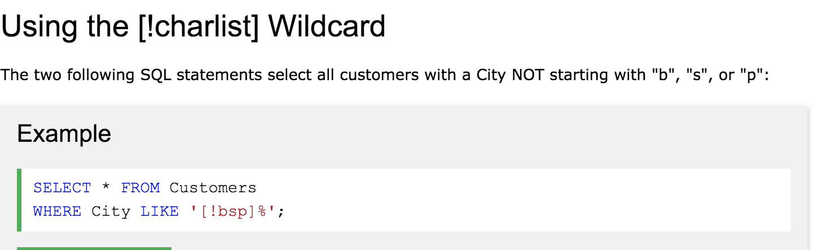
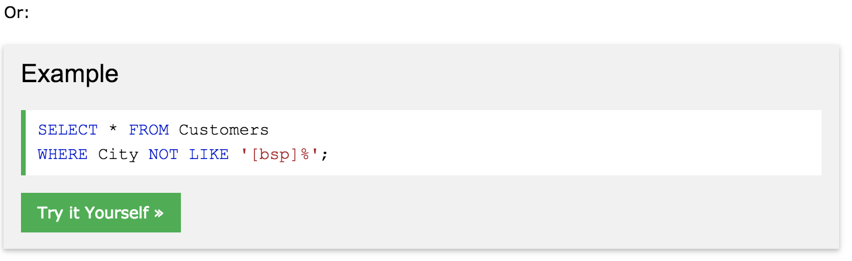

Slide 26
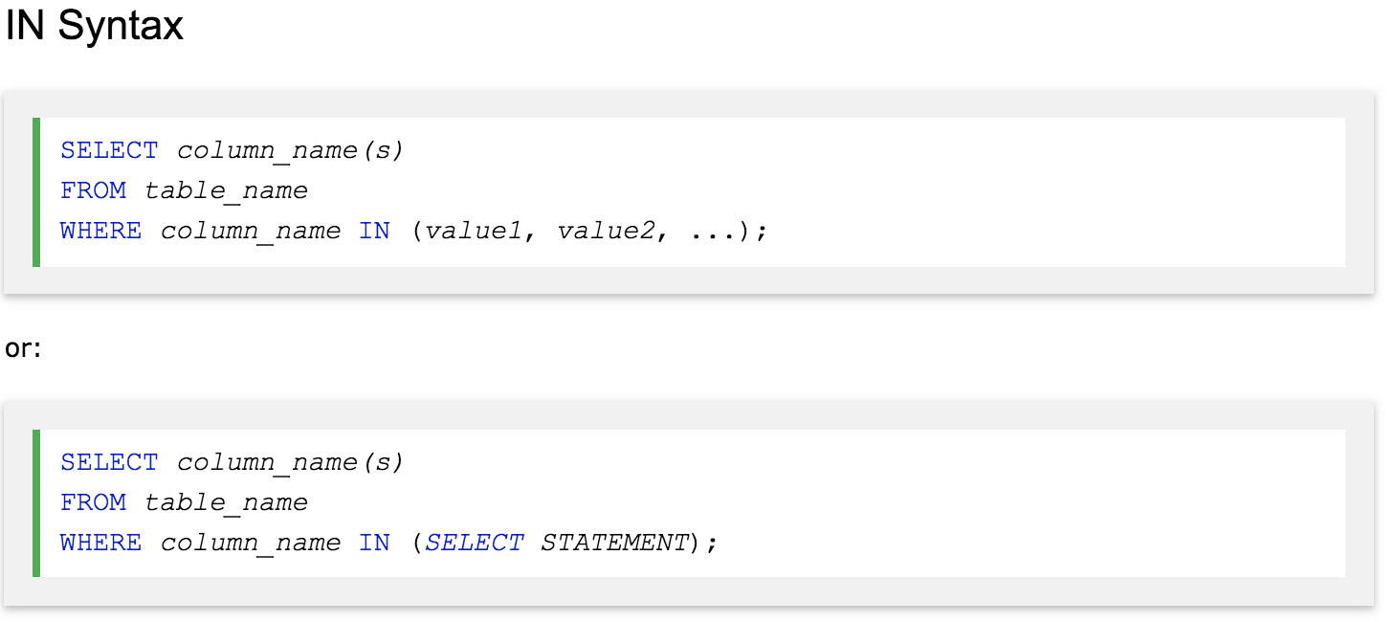
The SQL IN Operator
The IN operator allows you to specify multiple values in a WHERE clause.
The IN operator is a shorthand for multiple OR conditions.

Slide 27
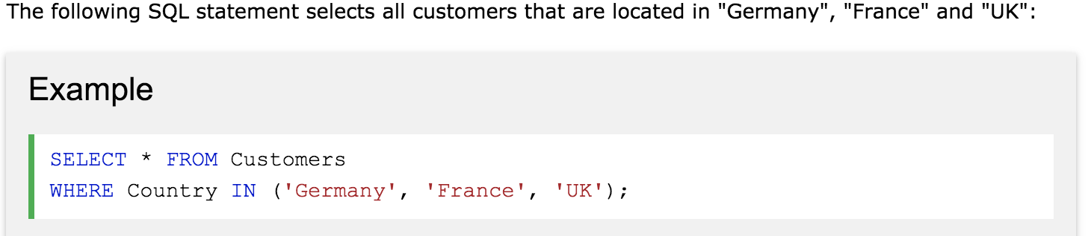
IN Operator Examples

Slide 28
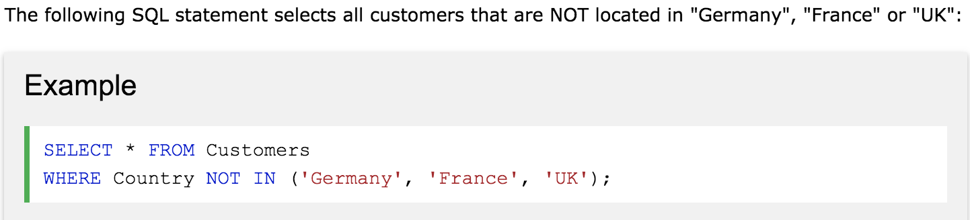

Slide 29
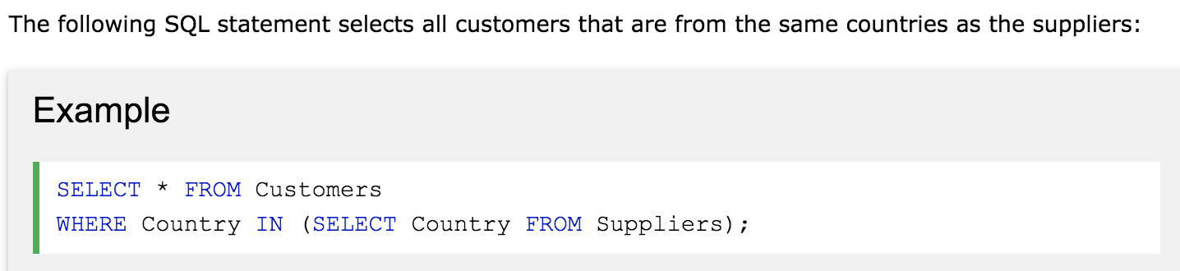
The SQL BETWEEN Operator

Slide 30
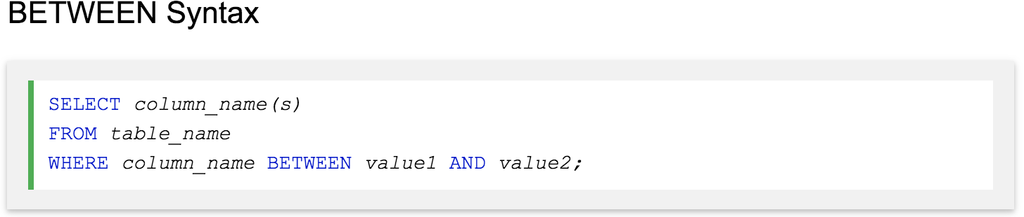
The SQL BETWEEN Operator
The BETWEEN operator selects values within a given range. The values can be numbers, text, or dates.
The BETWEEN operator is inclusive: begin and end values are included.

Slide 31
Write a SQL query to see all the records from ‘Products’ table.
Write a SQL statement selects all products with a price BETWEEN 10 and 20.

Slide 32
Solutions:
SELECT * FROM Products WHERE Price BETWEEN 10 AND 20;

Slide 33
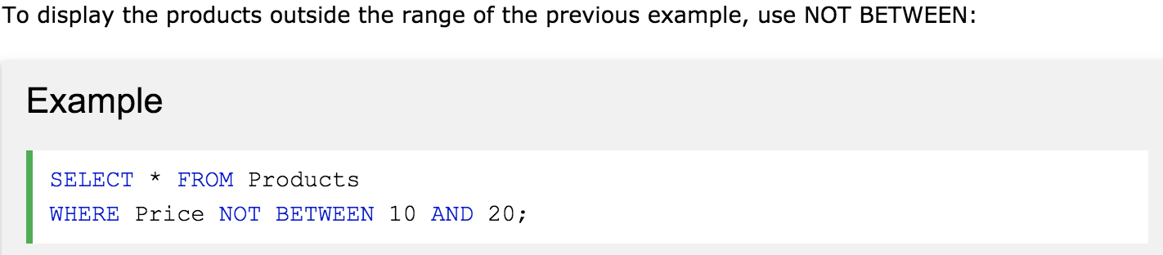
NOT BETWEEN Example

Slide 34
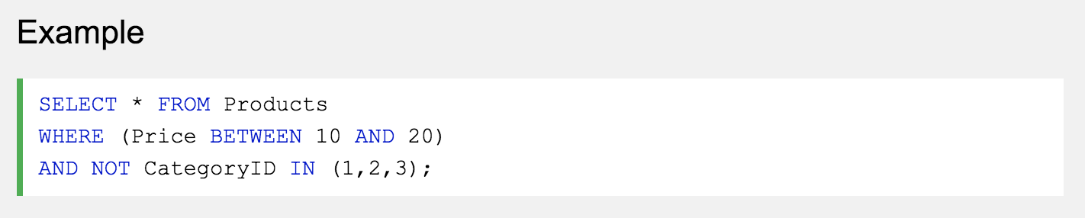
BETWEEN with IN Example
The following SQL statement selects all products with a price BETWEEN 10 and 20. In addition; do not show products with a CategoryID of 1,2, or 3:

Slide 35
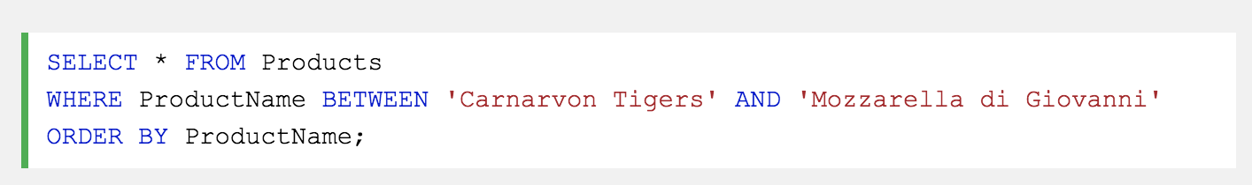
BETWEEN Text Values Example
The following SQL statement selects all products with a ProductName BETWEEN 'Carnarvon Tigers' and 'Mozzarella di Giovanni':

Slide 36
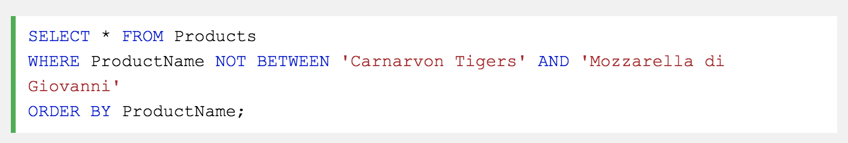
NOT BETWEEN Text Values Example
The following SQL statement selects all products with a ProductName NOT BETWEEN 'Carnarvon Tigers' and 'Mozzarella di Giovanni':

Slide 37
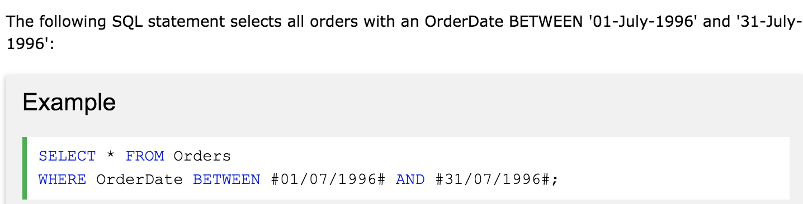
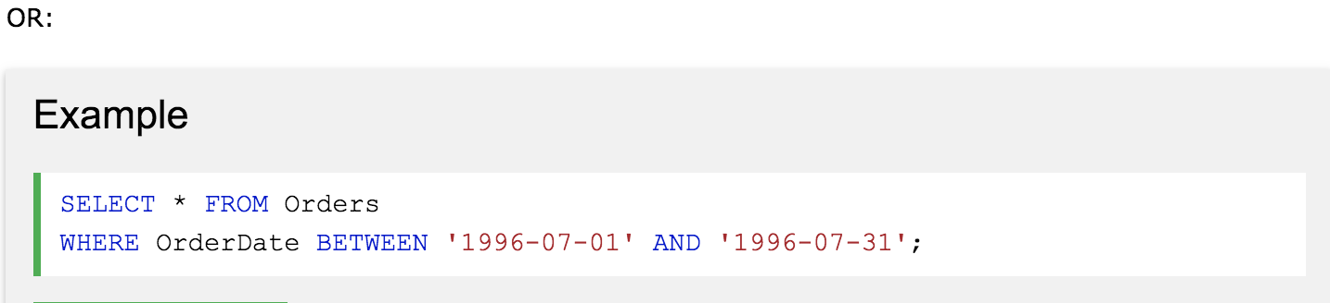
Write a SLQ statement that shows all the record in Orders table.

