Slide 1
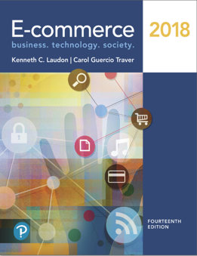
E-Commerce 2018: Business. Technology. Society
Fourteenth Edition
Chapter 7
Social, Mobile, and Local Marketing
Copyright © 2019, 2018, 2017 Pearson Education, Inc. All Rights Reserved
Notes:
If this PowerPoint presentation contains mathematical equations, you may need to check that your computer has the following installed:
1) MathType Plugin
2) Math Player (free versions available)
3) NVDA Reader (free versions available)

Slide 2
Learning Objectives
7.1 Understand the difference between traditional online marketing and the new social-mobile-local marketing platforms and the relationships between social, mobile, and local marketing.
7.2 Understand the social marketing process from fan acquisition to sales and the marketing capabilities of social marketing platforms such as Facebook, Twitter, and Pinterest.
7.3 Identify the key elements of a mobile marketing campaign.
7.4 Understand the capabilities of location-based local marketing.
Notes:
Slide 2 is list of textbook LO numbers and statements

Slide 3
Facebook: Putting Social Marketing to Work
Class Discussion
Have you ever made a purchase based on something you have read or seen on Facebook? What was the product and what made you interested?
Are there other ways for Facebook to make a profit from marketers and advertisers?
How does Facebook engage its users differently than “traditional” online marketing?

Slide 4
Introduction to Social, Mobile, and Local Marketing
New marketing concepts
Conversations
Engagement
Impact of smartphones and tablets
Social-mobile-local nexus
Strong ties between consumer use of social networks, mobile devices, and local shopping

Slide 5
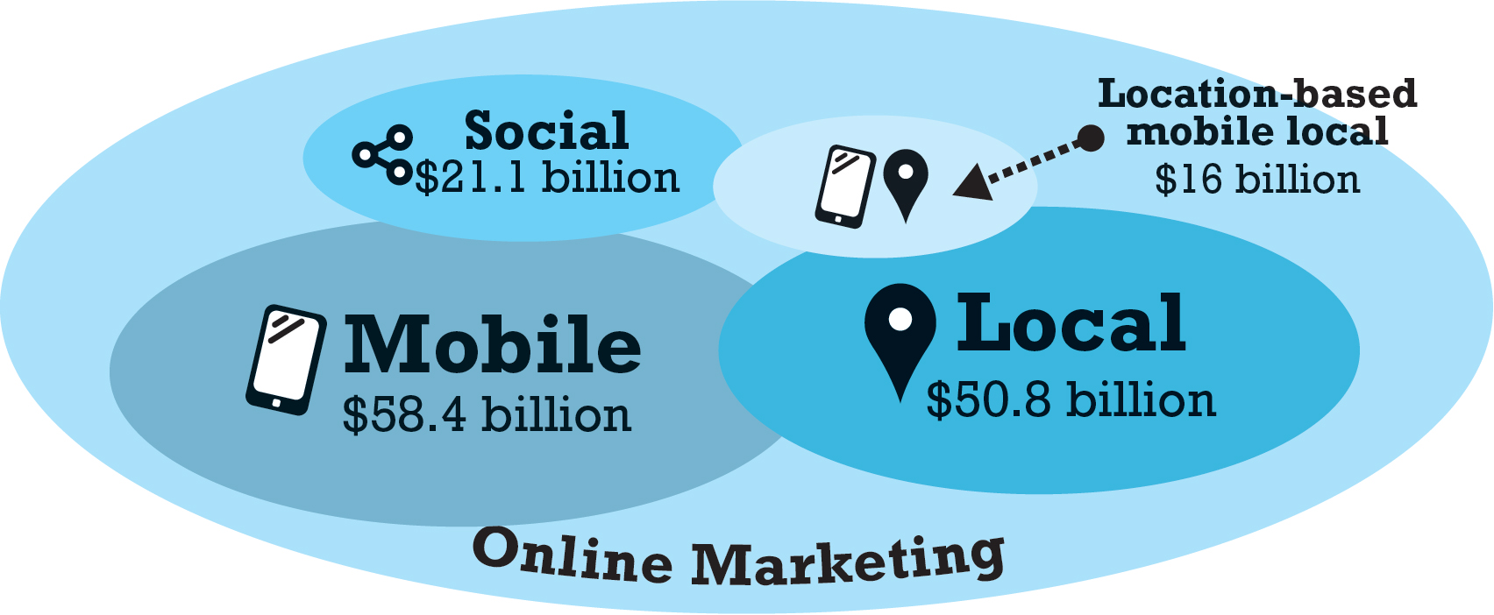
Figure 7.3 Online Marketing Platforms
Notes:
Figure 7.3, p. 437
Mobile marketing is aimed often at local audiences and is the fastest growing form of online marketing, followed closely by social marketing on social networks. Mobile local is in its infancy but it is also growing far faster than traditional desktop marketing.
SOURCES: Based on data from eMarketer, Inc., 2017a, 2017b, 2016a, BIA/Kelsey, 2017a.

Slide 6
Social Marketing
Traditional online marketing goals
Deliver business message to the most consumers
Social marketing goals
Encourage consumers to become fans and engage and enter conversations
Strengthen brand by increasing share of online conversation

Slide 7
Social Marketing Players
The most popular sites account for over 90% of all social network visits
Facebook, Twitter, LinkedIn, Pinterest, Instagram, Snapchat, Tumblr
Unique visitors versus. engagement
Engagement measures the amount and intensity of user involvement
Facebook dominates in both measures
Dark social – sharing outside of major social networks (e-mail, I M, texts, etc.)

Slide 8
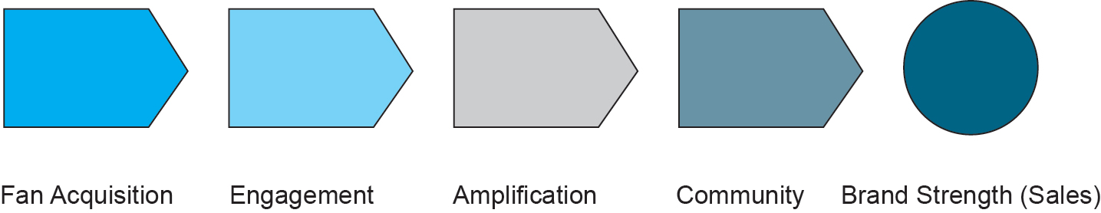
Figure 7.4 The Social Marketing Process
Notes:
Figure 7.4, Page 438
The social marketing process has five steps.

Slide 9
Facebook Marketing
Basic Facebook features
News Feed
Timeline (Profile)
Search
Social density of audience is magnified
Facebook is largest repository of deeply personal information
Facebook geared to maximizing connections between users

Slide 10
Facebook Marketing Tools
Reactions Buttons
Brand Pages
News Feed Page Post Ads
Right-Hand Column Sidebar Ads
Facebook Life
Video Ads/Mobile Ads
Facebook Messenger
Facebook Exchange (F B X)

Slide 11
Typical Facebook Marketing Campaign
Establish Facebook brand page
Use comment and feedback tools to develop fan comments
Develop a community of users
Encourage brand involvement through video, rich media, contests
Use display ads for other Facebook pages and social search
Display Like button liberally

Slide 12
Measuring Facebook Marketing Results
Basic metrics:
Fan acquisition (impressions)
Engagement (conversation rate)
Amplification (reach)
Community
Brand strength/sales
Facebook analytics tools
Facebook Page Insights
Social media management systems (HootSuite)
Analytics providers (Google Analytics, Webtrends)

Slide 13
Insight on Technology: Optimizing Social Marketing with Simply Measured
Class Discussion
How do social media analytics help companies identify and attract customers?
What are the challenges in measuring the effectiveness of social marketing campaigns?
What advantages did Trek Bicycle find in using Simply Measured’s analytics and tools?

Slide 14
Twitter Marketing
Real-time interaction with consumers
Around 328 million active users worldwide
Over 90% access Twitter from mobile device
Basic features
Tweets, retweets, followers, message (D M), hashtag, mention, reply, links
Moments tab, Timeline

Slide 15
Twitter Marketing Tools
Promoted Tweets
Promoted Trends
Promoted Accounts
Enhanced Profile Page
Amplify
Promoted Video
Television Ad Retargeting
Lead Generation Cards
Mobile Ads

Slide 16
Typical Twitter Marketing Campaign
Follow others relevant to your content and conversation
Experiment with simple Promoted Tweets
For larger budgets, use Promoted Trends and T V ad retargeting
For retail business local sales, build Lead Generation Card

Slide 17
Measuring Twitter Marketing Results
Similar to Facebook results
Fan acquisition, engagement, amplification, community, brand strength/sales
Analytics tools
Twitter’s real-time dashboard
Twitter’s Timeline activity and Followers dashboards
Third-party tools
TweetDeck, Twitalyzer, BackTweets

Slide 18
Pinterest Marketing
One of the fastest-growing and largest image-sharing sites
Enables users to talk about brands using pictures rather than words
Features include:
Pins and re-pins to boards
Share
Follow
Contributors
Links to U R L S
Price displays

Slide 19
Pinterest Marketing Tools
Rich Pins, Promoted Pins, Cinematic Pins
Buyable Pins/Shop Our Picks
Promoted Video
Add Pin It and Follow buttons
Pin as display ad
Theme-based (lifestyle) boards
Brand pages
U R L link to stores
Integration with other social sites
Network with users, followers, others

Slide 20
Typical Pinterest Marketing Campaign
Create Pinterest brand page and multiple lifestyle-themed boards
Improve quality of photos, use U R L links and keywords
Utilize Pinterest Rich Pins and/or Product pins, Pin It buttons
Integrate with Facebook and Twitter
Follow and interact with other pinners and boards
Measuring Pinterest Marketing Results
Same dimensions as Facebook, Twitter

Slide 21
Marketing on Other Social Networks
Instagram
Brand profiles, ad campaigns (display and video), Buy buttons, Marquee ads
Snapchat
Snapchat Stories, Live Stories, Discover, Snap Ads, Sponsored Geofilters, Sponsored Lenses
LinkedIn
Company profiles, showcase pages, Career Page, Display ads (Feeds), self-service ads or Advertising Partner Solutions, sponsored inMail, LinkedInPulse

Slide 22
The Downside of Social Marketing
Loss of control
Where ads appear in terms of other content
What people say
Posts
Comments
Inaccurate or embarrassing material
In contrast, T V ads maintain near complete control

Slide 23
Insight on Society: Marketing to Children of the Web in the Age of Social Networks
Class discussion:
Why is online marketing to children a controversial practice?
What is the Children’s Online Privacy Protection Act (C O P P A) and how does it protect the privacy of children?
How do companies verify the age of online users?
Should companies be allowed to target marketing efforts to children under the age of 13?

Slide 24
Mobile Marketing
Almost 265 million Americans use mobile phones; around 168 million use tablet computers
Devices used multiple times per day
By 2021, m-commerce will account for more than 50% of all retail and travel e-commerce.
Challenges: Mobile search
Motivating consumers to click
Raising fees for each click

Slide 25
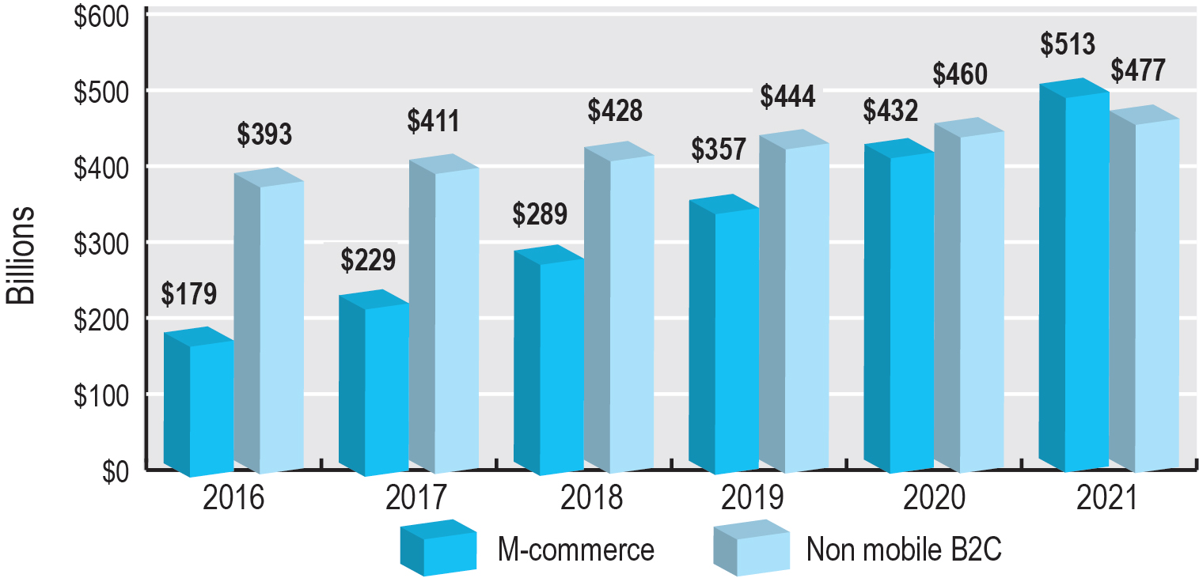
Figure 7.5 The Growth of M-Commerce
Notes:
Figure 7.5, Page 467.
M-commerce in the retail and travel industries is expected to grow to over $513 billion by 2021, surpassing the amount generated by desktop-based “traditional” e-commerce.
SOURCES: Based on data from eMarketer, Inc., 2017h, 2017i, 2017k.

Slide 26
How People Actually Use Mobile Devices
Average of about 3 1/4 hours hours daily on mobile devices
44% entertainment
20% social networks
70% occur in home
Activities are similar to desktop activities
Rapidly growing smartphone m-commerce sales
Mobile devices currently used more for communicating and entertainment than for shopping and buying

Slide 27
In-App Experiences and Ads
Mobile use
Smartphone apps—50% of total digital time
Almost 75% of app time spent on user’s top 3 apps
Users use about 25 apps/month.
App marketing
Most effective are in-app ads
Placed in most popular apps
Targeted to immediate activities and interests

Slide 28
How the Multi-Screen Environment Changes the Marketing Funnel
Consumers becoming multi-platform
Desktops, smartphones, tablets, T V
90% of multi-device users use multiple devices to complete action
View ad on T V, search on smartphone, purchase on tablet
Marketing implications
Consistent branding
Responsive design
Increased complexity, costs

Slide 29
Mobile Marketing Features
Mobile marketing over 70% of all online marketing
Dominant players are Google, Facebook
Mobile device features
Personal communicator and organizer
Screen size and resolution
G P S location
Web browser
Apps
Ultraportable and personal
Multimedia capable
Touch/haptic technology

Slide 30
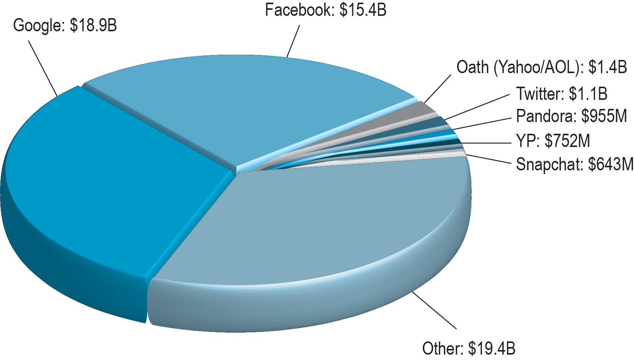
Figure 7.8 the Top U.S. Mobile Marketing Firms by U.S. Revenue
Notes:
Figure 7.8, Page 471.
Mobile advertising is still dominated by Google and its search engine, but Facebook has gained significant market share in the last four years.
SOURCE: Based on data from eMarketer, Inc., 2017m.

Slide 31
Mobile Marketing Tools: Ad Formats
Mobile marketing formats
Search ads
Display ads
Video
Text/video messaging
Other: e-mail, classifieds, lead generation
Mobile interface versions of social network techniques

Slide 32
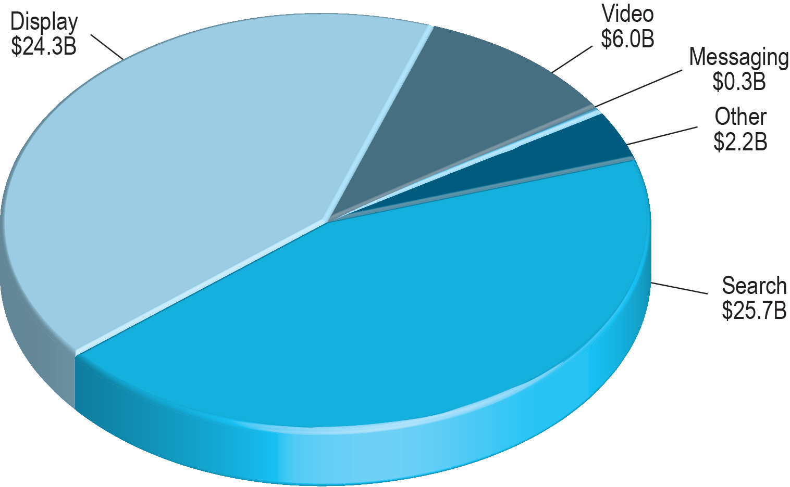
Figure 7.9 Mobile Ad Spending by Format
Notes:
Figure 7.9, page 473
Search engine advertising is the most popular mobile marketing format.
SOURCE: Based on data from eMarketer, Inc., 2017n.

Slide 33
Insight on Business: Mobile Marketing Goes 3-D
Class discussion:
Why do mobile devices represent such a promising opportunity for marketers?
What are the benefits and the appeal of 3-D mobile advertising?
Have you ever engaged with 3-D mobile ads?
What types of products are best suited for 3-D ads?

Slide 34
Mobile Marketing Campaigns
Mobile website
Facebook and Twitter brand pages
Mobile versions of display advertising campaigns
Ad networks
Interactive content aimed at mobile user
Tools for measuring responses
Key dimensions follow desktop and social marketing metrics

Slide 35
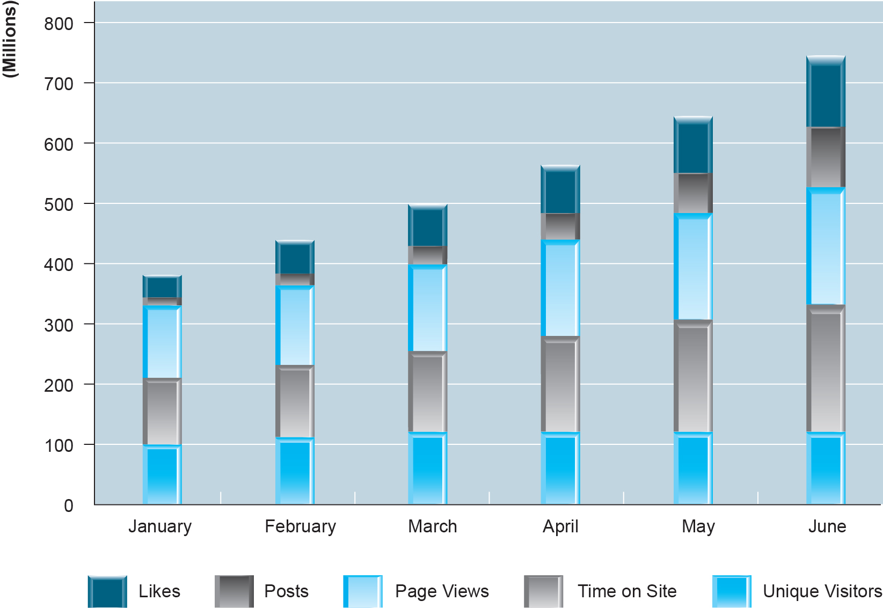
Figure 7.10 Measuring the Effectiveness of a Mobile Marketing Campaign
Notes:
Figure 7.10, page 478.
The effectiveness of a branding campaign utilizing the mobile platform and social marketing can be measured by examining the number of Likes, posts, page views, time on site, and unique visitors.

Slide 36
Local and Location-Based Marketing
Location-based marketing
Targets messages to users based on location
Marketing of location-based services
Location-based services
Provide services to users based on location
Personal navigation
Point-of-interest
Reviews
Friend-finders, family trackers
Consumers have high likelihood of responding to local ads

Slide 37
The Growth of Local and Location-Based Mobile Marketing
Prior to 2005, nearly all local advertising was non-digital
Google Maps (2005)
Enabled targeting ads to users based on I P address and general geographic location
Smartphones, Google’s mobile maps app (2007)
Enabled targeting ads based on G P S
Location-based mobile marketing
Expected to triple over next five years

Slide 38
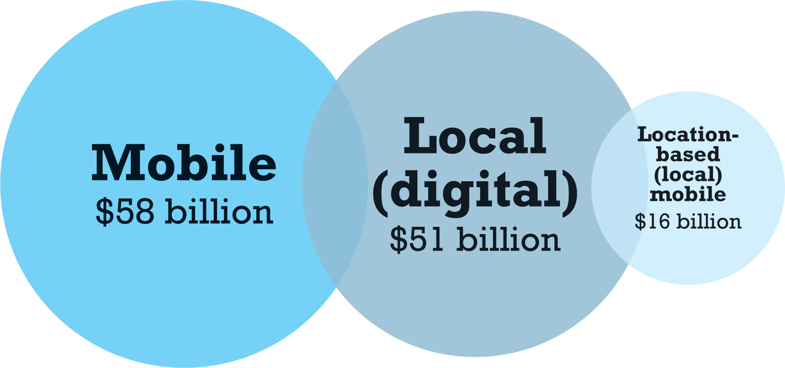
Figure 7.11 Local, Mobile, and Location-Based Mobile Marketing
Notes:
Figure 7.11, Page 480.
Local online marketing will account for about $51 billion in marketing expenditures in 2017, with location-based mobile expected to account for $16 billion of that amount.
SOURCES: Based on data from eMarketer, Inc., 2016b, 2016c; BIA/Kelsey, 2017b, 2016.

Slide 39
Location-Based Marketing Platforms
Google
Android O S, Google Maps, Google Places, AdMob, AdWords
Facebook
Apple
i O S
Twitter
Others: Y P, Pandora, Millennial Media

Slide 40
Location-Based Mobile Marketing Technologies
Two types of location-based marketing techniques
Geo-aware techniques
Identify location of user’s device and target ads, recommending actions within reach
Proximity marketing
Identify a perimeter around a location and target ads and recommendations within that perimeter
Identifying locations
G P S signals
Cell-tower locations
Wi-Fi locations

Slide 41
Why is Local Mobile Attractive to Marketers?
Mobile users more active, ready to purchase than desktop users
Over 80% of U.S. consumers use mobile devices to search for local products, services
50% of smartphone users visit a store within 1 day of local search
18% of smartphone users make a purchase

Slide 42
Location-Based Marketing Tools
Geo-social-based services marketing
Location-based services marketing
Mobile-local social network marketing
Proximity marketing
In-store messaging
Location-based app messaging

Slide 43
Location-Based Marketing Campaigns
Location-based considerations
Action-based, time-restrained offers and opportunities
Target demographic and location-aware mobile user demographics
Strategic analysis of marketspaces
Measuring marketing results
Same measures as mobile and Web marketing
Metrics for unique characteristics
Inquire
Reserve
Click-to-call
Friend
Purchase

Slide 44
Careers in E-Commerce
Position: Social Media Associate
Qualification/Skills
Preparing for the Interview
Possible Interview Questions

Slide 45

Copyright

