Slide 1
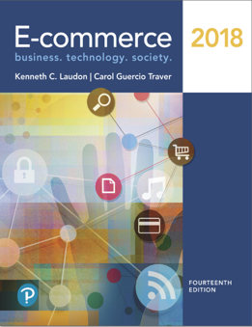
E-Commerce 2018: Business. Technology. Society
Fourteenth Edition
Chapter 8
Ethical, Social, and Political Issues in E-Commerce
Copyright © 2019, 2018, 2017 Pearson Education, Inc. All Rights Reserved
Notes:
If this PowerPoint presentation contains mathematical equations, you may need to check that your computer has the following installed:
1) MathType Plugin
2) Math Player (free versions available)
3) NVDA Reader (free versions available)

Slide 2
Learning Objectives
8.1 Understand why e-commerce raises ethical, social, and political issues.
8.2 Understand basic concepts related to privacy and information rights, the practices of e-commerce companies that threaten privacy, and the different methods that can be used to protect online privacy.
8.3 Understand the various forms of intellectual property and the challenges involved in protecting it.
8.4 Understand how the Internet is governed and why taxation of e-commerce raises governance and jurisdiction issues.
8.5 Identify major public safety and welfare issues raised by e-commerce.
Notes:
Slide 2 is list of textbook LO numbers and statements

Slide 3
The Right to Be Forgotten: Europe Leads on Internet Privacy
Class Discussion
Is Google responsible for the accuracy of links to other information? Why or why not?
Why do European and American views on privacy protection differ so dramatically?
How can the different perspectives on privacy be managed in a global environment like the Internet?

Slide 4
Understanding Ethical, Social, and Political Issues in E-Commerce
Internet, like other technologies, can:
Enable new crimes
Affect environment
Threaten social values
Costs and benefits must be carefully considered, especially when there are no clear-cut legal or cultural guidelines

Slide 5
A Model for Organizing the Issues
Issues raised by Internet and e-commerce can be viewed at individual, social, and political levels
Four major categories of issues:
Information rights
Property rights
Governance
Public safety and welfare

Slide 6
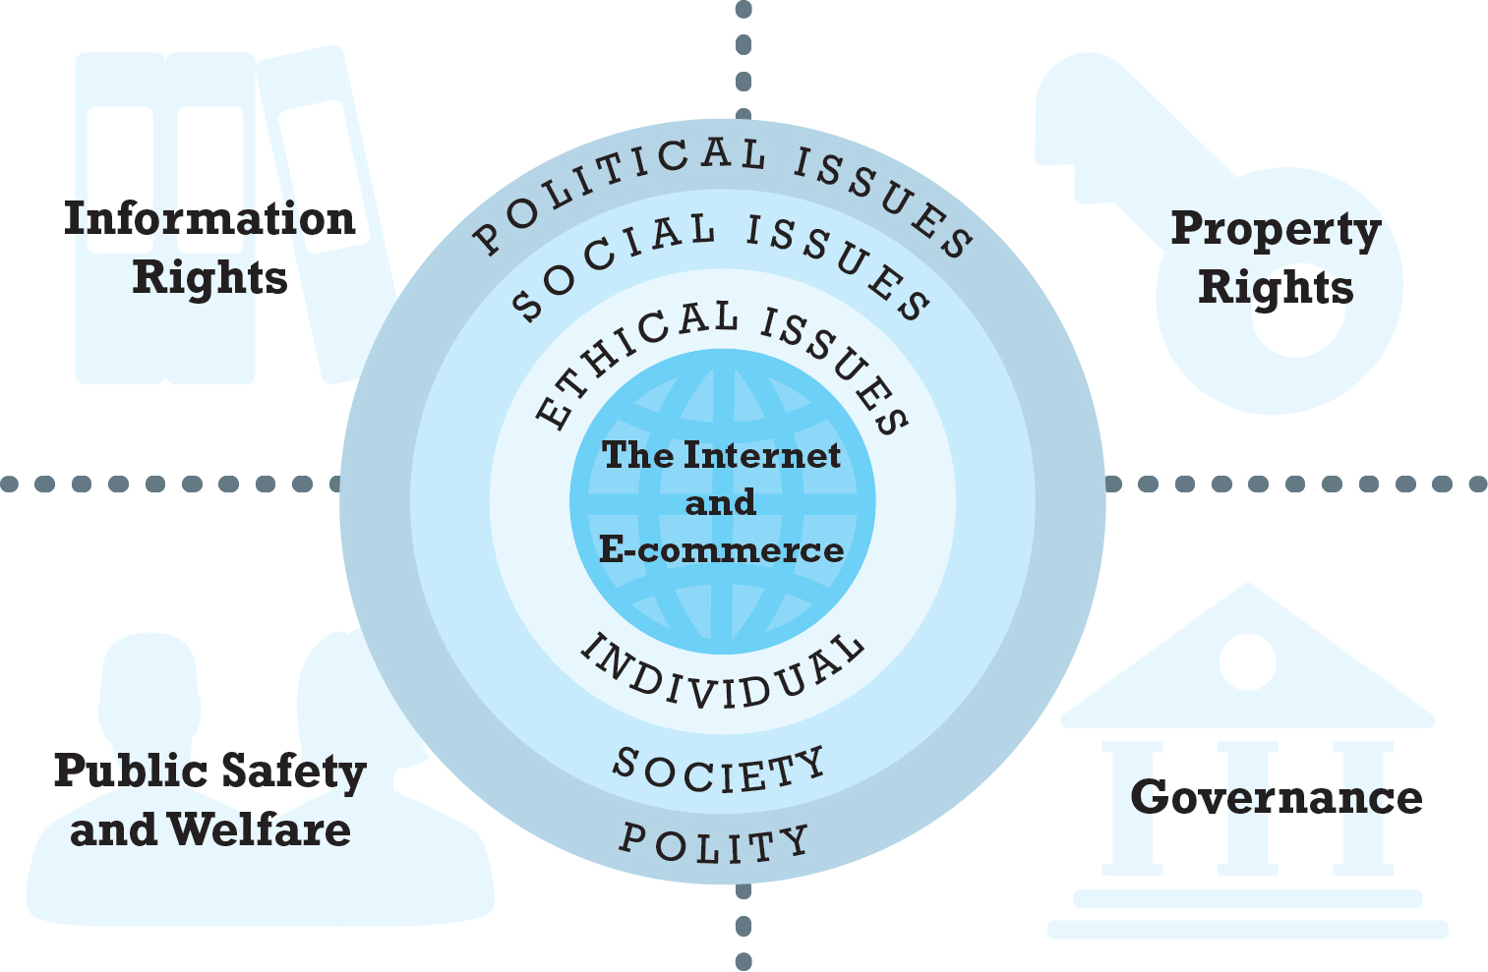
Figure 8.1 The Moral Dimensions of an Internet Society
Notes:
Figure 8.1, Page 508
The introduction of the Internet and e-commerce impacts individuals, societies, and political institutions. These impacts can be classified into four moral dimensions: property rights, information rights, governance, and public safety and welfare.

Slide 7
Basic Ethical Concepts
Ethics
Study of principles used to determine right and wrong courses of action
Responsibility
Accountability
Liability
Laws permitting individuals to recover damages
Due process
Laws are known, understood
Ability to appeal to higher authorities to ensure laws applied correctly

Slide 8
Analyzing Ethical Dilemmas
Process for analyzing ethical dilemmas:
Identify and clearly describe the facts
Define the conflict or dilemma and identify the higher-order values involved
Identify the stakeholders
Identify the options that you can reasonably take
Identify the potential consequences of your options

Slide 9
Candidate Ethical Principles
Golden Rule
Universalism
Slippery Slope
Collective Utilitarian Principle
Risk Aversion
No Free Lunch
The New York Times Test
The Social Contract Rule

Slide 10
Privacy and Information Rights
Privacy
Moral right of individuals to be left alone, free from surveillance or interference from other individuals, organizations, or state
Information privacy: 4 premises
Right to control information collected about them
“Right to be forgotten”
Right to know when information is collected and give consent
“Informed consent”
Right to personal information due process
Right to have personal information stored in a secure manner

Slide 11
Table 8.2 The F T C’s Fair Information Practice Principles
Principle | Description
Notice/Awareness (core principle) | Sites must disclose their information practices before collecting data. Includes identification of collector, uses of data, other recipients of data, nature of collection (active/inactive), voluntary or required, consequences of refusal, and steps taken to protect confidentiality, integrity, and quality of the data.
Choice/Consent (core principle) | There must be a choice regime in place allowing consumers to choose how their information will be used for secondary purposes other than supporting the transaction, including internal use and transfer to third parties. Opt-in/opt-out must be available.
Access/Participation | Consumers should be able to review and contest the accuracy and completeness of data collected about them in a timely, inexpensive process.
Security | Data collectors must take reasonable steps to assure that consumer information is accurate and secure from unauthorized use.
Enforcement | There must be a mechanism to enforce F I P principles in place. This can involve self-regulation, legislation giving consumers legal remedies for violations, or federal statutes and regulation.

Slide 12
Privacy in The Public Sector: Privacy Rights of Citizens
Public sector privacy rights have long history
First Amendment
Fourth Amendment
Fourteenth Amendment
Constitutional, implied privacy rights did not cover collection and use of personal information
1974 Privacy Act
Federal and state law to protect individuals against unreasonable government intrusion

Slide 13
Privacy in The Private Sector: Privacy Rights of Consumers
Privacy issues rose with first large-scale, nationwide computerized systems
Credit card systems, credit rating agencies
Piecemeal federal and state privacy legislation, applying to specific industries
Spokeo v. Robins: what harm must be shown in order to sue?
Historically, few claims to privacy in public, open markets such as in e-commerce
Emergence of Internet has created enormous collections of personal data
Ideal environment for business and government to invade personal privacy of consumers
Google, Amazon, Netflix, etc.

Slide 14
Information Collected by Websites
Data collected includes
Personally identifiable information (P I I)
Anonymous information
Types of data collected
Name, address, phone, e-mail, social security
Bank and credit accounts, gender, age, occupation, education
Preference data, transaction data, clickstream data, browser type

Slide 15
Key Issues in Online Privacy of Consumers
Top concerns
Profiling and ad targeting
Social network privacy
Sharing of information by marketers
Mobile phone privacy
Digital assistant privacy

Slide 16
Marketing: Profiling, Behavioral Targeting, and Retargeting (1 of 2 )
Profiling
Creation of data images that characterize online individual and group behavior
Anonymous profiles
Personal profiles
Facial recognition a new dimension
Advertising networks
Track consumer and browsing behavior on Web
Dynamically adjust what user sees on screen
Build and refresh profiles of consumers
Google’s new privacy policy

Slide 17
Marketing: Profiling, Behavioral Targeting, and Retargeting (2 of 2 )
Business perspective:
Increases effectiveness of advertising, subsidizes content
Enables sensing of demand for new products
Critics’ perspective:
Undermines expectation of anonymity and privacy
Enables price discrimination

Slide 18
Social Networks: Privacy and Self-Revelation
Social networks
Encourage sharing personal details
Pose unique challenge to maintaining privacy
Facebook
Massive database
Serving ads to users not on Facebook
Sharing information with third parties
Personal control over personal information versus. Organization’s desire to monetize social network

Slide 19
Mobile Devices: Privacy Issues
Mobile apps
Funnel personal information to mobile advertisers for targeting ads
Track and store user locations
Track users’ use of other apps
Persistent location tracking
U.S. Supreme Court rules that police need warrant prior to searching a cell phone for information

Slide 20
Consumer Privacy Regulation: the F T C (1 of 2)
Fair Information Practice (F I P) principles
Informed consent: Opt-in and opt-out
Harm-based approach
“Do Not Track” mechanism
Recent emphasis is to give consumer rights regarding collected personal information

Slide 21
Consumer Privacy Regulation: the F T C (2 of 2)
F T C’s new privacy framework
Scope:
Applies to all commercial entities
Privacy by Design:
Companies should promote consumer privacy throughout the organization and at all stages in the development of products
Simplified Choice
Companies should simplify consumer choice
Greater Transparency

Slide 22
Consumer Privacy Regulation: the Federal Communications Commission (F C C)
2015 classification of broadband I S P s as similar to public utility services and subject to F C C regulation
2016 F C C approved new privacy rules for broadband I S P s
Must notify users of privacy options or obtain user consent to collect information
Service cannot be contingent on users surrendering privacy
2017 Congress voted to repeal privacy rules for broadband I S P s

Slide 23
Privacy Policies
Website Terms of Use Notices
Recent study showed these polices would take average reader 8 hours to read policies
Have conflicting statements
Little oversight and comparison between policies of different companies

Slide 24
Privacy Protection in Europe
European privacy protection much stronger than in United States
1998 European Commission’s Directive on Data Protection (1998)
Safe harbor
2016 E. U. General Data Protection Regulation (G D P R)
Privacy Shield
Privacy environment has turned against U.S. firms like Facebook and unfettered collection and use of personal data

Slide 25
Industry Self-Regulation
Privacy seal programs
Network Advertising Initiative (N A I)
Ad Choices Program
In general, self-regulation has not succeeded in reducing American fears of privacy invasion or reducing the level of privacy invasion

Slide 26
Technology Solutions
Solutions include
Spyware blockers
Pop-up blockers and ad blockers
Secure e-mail, anonymous remailers
Cookie managers
Disk/file erasing programs
Public key encryption
None address core issues of consumer privacy
What information is collected and how it is used
Consumer rights

Slide 27
Privacy Protection
Privacy protection as a business
Privacy advocacy groups

Slide 28
Limitations on The Right to Privacy
Edward Snowden & N S A Prism program
Law enforcement and surveillance
U S A Freedom Act
Apple’s iPhone 6 and encryption
Use of personal data by government agencies

Slide 29
Insight on Technology: Apple: Defender of Privacy?
Class Discussion
Are there circumstances that warrant the invasion of personal digital information and property?
Is the All Writs Act of 1789 applicable to today’s technology-driven privacy issues?
Should citizens charged with a crime or convicted criminals have any rights to privacy?
How does Apple’s views on privacy differ from those of Facebook’s and Google’s?

Slide 30
Intellectual Property Rights
Intellectual property:
All tangible and intangible products of human mind
Major ethical issue:
How should we treat property that belongs to others?
Major social issue:
Is there continued value in protecting intellectual property in the Internet age?
Major political issue:
How can Internet and e-commerce be regulated or governed to protect intellectual property?

Slide 31
Intellectual Property Protection
Main types of protection:
Copyright
Patent
Trademark law
Trade secrets law
Goal of intellectual property law:
Balance two competing interests—public and private
Maintaining this balance of interests is always challenged by the invention of new technologies

Slide 32
Copyright
Protects original forms of expression (not ideas) from being copied by others for a period of time
Fair use doctrine
Digital Millennium Copyright Act of 1998
First major effort to adjust copyright laws to Internet age
Implements W I P O treaty that makes it illegal to make, distribute, or use devices that circumvent technology-based protections of copyrighted materials
Safe-harbor provisions

Slide 33
Patents
Grant owner 20-year monopoly on ideas behind an invention
Invention must be new, non-obvious, novel
Encourages inventors
Promotes dissemination of new techniques through licensing
Stifles competition by raising barriers to entry

Slide 34
E-Commerce Patents
1998 State Street Bank & Trust v. Signature Financial Group
Business method patents
2014 Alice Corporation lawsuit:
Supreme Court rules that software does not make a basic business method or abstract idea patentable
E-commerce patents
Amazon: One-click purchasing
Akamai: Internet content delivery global hosting system

Slide 35
Trademarks
Identify, distinguish goods, and indicate their source
Purpose
Ensure consumer gets what is paid for/expected to receive
Protect owner against piracy and misappropriation
Infringement
Dilution
Federal Trademark Dilution Act and Trademark Dilution Revision Act
Uniform Rapid Suspension System (U R S)

Slide 36
Trademarks and the Internet
Cybersquatting and brand-jacking
Anticybersquatting Consumer Protection Act (A C P A)
Cyberpiracy
Typosquatting
Metatagging
Keywording
Linking and deep linking
Framing

Slide 37
Trade Secrets
Business procedures, formulas, methods of manufacture and service delivery
May not be unique or novel
Trade secrets are
(a) secret
(b) have commercial value to owner
(c) owner has taken steps to protect
2016 Defend Trade Secrets Act

Slide 38
Who Governs the Internet and E-Commerce?
Mixed mode environment
Self-regulation, through variety of Internet policy and technical bodies, co-exists with limited government regulation
I C A N N : Domain Name System
Internet can be easily controlled, monitored, and regulated from a central location

Slide 39
Taxation
Non-local nature of Internet commerce complicates governance and jurisdiction issues
Sales taxes
Governments in Europe and U.S. rely on sales taxes
M O T O retailing tax subsidies
E-commerce tax subsidy
Internet Tax Freedom Act

Slide 40
Insight on Business: Internet Sales Tax Battle
Class discussion:
Given the nature of the Internet, should sales tax be based on the location of the consumer rather than the seller?
What are the different approaches Amazon has taken with respect to sales taxes?
Are bricks-and-clicks retailers disadvantaged by local sales tax laws?

Slide 41
Net Neutrality
All Internet activities charged the same rate, regardless of bandwidth used
Netflix and YouTube together consume about 50% of bandwidth in United States
Prior to 2015, I S P s could throttle high-volume users
February 2015, F C C ruled that broadband I S P s should be viewed and regulated as public utilities
Under Trump administration, net neutrality regulations likely to be repealed

Slide 42
Public Safety and Welfare
Protection of children against pornography and privacy infringement
Passing legislation that will survive court challenges has proved difficult
Efforts to control gambling and restrict sales of drugs and cigarettes
Prevent All Cigarette Trafficking Act
Unlawful Internet Gambling Enforcement Act
Increase in number of states allowing online gambling

Slide 43
Insight on Society: the Internet Drug Bazaar
Class discussion:
What’s wrong with buying prescription drugs online, especially if the prices are lower?
What are the risks and benefits of online pharmacies?
Should online pharmacies require a physician’s prescription?
How do online pharmacies challenge the traditional business model of pharmacies and drug firms?
What are the challenges in regulating online pharmacies?
Who benefits and who loses from online pharmacies?

Slide 44
Careers in E-Commerce
Position: E-commerce Privacy Research Associate
Qualification/Skills
Preparing for the Interview
Possible Interview Questions

Slide 45

Copyright

