Slide 1
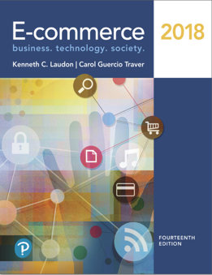
E-Commerce 2018: Business. Technology. Society
Fourteenth Edition
Chapter 9
Online Retail and Services
Copyright © 2019, 2018, 2017 Pearson Education, Inc. All Rights Reserved
Notes:
If this PowerPoint presentation contains mathematical equations, you may need to check that your computer has the following installed:
1) MathType Plugin
2) Math Player (free versions available)
3) NVDA Reader (free versions available)

Slide 2
Learning Objectives
9.1 Understand the environment in which the online retail sector operates today.
9.2 Explain how to analyze the economic viability of an online firm.
9.3 Identify the challenges faced by the different types of online retailers.
9.4 Describe the major features of the online service sector.
9.5 Discuss the trends taking place in the online financial services industry.
9.6 Describe the major trends in the online travel services industry today.
9.7 Identify current trends in the online career services industry.
9.8 Understand the business models of on-demand service companies.
Notes:
Slide 2 is list of textbook LO numbers and statements

Slide 3
Blue Nile Sparkles for Your Cleopatra
Class Discussion
Why is selling (or buying) diamonds over the Internet difficult?
How has Blue Nile built its supply chain to keep costs low?
How has Blue Nile reduced consumer anxiety over online diamond purchases?
What are some vulnerabilities facing Blue Nile?
Would you buy a $5,000 engagement ring at Blue Nile?

Slide 4
What’s New in Online Retail
Retail mobile e-commerce exploding
Social networks experiment with social e-commerce
Local e-commerce skyrockets to around $80 billion
Online retail still the fastest growing retail channel
Selection of goods increases, includes luxury goods
Specialty retail sites show rapid growth
New subscription based model for online retailing
Big data used for predictive marketing

Slide 5
The Online Retail Sector
Most important theme in online retailing is effort to integrate online and offline operations
$19.25 trillion U.S. economy
U.S. retail market
Personal consumption of goods and services accounts for $13.3 trillion (about 69%) of total gross domestic product (G D P)

Slide 6
The Retail Industry
7 segments (clothing, durable goods, etc.)
For each, uses of Internet may differ
Information versus. direct purchasing
Mail order/telephone order (M O T O) sector
Most similar to online retail sector
Sophisticated order entry, delivery, inventory control systems

Slide 7
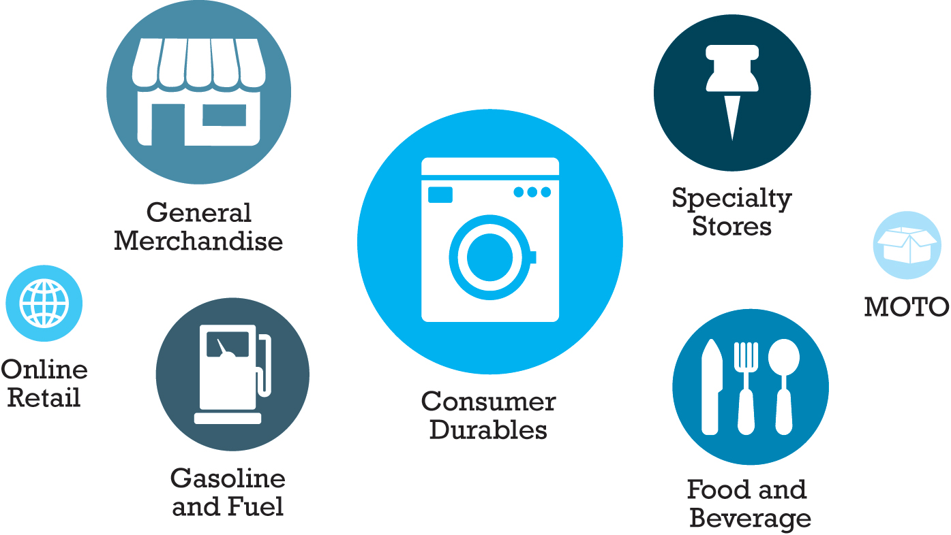
Figure 9.1 Composition of the U.S. Retail Industry
Notes:
Figure 9.1, Page 596
The retail industry can be grouped into seven major segments.

Slide 8
E-Commerce Retail: The Vision
The Vision
Reduced search and transaction costs; customers able to find lowest prices
Lowered market entry costs, lower operating costs, higher efficiency
Traditional physical store merchants forced out of business
Some industries would be disintermediated
Few of these assumptions were correct—structure of retail marketplace has not been revolutionized
Internet has created new venues for omni-channel firms and supported a few pure-play merchants

Slide 9
The Online Retail Sector Today (1 of 2)
Smallest segment of retail industry (9%)
Growing at faster rate than offline segments
Apparel and accessories generate highest percentage of revenue
78% of Internet users bought online in 2017
Primary beneficiaries:
Established offline retailers with online presence (e.g., Staples)
Pure-play online retailers (e.g., Amazon)

Slide 10
The Online Retail Sector Today (2 of 2)
Omni-channel integration
Integrating web operations with physical store operations
Leverage value of physical store
Types of integration, e.g. online order, in-store pickup
Social e-commerce growth
Location-based marketing of local goods and services
Rapidly growing mobile platform

Slide 11
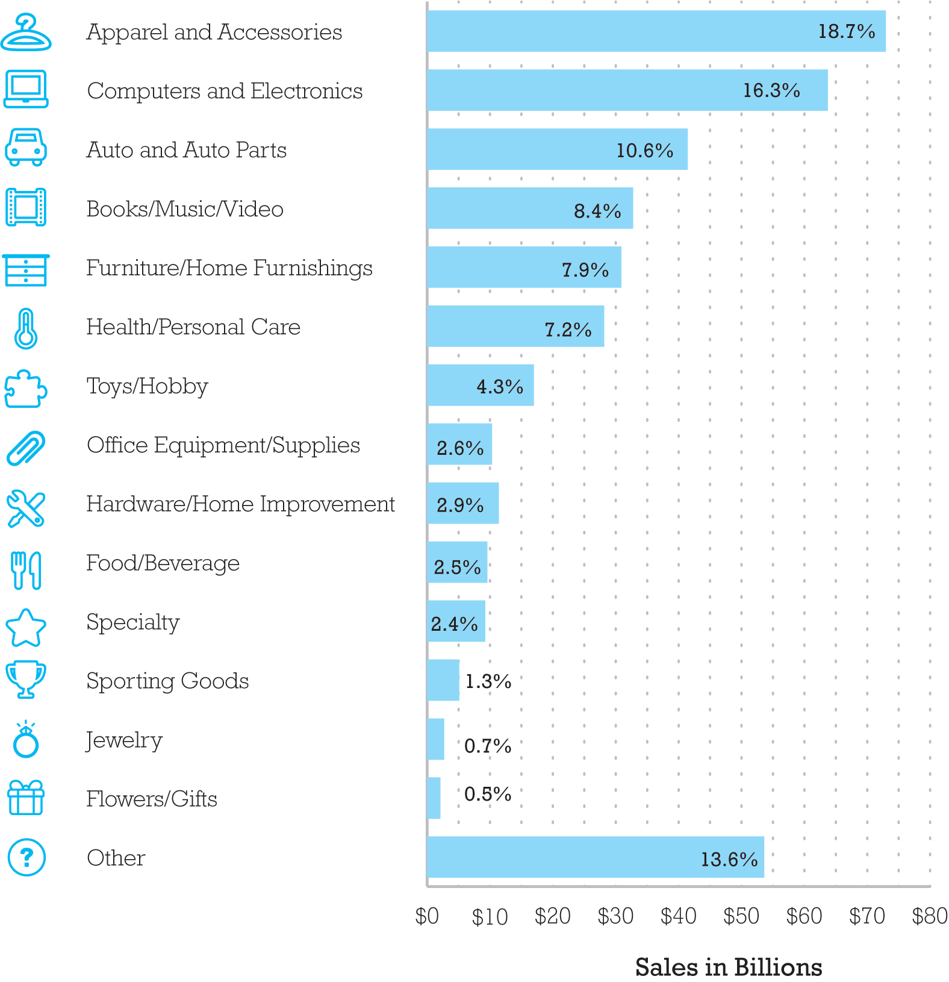
Figure 9.2 Online Retail Revenues by Category, 2016
Notes:
Figure 9.2, Page 599
Apparel and accessories is the leading online purchase category in terms of revenue generated, accounting for over 18% of all online retail revenues.

Slide 12
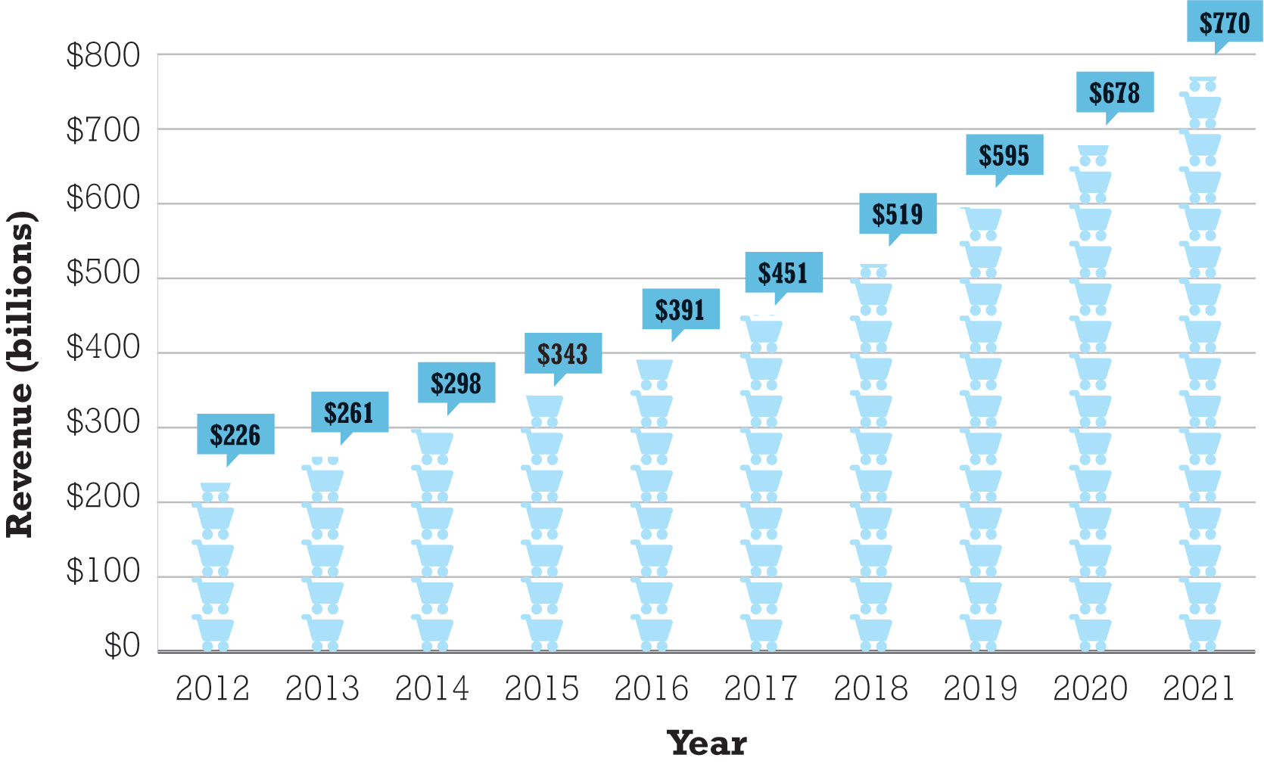
Figure 9.3 The Growth of Online Retail in the United States
Notes:
Figure 9.3, Page 600.
Online retail revenues will be an estimated $451 billion in 2017, and are expected to increase to $770 billion by 2021, almost doubling since 2016.

Slide 13
Analyzing the Viability of Online Firms
Economic viability:
Ability of firms to survive as profitable business firms during specified period (i.e., 1–3 years)
Two business analysis approaches:
Strategic analysis
Focuses on both industry as a whole and firm itself
Financial analysis
How firm is performing

Slide 14
Strategic Analysis Factors (1 of 2)
Key industry strategic factors
Barriers to entry
Power of suppliers
Power of customers
Existence of substitute products
Industry value chain
Nature of intra-industry competition

Slide 15
Strategic Analysis Factors (2 of 2)
Firm-specific factors
Firm value chain
Core competencies
Synergies
Technology
Social and legal challenges

Slide 16
Financial Analysis Factors (1 of 2)
Statements of Operations
Revenues
Cost of sales
Gross margin
Operating expenses
Operating margin
Net margin
Pro forma earnings—E B I T D A

Slide 17
Financial Analysis Factors (2 of 2)
Balance sheet
Asset
Current assets
Liabilities
Current liabilities
Long-term debt
Working capital

Slide 18
E-Commerce in Action: Amazon.Com (1 of 3)
Vision:
Earth’s biggest selection, lowest prices, most customer-centric
Business model:
Retail, Third-Party Merchants, and Amazon Web Services
Financial analysis:
Continued explosive revenue growth, profitable
Strategic analysis/business strategy:
Maximize sales volume, lower costs and prices, acquisitions, mobile shopping, new products and services

Slide 19
E-Commerce in Action: Amazon.Com (2 of 3)
Strategic analysis/competition:
Online and offline general and catalog merchandisers, Web services
Strategic analysis/technology:
Largest, most sophisticated collection of online retailing technologies available
Strategic analysis/social, legal:
Sales tax, patent lawsuits

Slide 20
E-Commerce in Action: Amazon.Com (3 of 3)
Future prospects:
Amazon has turned corner to sustainable profitability
Landmark $879 profit in 2016 Q2
Increased profits from Amazon Web Services
Amazon Prime
Continues to invest in future products and services

Slide 21
E-Tailing Business Models
Virtual merchant
Amazon, Newegg, Overstock, Wayfair, Blue Nile
Omni-channel merchants (bricks-and-clicks)
Walmart, Macy’s, J C Penney, Staples, Target
Catalog merchant
Lands’ End, L.L. Bean, C D W Corp, Cabela’s
Manufacturer-direct
Apple, Dell, Sony
Digital native verticals: Warby Parker, Everlane

Slide 22
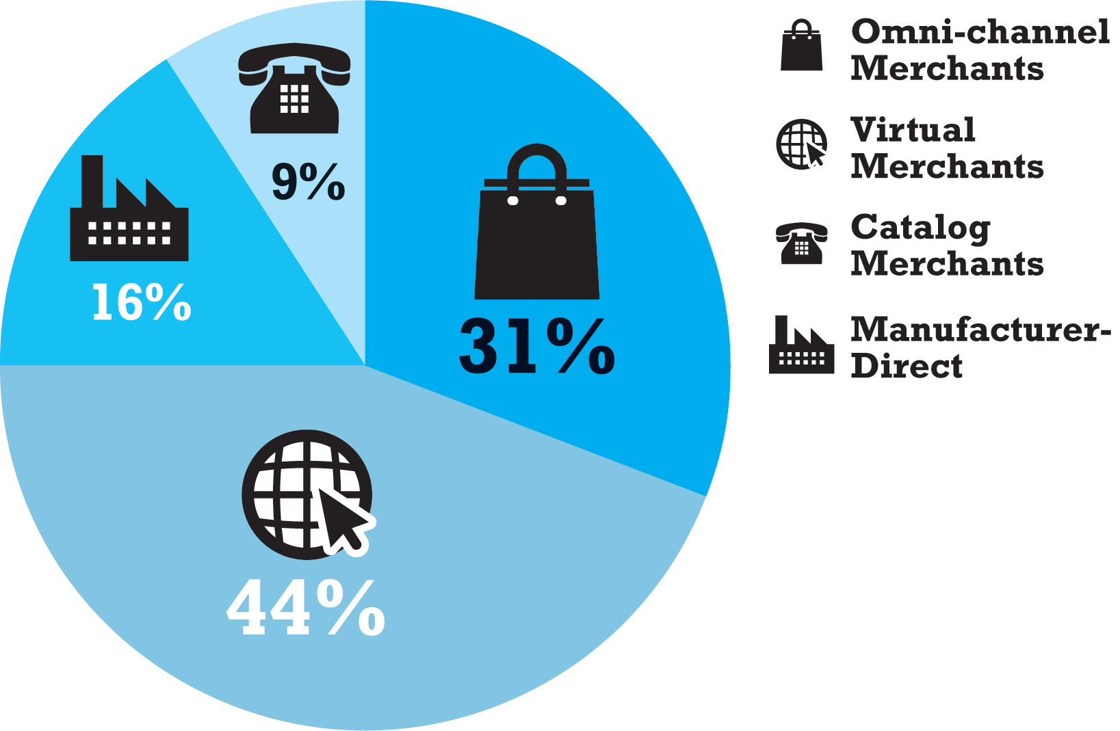
Figure 9.4 Share of Online Retail Sales by Type of Company
Notes:
Figure 9.4, Page 607
Virtual merchants account for 44% of online retail sales, although this percentage is heavily skewed by the dominance of Amazon, which by itself accounts for over 30%.

Slide 23
Common Themes in Online Retailing
Online retail fastest growing channel in retail commerce
Profits for startup ventures have been difficult to achieve
Disintermediation has not occurred
Established merchants need to create integrated shopping experience to succeed online
Growth of online specialty merchants (e.g., Blue Nile)
Extraordinary growth of social, local, and mobile e-commerce
Increasing use of big data analytics by retailers

Slide 24
Insight on Technology: Big Data and Predictive Marketing
Class Discussion
How does big data enable predictive marketing?
Are there any drawbacks to the increasing use of predictive marketing?
Have you experienced predictive marketing in your own shopping? If so, what was the experience like – were suggestions accurate and helpful?

Slide 25
The Service Sector: Offline and Online
Service sector:
Largest and most rapidly expanding part of economies of advanced industrial nations
Concerned with performing tasks in and around households, business firms, and institutions
Includes doctors, lawyers, accountants, business consultants, and so on
Employs 4 out of 5 U.S. workers
80% of U.S. G D P

Slide 26
Service Industries
Major service industry groups:
Finance
Insurance
Real estate
Travel
Professional services—legal, accounting
Business services—consulting, advertising, marketing, and so on
Health services
Educational services

Slide 27
Online Financial Services
E-commerce has transformed banking and financial services
Major institutions deploy online services
Online financial consumer behavior
Most online consumers use financial services sites
Check balances
Pay bills
Experienced users move on to more complex financial services

Slide 28
Online Banking and Brokerage
Established brand-name national banks have taken substantial lead in market share
Over 60% of U.S. adults use online banking
Online banking provides significant savings for bank
Early innovators in online brokerage (E*Trade) have been displaced by established brokerages (Fidelity, Schwab)
Online financial advisors

Slide 29
Multi-Channel versus. Pure Online Financial Service Firms
Online consumers prefer multi-channel firms with physical presence
Multi-channel firms
Growing faster than pure online firms
Lower online customer acquisition costs
Pure online firms
Cannot provide all services that require face-to-face interaction

Slide 30
Financial Portals and Account Aggregators
Financial portals
Comparison shopping services, independent financial advice, financial planning
Revenues from advertising, referrals, subscriptions
Example: Yahoo! Finance, Quicken, M S N Money
Account aggregation
Pulls together all of a customer’s financial data at a personalized website
Privacy concerns: control of personal data, security, and so on
Example: Yodlee

Slide 31
Online Mortgage and Lending Services
Market is slowly growing; dominated by:
Established online banks, brokerages, and lending organizations
Traditional mortgage vendors
Pure online mortgage firms
Online mortgage industry has not transformed process of obtaining mortgage
Rocket Mortgage
Online lending services

Slide 32
Online Insurance Services
Online term life insurance
One of few online insurance with lowered search costs, increased price comparison, lower prices
Commodity
Most insurance not purchased online
Online industry geared more toward
Product information, search
Price discovery
Online quotes
Influencing the offline purchasing decision

Slide 33
Online Real Estate Services
Early vision: Disintermediation of a complex industry
However, major impact is influence of purchases offline
Impossible to complete property transaction online
Main services are online property listings, loan calculators, research and reference material, with mobile apps increasing
Despite revolution in available information, there has not been a revolution in the industry value chain

Slide 34
Online Travel Services (1 of 2)
One of the most successful B2C e-commerce segments
More travel is booked online than offline
Online travel services revenues in 2017: Almost $190 billion
For consumers: More convenient than traditional travel agents
For suppliers: A singular, focused customer pool that can be efficiently reached through onsite advertising

Slide 35
Online Travel Services (2 of 2)
Travel an ideal service/product for Internet
Information-intensive product
Electronic product—travel arrangements can be accomplished for the most part online
Does not require inventory
Does not require physical offices with multiple employees
Suppliers are always looking for customers to fill excess capacity
Does not require an expensive multi-channel presence

Slide 36
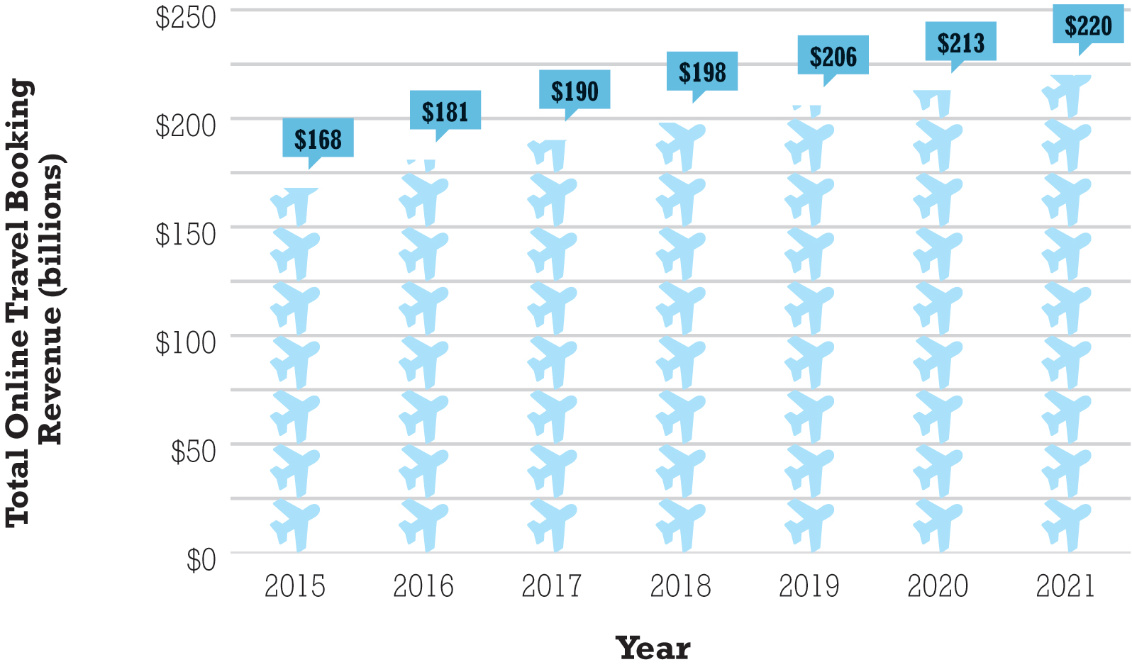
Figure 9.5 Online Travel Services Revenues
Notes:
Figure 9.5, Page 631
U.S. online leisure/unmanaged business travel service revenues has resumed growing and is expected to reach almost $220 billion by 2021.

Slide 37
The Online Travel Market
Four major sectors:
Airline tickets
Greatest source of revenue
Hotel reservations
Car rentals
Travel packages
Corporate online-booking solutions (C O B S)

Slide 38
Online Travel Industry Dynamics
Intense competition among online providers
Price competition difficult
Industry consolidation
Industry impacted by meta-search engines
Commoditize online travel
Mobile applications are also transforming industry
Social media content, reviews have an increasing influence on travel purchases

Slide 39
Insight on Society: Phony Reviews
Class discussion:
Should there be repercussions to individuals and/or businesses for posting false reviews of products or services?
Can phony reviews be recognized and moderated?
Do you rely more on some types of reviews or comments on websites and blogs over others?

Slide 40
Online Career Services
Two main players: CareerBuilder, Monster
Indeed, Glassdoor, SimplyHired, LinkedIn
Five traditional recruitment tools:
Classified and print ads, career expos, on-campus recruitment, staffing firms, internal referral programs
Online recruiting
More efficient, cost-effective, reduces total time-to-hire
Enables job hunters to more easily distribute resumes while conducting job searches
Ideally suited for Web due to information-intense nature of process

Slide 41
It’s Just Information: The Ideal Web Business?
Recruitment ideally suited for the Web
Information-intense process
Initial match-up doesn’t require much personalization
Saves time and money for both job hunters and employers
One of most important functions:
Ability to establish market prices and terms (online national marketplace)

Slide 42
Online Recruitment Industry Trends
Social recruiting
87% recruiters use social recruiting, LinkedIn
Mobile
Millennials and Gen X use primarily mobile devices
Job search engines/aggregators:
Data analytics and algorithms
Hiring by algorithm
Sifting online applications for key words

Slide 43
On-Demand Service Companies
Platforms for users to share/lease assets and resources
Bikes, cars, homes, rooms with beds, etc.
Fees collected from sellers and buyers
Use of online reputation systems, peer review
Successful firms are disrupters, lowering cost of services
Uber
Airbnb

Slide 44
Insight on Business: Food on Demand: Instacart and Grubhub
Class discussion:
What features or practices have made Instacart successful?
What challenges do grocery and meal delivery services face?
Have you used any grocery or meal delivery services? If so, what was your experience?

Slide 45
Careers in E-Commerce
Position: Associate, E-commerce Initiatives
Qualification/Skills
Preparing for the Interview
Possible Interview Questions

Slide 46

Copyright

