Slide 1

E-Commerce 2018: Business. Technology. Society
Fourteenth Edition
Chapter 11
Social Networks, Auctions, and Portals
Copyright © 2019, 2018, 2017 Pearson Education, Inc. All Rights Reserved
Notes:
If this PowerPoint presentation contains mathematical equations, you may need to check that your computer has the following installed:
1) MathType Plugin
2) Math Player (free versions available)
3) NVDA Reader (free versions available)

Slide 2
Learning Objectives
11.1 Describe the different types of social networks and online communities and their business models.
11.2 Describe the major types of auctions, their benefits and costs, how they operate, when to use them, and the potential for auction abuse and fraud.
11.3 Describe the major types of Internet portals and their business models.
Notes:
Slide 2 is list of textbook LO numbers and statements

Slide 3
Social Network Fever Spreads to the Professions
Class Discussion
How has the growth of social networks enabled the creation of more specific niche sites?
What are some examples of social network sites with a financial or business focus?
Describe some common features and activities on these social network sites.
What features of social networks best explain their popularity?

Slide 4
Social Networks and Online Communities
Internet began as communications medium for scientists
Early communities were bulletin boards, newsgroups (e.g., the Well)
Today social networks, photo/video sharing, blogs have created new era of online socializing
Social networks now one of most common Internet activities

Slide 5
What is an Online Social Network?
Working definition of social network
Group of people
Shared social interaction
Common ties
Sharing an area for period of time
Online social network
Internet removes geographic and time limitations of offline social networks

Slide 6
The Growth of Social Networks and Online Communities
Top social networks: over 90% of social networking activity
Facebook users: More than 35% are 44+
Growth of new social networks like Pinterest, Instagram, Snapchat
Search engine advertising still generates more revenue than advertising on social networks

Slide 7
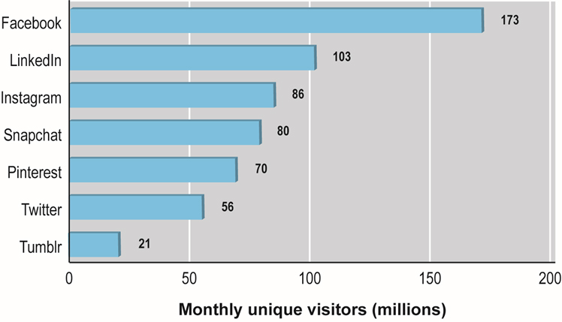
Figure 11.1: Top U.S. Social Networks 2017
Notes:
Figure 11.1, Page 729
Facebook is by far and away the dominant social network in the United States in terms of monthly unique visitors.

Slide 8
Turning Social Networks into Businesses
Most social networks monetize audiences through advertising
LinkedIn – fees for premium services
Twitter – struggling to make profits
Business use of social networks
Marketing and branding
Reaching younger audience
Listening tool, monitoring online reputation
Collaboration tool

Slide 9
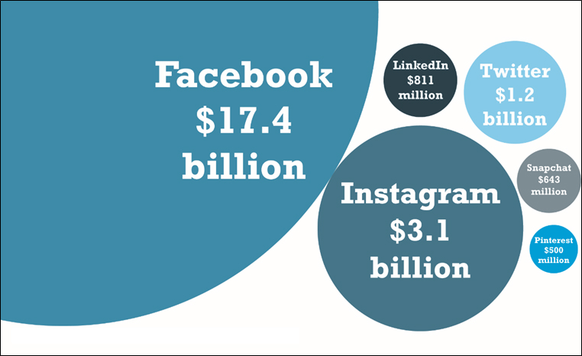
Figure 11.2: U.S. Ad Spending on Social Networks, 2017
Notes:
Figure 11.2, Page 732

Slide 10
Insight on Society: the Dark Side of Social Networks
Class discussion:
How can businesses accurately judge whether negative comments are trolling or have merit and should be responded to?
Have you ever left a negative comment about a product or business? Have others’ negative comments influenced a purchase?
Should a business have any say in how an employee uses social networks outside of the office?

Slide 11
Types of Social Networks and Their Business Models (1 of 2)
General communities:
Offer opportunities to interact with general audience organized into general topics
Advertising supported by selling ad space on pages and videos
Practice networks:
Offer focused discussion groups, help, and knowledge related to area of shared practice
May be profit or nonprofit; rely on advertising or user donations

Slide 12
Types of Social Networks and Their Business Models (2 of 2)
Interest-based social networks:
Offer focused discussion groups based on shared interest in some specific subject
Usually advertising supported
Affinity communities:
Offer focused discussion and interaction with other people who share same affinity (self or group identification)
Advertising and revenues from sales of products
Sponsored communities:
Created by government, nonprofit, or for-profit organizations for purpose of pursuing organizational goals

Slide 13
Social Network Features and Technologies
Algorithms, computer algorithms
Produce relationship-based content
Affinity groups
Profiles, Newsfeed, Timeline, Favorites (Like)
Friends networks, Groups, Network discovery
Games and apps
Instant messaging, Message boards
Storage

Slide 14
Insight on Technology: Trapped Inside the Facebook Bubble?
Class Discussion
How does Facebook’s Trending Topics work? How does the News Feed algorithm work?
Facebook has been described as an echo chamber. What is this, and is this a feature of other social networks?
Should Facebook be held responsible for presenting an equal number of both liberal and conservative opinions?
Should algorithms for presenting news to readers be monitored and adjusted by human editors? Why or why not?

Slide 15
Online Auctions
C2C auctions, e.g. eBay
B2C auctions
Several hundred different auction sites in United States alone
Online retail sites are adding auctions
Can be used to
Sell goods and services
Allocate resources
Allocate and bundle resources

Slide 16
Benefits of Auctions
Liquidity
Price discovery
Price transparency
Market efficiency
Lower transaction costs
Consumer aggregation
Network effects

Slide 17
Risks and Costs of Auctions
Delayed consumption costs
Monitoring costs
Possible solutions include fixed pricing
Equipment costs
Trust risks
Possible solution—rating systems
Fulfillment costs
Merchants also face risks; e.g. nonpayment, false bidding, bid rigging, and so on

Slide 18
Auctions as an E-Commerce Business Model
No inventory
No fulfillment activities
No warehouses, shipping, or logistical facilities
eBay makes money from every stage in auction cycle
Transaction fees, listing fees, financial services fees, advertising or placement fees
Difficulty in establishing audience
eBay dominates online auction market

Slide 19
Types of Auctions (1 of 2)
English auction:
Single item up for sale to single seller
Highest bidder wins
Dutch Internet auction:
Public ascending price, multiple units
Final price is lowest successful bid, which sets price for all higher bidders
Penny (bidding fee) auction
Must purchase bids ahead of time
Items owned by the site
Timed auction; last and highest bidder wins

Slide 20
Types of Auctions (2 of 2)
Name Your Own Price Auction
Users specify what they are willing to pay for goods or services and multiple providers bid for their business
Prices do not descend and are fixed
Consumer offer is commitment to buy at that price
Enables sellers to unload unsold excess capacity
Example: Priceline

Slide 21
Table 11.6: Factors to Consider When Choosing Auctions
Considerations | Description
Type of product | Rare, unique, commodity, perishable
Stage of product life cycle | Early, mature, late
Channel-management issues | Conflict with retail distributors; differentiation
Type of auction | Seller versus. buyer bias
Initial pricing | Low versus. high
Bid increment amounts | Low versus. high
Auction length | Short versus. long
Number of items | Single versus. multiple
Price-allocation rule | Uniform versus. discriminatory
Information sharing | Closed versus. open bidding

Slide 22
Auction Prices: Are They the Lowest?
Auction prices not necessarily the lowest
Auctions are social events
Herd behavior
Unintended results:
Winner’s regret
Seller’s lament
Loser’s lament
Consumer trust an important motivating factor in auctions

Slide 23
Fraud and Abuse in Auctions
Fraud produces information asymmetries between buyers and sellers, causing auctions to fail
Types include:
Bid rigging, price matching, shill feedback, feedback extortion, shill bidding, bid siphoning
Fraud prevention solutions include:
Rating systems, watch lists, proxy bidding
Investigation units

Slide 24
E-Commerce Portals
Most frequently visited sites on Web
Original portals were search engines
As search sites, attracted huge audiences
Today provide:
Navigation of the Web
Commerce
Content (owned and others’)
Goal is to keep visitors present and viewing ads
Enterprise portals
Help employees find important organizational content

Slide 25
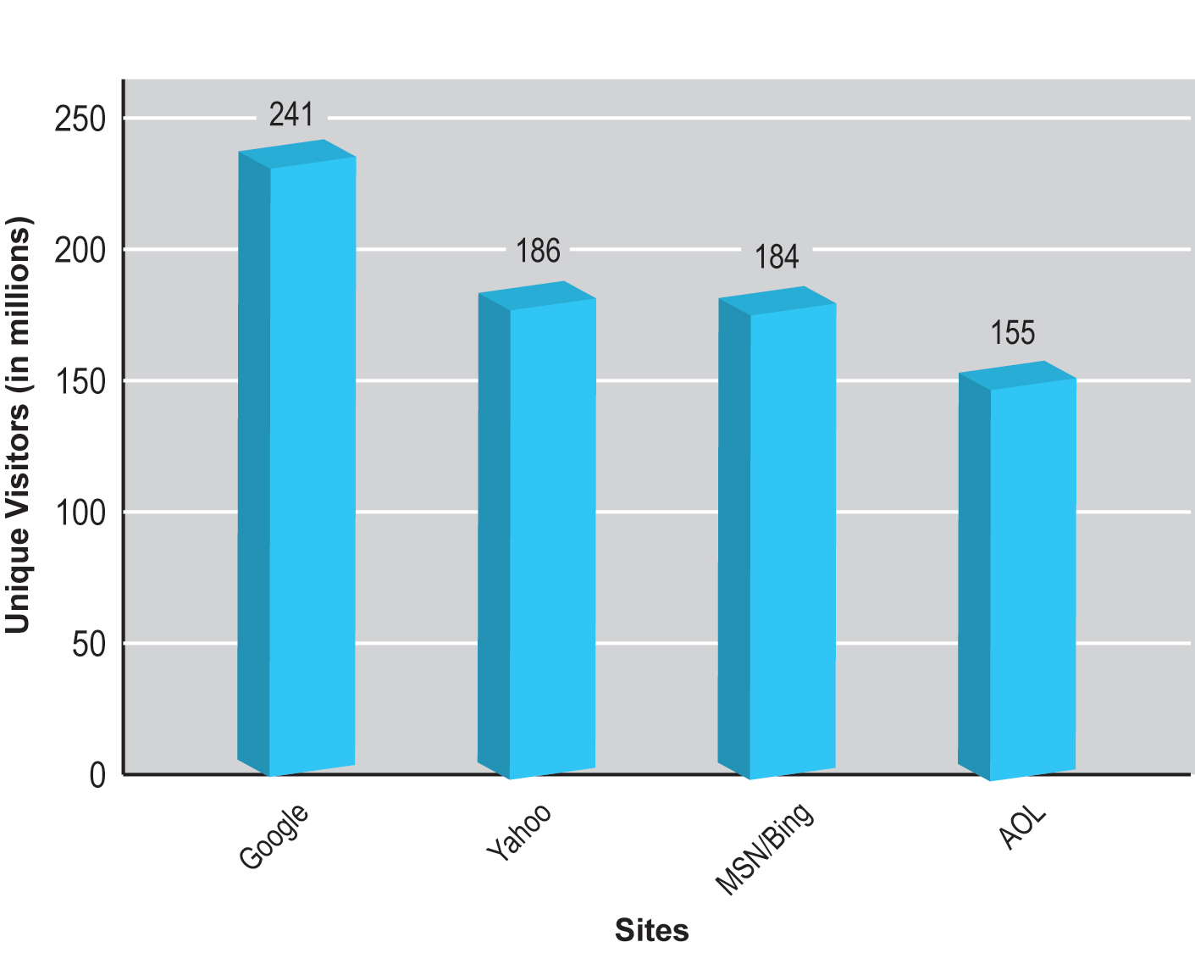
Figure 11.4 the Top U.S. Portal/Search Engines, 2017
Notes:
Figure 11.4, Page 753

Slide 26
Insight on Business: Verizon Doubles Down on Portals
Class discussion:
What prompted Verizon’s change in business focus?
What steps is Verizon taking to accomplish its goal?
How does the purchase of A O L and Yahoo help Verizon accomplish its goal?
What abilities does Verizon have to use in become a major player in online media and advertising?

Slide 27
Types of Portals
General purpose portals:
Attempt to attract very large general audience
Retain audience by providing in-depth vertical content channels
Example: Yahoo
Vertical market portals:
Attempt to attract highly-focused, loyal audiences with specific interest in:
Community
Specialized content

Slide 28
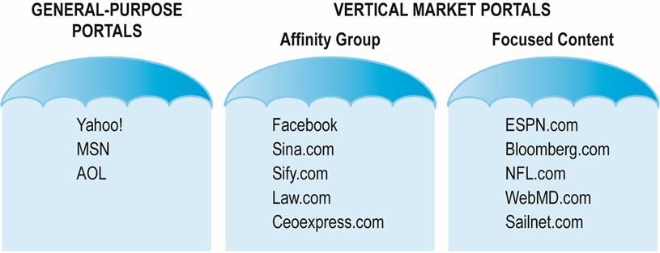
Figure 11.5 Two General Types of Portals: General Purpose and Vertical Market Portals
Notes:
Figure 11.5, Page 757
There are two general types of portals: general-purpose and vertical market. Vertical market portals may be based on affinity groups or on focused content.

Slide 29
Portal Business Models
General advertising revenue
Tenancy deals
Fixed charge for number of impressions, exclusive partnerships, “sole providers”
Commissions on sales
Subscription fees
Charging for premium content
Applications and games

Slide 30
Careers in E-Commerce
Position: Social Marketing Specialist
Qualification/Skills
Preparing for the Interview
Possible Interview Questions

Slide 31

Copyright

