Slide 1

E-Commerce 2018: Business. Technology. Society
Fourteenth Edition
Chapter 3
E-Commerce Infrastructure: The Internet, Web, and Mobile Platform
Slides in this presentation contain hyperlinks. JAWS users should be able to get a list of links by using INSERT+F7
Copyright © 2019, 2018, 2017 Pearson Education, Inc. All Rights Reserved
Notes:
If this PowerPoint presentation contains mathematical equations, you may need to check that your computer has the following installed:
1) MathType Plugin
2) Math Player (free versions available)
3) NVDA Reader (free versions available)

Slide 2
Learning Objectives
3.1 Discuss the origins of, and the key technology concepts behind, the Internet.
3.2 Explain the current structure of the Internet.
3.3 Understand the limitations of today’s Internet and the potential capabilities of the Internet of the future.
3.4 Understand how the Web works.
3.5 Describe how Internet and web features and services support e-commerce.
3.6 Understand the impact of mobile applications.
Notes:
Slide 2 is list of textbook LO numbers and statements

Slide 3
Voice-Controlled Intelligent Digital Assistants: Will They Revolutionize E-Commerce?
Class Discussion
What are intelligent assistants and why are they so popular?
Do you use conversational A I assistants? What for?
What are the benefits of these assistants? The disadvantages?
Are there any benefits/disadvantages to the proprietary nature of these assistants and chatbots?

Slide 4
The Internet: Technology Background
Internet
Interconnected network of thousands of networks and millions of computers
Links businesses, educational institutions, government agencies, and individuals
World Wide Web (Web)
One of the Internet’s most popular services
Provides access to billions, possibly trillions, of web pages

Slide 5
The Evolution of the Internet 1961–Present
Innovation Phase, 1961–1974
Creation of fundamental building blocks
Institutionalization Phase, 1975–1995
Large institutions provide funding and legitimization
Commercialization Phase, 1995–present
Private corporations take over, expand Internet backbone and local service

Slide 6
Domain Names, D N S, and U R L s
Domain name
I P address expressed in natural language
Domain name system (D N S)
Allows numeric I P addresses to be expressed in natural language
Uniform resource locator (U R L)
Address used by Web browser to identify location of content on the Web
For example: http://www.azimuth-interactive.com/

Slide 7
Client/Server Computing
Powerful personal computers (clients) connected in network with one or more servers
Servers perform common functions for the clients
Storing files
Software applications
Access to printers, and so on

Slide 8
The Mobile Platform
Primary Internet access is now through tablets and smartphones
Tablets supplement P Cs for mobile situations
Over 160 million people in U . S. use Internet with tablets
Smartphones are a disruptive technology
New processors and operating systems
Over 220 million in U.S. access Internet with smartphones

Slide 9
The Internet “Cloud Computing” Model (1 of 2)
Firms and individuals obtain computing power and software over Internet
Three types of services
Infrastructure as a service (I a a S)
Software as a service (S a a S)
Platform as a service (P a a S)
Public, private, and hybrid clouds
Watch : https://www.youtube.com/watch?v=DGDtujmOBKc

Slide 10
The Internet “Cloud Computing” Model (2 of 2)
Drawbacks
Security risks
Shifts responsibility for storage and control to providers
Radically reduces costs of:
Building and operating websites
Infrastructure, I T support
Hardware, software

Slide 11
The Internet Today
Internet growth has boomed without disruption because of:
Client/server computing model
Hourglass, layered architecture
Network Technology Substrate
Transport Services and Representation Standards
Middleware Services
Applications

Slide 12
Who Governs the Internet?
Organizations that influence the Internet and monitor its operations include:
Internet Corporation for Assigned Names and Numbers (I C A N N)
Internet Engineering Task Force (I E T F)
Internet Research Task Force (I R T F)
Internet Engineering Steering Group (I E S G)
Internet Architecture Board (I A B)
Internet Society (I S O C)
Internet Governance Forum (I G F)
World Wide Web Consortium (W3C)
Internet Network Operators Groups (N O G s)

Slide 13
Insight on Society: Government Regulation and Surveillance of the Internet
Class discussion:
How is it possible for any government to “control” or censor the Web?
Does the Chinese government, or the U.S. government, have the right to censor content on the Web?
How should U.S. companies deal with governments that want to censor content?
What would happen to e-commerce if the existing Web split into a different Web for each country?

Slide 14
Limitations of the Current Internet
Bandwidth limitations
Slow peak-hour service
Quality of service limitations
Latency
Network architecture limitations
Identical requests are processed individually
Wired Internet
Copper and expensive fiber-optic cables

Slide 15
Wireless Local Area Network (W L A N) –Based Internet Access
Wi-Fi
High-speed, fixed broadband wireless L A N (W L A N)
Wireless access point (“hot spots”)
Limited range but inexpensive
WiMax
Bluetooth

Slide 16
Other Innovative Internet Access Technologies: Drones, Balloons, and White Space
Google: Project Loon
Facebook: Facebook Connectivity Lab/Acquila drone
Microsoft: White spaces project

Slide 17
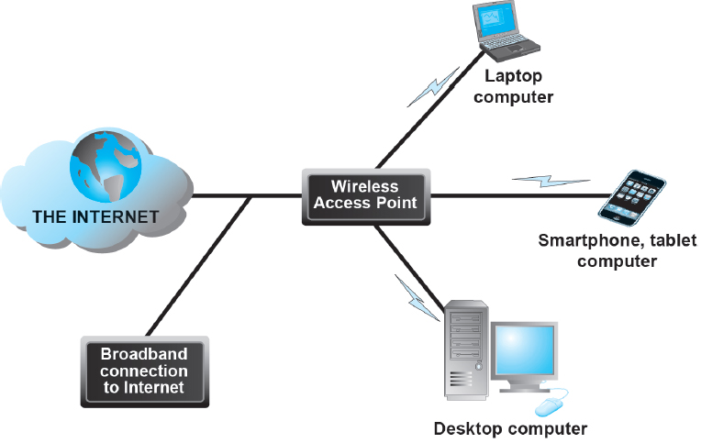
Figure 3.13 Wi-Fi Networks
Notes:
Figure 3.13, page 151.
In a Wi-Fi network, wireless access points connect to the Internet using a land-based broadband connection. Clients, which could be desktops, laptops, tablet computers, or smartphones, connect to the access point using radio signals.

Slide 18
The Future Internet
Latency solutions
diffserv (differentiated quality of service)
Guaranteed service levels and lower error rates
Declining costs
The Internet of Things (I o T)
Objects connected via sensors/R F I D to the Internet
“Smart things”
Interoperability issues and standards
Security and privacy concerns
Watch: https://www.youtube.com/watch?v=QSIPNhOiMoE

Slide 19
Insight on Business: The Apple Watch: Bringing the Internet of Things to Your Wrist
Class Discussion
Are you or anyone you know using the Apple Watch? If not, why not? If so, what apps do you use most?
What are the potential benefits of wearable technology? Are there any disadvantages?
What effects will features like the Apple Pay button and Taptic Engine have?
Are there any privacy issues raised by wearable technology?

Slide 20
The Web
1989–1991: Web invented
Tim Berners-Lee at C E R N
H T M L, H T T P, web server, web browser
1993: Mosaic web browser w/G U I
Andreessen and others at N C S A
Runs on Windows, Macintosh, or Unix
1994: Netscape Navigator, first commercial web browser
1995: Microsoft Internet Explorer

Slide 21
Hypertext
Text formatted with embedded links
Links connect documents to one another, and to other objects such as sound, video, or animation files
Uses Hypertext Transfer Protocol (H T T P) and U R L s to locate resources on the Web
Example U R L: http://megacorp.com/content/features/082602.html

Slide 22
Markup Languages
Hypertext Markup Language (H T M L)
Fixed set of pre-defined markup “tags” used to format text
Controls look and feel of web pages
H T M L5 the newest version
eXtensible Markup Language (X M L)
Designed to describe data and information
Tags used are defined by user

Slide 23
Insight on Technology: the Rise of H T M L5
Class Discussion
What features of H T M L5 are changing the way websites are built?
Is H T M L5 a disruptive technology, and if so, for whom?
Are there any disadvantages in websites and mobile apps moving to an H T M L5 platform?

Slide 24
Web Servers and Web Clients
Web server software
Enables a computer to deliver web pages to clients on a network that request this service by sending an H T T P request
Basic capabilities: Security services, F T P, search engine, data capture
Web server
May refer to either web server software or physical server
Specialized servers: Database servers, ad servers, and so on
Web client
Any computing device attached to the Internet that is capable of making H T T P requests and displaying H T M L pages

Slide 25
Web Browsers
Primary purpose is to display web page, but may include added features
Google’s Chrome: 60% of desktop market, 56% mobile market
Open source
Internet Explorer: 17% of desktop, >1% mobile
Mozilla Firefox: 12% desktop, >1% mobile
Open source
Apple’s Safari: 4% desktop, 33% mobile

Slide 26
The Internet and Web: Features
Features on which the foundations of e-commerce are built:
Communication tools
Search engines
Downloadable and streaming media
Web 2.0 applications and services
Virtual reality and augmented reality
Intelligent digital assistants

Slide 27
Communication Tools
E-mail
Most used application of the Internet
Messaging Applications
Instant messaging
Online message boards
Internet telephony
V O I P
Video conferencing, video chatting, telepresence

Slide 28
Search Engines
Identify web pages that match queries based on one or more techniques
Keyword indexes
Page ranking
Also serve as:
Shopping tools
Advertising vehicles (search engine marketing)
Tool within e-commerce sites
Top three providers: Google, Bing, Yahoo

Slide 29
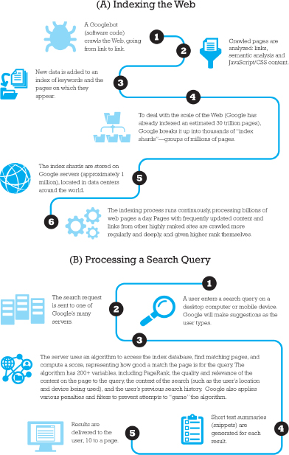
Figure 3.17 How Google Works
Notes:
Figure 3.18, page 172.

Slide 30
Downloadable and Streaming Media
Downloads:
Growth in broadband connections enables large media file downloads
Streaming technologies
Enables music, video, and other large files to be sent to users in chunks so that the file can play uninterrupted
Podcasting
Explosion in online video viewing

Slide 31
Web 2.0 Features and Services
Online Social Networks
Services that support communication among networks of friends, peers
Blogs
Personal web page of chronological entries
Enables web page publishing with no knowledge of H T M L
Wikis
Enables documents to be written collectively and collaboratively
E.g. Wikipedia

Slide 32
Virtual Reality and Augmented Reality
Virtual reality
Immersing users within virtual world
Typically uses head-mounted display (H M D)
Oculus Rift, Vive, PlayStation V R
Augmented reality
Overlaying virtual objects over the real world, via mobile devices or H M D s
Pokémon GO

Slide 33
Intelligent Digital Assistants
Computer search engine using:
Natural language
Conversational interface, verbal commands
Situational awareness
Can handle requests for appointments, flights, routes, event scheduling, and more.
Examples:
Apple’s Siri
Google Now
Google Assistant

Slide 34
Mobile Apps
Use of mobile apps has exploded
Most popular entertainment media, over T V
Always present shopping tool
Almost all top 100 brands have an app
Platforms
iPhone/iPad (i O S), Android, Blackberry
App marketplaces
Google Play, Apple’s App Store, R I M’s App World, Windows Phone Marketplace

Slide 35
Careers in E-Commerce
Position: E-commerce Specialist
Qualification/Skills
Preparing for the Interview
Possible Interview Questions

Slide 36

Copyright

