Slide 1

E-Commerce 2018: Business. Technology. Society
Fourteenth Edition
Chapter 1
The Revolution Is Just Beginning
Copyright © 2019, 2018, 2017 Pearson Education, Inc. All Rights Reserved
Notes:
If this PowerPoint presentation contains mathematical equations, you may need to check that your computer has the following installed:
1) MathType Plugin
2) Math Player (free versions available)
3) NVDA Reader (free versions available)

Slide 2
Learning Objectives
1.1 Understand why it is important to study e-commerce.
1.2 Define e-commerce, understand how e-commerce differs from e-business, identify the primary technological building blocks underlying e-commerce, and recognize major current themes in e-commerce.
1.3 Identify and describe the unique features of e-commerce technology and discuss their business significance.
1.4 Describe the major types of e-commerce.
1.5 Understand the evolution of e-commerce from its early years to today.
1.6 Describe the major themes underlying the study of e-commerce.
1.7 Identify the major academic disciplines contributing to e-commerce.
Notes:
Slide 2 is list of textbook LO numbers and statements

Slide 3
Uber: The New Face of E-Commerce?
Class Discussion
Have you used Uber or any other on-demand service companies?
What is the appeal of these companies for users and providers?
Are there any negative consequences to the increased use of on-demand services like Uber and Airbnb?

Slide 4
The First Thirty Seconds
First 20 years of e-commerce
Just the beginning
Rapid growth and change
Technologies evolve at exponential rates
Disruptive business change
New opportunities
Why study e-commerce
Understand opportunities and risks
Analyze e-commerce ideas, models, issues

Slide 5
Introduction to E - c o m m e r c e
Use of Internet to transact business
Includes Web, mobile browsers and apps
More formally:
Digitally enabled commercial transactions between and among organizations and individuals

Slide 6
The Difference between E-Commerce and E-Business
E-business:
Digital enabling of transactions and processes within a firm, involving information systems under firm’s control
Does not include commercial transactions involving an exchange of value across organizational boundaries

Slide 7
Technological Building Blocks Underlying E -Commerce
Internet
World Wide Web
H T M L
Deep Web versus. “surface” Web
Mobile platform
Mobile apps

Slide 8
Insight on Technology: Will Apps Make the Web Irrelevant?
Class Discussion
What are the advantages and disadvantages of apps, compared with websites, for mobile users?
What are the benefits of apps for content owners and creators?
Will apps eventually make the Web irrelevant? Why or why not?

Slide 9
Major Trends in E-Commerce
Business trends include:
All forms of e-commerce show very strong growth
Technology trends include:
Mobile platform has made mobile e-commerce reality
Societal trends include:
Increased online social interaction and sharing

Slide 10
Unique Features of E-Commerce Technology (1 of 2)
Ubiquity
Global reach
Universal standards
Information richness
Notes:
Additional concepts and terminology include: Information asymmetry, menu costs, marketplaces and marketspaces, transaction costs, cognitive energy, market entry costs, search costs, price discovery, network externalities.

Slide 11
Unique Features of E-Commerce Technology (2 of 2)
Interactivity
Information density
Personalization/customization
Social technology
Notes:
Additional concepts and terminology include price transparency, cost transparency, and price discrimination.

Slide 12
Types of E-Commerce
Business-to-Consumer (B2C)
Business-to-Business (B2B)
Consumer-to-Consumer (C2C)
Mobile e-commerce (M-commerce)
Social e-commerce
Local e-commerce

Slide 13
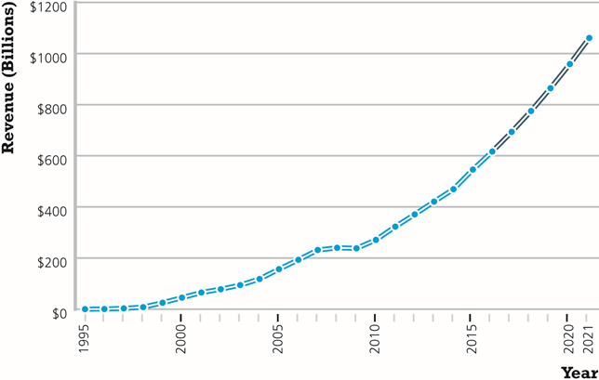
Figure 1.5 The Growth of B2C E-Commerce in the United States
Notes:
Figure 1.5, Page 22.
In the early years, B2C e-commerce was doubling or tripling each year. Although B2C e-commerce growth in the United States slowed in 2008–2009 due to the economic recession, it resumed growing at about 13% in 2010 and since then, has continued to grow at double-digit rates.
SOURCES: Based on data from eMarketer, Inc., 2017d, 2017e; authors’ estimates.

Slide 14
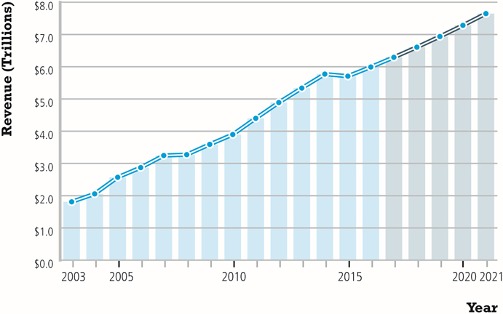
Figure 1.7 The Growth of B2B E-Commerce in the United States
Notes:
Figure 1.7, Page 24.
B2B e-commerce in the United States is about 10 times the size of B2C e-commerce. In 2021, B2B e-commerce is projected to reach about $7.6 trillion. (Note: Does not include EDI transactions.)
SOURCES: Based on data from U.S. Census Bureau, 2017; authors’ estimates.

Slide 15
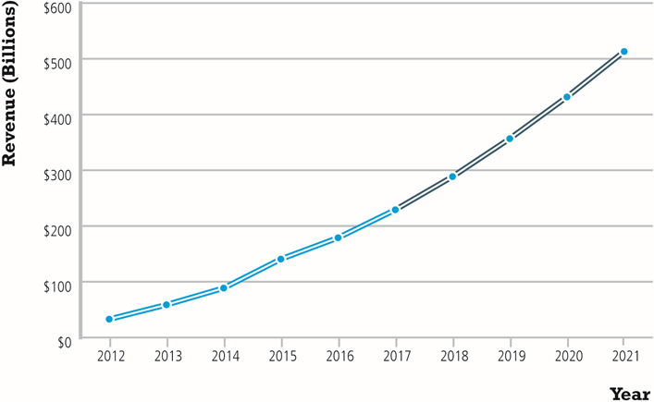
Figure 1.8 The Growth of M-Commerce in the United States
Notes:
Figure 1.8, page 25.
In the last five years, m-commerce has increased astronomically, from just $32.8 billion in 2012 to almost $230 billion in 2017, and it is anticipated that it will continue to grow by over 20% over the next five years as consumers become more and more accustomed to using mobile devices to purchase products and services.
SOURCE: Based on data from eMarketer, Inc., 2017f, 2017g, 2015a, 2015b, 2014.

Slide 16
E-Commerce: A Brief History (1 of 4)
Precursors
Baxter Healthcare modem-based system
Order entry systems
Electronic Data Interchange (E D I) standards
French Minitel

Slide 17
E-Commerce: A Brief History (2 of 4)
1995–2000: Invention
Sale of simple retail goods
Limited bandwidth and media
Euphoric visions of
Friction-free commerce
First-mover advantages
Dot-com crash of 2000
Notes:
Additional concepts include disintermediation, monopoly profits, switching costs, network effects, disrupting traditional channels.

Slide 18
E-Commerce: A Brief History (3 of 4)
2001–2006: Consolidation
Emphasis on business-driven approach
Traditional large firms expand presence
Start-up financing shrinks
More complex products and services sold
Growth of search engine advertising
Business web presences expand

Slide 19
E-Commerce: A Brief History (4 of 4)
2007–Present: Reinvention
Rapid growth of:
Web 2.0, including online social networks
Mobile platform
Local commerce
On-demand service economy
Entertainment content develops as source of revenues
Transformation of marketing

Slide 20
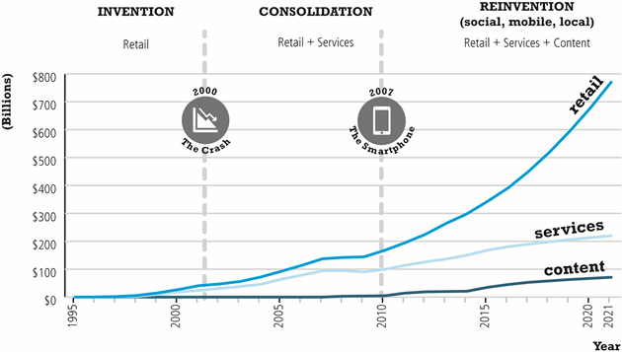
Figure 1.10 Periods in the Development of E-Commerce
Notes:
Figure 1.10, page 28.

Slide 21
Insight on Business: Startup Boot Camp
Class Discussion
Why do you think investors today are still interested in investing in startups?
What are the benefits of investing in a company that is a graduate of a Y Combinator boot camp?
Is an incubator the best solution for startups to find funding? Why or why not?

Slide 22
Assessing E-Commerce (1 of 2)
Stunning technological success
Early years a mixed business success
Few early dot-coms have survived
Online sales growing rapidly
Many early visions not fulfilled
Price dispersion
Information asymmetry
New intermediaries

Slide 23
Assessing E-Commerce (2 of 2)
Other surprises
Fast-follower advantages
Start-up costs
Impact of mobile platform
Emergence of on-demand e-commerce

Slide 24
Understanding E-Commerce: Organizing Themes
Technology:
Development and mastery of digital computing and communications technology
Business:
New technologies present businesses with new ways of organizing production and transacting business
Society:
Intellectual property, individual privacy, public welfare policy

Slide 25
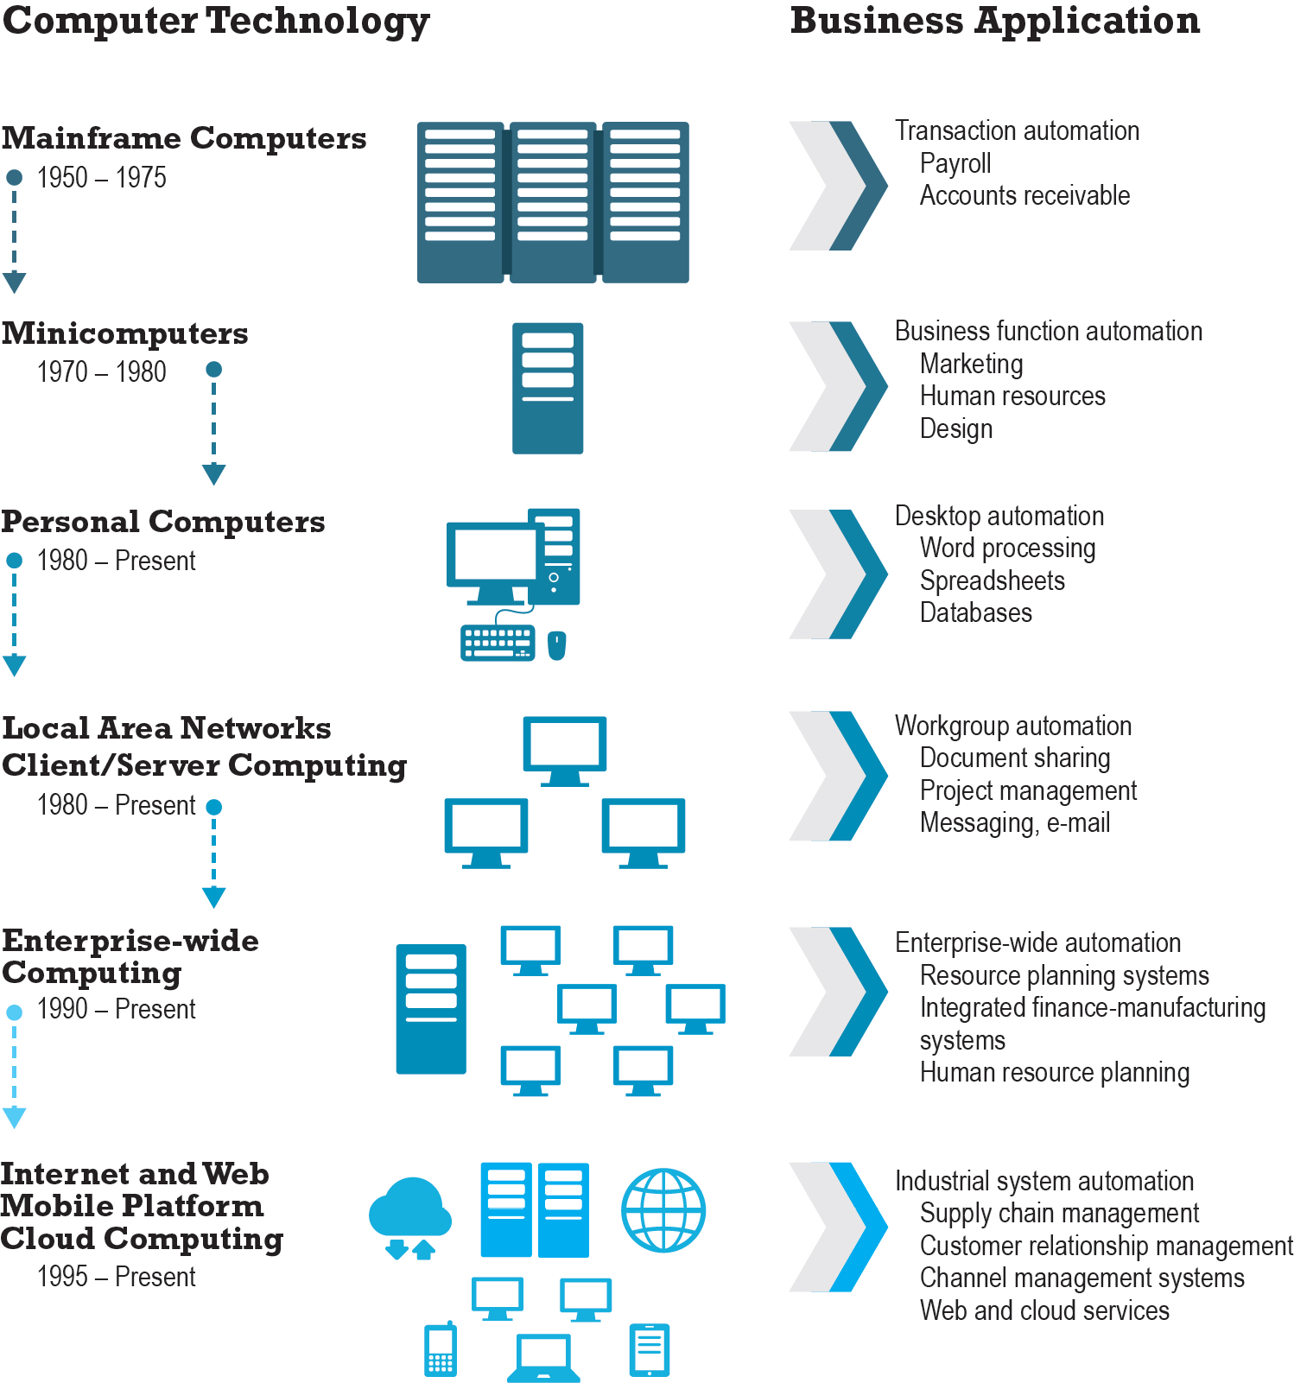
Figure 1.11 The Internet and the Evolution of Corporate Computing
Notes:
Figure 1.11, page 38.
The Internet and Web, and the emergence of a mobile platform held together by the Internet cloud, are the latest in a chain of evolving technologies and related business applications, each of which builds on its predecessors.

Slide 26
Insight on Society: Facebook and the Age of Privacy
Class discussion:
Why are social networks interested in collecting user information?
What types of privacy invasion are described in the case? Which is the most privacy-invading, and why?
Is e-commerce any different than traditional markets with respect to privacy? Don’t merchants always want to know their customer?
How do you protect your privacy on the Web?

Slide 27
Academic Disciplines Concerned with Technology
Technical
Computer science, management science, information systems
Behavioral
Information systems research, economics, marketing, management, finance/accounting, sociology

Slide 28
Careers in E-Commerce
Position: Category specialist in E-commerce Retail Program
Qualification/Skills
Preparing for the Interview
Possible Interview Questions

Slide 29

Copyright

