Slide 1
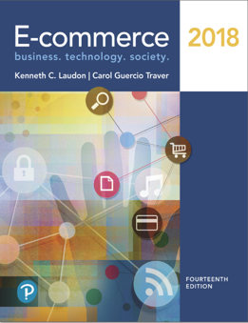
E-Commerce 2018: Business. Technology. Society
Fourteenth Edition
Chapter 3
E-Commerce Infrastructure: The Internet, Web, and Mobile Platform
Slides in this presentation contain hyperlinks. JAWS users should be able to get a list of links by using INSERT+F7
Copyright © 2019, 2018, 2017 Pearson Education, Inc. All Rights Reserved
Notes:
If this PowerPoint presentation contains mathematical equations, you may need to check that your computer has the following installed:
1) MathType Plugin
2) Math Player (free versions available)
3) NVDA Reader (free versions available)

Slide 2
Learning Objectives
3.1 Discuss the origins of, and the key technology concepts behind, the Internet.
3.2 Explain the current structure of the Internet.
3.3 Understand the limitations of today’s Internet and the potential capabilities of the Internet of the future.
3.4 Understand how the Web works.
3.5 Describe how Internet and web features and services support e-commerce.
3.6 Understand the impact of mobile applications.
Notes:
Slide 2 is list of textbook LO numbers and statements

Slide 3
Voice-Controlled Intelligent Digital Assistants: Will They Revolutionize E-Commerce?
Class Discussion
What are intelligent assistants and why are they so popular?
Do you use conversational A I assistants? What for?
What are the benefits of these assistants? The disadvantages?
Are there any benefits/disadvantages to the proprietary nature of these assistants and chatbots?

Slide 4
The Internet: Technology Background
Internet
Interconnected network of thousands of networks and millions of computers
Links businesses, educational institutions, government agencies, and individuals
World Wide Web (Web)
One of the Internet’s most popular services
Provides access to billions, possibly trillions, of web pages

Slide 5
The Evolution of the Internet 1961–Present
Innovation Phase, 1961–1974
Creation of fundamental building blocks
Institutionalization Phase, 1975–1995
Large institutions provide funding and legitimization
Commercialization Phase, 1995–present
Private corporations take over, expand Internet backbone and local service

Slide 6
The Internet: Key Technology Concepts
Internet defined as network that:
Uses I P addressing
Supports T C P/I P
Provides services to users, in manner similar to telephone system
Three important concepts:
Packet switching
T C P/I P communications protocol
Client/server computing

Slide 7
Packet Switching
Slices digital messages into packets
Sends packets along different communication paths as they become available
Reassembles packets once they arrive at destination
Uses routers
Less expensive, wasteful than circuit-switching

Slide 8
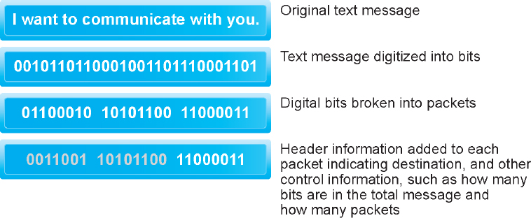
Figure 3.3 Packet Switching
Notes:
Figure 3.3, Page 121.
In packet switching, digital messages are divided into fixed-length packets of bits (generally about 1,500 bytes). Header information indicates both the origin and the ultimate destination address of the packet, the size of the message, and the number of packets the receiving node should expect. Because the receipt of each packet is acknowledged by the receiving computer, for a considerable amount of time, the network is not passing information, only acknowledgments, producing a delay called latency.

Slide 9
T C P/I P
Transmission Control Protocol (T C P)
Establishes connections among sending and receiving Web computers
Handles assembly of packets at point of transmission, and reassembly at receiving end
Internet Protocol (I P)
Four T C P/I P layers
Network interface layer
Internet layer
Transport layer
Application layer

Slide 10
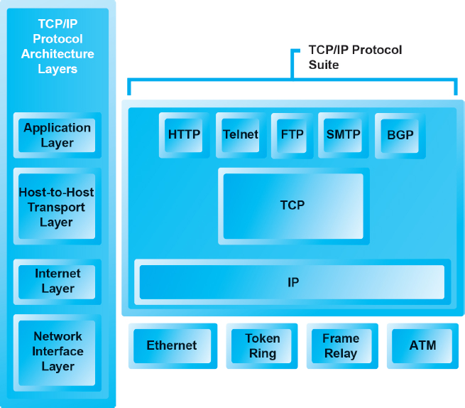
Figure 3.4 The T C P/I P Architecture and Protocol Suite
Notes:
Figure 3.4, Page 123.
TCP/IP is an industry-standard suite of protocols for large internetworks. The purpose of TCP/IP is to provide high-speed communication network links.

Slide 11
Internet (I P) Addresses
I P v4
32-bit number
Four sets of numbers marked off by periods: 201.61.186.227
Class C address: Network identified by first three sets, computer identified by last set
I P v6
128-bit addresses, able to handle up to 1 quadrillion addresses (I P v4 can handle only 4 billion)

Slide 12
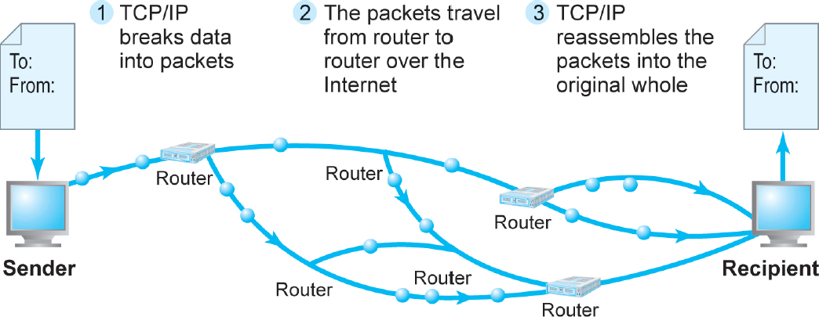
Figure 3.5 Routing Internet Messages: T C P/I P and Packet Switching
Notes:
Figure 3.5, Page 124.
The Internet uses packet-switched networks and the TCP/IP communications protocol to send, route, and assemble messages. Messages are broken into packets, and packets from the same message can travel along different routes.

Slide 13
Domain Names, D N S, and U R L s
Domain name
I P address expressed in natural language
Domain name system (D N S)
Allows numeric I P addresses to be expressed in natural language
Uniform resource locator (U R L)
Address used by Web browser to identify location of content on the Web
For example: http://www.azimuth-interactive.com/

Slide 14
Client/Server Computing
Powerful personal computers (clients) connected in network with one or more servers
Servers perform common functions for the clients
Storing files
Software applications
Access to printers, and so on

Slide 15
The Mobile Platform
Primary Internet access is now through tablets and smartphones
Tablets supplement P Cs for mobile situations
Over 160 million people in U . S. use Internet with tablets
Smartphones are a disruptive technology
New processors and operating systems
Over 220 million in U.S. access Internet with smartphones

Slide 16
The Internet “Cloud Computing” Model (1 of 2)
Firms and individuals obtain computing power and software over Internet
Three types of services
Infrastructure as a service (I a a S)
Software as a service (S a a S)
Platform as a service (P a a S)
Public, private, and hybrid clouds

Slide 17
The Internet “Cloud Computing” Model (2 of 2)
Drawbacks
Security risks
Shifts responsibility for storage and control to providers
Radically reduces costs of:
Building and operating websites
Infrastructure, I T support
Hardware, software

Slide 18
Other Internet Protocols and Utility Programs
Internet protocols
H T T P
E-mail: S M T P, P O P 3, I M A P
F T P, Telnet, S S L/T L S
Utility programs
Ping
Tracert

Slide 19
The Internet Today
Internet growth has boomed without disruption because of:
Client/server computing model
Hourglass, layered architecture
Network Technology Substrate
Transport Services and Representation Standards
Middleware Services
Applications

Slide 20
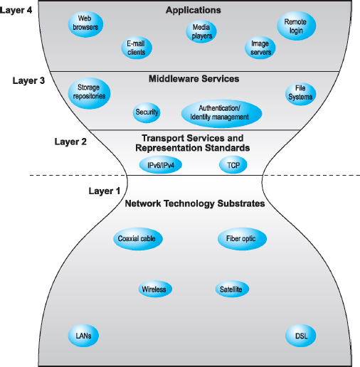
Figure 3.10 The Hourglass Model of the Internet
Notes:
Figure 3.10 Page 135.
The Internet can be characterized as an hourglass modular structure with a lower layer containing the bit-carrying infrastructure (including cables and switches) and an upper layer containing user applications such as e-mail and the Web. In the narrow waist are transportation protocols such as TCP/IP.

Slide 21
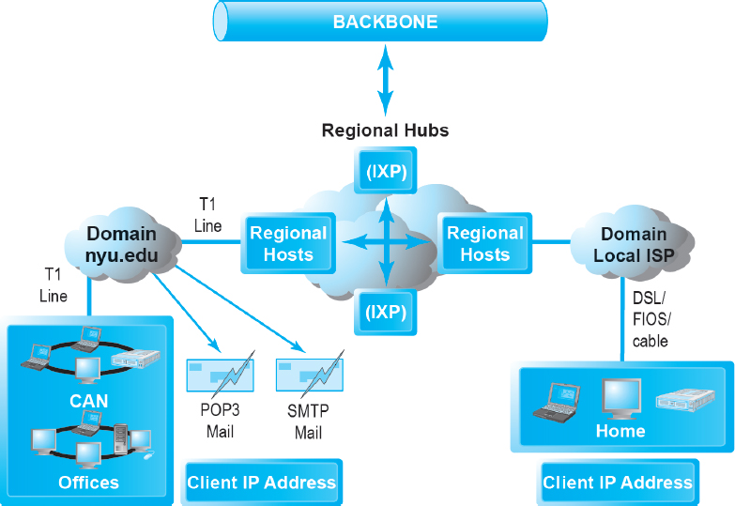
Figure 3.11 Internet Network Architecture
Notes:
Figure 3.11, Page 136.
Today’s Internet has a multi-tiered open network architecture featuring multiple backbones, regional hubs,
campus/corporate area networks, and local client computers.

Slide 22
The Internet Backbone
Tier 1 Internet Service Providers (Tier 1 I S P s) or transit I S P s
Numerous private networks physically connected to each other
Undersea fiber optics, satellite links

Slide 23
Internet Exchange Points (I X P s)
Regional hubs where Tier 1 I S P s physically connect with one another and with regional Tier 2 I S P s.
Tier 2 I S P s provide Tier 3 I S P s with Internet access.
Originally called Network Access Points (N A P s) or Metropolitan Area Exchanges (M A E s).

Slide 24
Tier 3 Internet Service Providers
Retail providers
Lease Internet access to home owners, small businesses
Large providers: Comcast, Verizon, Time Warner Cable
Smaller local providers
Services
Narrowband
Broadband
Digital subscriber line (D S L)
Cable Internet
Satellite Internet

Slide 25
Campus/Corporate Area Networks
Local area networks operating within single organization
E.g. N Y U, Microsoft Corporation
Lease Internet access directly from regional and national carriers

Slide 26
Intranets
Intranet
T C P/I P network located within a single organization for communications and processing
Used by private and government organizations for internal networks
All Internet applications can be used in private intranets

Slide 27
Who Governs the Internet?
Organizations that influence the Internet and monitor its operations include:
Internet Corporation for Assigned Names and Numbers (I C A N N)
Internet Engineering Task Force (I E T F)
Internet Research Task Force (I R T F)
Internet Engineering Steering Group (I E S G)
Internet Architecture Board (I A B)
Internet Society (I S O C)
Internet Governance Forum (I G F)
World Wide Web Consortium (W3C)
Internet Network Operators Groups (N O G s)

Slide 28
Insight on Society: Government Regulation and Surveillance of the Internet
Class discussion:
How is it possible for any government to “control” or censor the Web?
Does the Chinese government, or the U.S. government, have the right to censor content on the Web?
How should U.S. companies deal with governments that want to censor content?
What would happen to e-commerce if the existing Web split into a different Web for each country?

Slide 29
Limitations of the Current Internet
Bandwidth limitations
Slow peak-hour service
Quality of service limitations
Latency
Network architecture limitations
Identical requests are processed individually
Wired Internet
Copper and expensive fiber-optic cables

Slide 30
The Internet2 Project
Consortium of 450+ institutions collaborating to facilitate revolutionary Internet technologies
Primary goals:
Provides leading-edge very-high-speed network for national research community
Environment for developing and testing new technologies
Distributed and collaborative computing environments for sciences, health, arts, and humanities initiatives

Slide 31
The First Mile and the Last Mile
Most significant private initiatives
Fiber optic trunk-line bandwidth (first mile)
Wireless internet services (last mile)

Slide 32
Fiber Optics and the Bandwidth Explosion in the First Mile
“First mile”: Backbone Internet services that carry bulk traffic over long distances
Fiber-optic cable: hundreds of glass strands that use light to transmit data
Faster speeds and greater bandwidth
Thinner, lighter cables
Less interference
Better data security
Substantial investments in fiber optic by telecommunications firms in last decade

Slide 33
The Last Mile: Mobile Internet Access
“Last mile”: From Internet backbone to user’s computer, smartphone, and so on
Two basic types of wireless Internet access:
Telephone-based (mobile phones, smartphones)
Computer network–based (wireless local area network–based)

Slide 34
Wireless Local Area Network (W L A N) –Based Internet Access
Wi-Fi
High-speed, fixed broadband wireless L A N (W L A N)
Wireless access point (“hot spots”)
Limited range but inexpensive
WiMax
Bluetooth

Slide 35
Other Innovative Internet Access Technologies: Drones, Balloons, and White Space
Google: Project Loon
Facebook: Facebook Connectivity Lab/Acquila drone
Microsoft: White spaces project

Slide 36
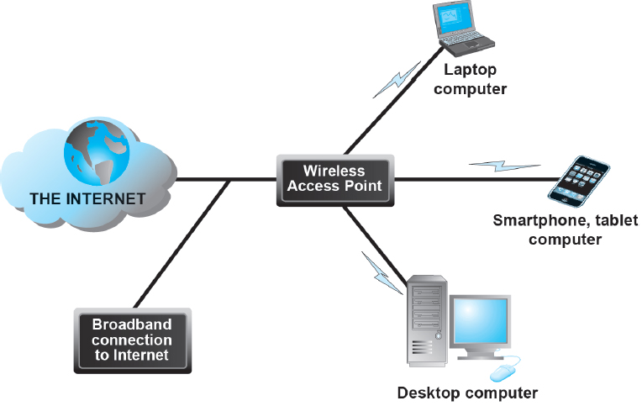
Figure 3.13 Wi-Fi Networks
Notes:
Figure 3.13, page 151.
In a Wi-Fi network, wireless access points connect to the Internet using a land-based broadband connection. Clients, which could be desktops, laptops, tablet computers, or smartphones, connect to the access point using radio signals.

Slide 37
The Future Internet
Latency solutions
diffserv (differentiated quality of service)
Guaranteed service levels and lower error rates
Declining costs
The Internet of Things (I o T)
Objects connected via sensors/R F I D to the Internet
“Smart things”
Interoperability issues and standards
Security and privacy concerns

Slide 38
Insight on Business: The Apple Watch: Bringing the Internet of Things to Your Wrist
Class Discussion
Are you or anyone you know using the Apple Watch? If not, why not? If so, what apps do you use most?
What are the potential benefits of wearable technology? Are there any disadvantages?
What effects will features like the Apple Pay button and Taptic Engine have?
Are there any privacy issues raised by wearable technology?

Slide 39
The Web
1989–1991: Web invented
Tim Berners-Lee at C E R N
H T M L, H T T P, web server, web browser
1993: Mosaic web browser w/G U I
Andreessen and others at N C S A
Runs on Windows, Macintosh, or Unix
1994: Netscape Navigator, first commercial web browser
1995: Microsoft Internet Explorer

Slide 40
Hypertext
Text formatted with embedded links
Links connect documents to one another, and to other objects such as sound, video, or animation files
Uses Hypertext Transfer Protocol (H T T P) and U R L s to locate resources on the Web
Example U R L: http://megacorp.com/content/features/082602.html

Slide 41
Markup Languages
Hypertext Markup Language (H T M L)
Fixed set of pre-defined markup “tags” used to format text
Controls look and feel of web pages
H T M L5 the newest version
eXtensible Markup Language (X M L)
Designed to describe data and information
Tags used are defined by user

Slide 42
Insight on Technology: the Rise of H T M L5
Class Discussion
What features of H T M L5 are changing the way websites are built?
Is H T M L5 a disruptive technology, and if so, for whom?
Are there any disadvantages in websites and mobile apps moving to an H T M L5 platform?

Slide 43
Web Servers and Web Clients
Web server software
Enables a computer to deliver web pages to clients on a network that request this service by sending an H T T P request
Basic capabilities: Security services, F T P, search engine, data capture
Web server
May refer to either web server software or physical server
Specialized servers: Database servers, ad servers, and so on
Web client
Any computing device attached to the Internet that is capable of making H T T P requests and displaying H T M L pages

Slide 44
Web Browsers
Primary purpose is to display web page, but may include added features
Google’s Chrome: 60% of desktop market, 56% mobile market
Open source
Internet Explorer: 17% of desktop, >1% mobile
Mozilla Firefox: 12% desktop, >1% mobile
Open source
Apple’s Safari: 4% desktop, 33% mobile

Slide 45
The Internet and Web: Features
Features on which the foundations of e-commerce are built:
Communication tools
Search engines
Downloadable and streaming media
Web 2.0 applications and services
Virtual reality and augmented reality
Intelligent digital assistants

Slide 46
Communication Tools
E-mail
Most used application of the Internet
Messaging Applications
Instant messaging
Online message boards
Internet telephony
V O I P
Video conferencing, video chatting, telepresence

Slide 47
Search Engines
Identify web pages that match queries based on one or more techniques
Keyword indexes
Page ranking
Also serve as:
Shopping tools
Advertising vehicles (search engine marketing)
Tool within e-commerce sites
Top three providers: Google, Bing, Yahoo

Slide 48
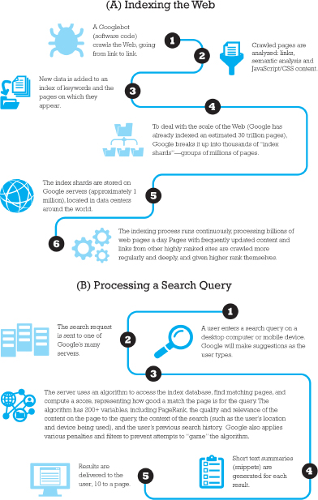
Figure 3.17 How Google Works
Notes:
Figure 3.18, page 172.

Slide 49
Downloadable and Streaming Media
Downloads:
Growth in broadband connections enables large media file downloads
Streaming technologies
Enables music, video, and other large files to be sent to users in chunks so that the file can play uninterrupted
Podcasting
Explosion in online video viewing

Slide 50
Web 2.0 Features and Services
Online Social Networks
Services that support communication among networks of friends, peers
Blogs
Personal web page of chronological entries
Enables web page publishing with no knowledge of H T M L
Wikis
Enables documents to be written collectively and collaboratively
E.g. Wikipedia

Slide 51
Virtual Reality and Augmented Reality
Virtual reality
Immersing users within virtual world
Typically uses head-mounted display (H M D)
Oculus Rift, Vive, PlayStation V R
Augmented reality
Overlaying virtual objects over the real world, via mobile devices or H M D s
Pokémon GO

Slide 52
Intelligent Digital Assistants
Computer search engine using:
Natural language
Conversational interface, verbal commands
Situational awareness
Can handle requests for appointments, flights, routes, event scheduling, and more.
Examples:
Apple’s Siri
Google Now
Google Assistant

Slide 53
Mobile Apps
Use of mobile apps has exploded
Most popular entertainment media, over T V
Always present shopping tool
Almost all top 100 brands have an app
Platforms
iPhone/iPad (i O S), Android, Blackberry
App marketplaces
Google Play, Apple’s App Store, R I M’s App World, Windows Phone Marketplace

Slide 54
Careers in E-Commerce
Position: E-commerce Specialist
Qualification/Skills
Preparing for the Interview
Possible Interview Questions

Slide 55

Copyright

