Slide 1



Slide 2



Slide 3
What is HTML used for?

Slide 4

STRUCTURE
Text
Video
Lists
Audio
Links
Forms
Images
Tables
Notes:
Click: Fades in text, lists, links, images, tables, forms, audio, video
Explain: Different types of structural markup

Slide 5
What is CSS used for?

Slide 6
PRESENTATION
LAYOUT
Notes:
Explain: Pure HTML examples will look plain until students learn to add styling via CSS

Slide 7

ACCESSING THE WEB
.
.
.
.
.
.
.
.
.
.
.
.
.
.
.
.
.
.
.
.
.
.
.
.
.
.
.
.
.
.
.
.
.
.
.
.
.
.
.
.
.
.
.
.
.
.
.
.
.
.
.
.
.
.
.
.
.
.
.
.
.
.
.
.
.
.
.
.
.
.
.
.
.
.
.
.
.
.
.
.
.
.
.
.
.
.
.
.
.
.
.
.
.
.
.
.
.
.
.
.
.
.
.
.
.
.
.
.
.
.
.
.
.
.
.
.
.
.
.
.
.
.
.
.
.
.
.
.
.
.
.
.
.
.
.
.
.
.
.
.
.
.
.
.
.
.
.
.
.
.
.
.
.
.
.
.
.
.
.
.
.
.
Notes:
Explain: People access websites via a web browser (e.g. Firefox, IE, Chrome, Safari)
Explain: Users type in URL for web page, follow link, or click on bookmark
Explain: Browser makers regularly release new versions of their browsers
Click: Arrows point to a server
Explain: When you request a web page, the request goes to a web server that hosts the site
Explain: What a server is (and the role of hosting companies)
Click: Tablet/phone fades in
Explain: Browsers come on different devices, desktop computers, mobile, tablet, tv etc.
Click: Headphones fade in
Explain: Screen readers (depicted here by headphones)

Slide 8
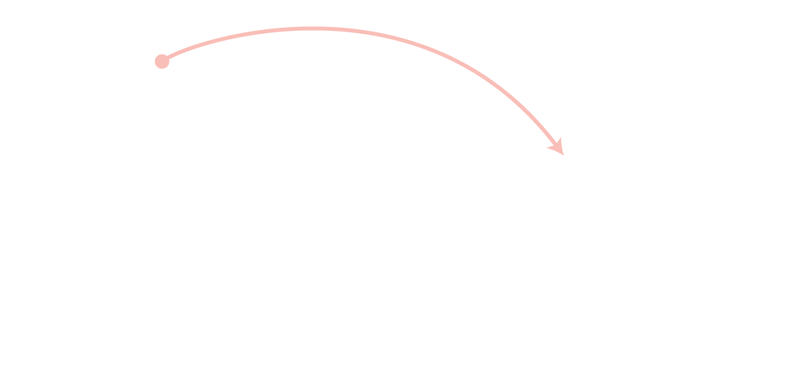

HOW THE WEB WORKS
A user in Vancouver visits airindia.in in Bangalore
Notes:
Illustrates how web users can be anywhere in the world, and request pages from servers in other parts of the world.

Slide 9

HOW THE WEB WORKS
A user in Stockholm visits qantas.com.au in Sydney

Slide 10

HOW THE WEB WORKS
A user in New York visits google.com in San Francisco

Slide 11
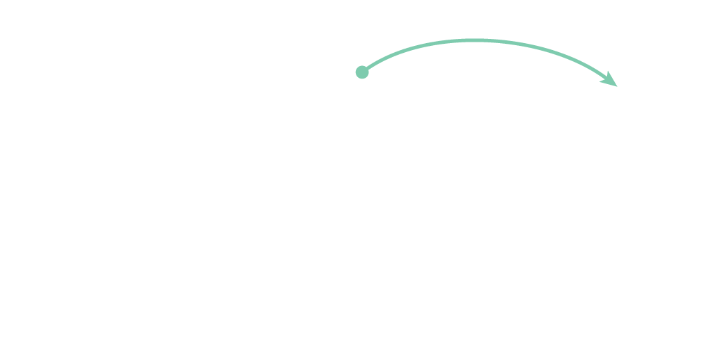
HOW THE WEB WORKS
A user in Barcelona visits sony.jp in Tokyo

Slide 12
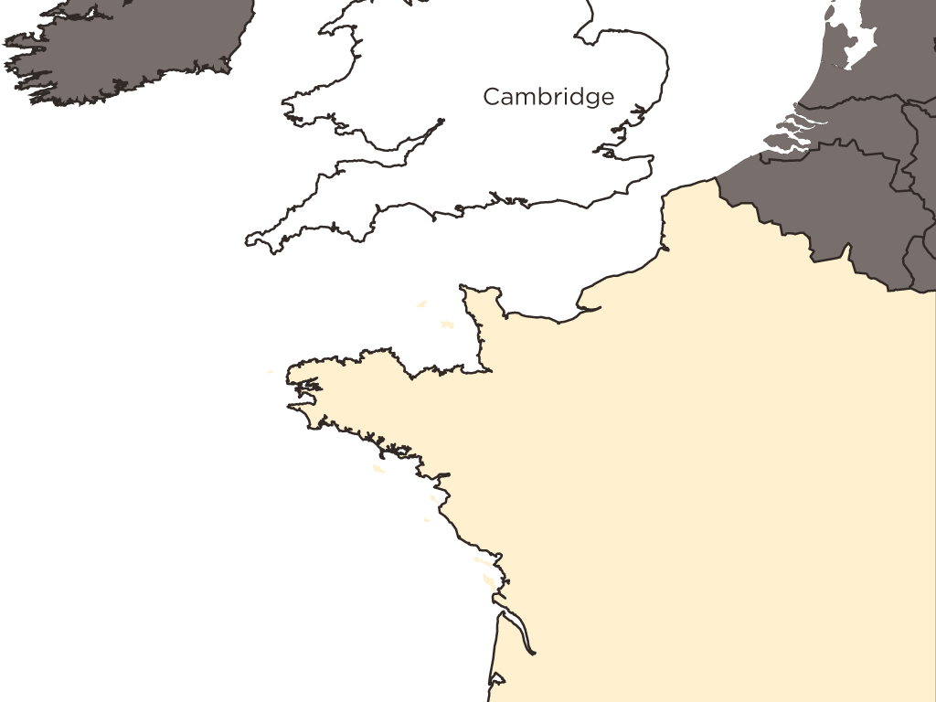
1
You connect to the web via an Internet Service Provider (ISP).
Notes:
Explain: You connect to the web via an Internet Service Provider (ISP).

Slide 13
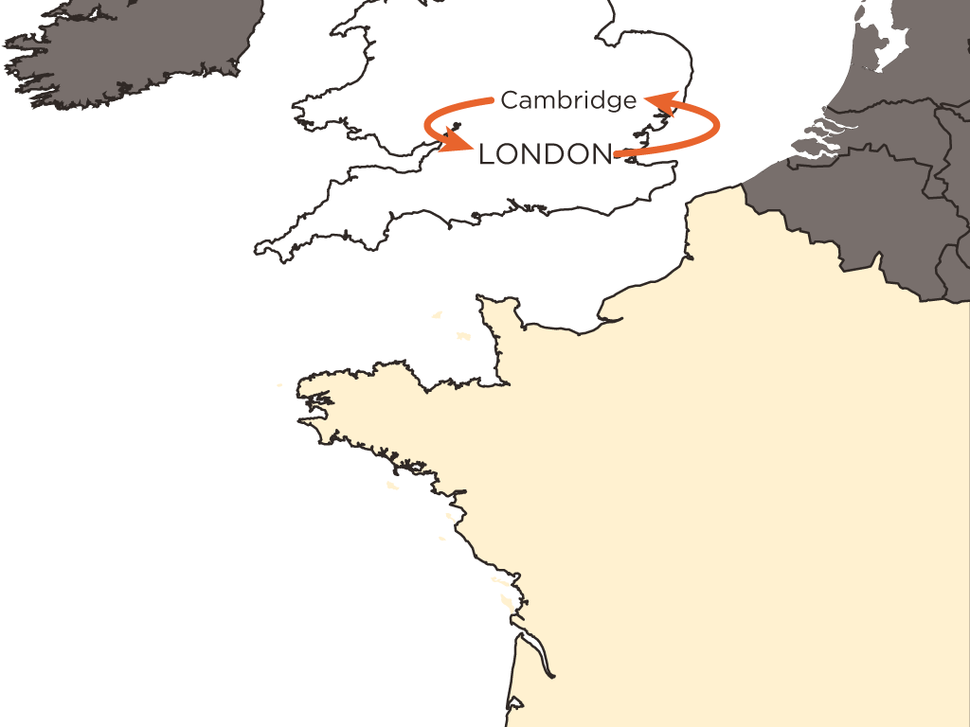
2
Your computer contacts a network of servers called Domain Name System (DNS) servers. They return an IP address.
Notes:
Explain: When a user requests a web page, a DNS server is consulted. The DNS server sends back an IP address for the server that the site lives on.

Slide 14
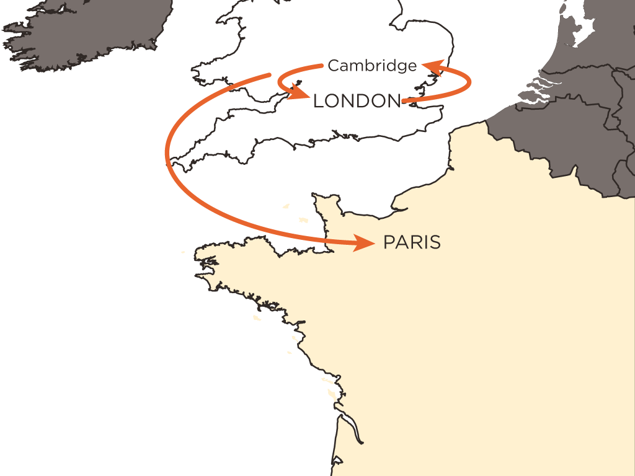
3
Your computer uses the number provided by the DNS servers to go to the web server hosting the website you want to visit.
Notes:
Explain: The IP address is used to contact the web server.

Slide 15
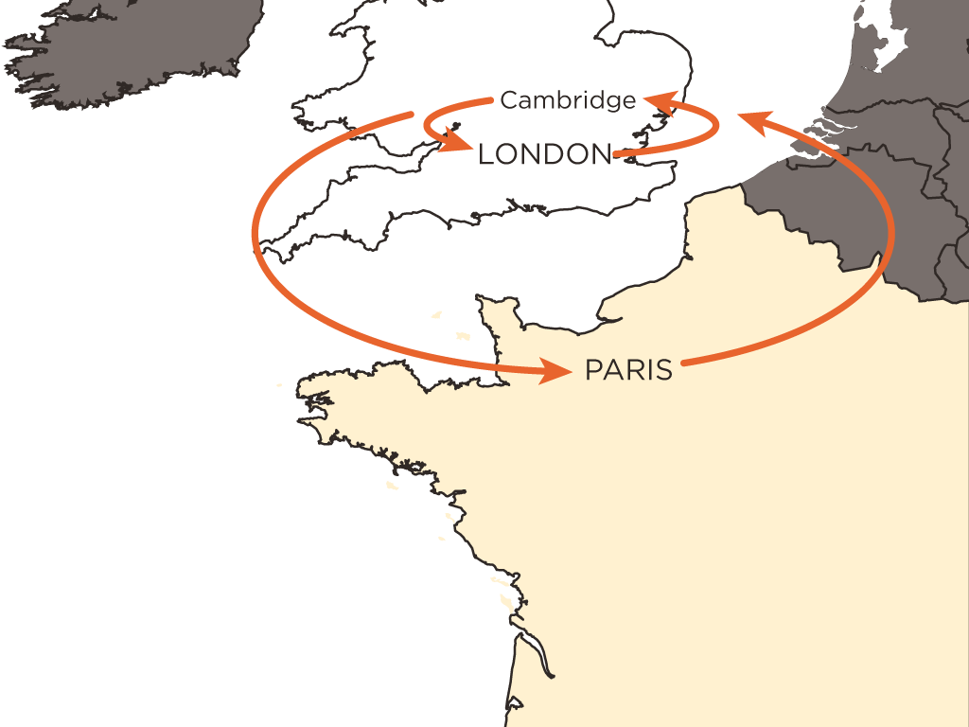
4
The web server then sends the page you requested back to your web browser.
Notes:
Explain: The server sends back the appropriate page.

Slide 16


