Slide 1



Slide 2
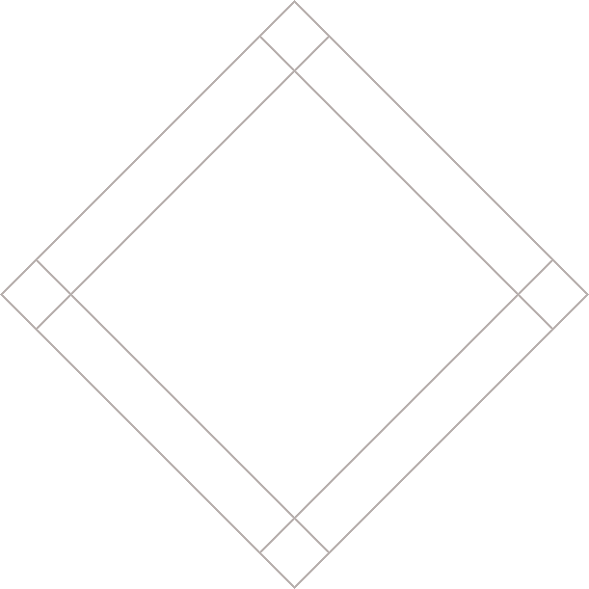


Slide 3
UNDERSTANDING CSS:
THINKING INSIDE THE BOX
The Cottage Garden
The cottage garden is a distinct style of garden that uses an informal design, dense planting and a mixture of ornamental and edible plants.
The Cottage Garden originated in England and its history can be traced back for centuries, although they were re-invented in 1870's England, when stylized versions were formed as a reaction to the more structured and rigorously maintained English estate gardens.
The earliest cottage gardens were more practical than their modern descendants, with an emphasis on vegetables and herbs, along with some fruit trees.
Notes:
Explain: how CSS treats each element as if it creates its own box
Click: box around entire page
Click: box around block level elements
Click: box around inline elements

Slide 4
CSS ASSOCIATES STYLE RULES WITH HTML ELEMENTS
p {
font-family: Arial;}
Notes:
Explain: CSS uses rules to indicate how certain elements should look

Slide 5
CSS ASSOCIATES STYLE RULES WITH HTML ELEMENTS
SELECTOR
p {
font-family: Arial;}
Notes:
Explain: Selector indicates which elements the rule applies to

Slide 6
CSS ASSOCIATES STYLE RULES WITH HTML ELEMENTS
SELECTOR
p {
font-family: Arial;}
DECLARATION
Notes:
Explain: Declaration says how that element should look

Slide 7
CSS PROPERTIES AFFECT HOW ELEMENTS ARE DISPLAYED
h1, h2, h3 {
font-family: Arial;
color: yellow;}
Notes:
Explain: a selector can apply to several elements (here: h1, h2, h3)
Explain: a declaration can affect several aspects of an element's appearance
Explain: a declaration consists of a property and a value

Slide 8
CSS PROPERTIES AFFECT HOW ELEMENTS ARE DISPLAYED
h1, h2, h3 {
font-family: Arial;
color: yellow;}
PROPERTY

Slide 9
CSS PROPERTIES AFFECT HOW ELEMENTS ARE DISPLAYED
h1, h2, h3 {
font-family: Arial;
color: yellow;}
PROPERTY
VALUE

Slide 10
INTRODUCING CSS
<h1>From Garden to Plate</h1>
<p>A <i>potager</i> is a French term for
an ornamental vegetable or kitchen
garden...</p>
<h2>What to Plant</h2>
<p>Plants are chosen as much for their
functionality as for their color and
form...</p>
Notes:
This is an example of an HTML page. The next slide shows it without any styling.

Slide 11
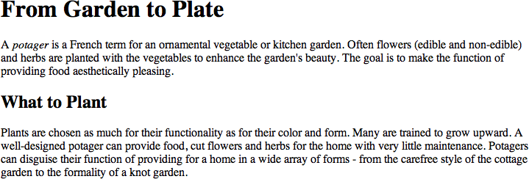

Slide 12
INTRODUCING CSS
body {
font-family: Arial, Verdana, sans-serif;}
h1, h2 {
color: #ee3e80;}
p {
color: #665544;}
Notes:
This style sheet uses several rules to control the appearance of a whole web page.

Slide 13
INTRODUCING CSS
Change the font used
body {
font-family: Arial, Verdana, sans-serif;}
h1, h2 {
color: #ee3e80;}
p {
color: #665544;}

Slide 14
INTRODUCING CSS
body {
font-family: Arial, Verdana, sans-serif;}
h1, h2 {
color: #ee3e80;}
p {
color: #665544;}
Change the color of the headings

Slide 15
INTRODUCING CSS
body {
font-family: Arial, Verdana, sans-serif;}
h1, h2 {
color: #ee3e80;}
p {
color: #665544;}
Change the color of the paragraphs

Slide 16
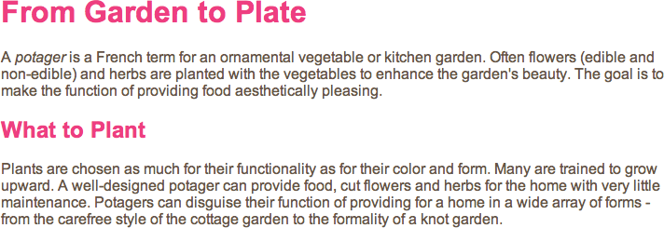
Notes:
Note: The following have now changed:
The font is now Arial.
The headings are now pink.
The main text is dark brown (not black - difference may be harder to see).

Slide 17
USING EXTERNAL CSS
<html>
<head>
<title>Using External CSS</title>
<link href="css/styles.css"
type="text/css"
rel="stylesheet">
</head>
<body>
<h1>Potatoes</h1>
<p>There are dozens of...</p>
</body>
</html>

Slide 18
USING EXTERNAL CSS
<html>
<head>
<title>Using External CSS</title>
<link href="css/styles.css"
type="text/css"
rel="stylesheet">
</head>
<body>
<h1>Potatoes</h1>
<p>There are dozens of...</p>
</body>
</html>

Slide 19
USING EXTERNAL CSS
<html>
<head>
<title>Using External CSS</title>
<link href="css/styles.css"
type="text/css"
rel="stylesheet">
</head>
<body>
<h1>Potatoes</h1>
<p>There are dozens of...</p>
</body>
</html>

Slide 20
USING EXTERNAL CSS
<html>
<head>
<title>Using External CSS</title>
<link href="css/styles.css"
type="text/css"
rel="stylesheet">
</head>
<body>
<h1>Potatoes</h1>
<p>There are dozens of...</p>
</body>
</html>

Slide 21
USING INTERNAL CSS
<head>
<title>Using Internal CSS</title>
<style type="text/css">
body {
font-family: arial;
background-color: #rgb(185,179,175);}
h1 {
color: rgb(255,255,255);}
</style>
</head>

Slide 22
CSS SELECTORS
Universal
* {}
Type
h1, h2, h3 {}
Class
.note {}
p.note {}
ID
#introduction {}
Notes:
Fade in: universal selector
Click: type selector
Click: class selector
Click: id attribute

Slide 23
CSS SELECTORS
Child
li>a {}
Descendent
p a {}
Adjacent sibling
h1+p {}
General sibling
h1~p {}
Notes:
Fade in: child selector
Click: descendent selector
Click: adjacent sibling selector
Click: general sibling selector

Slide 24
HOW CSS RULES CASCADE
* {
font-family: Arial;
color: #333333;}
h1 {
font-family: "Courier New", monospace;}
i {color: green;}
i {color: red;}
p b {color: blue !important;}
p b {color: violet;}
Notes:
Explain:
last rule takes precedence = <i> will be in red
More specific rule takes precedence = <h1> will be in monospace
!important makes it more important than others

Slide 25
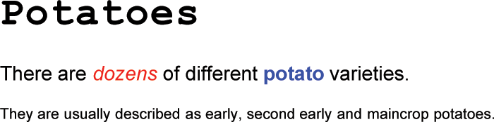

Slide 26
INHERITANCE
body {
font-family: Arial, sans-serif;
color: #665544;
padding: 10px;}
.page {
border: 1px solid #665544;
background-color: #efefef;
padding: inherit;}
Notes:
Explain:
Some styles are inherited (e.g. font-family or color on body)
Some are not (e.g. border styles not inherited by headings / paragraphs)
Note: can force some properties to inherit by giving them a value of inherit

Slide 27
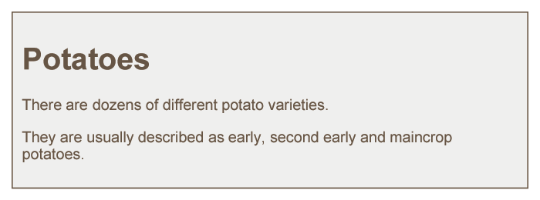

Slide 28
WHY USE EXTERNAL
STYLE SHEETS
Same CSS can be used for every page of website

Slide 29
WHY USE EXTERNAL
STYLE SHEETS
No need to copy style code into each webpage

Slide 30
WHY USE EXTERNAL
STYLE SHEETS
Changes to CSS automatically apply to the entire website

Slide 31
WHY USE EXTERNAL
STYLE SHEETS
Faster download time for subsequent pages

Slide 32
WHY USE EXTERNAL
STYLE SHEETS
Easier for many people to create new pages in same style

Slide 33
DIFFERENT VERSIONS OF CSS & BROWSER QUIRKS
Several different versions

Slide 34
DIFFERENT VERSIONS OF CSS & BROWSER QUIRKS
Browsers not implemented all features

Slide 35
DIFFERENT VERSIONS OF CSS & BROWSER QUIRKS
Older browsers do not support each property

Slide 36
DIFFERENT VERSIONS OF CSS & BROWSER QUIRKS
Important to test

Slide 37
DIFFERENT VERSIONS OF CSS & BROWSER QUIRKS
Some browsers have "bugs" or "quirks"

Slide 38
SUMMARY
CSS treats each HTML element as if it appears inside its own box and uses rules to indicate how that element should look.
Notes:
Clicks: Load individual bullets

Slide 39
SUMMARY
Rules are made up of selectors (to specify which elements the rule applies to) and declarations (to say what these elements should look like).
Notes:
Clicks: Load individual bullets

Slide 40
SUMMARY
Different types of selectors allow you to target your rules at different elements.
Notes:
Clicks: Load individual bullets

Slide 41
SUMMARY
Declarations are made up of two parts: the properties of the element that you want to change, and the values of those properties.
Notes:
Clicks: Load individual bullets

Slide 42
SUMMARY
CSS rules usually appear in a separate document, although they may appear within an HTML page.
Notes:
Clicks: Load individual bullets

Slide 43
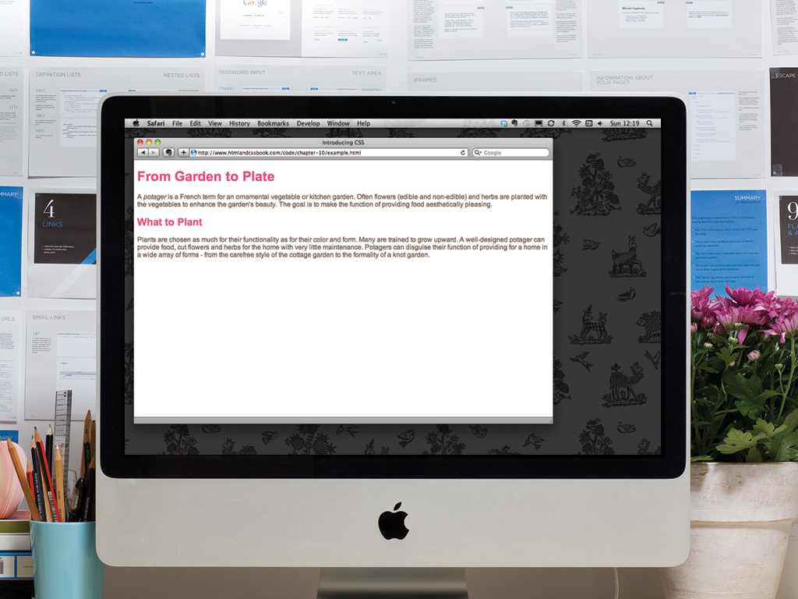

Slide 44


