Slide 1



Slide 2
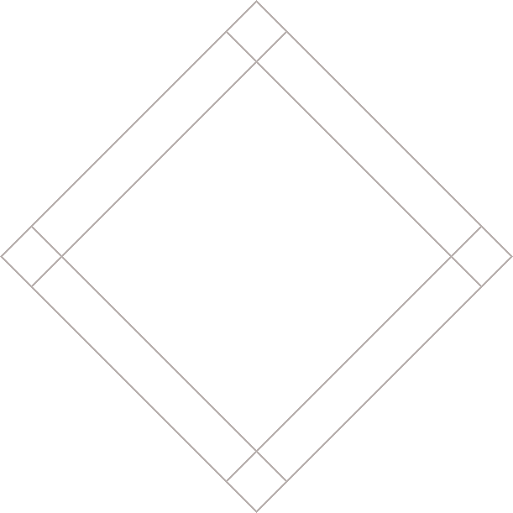


Slide 3
NEW HTML5 LAYOUT ELEMENTS
<body>
<div id="page">
<div id="header">
<div id="nav">
<div id="content">
<div id=
"sidebar">
<div class="article">
<div class="article">
<div id="footer">
Notes:
Explain: Going to see markup typically used to create this kind of layout
Click: sections of page appear, until you see two articles in the middle

Slide 4
NEW HTML5 LAYOUT ELEMENTS
<body>
<div id="page">
<div id="nav">
<div id="content">
<div id=
"sidebar">
<div class="article">
<div class="article">
<div id="footer">
Notes:
Explain: Going to see markup typically used to create this kind of layout
Click: sections of page appear, until you see two articles in the middle

Slide 5
NEW HTML5 LAYOUT ELEMENTS
<body>
<div id="page">
<nav>
<div id="content">
<div id=
"sidebar">
<div class="article">
<div class="article">
<div id="footer">
Notes:
Explain: Going to see markup typically used to create this kind of layout
Click: sections of page appear, until you see two articles in the middle

Slide 6
NEW HTML5 LAYOUT ELEMENTS
<body>
<div id="page">
<nav>
<div id="content">
<div id=
"sidebar">
<article>
<article>
<div id="footer">
Notes:
Explain: Going to see markup typically used to create this kind of layout
Click: sections of page appear, until you see two articles in the middle

Slide 7
NEW HTML5 LAYOUT ELEMENTS
<body>
<div id="page">
<nav>
<div id="content">
<aside>
<article>
<article>
<div id="footer">
Notes:
Explain: Going to see markup typically used to create this kind of layout
Click: sections of page appear, until you see two articles in the middle

Slide 8
NEW HTML5 LAYOUT ELEMENTS
<body>
<div id="page">
<nav>
<div id="content">
<aside>
<article>
<article>
Notes:
Explain: Going to see markup typically used to create this kind of layout
Click: sections of page appear, until you see two articles in the middle

Slide 9
HEADER
<header>
<header>
<h1>Yoko's Kitchen</h1>
<nav>
<ul>
<li><a href="">home</a></li>
<li><a href="">classes</a></li>
<li><a href="">catering</a></li>
<li><a href="">about</a></li>
<li><a href="">contact</a></li>
</ul>
</nav>
</header>
Notes:
Explain: Can be used for main header of page or for an individual article or section on that page

Slide 10
FOOTER
<footer>
<footer>
&copy; 2011 Yoko's Kitchen</footer>
Notes:
Explain: again can be used for entire page or the footer of an article or section

Slide 11
NAVIGATION
<nav>
<nav>
<ul>
<li><a href="">home</a></li>
<li><a href="">classes</a></li>
<li><a href="">catering</a></li>
<li><a href="">about</a></li>
<li><a href="">contact</a></li>
</ul>
</nav>
Notes:
Likely that it will only be used for the primary navigation

Slide 12
ARTICLES
<article>
<article>
<figure>
<img src="bok-choi.jpg" alt="BokChoi" />
<figcaption>Bok Choi</figcaption>
</figure>
<h2>Japanese Vegetarian</h2>
<h3>Five week course in London</h3>
<p>A five week introduction to
traditional Japanese…</p>
</article>
Notes:
Explain: container for section of page that could standalone or be syndicated

Slide 13
ASIDE
<aside>
<aside>
<section class="popular-recipes">
<h2>Popular Recipes</h2>
<a href="">Yakitori (...)</a>
<a href="">Tsukune (...)</a>
<a href="">Okonomiyaki (...)</a>
<a href="">Mizutaki (...)</a>
</section>
</aside>
Notes:
Explain:
Inside an <article> element = information related to an article (not essential to)
Outside an <article> element = information related to entire page

Slide 14
SECTIONS
<section>
<section class="popular-recipes">
<h2>Popular Recipes</h2>
<a href="">Yakitori (...)</a>
<a href="">Tsukune (...)</a>
<a href="">Okonomiyaki (...)</a>
<a href="">Mizutaki (...)</a>
</section>
Notes:
Explain: groups related content together and typically each section would have its own heading
May contain several <article> elements
(Generally not good for wrapping an entire page)

Slide 15
HEADING GROUPS
<hgroup>
<hgroup>
<h2>Japanese Vegetarian</h2>
<h3>Five week course in London</h3>
</hgroup>
Notes:
Explain: groups together multiple <h1> - <h6> headings to create single heading

Slide 16
FIGURES
<figure> <figcaption>
<figure>
<img src="images/bok-choi.jpg"
alt="Bok Choi" />
<figcaption>Bok Choi</figcaption>
</figure>
Notes:
Explain: not just used for images, can also be used for videos, graphs, diagrams, code samples, and text that supports the main example

Slide 17
LINKING AROUND
BLOCK-LEVEL ELEMENTS
<a href="introduction.html">
<article>
<figure>
<img src="bokchoi.jpg" alt="BokChoi" />
<figcaption>Bok Choi</figcaption>
</figure>
<hgroup>
<h2>Japanese Vegetarian</h2>
<h3>Five week course in London</h3>
</hgroup>
</article>
</a>
Notes:
Explain: formally now allowed in HTML5 (was not previously)

Slide 18
HELPING OLDER
BROWSERS UNDERSTAND
header, section, footer, aside, nav, article, figure, figcaption {
display: block;}
Notes:
Explain: need to tell older browsers which elements are block-level elements

Slide 19
HELPING OLDER
BROWSERS HTML SHIV
<!--[if lt IE 9]>
<script
src="http://html5shiv.googlecode.com/
/svn/trunk/html5.js">
</script>
<![endif]-->
Notes:
Explain: IE9 was first version of IE to allow CSS to be associated with HTML5 layout elements
To get that to work in older browsers you need to use HTML5 shiv or shim script
(Requires JS to be enable)

Slide 20
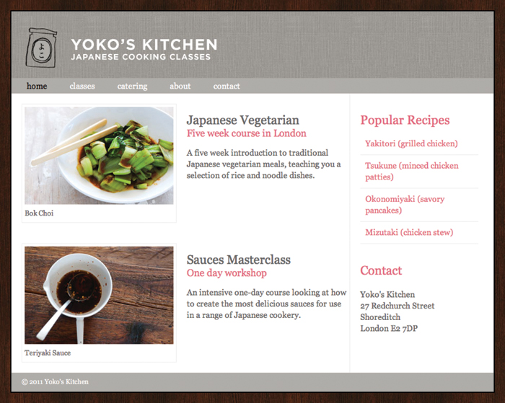

Slide 21
SUMMARY
The new HTML5 elements indicate the purpose of different parts of a web page and help to describe its structure.
Notes:
Clicks: Load individual bullets

Slide 22
SUMMARY
The new elements provide clearer code (compared with using multiple <div> elements).
Notes:
Clicks: Load individual bullets

Slide 23
SUMMARY
Older browsers that do not understand HTML5 elements need to be told which elements are block-level elements.
Notes:
Clicks: Load individual bullets

Slide 24
SUMMARY
To make HTML5 elements work in Internet Explorer 8 (and older versions of IE), extra JavaScript is needed, which is available free
from Google.
Notes:
Clicks: Load individual bullets

Slide 25


Slide 26


