Slide 1
KSEM 2024
The 17th International Conference on Knowledge Science, Engineering and Management
https://ksem24.ai-edge.net/ August 16-18th, 2024, Birmingham, United Kingdom

Slide 2
Conference Organisation TEAM
Steering Committees
• Ruqian Lu (Honorary Chair), Chinese Academy of Sciences, China • Dimitris Karagiannis (Chair), University of Vienna, Austria • Bo Yang, Jilin University, China • Chengqi Zhang, University of Technology Sydney, Australia • Christos Douligeris, University of Piraeus, Greece • Claudiu Kifor, "Lucian Blaga" University of Sibiu, Romania • Gang Li, Deakin University, Australia • Hui Xiong, The State University of New Jersey, USA • Jörg Siekmann, German Research Centre of Artificial Intelligence, Germany • Martin Wirsing, Ludwig-Maximilians-Universität München, Germany • Meikang Qiu, Texas A&M University-Commerce, USA • Xiaoyang Wang, Zhejiang Gongshang University, China • Yaxin Bi, Ulster University, UK • Yoshiteru Nakamori, Japan Advanced Institute of Science and Technology, Japan • Zhi Jin, Peking University, China • Zili Zhang, Southwest University, China
General Co-Chairs
• Yonghao Leo Wang, Birmingham City University, UK • Gerard Memmi, Telecom Paris, France
PC Co-Chairs
• Sun-Yuan Kung， Princeton University, USA • Junaid Arshad, Birmingham City University, UK • Sen He, University of Arizona, USA • Ron Austin, Birmingham City University, UK • Taufiq Asyhari, Monash University, Australia
Publicity Chair
• De Mi, Birmingham City University, UK • Peggy Zhu, Birmingham City University, UK
And many colleagues more …

Slide 3
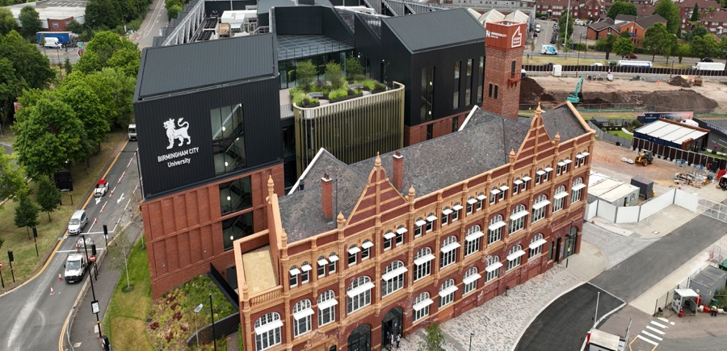
Hosting University
The KSEM 2024 conference is set to be hosted in close collaboration with our Cyber-Physical Systems (CPS) research group, in association with the Networks and Cybersecurity Department at Birmingham City University (BCU), UK.

Slide 4
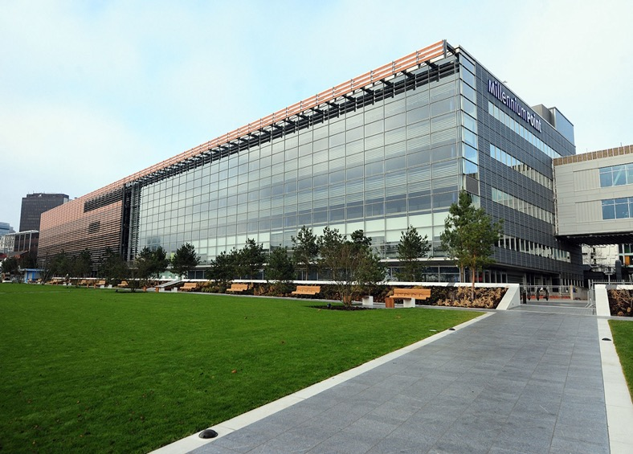
Birmingham City University (BCU)
BCU is at center of United Kingdom
26,900 students 100 countries.
One of largest diverse university in Birmingham, UK.
BCU is investing £340 million in major expansion of city center campus.
It also owns the largest creative education sector outside London, the Birmingham Royal Conservatoire.

Slide 5


Birmingham
Birmingham Museum and Art Gallery: one of the largest museum in the country
Cadbury World
Bullring & Grand Central
Jewelry Quarter
Symphony Hall &Birmingham's Historic Canals

Slide 6
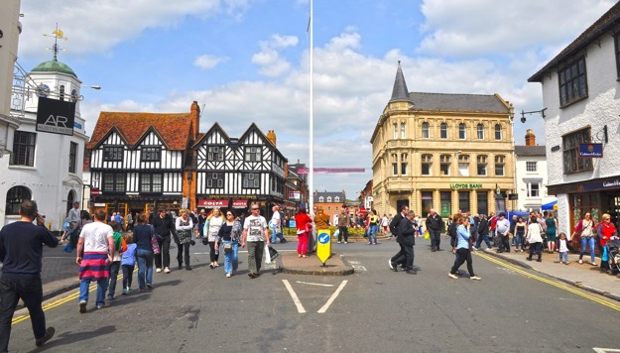

City Location
The City of Birmingham is in middle of England
It is very convenient to travel to the city London about 1 hour by train.
It is easy to reach any parts of the Country including Lake District and Wales.
Very close to Stratford-upon-Avon (the Shakespeare Birthplace)

Slide 7
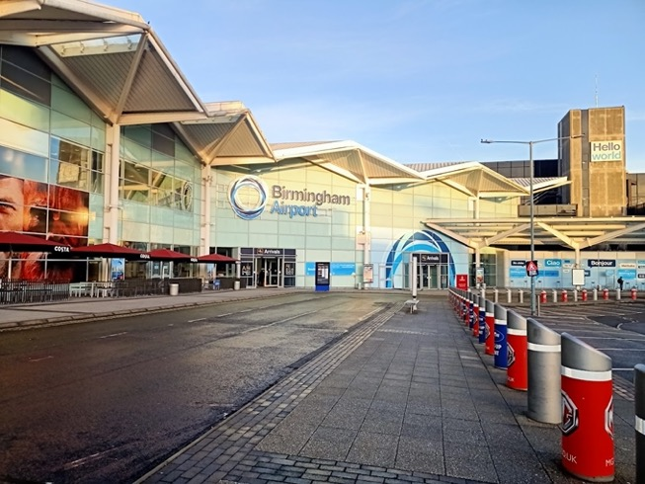
Travel to Birmingham
Birmingham is the second-largest city in the United Kingdom.
It is known as the birthplace of the Frist Industrial Revolution.
By Air: Birmingham International Airport (BHX)
Address: Birmingham B26 3QJ
By Train from London:
Birmingham New Street Station
Birmingham Moor Street Station

Slide 8
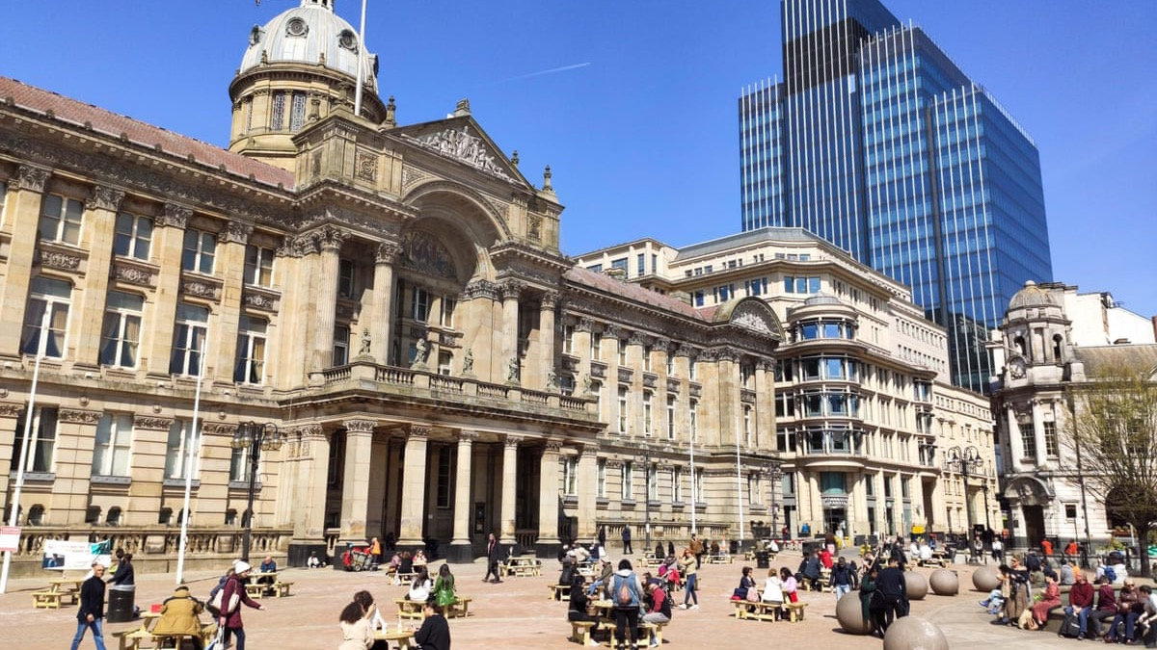
Welcome !
And see you in Birmingham 2024!
https://ksem24.ai-edge.net/

