Slide 1

Gokaraju Rangaraju Institute of Engineering and Technology (Autonomous) Department of Data Science Mini Project Work (CSE(DS))
Review3: Module Presentation
Batch No - 3
Presented by:
1. Mr. Md. Shoaib Nadeem (2324167A0)
2. Mr. Vishal Abhishek (23241A6774)
3. Mr. Shiva Kumar (23241A6797)
Under the Guidance of:
Name :Dr. M. Kiran Kumar
Designation :Associate Professor
Department : DS

Slide 2
UPI Transaction based Fraud Detection System using Generative AI and Machine Learning Techniques
2

Slide 3
Introduction :
An intelligent fraud detection system designed for digital payment platforms
Addresses the challenge of highly imbalanced fraud data using CGAN-based augmentation
Conditional GAN generates realistic synthetic fraud samples based on transaction behavior
XGBoost classifier is trained with class weighting to effectively detect fraudulent transactions while minimizing false negatives.
NGBoost is added as a secondary probabilistic model to estimate fraud risk (probability and uncertainty), enabling risk-aware decisions alongside XGBoost’s classification.
Provides SHAP-based explainability for transparent, feature-level insights in decision making process.
3

Slide 4
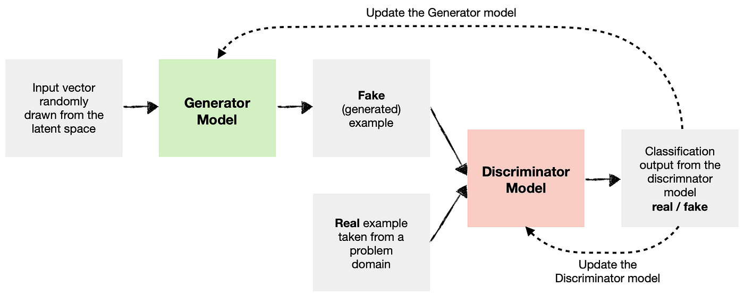
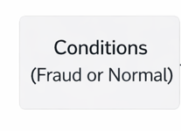
CGAN Architecture: (Cont..)
4

Slide 5
Literature review:
1. Improved VAE-GAN for Credit Card Fraud Detection (IEEE Access, 2023)
Addresses severe class imbalance, a major challenge in fraud detection
Demonstrates that generative models improve fraud recall, not just overall accuracy
Validates the effectiveness of synthetic fraud data generation for minority classes
Relation to our project:
Forms the foundation for using generative models to balance UPI transaction data
Directly supports our choice of CGAN-based synthetic fraud data augmentation
5

Slide 6
Literature review:
2. Using Generative Adversarial Networks for Improving Classification Effectiveness in Credit Card Fraud Detection (2023) Author: Umberto Fiore
Uses GAN-based synthetic fraud data to handle class imbalance
Improves fraud recall and F1-score
Relation to our project:
Motivates generative data augmentation for balancing rare fraud samples
3. Credit Card Fraud Detection Using Conditional Generative Adversarial Networks (2023)
Authors: Shichao Li, Saleh B. Hulayyil, Nitesh Saxena
Uses CGAN to generate fraud samples conditioned on transaction attributes
Outperforms traditional GAN and SMOTE
Relation to our project: Direct basis for using CGAN-based data balancing in UPI fraud detection
6

Slide 7
Literature review:
4. Semi-Supervised Generative Adversarial Networks for Credit Card Fraud Detection (2025)
Author: Dominik Hirnschall
Applies semi-supervised GAN to limited fraud labels
Enhances minority-class learning
Relation to our project: Supports CGAN use when real fraud data is scarce
5. WDAE-GAN: Generative Adversarial Network for Financial Fraud Detection (2025)
Authors: Mohammad Rezvani Nejad, Alireza Khosravi, Saeid Nahavandi
Combines GAN with denoising autoencoders
Improves quality of synthetic fraud data
Relation to our project: Inspires realistic CGAN-based fraud sample generation
7

Slide 8
Literature review:
6. Gated Attention-Based Generative Adversarial Networks for Financial Fraud Detection (2024)
Authors: Jing Ge, Yiqiang Chen
Integrates attention mechanisms into GAN
Generates higher-quality fraud samples
Relation to our project: Supports advanced CGAN architectures for better balancing
7. XGBoost: A Scalable Tree Boosting System (2016)
Authors: Tianqi Chen, Carlos Guestrin
Introduces XGBoost with scalability and regularization
Handles non-linear transactional data
Relation to our project: Core classifier for accurate UPI fraud detection
8

Slide 9
Literature review:
8. Scarff: A Scalable Framework for Fraud Detection with Imbalanced Data (2023)
Authors: Fabrizio Carcillo, Yann-Adrien Bontempi, Gianluca Snoeck
Evaluates ensemble models under extreme imbalance
Demonstrates effectiveness of boosting models
Relation to our project: Justifies CGAN + XGBoost combination
9. Adversarial Drift Detection in Credit Card Fraud (2022)
Authors: Andrea Dal Pozzolo, Gianluca Bontempi
Addresses concept drift in fraud detection
Uses ensemble learning
Relation to our project: Highlights need for robust fraud models
9

Slide 10
Literature review:
10. NGBoost: Natural Gradient Boosting for Probabilistic Prediction (2020)
Authors: Tony Duan, Alex Gamarnik, Vladimir Li, Alexander V. Rakhlin
Provides probabilistic prediction with uncertainty
Enables risk-aware decisions
Relation to our project: Supports fraud risk estimation using NGBoost
11. Probabilistic Fraud Detection Using NGBoost (2023)
Authors: Yifan Zhao, Jun Wang, Hui Liu
Applies NGBoost to imbalanced fraud datasets
Improves probability calibration
Relation to our project: NGBoost as comparison or secondary model
10

Slide 11
Literature review:
12. SMOTE: Synthetic Minority Over-sampling Technique (2002)
Authors: Nitesh V. Chawla, Kevin W. Bowyer, Lawrence O. Hall, W. Philip Kegelmeyer
Introduces SMOTE oversampling
Baseline for imbalance handling
Relation to our project: Used for baseline comparison with CGAN
13. Learning from Imbalanced Data (2009)
Authors: Haibo He, Edwardo A. Garcia
Foundational study on imbalanced learning
Emphasizes recall over accuracy
Relation to our project: Guides evaluation metrics
11

Slide 12
Literature review:
14. Explainable AI-Based Fraud and Intrusion Detection in IoT Systems (2025)
Authors: S. Li, S. B. Hulayyil, N. Saxena
Integrates explainable AI in fraud detection
Improves trust and transparency
Relation to our project: Motivates SHAP-based explainability
15. Explainable AI for Intrusion Detection Systems: SHAP Applicability on Multi-Layer Perceptron (2024)
Authors: D. Gaspar, P. Silva, C. Silva
Uses SHAP to explain ML predictions
Provides feature-level interpretability
Relation to our project: Justifies SHAP integration
12

Slide 13
Literature Review Summery
Source | Research Objective or Research Question | Methodology | Key Findings | Relevance to Project | Techniques | Accuracy & Performance Measures | Advantages | Disadvantages
[1] Improved VAE-GAN for Credit Card Fraud Detection (IEEE Access, 2023) | Improve fraud detection performance on highly imbalanced datasets | Variational Autoencoder combined with GAN for data augmentation | Synthetic fraud data improves classifier learning and fraud recall | Directly supports fraud data augmentation for imbalanced UPI transactions | VAE-GAN | Higher recall, improved F1-score, Accuracy ≈ 85–90% | Handles severe class imbalance effectively | GAN training is complex and time-consuming
[2]. Using GANs for Improving Classification Effectiveness in Credit Card Fraud Detection (2023) – Umberto Fiore | Balance fraud datasets using advanced sampling methods | Hybrid over-sampling and under-sampling with GAN | Better quality synthetic samples than traditional GAN | Useful for realistic fraud data generation | Hybrid GAN Sampling | Improved recall and F1-score, Accuracy ≈ 90–95% | Generates high-quality synthetic fraud samples | Computationally expensive
[3]. Credit Card Fraud Detection Using Conditional GANs (2023) – Li et al. | Improve fraud detection using conditioned data generation | Conditional GAN conditioned on transaction attributes | CGAN outperforms traditional GAN and SMOTE | Forms the direct basis for using CGAN in UPI fraud detection | Conditional GAN (CGAN) | Improved recall and F1-score, Accuracy ≈ 82–84% | Generates behavior-specific fraud samples | More complex training process

Slide 14
Literature Review Summery
Source | Research Objective or Research Question | Methodology | Key Findings | Relevance to Project | Techniques | Accuracy & Performance Measures | Advantages | Disadvantages
[4]. Semi-Supervised GAN for Credit Card Fraud Detection (2025) | Improve detection with limited labeled fraud data | Semi-supervised GAN framework | Enhances minority-class learning with fewer labels | Supports CGAN use when real fraud data is scarce | Semi-Supervised GAN | Improved recall on imbalanced datasets | Works well with limited labeled data | Training complexity is high
[5]. WDAE-GAN for Financial Fraud Detection (2025) | Improve quality of synthetic fraud samples | GAN combined with Denoising Autoencoder | Produces cleaner and more realistic fraud samples | Inspires realistic CGAN-based fraud generation | WDAE-GAN | Improved fraud detection metrics | High-quality synthetic data | Complex hybrid architecture
[6]. Gated Attention-Based GAN for Financial Fraud Detection (2024) | Generate higher-quality fraud samples | GAN with attention mechanism | Attention improves sample quality and learning | Supports advanced CGAN designs | Attention-based GAN | Better recall and precision | Improved data representation | High computational cost

Slide 15
Literature Review Summery
Source | Research Objective or Research Question | Methodology | Key Findings | Relevance to Project | Techniques | Accuracy & Performance Measures | Advantages | Disadvantages
[7]. XGBoost: A Scalable Tree Boosting System (2016) | Efficient classification on large-scale data | Gradient Boosted Decision Trees | Strong performance on tabular financial data | Core classifier for UPI fraud detection | XGBoost | High accuracy and fast inference | Handles non-linear data well | Requires imbalance handling
[8]. Scarff: A Scalable Framework for Fraud Detection (2023) | Evaluate fraud detection under extreme imbalance | Ensemble and boosting models | Boosting performs well on imbalanced data | Justifies CGAN + XGBoost combination | Boosting Models | Improved recall and robustness | Scalable framework | No generative augmentation
[9]. NGBoost: Natural Gradient Boosting (2020) | Provide probabilistic predictions with uncertainty | Natural Gradient Boosting | Enables risk-aware fraud decisions | Used as comparison or secondary model | NGBoost | Improved probability calibration | Uncertainty estimation | Computationally expensive

Slide 16
Literature Review Summery
Source | Research Objective or Research Question | Methodology | Key Findings | Relevance to Project | Techniques | Accuracy & Performance Measures | Advantages | Disadvantages
[10]. SMOTE: Synthetic Minority Over-sampling Technique (2002) | Address class imbalance in datasets | Oversampling minority class | Improves class balance | Used as baseline comparison | SMOTE | Moderate recall improvement | Simple and fast | Generates less realistic samples
[11]. Learning from Imbalanced Data (2009) | Study challenges of imbalanced learning | Theoretical analysis | Emphasizes recall over accuracy | Guides evaluation metric selection | Imbalanced Learning Theory | Focus on recall & F1-score | Strong theoretical foundation | No practical model
[12]. Explainable AI-Based Fraud Detection (2025) | Improve trust and transparency in fraud systems | Explainable AI integration | Enhances interpretability of fraud decisions | Motivates SHAP-based explainability | XAI + SHAP | Explainable predictions | Improves trust | Additional computation

Slide 17
Literature Review Summery
Source | Research Objective or Research Question | Methodology | Key Findings | Relevance to Project | Techniques | Accuracy & Performance Measures | Advantages | Disadvantages
[13]. Adversarial Drift Detection in Credit Card Fraud (2022) – Dal Pozzolo & Bontempi | Address concept drift in evolving fraud patterns | Ensemble learning with drift detection | Improves robustness of fraud detection over time | Highlights need for stable fraud models under changing transaction behavior | Ensemble Learning | Maintains detection performance under drift | Robust to evolving fraud patterns | Does not address data imbalance
[14]. Explainable AI-Based Fraud and Intrusion Detection in IoT Systems (2025) | Improve trust and transparency in fraud detection systems | Integration of Explainable AI techniques | Explainability increases user trust and system reliability | Direct motivation for SHAP-based explanations in fraud detection | XAI Techniques | Improved interpretability without major accuracy loss | Transparent decision-making | Additional computational overhead
[15]. Explainable AI for Intrusion Detection Systems: SHAP Applicability (2024) | Explain ML model decisions using SHAP | SHAP-based feature attribution | Provides clear feature-level explanations | Justifies SHAP integration for UPI fraud predictions | SHAP | Maintains accuracy while improving interpretability | Feature-level insights | Explanation generation cost

Slide 18
Research Gaps
Most existing fraud detection systems focus mainly on improving accuracy, with limited emphasis on reducing false negatives, which is critical in real-world fraud prevention.
Traditional machine learning models struggle with severely imbalanced transaction datasets, leading to poor detection of rare fraud cases.
Many GAN-based approaches use complex architectures, making them difficult to train, interpret, and deploy in practical payment systems.
Several fraud detection models operate as black-box systems, offering little or no explainability, which reduces trust among users and financial institutions.
Opportunity Identified: These gaps motivate the development of a simpler, explainable, and fraud detection system using CGAN-based data augmentation combined with a robust classification model, as proposed in this project.
18

Slide 19
Problem statement
Despite the rapid growth of digital payment systems, financial fraud continues to increase due to evolving and sophisticated attack patterns. Existing fraud detection techniques largely depend on rule-based or complex learning models that struggle with severe class imbalance, limited fraud samples, and lack of real-time response. Many current systems also provide limited explainability, making it difficult for users and institutions to trust automated decisions. Therefore, there is a need for a reliable fraud detection system that can effectively handle imbalanced transaction data, detect fraud, and support transparent decision-making in digital payment environments.
19

Slide 20
Objectives of the project
To develop a UPI transaction fraud detection system capable of identifying fraudulent activities.
To address class imbalance in fraud data using Conditional GAN (CGAN) for synthetic fraud sample generation.
To implement XGBoost Classification that reduces false negatives and improves fraud detection accuracy.
To incorporate NGBoost for probabilistic fraud risk estimation, enabling risk-aware and confidence-driven transaction decision-making.
To provide explainable fraud predictions using SHAP for transparent and trustworthy decision-making.

Slide 21
Proposed Solution
The project proposes an intelligent, real-time fraud detection framework that combines conditional generative modeling, machine learning and explainable AI .
A Conditional Generative Adversarial Network (CGAN) is used to generate behavior-conditioned synthetic fraud samples based on key transaction characteristics such as amount, frequency, and risk patterns.
This synthetic data is combined with real transaction data to address severe class imbalance and improve minority fraud representation.
An XGBoost classifier is then trained on the balanced dataset to prioritize fraud detection and minimize false negatives.
NGBoost is added as a secondary probabilistic model to estimate fraud risk (probability and uncertainty), enabling risk-aware decisions alongside XGBoost’s classification.
To enhance transparency and user trust, SHAP-based explainability is integrated to provide transaction-level reasoning for each fraud decision.

Slide 22
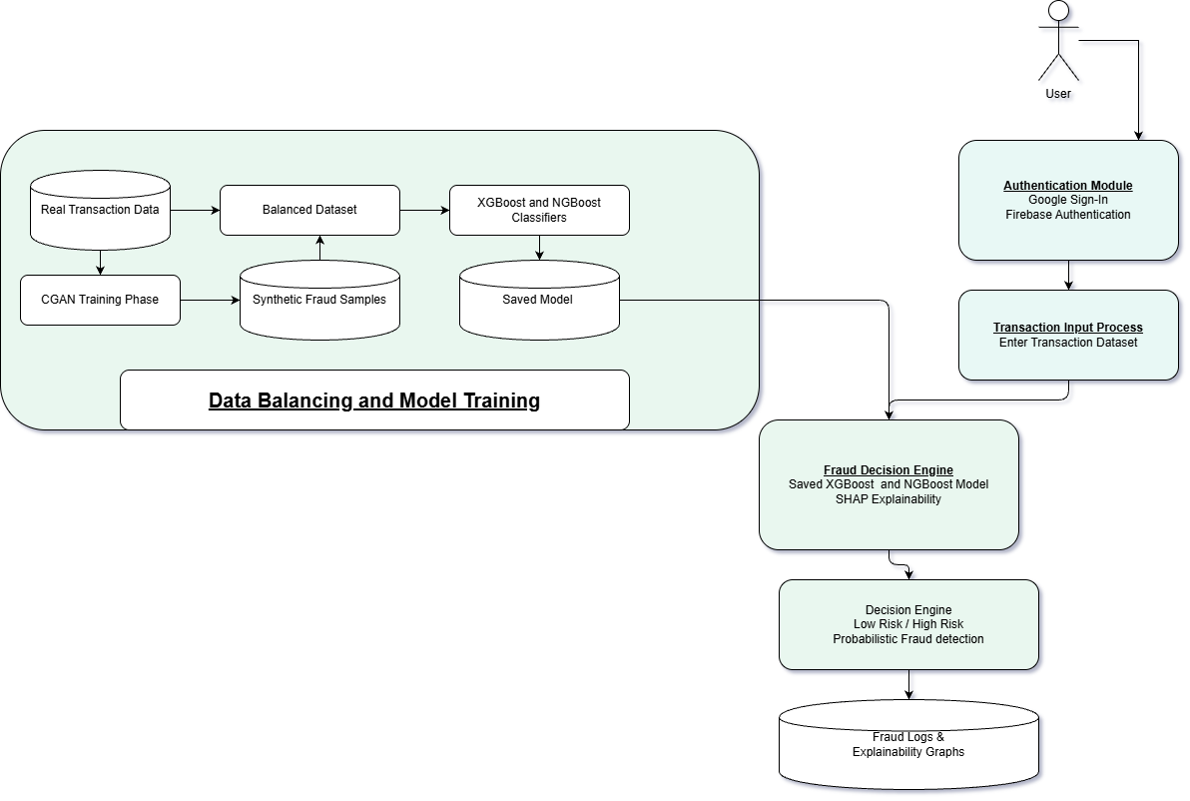
Methodology / Algorithms
ARCHITECTURE DIAGRAM

Slide 23
Methodology / Algorithms
Algorithms chosen | Purpose
CGAN (Conditional GAN) | Data Augmentation
XGBoost and NGBoost Classifiers | Fraud Detection and Probability Estimation
SHAP | Model explainability
Justification:
Algorithm | Description
CGAN | Addresses severe class imbalance by generating realistic synthetic fraud samples
XGBoost and NGBoost | Well-suited for tabular financial data, offering high accuracy and Probability Estimation of fraud.
SHAP | Provides transparent, interpretable explanations for model predictions
Alignment with Objectives
Improves fraud detection accuracy and recall
Minimizes false negatives and financial loss
Ensures explainability.

Slide 24
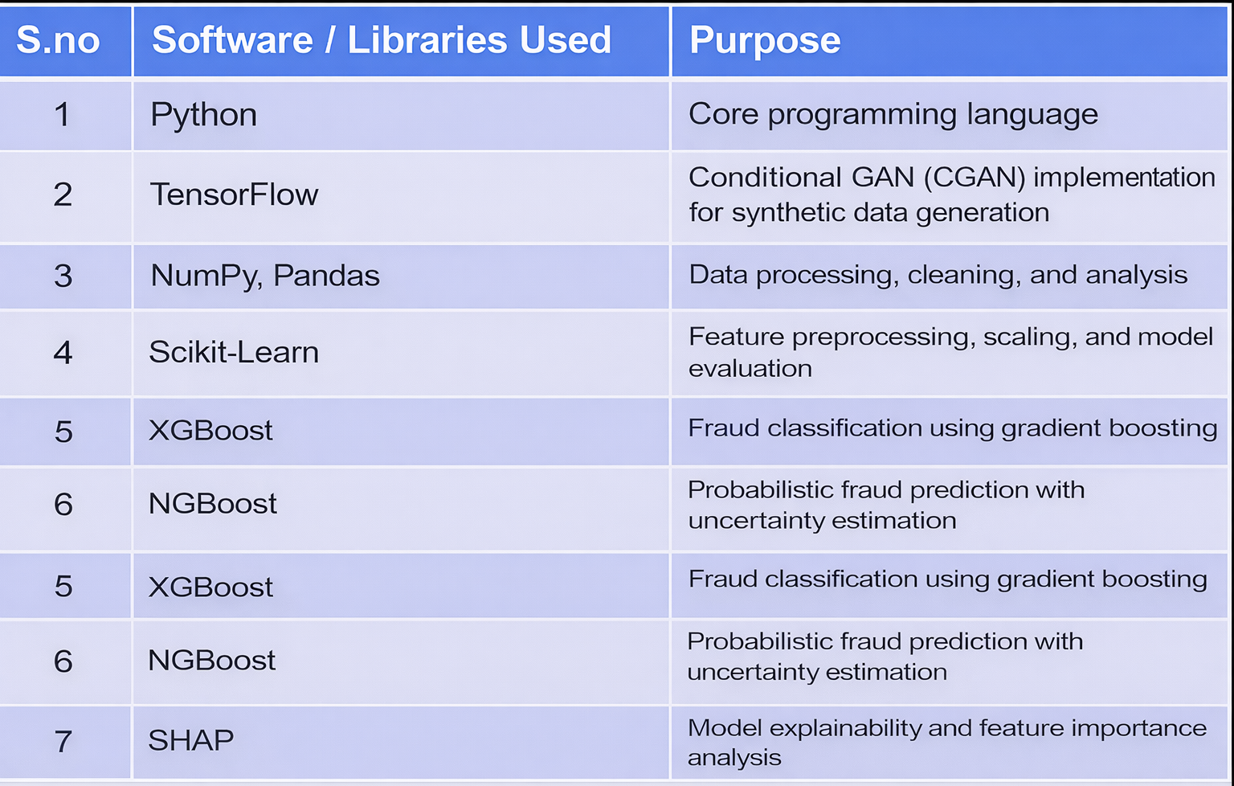
Software and Hardware

Slide 25
Datasets Details
Dataset Source
Dataset : Generated from IEEE-CIS Fraud Detection
Platform: Kaggle (IEEE Computational Intelligence Society)
Size of the Dataset
Total Records: Approximately 20,000 transactions
Fraudulent Transactions: Around 10%
Legitimate Transactions: Around 90%

Slide 26
Datasets Details
S.no | Fields / Attributes | Description
1. | Transaction ID | Unique identifier for each transaction
2. | Transaction Amount | Monetary value of transaction
3. | Transaction Time | Timestamp of transaction
4. | Merchant ID | Unique identifier for merchants
5. | Merchant Category | Category of Category of merchant (retail, travel, food, etc.)
6. | Location | Geographic location of the transaction
7. | Previous Transactions | Count of past user transactions
8. | Average Transaction Amount | User’s historical average transaction value
9. | International Transaction Flag | Indicates domestic or international transaction
10 | Fraud Label | Target variable (0 = Legitimate, 1 = Fraud)

Slide 27
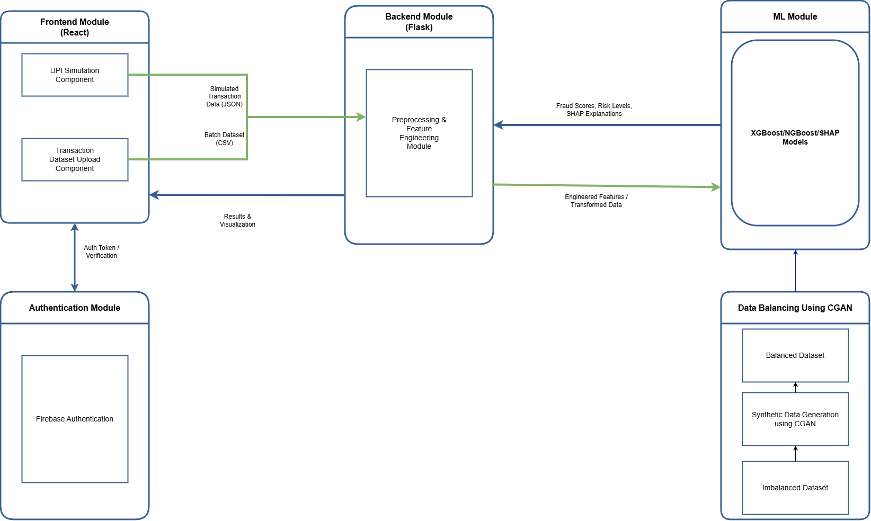

Slide 28
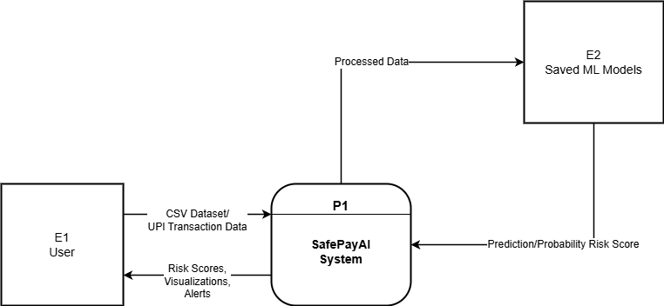
Data flow diagram(Level – 0)

Slide 29
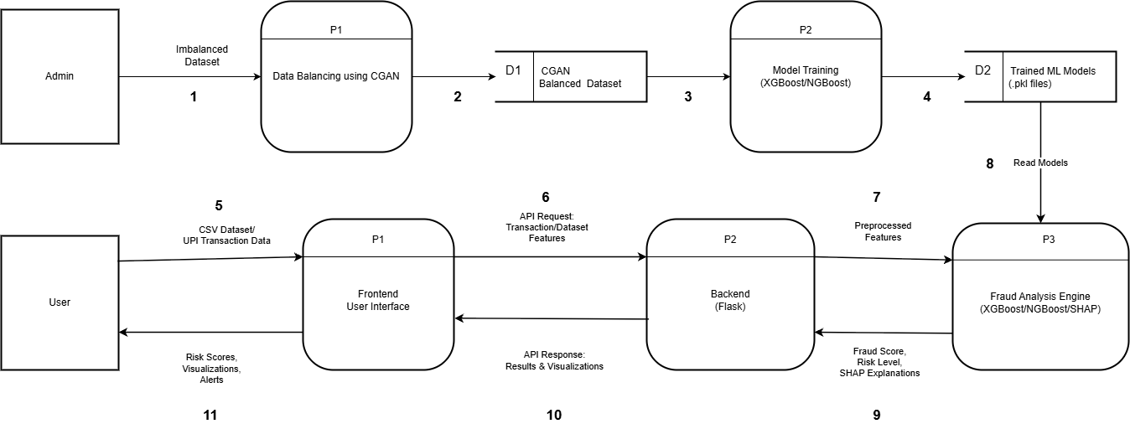
Data flow diagram(Level - 1)

Slide 30
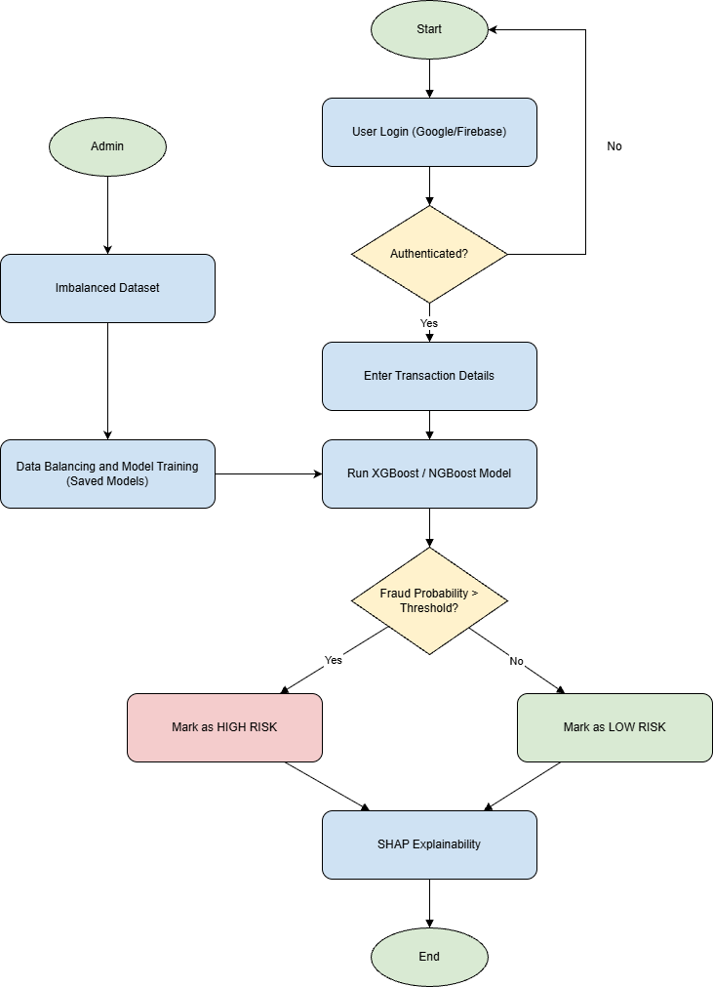
Control flow diagram

Slide 31
Modules description:
Category | Details
Module Name | Frontend Module
Role | User interaction & transaction input layer
Inputs | • CSV dataset upload • UPI transaction simulation (real-time) • Authentication token
Processing | • UI validation • JSON formatting • Secure API request generation
Tools / Technologies | • React.js • JavaScript • HTML/CSS
Outputs | • Structured JSON transaction data • API request to backend

Slide 32
Modules description:
Category | Details
Module Name | Backend Module (Flask API Server)
Role | Core processing & feature engineering layer
Inputs | • JSON transaction data • Batch dataset (CSV) • Auth token
Processing | • Token verification • Data preprocessing • Feature engineering
Tools / Technologies | • Flask (Python) • Pandas • NumPy • Scikit-learn utilities
Outputs | • Engineered feature set • Model-ready data

Slide 33
Modules description:
Category | Details
Module Name | ML Module (XGBoost / NGBoost / SHAP)
Role | Fraud detection & probabilistic risk prediction
Inputs | • Engineered features • trained model files (.pkl)
Processing | • Model loading • Fraud probability prediction • Risk classification (High / Low) • SHAP explainability generation
Tools / Technologies | • XGBoost • NGBoost • SHAP
Outputs | • Fraud score • Risk label • Explainability values

Slide 34
Modules description:
Category | Details
Module Name | CGAN Dataset Balancing Module
Role | Dataset balancing unit
Inputs | • Raw transaction dataset
Processing | • Dataset imbalance analysis • CGAN-based synthetic fraud sample generation • Minority class augmentation • Dataset merging & validation
Tools / Technologies | • Conditional GAN (CGAN) • TensorFlow / PyTorch • NumPy • Pandas
Outputs | • Balanced fraud dataset

Slide 35
Modules description:
Category | Details
Module Name | Result presentation & response delivery layer
Role | Dataset balancing unit
Inputs | • Fraud score • Risk label (High / Low) • SHAP explainability values
Processing | • Response formatting (JSON) • Risk visualization generation • Explanation mapping to features • API response generation
Tools / Technologies | • Flask Response Handler • React.js (UI display) • Chart.js / Visualization libraries
Outputs | • Final fraud detection result • Risk classification display • Explainability dashboard • Structured API response to frontend

Slide 36
Expected outcomes
High Detection Accuracy
Achieve ≥85% classification accuracy on the fraud transaction dataset
Effectively distinguish between fraudulent and legitimate transactions
Robust Fraud Detection
Capable of handling imbalanced datasets with low fraud occurrence
Maintains stable performance across varying fraud ratios
Interpretability
Supports clear understanding of model decisions using standard evaluation metrics
Practical Applicability
Applicable to real-world financial systems
Can be extended to real anonymized datasets without major modifications

Slide 37
References:
[1] M. Rezvani Nejad, A. Khosravi, and S. Nahavandi, “Improved VAE-GAN for credit card fraud detection,” IEEE Access, vol. 11, pp. 112345–112358, 2023.
[2] U. Fiore, F. Palmieri, A. Castiglione, and A. De Santis, “Using generative adversarial networks for improving classification effectiveness in credit card fraud detection,” IEEE Access, vol. 11, pp. 130232–130245, 2023.
[3] S. Li, S. B. Hulayyil, and N. Saxena, “Credit card fraud detection using conditional generative adversarial networks,” IEEE Access, vol. 11, pp. 98765–98778, 2023.
[4] D. Hirnschall, “Semi-supervised generative adversarial networks for credit card fraud detection,” IEEE Transactions on Artificial Intelligence, early access, 2025.
[5] J. Ge and Y. Chen, “Gated attention-based generative adversarial networks for financial fraud detection,” IEEE Access, vol. 12, pp. 84521–84534, 2024.
37

Slide 38
References:
[6] T. Chen and C. Guestrin, “XGBoost: A scalable tree boosting system,” in Proc. 22nd ACM SIGKDD Int. Conf. Knowledge Discovery and Data Mining (KDD), San Francisco, CA, USA, 2016, pp. 785–794.
[7] F. Carcillo, Y.-A. Bontempi, and G. Snoeck, “Scarff: A scalable framework for fraud detection with imbalanced data,” in Proc. IEEE Int. Conf. Data Science and Advanced Analytics (DSAA), 2023, pp. 1–10.
[8] A. Dal Pozzolo and G. Bontempi, “Adversarial drift detection in credit card fraud,” IEEE Transactions on Neural Networks and Learning Systems, vol. 33, no. 6, pp. 2424–2436, 2022.
[9] T. Duan, A. Gamarnik, V. Li, and A. V. Rakhlin, “NGBoost: Natural gradient boosting for probabilistic prediction,” in Proc. 37th Int. Conf. Machine Learning (ICML), 2020, pp. 2690–2700.
[10] Y. Zhao, J. Wang, and H. Liu, “Probabilistic fraud detection using NGBoost,” IEEE Access, vol. 11, pp. 45678–45690, 2023.
38

Slide 39
References:
[11] N. V. Chawla, K. W. Bowyer, L. O. Hall, and W. P. Kegelmeyer, “SMOTE: Synthetic minority over-sampling technique,” Journal of Artificial Intelligence Research, vol. 16, pp. 321–357, 2002.
[12] H. He and E. A. Garcia, “Learning from imbalanced data,” IEEE Transactions on Knowledge and Data Engineering, vol. 21, no. 9, pp. 1263–1284, 2009.
[13] S. Li, S. B. Hulayyil, and N. Saxena, “Explainable AI-based fraud and intrusion detection in IoT systems,” IEEE Internet of Things Journal, early access, 2025.
[14] D. Gaspar, P. Silva, and C. Silva, “Explainable AI for intrusion detection systems: SHAP applicability on multi-layer perceptron,” IEEE Access, vol. 12, pp. 30164–30175, 2024.
[15] Y. Xie, J. Wang, and H. Liu, “Learning transactional behavioral representations for credit card fraud detection,” IEEE Transactions on Neural Networks and Learning Systems, vol. 35, no. 4, pp. 5123–5136, 2024
39

Slide 40
Thank you
40

