Slide 1


KitabHoshmand
AI-Powered PDF
Study Companion
Software Engineering
Monograph
[Student Name]
[Department] · [University Name]
Supervisor: [Supervisor Name] · 2026
PRIVATE LIBRARY · SEARCH · VOICE · CHAT · STUDY GUIDES
Notes:
Introduce KitabHoshmand as an AI-powered PDF study companion and explain that the defense presents only verified implementation facts. Replace the title placeholders before presenting.
[Sources]
- README.md
- app/layout.tsx
- public/brand/kitabhoshmand-logo-mark.svg

Slide 2
PROJECT BACKGROUND
02
A static PDF becomes an interactive study resource
Academic material often arrives as long PDF files.
PDF
KitabHoshmand creates one private workflow for reading, searching, discussing, and reviewing that material.
Searchable text segments
Voice and text conversation
Saved study guides
Designed for authenticated individuals studying their own documents
KITABHOSHMAND · SOFTWARE ENGINEERING MONOGRAPH
Notes:
Explain the context without presenting unsupported survey results. The implemented system turns a searchable PDF into a private library item with multiple study modes.
[Sources]
- docs/proposal/build-proposal.mjs
- README.md

Slide 3
PROBLEM STATEMENT
03
The project addresses four practical study gaps
01
Passive reading
02
Fragmented tools
Basic viewers do not support dialogue with the document.
Reading, notes, search, and summaries are often separated.
03
Weak continuity
04
Limited interaction
Questions and explanations are difficult to revisit later.
Long documents are hard to explore through natural conversation.
KITABHOSHMAND · SOFTWARE ENGINEERING MONOGRAPH
Notes:
Frame these points as documented project context reflected in the implemented workflow. Do not claim interviews, surveys, or measured productivity improvements.
[Sources]
- docs/proposal/build-proposal.mjs
- MONOGRAPH_IMPLEMENTATION_PLAN.md

Slide 4
PROJECT OBJECTIVES
04
Objectives align directly with implemented behavior
Ingest and search PDF content
General objective
Build a secure, interactive study system around user-selected PDF documents.
Support voice and text study
Preserve sessions and transcripts
Generate grounded study guides
Isolate each user’s data
KITABHOSHMAND · SOFTWARE ENGINEERING MONOGRAPH
Notes:
State the general objective and connect each specific objective to an existing implementation module. Avoid adding objectives for administration, subscriptions, or reporting.
[Sources]
- components/UploadForm.tsx
- lib/actions/conversation.actions.ts
- lib/actions/summary.actions.ts
- supabase/migrations/202608090001_initial_schema.sql

Slide 5
PROPOSED SOLUTION
05
One workflow connects upload, study, and review
01
02
03
04
05
Sign in
Upload
Process
Study
Revisit
Access a private account
Select a searchable PDF and voice
Extract, segment, validate, and store
Voice, chat, search, or summarize
Open saved sessions and guides
Every study mode remains attached to one owned book.
KITABHOSHMAND · SOFTWARE ENGINEERING MONOGRAPH
Notes:
Walk through the end-to-end user journey and emphasize that voice, chat, and study guides share the selected book as context.
[Sources]
- app/(root)/page.tsx
- app/books/[slug]/page.tsx
- app/books/[slug]/chat/page.tsx
- app/books/[slug]/summary/page.tsx

Slide 6
SYSTEM ARCHITECTURE
06
The architecture separates interface, server logic, and services
User
Next.js interface
Trusted server
Supabase
Authenticated reader
React UI · PDF.js · Vapi client
Server actions · route handlers · Gemini calls
Auth · PostgreSQL · RLS · private storage
External AI services
Gemini for grounded text generation · Vapi for real-time voice
KITABHOSHMAND · SOFTWARE ENGINEERING MONOGRAPH
Notes:
Explain the browser, trusted Next.js server boundary, Supabase services, and external AI/voice services. Clarify that service credentials remain server-side.
[Sources]
- lib/supabase/server.ts
- lib/supabase/client.ts
- lib/supabase/admin.ts
- lib/gemini.ts
- hooks/useVapi.ts

Slide 7
TECHNOLOGY STACK
07
Each technology has a specific responsibility
Main technologies
Supporting tools
Next.js + React
Application interface, routes, server components, and server actions
PDF.js
Text extraction and cover rendering
Zod + React Hook Form
Validation and form state
TypeScript
Typed application logic and shared data contracts
Gemini
Grounded chat and study guides
Supabase
Authentication, PostgreSQL, RLS, RPCs, and private storage
Vapi + ElevenLabs voices
Real-time voice interaction
Tailwind CSS
Responsive styling and visual system
Vitest + Playwright
Automated verification
KITABHOSHMAND · SOFTWARE ENGINEERING MONOGRAPH
Notes:
Describe each technology by its actual role in the project. The slide intentionally excludes dependencies that are not central to the implemented workflows.
[Sources]
- package.json
- app/globals.css
- lib/utils.ts
- lib/zod.ts

Slide 8
MAIN FEATURES
08
Six implemented capabilities form the working system
01
02
03
Account access
PDF ingestion
Private library
Sign-up, sign-in, recovery, and reset
Validation, extraction, segmentation, and storage
Owned book listing and title/author search
04
05
06
Voice study
Grounded chat
Study guides
Live sessions with saved final transcripts
Book-segment retrieval and persisted messages
Chapter summaries, concepts, takeaways, and questions
KITABHOSHMAND · SOFTWARE ENGINEERING MONOGRAPH
Notes:
Summarize only working modules. Explicitly avoid claiming administration, subscriptions, payments, or operational reporting.
[Sources]
- app/
- components/
- lib/actions/

Slide 9
IMPORTANT WORKFLOW
09
Upload is the core end-to-end workflow
1
Validate
Zod checks metadata, MIME types, and size limits.
2
Extract
PDF.js reads text and creates 500-word overlapping segments.
3
Upload
PDF and cover enter a private user/book storage folder.
4
Revalidate
The server checks UUIDs, paths, size, and segment order.
5
Persist
The ingest_book RPC inserts the book and its segments.
Failure handling: uploaded objects are removed if ingestion does not complete.
KITABHOSHMAND · SOFTWARE ENGINEERING MONOGRAPH
Notes:
Explain the upload pipeline precisely and note the repeated validation at browser, server, and database layers. Mention cleanup of uploaded files after an ingestion error.
[Sources]
- lib/zod.ts
- components/UploadForm.tsx
- lib/utils.ts
- lib/actions/book.actions.ts
- supabase/migrations/202608100003_remove_book_limit.sql

Slide 10
DATABASE DESIGN
10
The database follows ownership and study activity
profiles
1
N
books
book segments
chat sessions
chat messages
auth.users 1:1
owned library item
ordered text
per book
ordered messages
voice sessions
per user and book
summary chapters
book summaries
segment ranges
one guide per book
voice messages
ordered transcript
Complete schema: 10 application/supporting tables
KITABHOSHMAND · SOFTWARE ENGINEERING MONOGRAPH
Notes:
Explain profiles-to-books ownership, book segments, per-book chat and voice histories, and one saved summary. State that the diagram is intentionally simplified.
[Sources]
- supabase/migrations/202608090001_initial_schema.sql
- supabase/migrations/202608100001_conversation_history_and_segments.sql
- supabase/migrations/202608100002_book_summaries.sql

Slide 11
AUTHENTICATION · VALIDATION · SECURITY
11
Protection is applied in layers
1 Authentication
Supabase email/password sessions and verified current-user checks
2 Application authorization
Protected pages/actions call requireUser()
3 Input validation
Zod schemas, path checks, size limits, and message limits
4 Database protection
Constraints, ownership checks, RPC validation, and Row Level Security
5 Private file access
User-ID storage folders and short-lived signed cover URLs
Vapi tool calls additionally require a timing-safe bearer-secret check.
KITABHOSHMAND · SOFTWARE ENGINEERING MONOGRAPH
Notes:
Explain security as layered controls. Clarify that the Vapi bearer secret protects the webhook but is not a per-user role or ownership token.
[Sources]
- lib/auth.ts
- lib/zod.ts
- lib/actions/book.actions.ts
- supabase/migrations/202608090001_initial_schema.sql
- app/api/vapi/search-book/route.ts

Slide 12
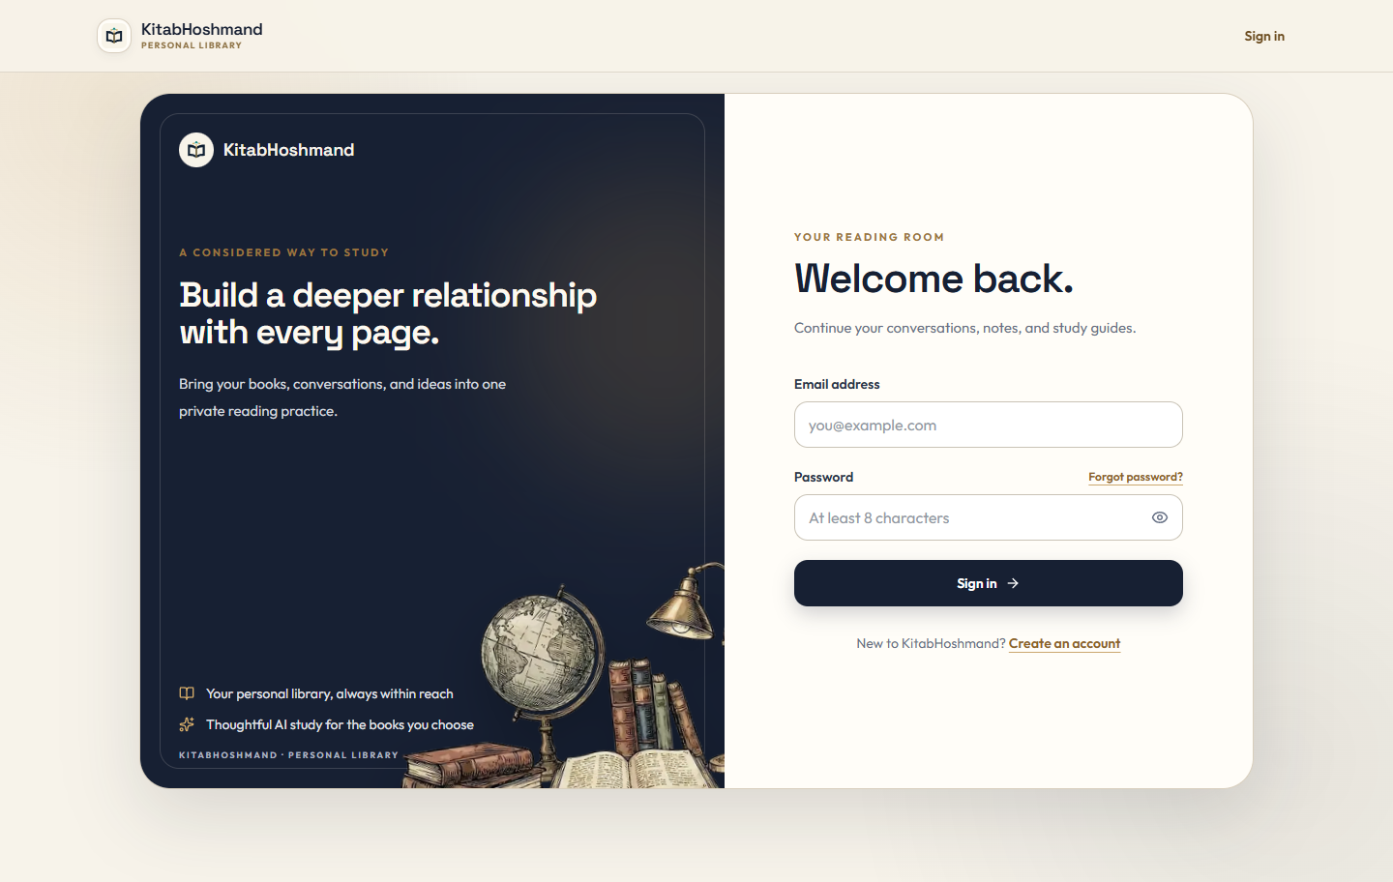
USER INTERFACE EVIDENCE
12
The implemented interface emphasizes private study
Actual running route
/sign-in
Email/password access
Password recovery
Account creation
No credentials displayed
KITABHOSHMAND · SOFTWARE ENGINEERING MONOGRAPH
Notes:
Identify the screenshot as the actual locally running sign-in page. Point out the brand identity and account-access workflows while noting that no credentials or private records are shown.
[Sources]
- presentation/screenshots/sign-in.png
- components/AuthForm.tsx
- components/Navbar.tsx

Slide 13
TESTING AND FINDINGS
13
Current verification confirms core logic and build readiness
10 / 10
PASS
PASS
Vitest tests passed
TypeScript check
Production build
4 test files · segmentation, Gemini, summaries
npx tsc --noEmit · exit code 0
Next.js compiled and generated all routes
Coverage boundary
Live Supabase policies, authenticated upload, Vapi integration, and complete browser workflows remain outside the executed automated checks.
KITABHOSHMAND · SOFTWARE ENGINEERING MONOGRAPH
Notes:
Report the verified command results from 15 August 2026 and then explain the scope of the existing tests. Do not imply that all integrations were tested.
[Sources]
- Current command output: npm test
- Current command output: npx tsc --noEmit
- Current command output: npm run build
- tests/

Slide 14
LIMITATIONS AND FUTURE WORK
14
Limitations define a realistic next iteration
Current limitations
Appropriate improvements
No OCR for scanned PDFs
OCR for image-only documents
External Vapi assistant setup
End-to-end Supabase and voice tests
No admin roles, analytics, or export
Book-scoped Vapi authorization
Limited live integration coverage
Exportable study materials
No verified production deployment
Accessibility and usability evaluation
KITABHOSHMAND · SOFTWARE ENGINEERING MONOGRAPH
Notes:
Separate implemented limitations from proposed improvements. Make clear that the right column is future work, not existing functionality.
[Sources]
- lib/utils.ts
- app/api/vapi/search-book/route.ts
- tests/
- app/

Slide 15
KitabHoshmand demonstrates a complete private study workflow.
A user-selected PDF becomes searchable, conversational, and reusable study material through document processing, managed data services, and layered access control.
Thank You
Questions & Discussion
KITABHOSHMAND
Notes:
Conclude that the project integrates document processing, AI interaction, and ownership-based protection into one coherent study application. Thank the audience and invite questions.
[Sources]
- README.md
- lib/actions/
- supabase/migrations/

